Slide 1
A Tentative Title
Online judges programming problem recommendation system using collaborative filtering

Slide 2

Online judges programming problem recommendation system using collaborative filtering
Presented By
Shorojit Kumar Sarkar
ID: 16CSE067
Dept. of CSE, BSMRSTU
Supervised By
Md. Monowar Hossain
Assistant Professor
Dept. of CSE, BSMRSTU

Slide 3
Outlines
Introduction
Motivation
Related Work
Objectives
Proposed Methods
Data Descriptions
Timeline/Status
Expected Result
Conclusion
Future Work
References

Slide 4
INTRODUCTION
Online judges provide programming exercises to enhance students' programming skills.
Large number of problems available causes confusion for students in selecting the appropriate problems.
Integration of online judges into e-learning systems is challenging due to the lack of necessary information in these systems.
Collaborative filtering recommendation method is proposed to overcome the issue of information overload.

Slide 5
MOTIVATION
The primary motivation for this research is to help students overcome the issue of information overload while selecting programming problems.
Providing personalized recommendations for programming problems can enhance students' programming skills.
The proposed method can be integrated into e-learning systems to improve the learning experience for students.

Slide 6
RELATED WORK
Collaborative recommendations in online judges using autoencoder neural networks[1].
An enhanced memory-based collaborative filtering algorithm based on user similarity for recommender systems[2].
A Recommender System for Supporting Students in Programming Online Judges[3].
Automatically learning topics and difficulty levels of problems in online judge systems[4].
Similar Users or Similar Items? Comparing Similarity-Based Approaches for Recommender Systems in Online Judges[8]

Slide 7
OBJECTIVES
The main objective of this research is to propose a collaborative filtering recommendation method for programming exercises that is more accurate and efficient.
This research proposes a collaborative filtering recommendation method to overcome the issue of information overload.
To achieve this objective, an enriched user-problem matrix will be used for better student role representation.
The proposed method will be evaluated on a real dataset to demonstrate its effectiveness.

Slide 8
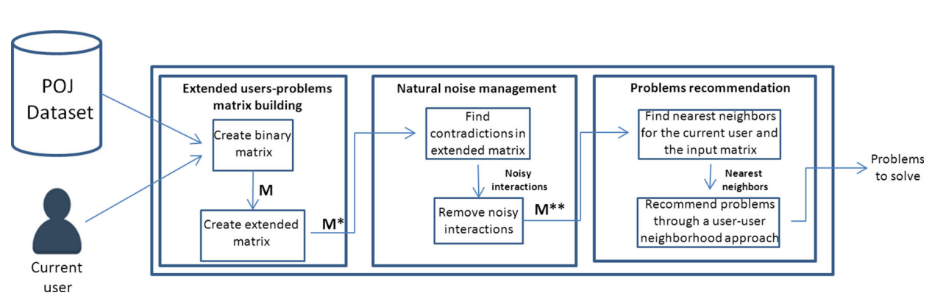
PROPOSED METHODS
Categorized problems matrix
Remove noisy interactions
Fig.1 General overview of recommendations systems

Slide 9
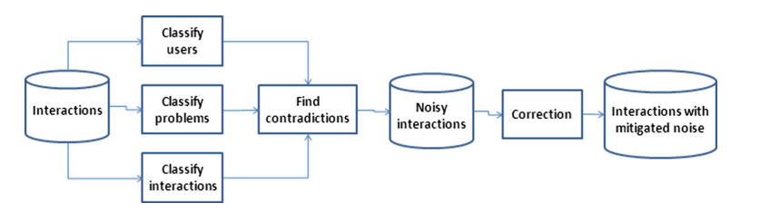
PROPOSED METHODS
Fig.2 The proposed approach for recommendations in the presented scenario

Slide 10
DATA DESCRIPTIONS
The proposed method will be evaluated on a real dataset of Codeforces for first time.
The dataset contains information about users' solved problems, and problem difficulty levels and tags.
Here I used total 2027 user data and 8000 plus problem set.
The dataset will be pre-processed to extract relevant features for the proposed method.

Slide 11
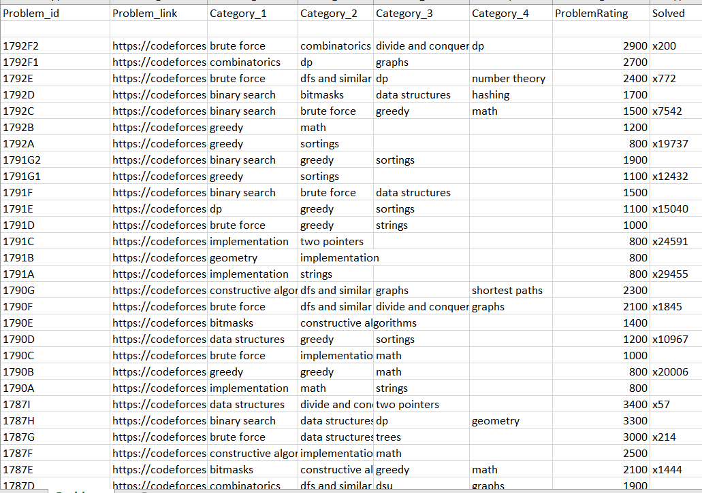
DATA DESCRIPTIONS
Sample for Problems dataset:

Slide 12
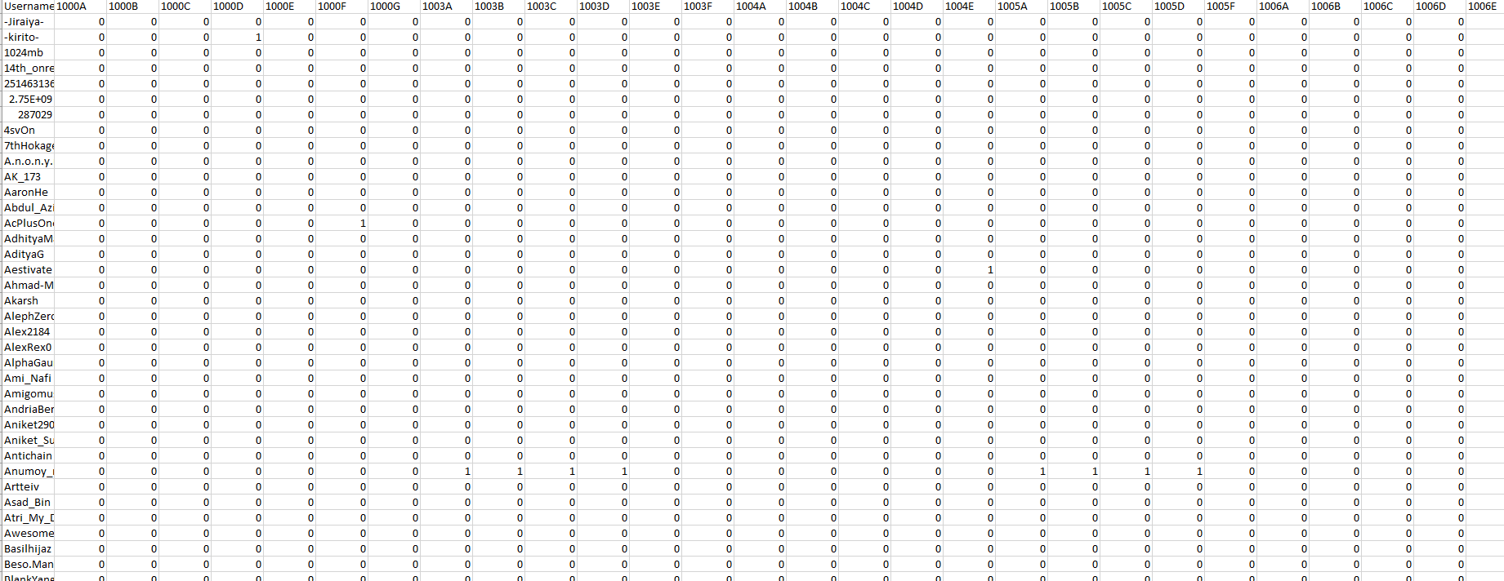
DATA DESCRIPTIONS
Sample for User-Problem Matrix:

Slide 13
TIMELINE
Timeline graph:
Running
Finished
Week
Topics | 1 | 2 | 3 | 4 | 5 | 6 | 7 | 8 | 9 | 10 | 11 | 12 | 13 | 14 | 15 | 16 | 17 | 18 | 19
Study about recommendation systems
Generate idea about my research
Dataset making
Data Processing
Noise management
Implementations
Report Generations

Slide 14

EXPECTED RESULT
Table : F1 values of different value of k

Slide 15
CONCLUSION
The proposed collaborative filtering recommendation method can help students overcome information overload while selecting programming problems.
The enriched user-problem matrix provides a better student role representation, resulting in more accurate recommendations.
The proposed approach outperforms previous methods, making it a viable option for e-learning systems.
The proposed method can be extended and integrated into e-learning systems to enhance the learning experience for students.

Slide 16
FUTURE WORK
Future work will involve the integration of the proposed method into e-learning systems.
For better accuracy I will try to used deep learning algorithms.
Evaluation of the proposed method on other datasets will be considered.

Slide 17
REFERENCES
Fantozzi, P. and Laura, L., 2021. Collaborative recommendations in online judges using autoencoder neural networks. In Distributed Computing and Artificial Intelligence, 17th International Conference (pp. 113-123). Springer International Publishing.
Lumauag, R., Sison, A. and Medina, R.P., 2019. An enhanced memory-based collaborative filtering algorithm based on user similarity for recommender systems. Int. Journal of Recent Technology and Engineering, 7, pp.778-782.
Yera, R., Rodríguez, R.M., Castro, J. and Martínez, L., 2018. A Recommender System for Supporting Students in Programming Online Judges. In Smart Education and e-Learning 2017 4 (pp. 215-224). Springer International Publishing.
Zhao, W.X., Zhang, W., He, Y., Xie, X. and Wen, J.R., 2018. Automatically learning topics and difficulty levels of problems in online judge systems. ACM Transactions on Information Systems (TOIS), 36(3), pp.1-33.
Wang, M., Han, W. and Chen, W., 2021. MetaOJ: A massive distributed online judge system. Tsinghua Science and Technology, 26(4), pp.548-557.
Ahmed, D.M., Abdulazeez, A.M., Zeebaree, D.Q. and Ahmed, F.Y., 2021, June. Predicting university's students performance based on machine learning techniques. In 2021 IEEE International Conference on Automatic Control & Intelligent Systems (I2CACIS) (pp. 276-281). IEEE.
Caro-Martinez, M. and Jimenez-Diaz, G., 2017. Similar users or similar items? Comparing similarity-based approaches for recommender systems in online judges. In Case-Based Reasoning Research and Development: 25th International Conference, ICCBR 2017, Trondheim, Norway, June 26-28, 2017, Proceedings 25 (pp. 92-107). Springer International Publishing.
Amatriain X, Pujol JM (2015) Data mining methods for recommender systems. In: Recommender Systems Handbook. Springer, pp 227–262

Slide 18
THANKS TO ALL

