Slide 1
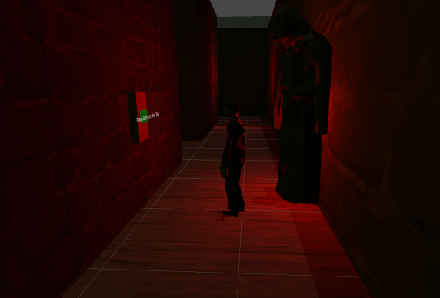
Whisper of the Monolith
By Never Seen Again
Horror maze runner where you find the key to get out of the maze while being chased by a monster.

Slide 2

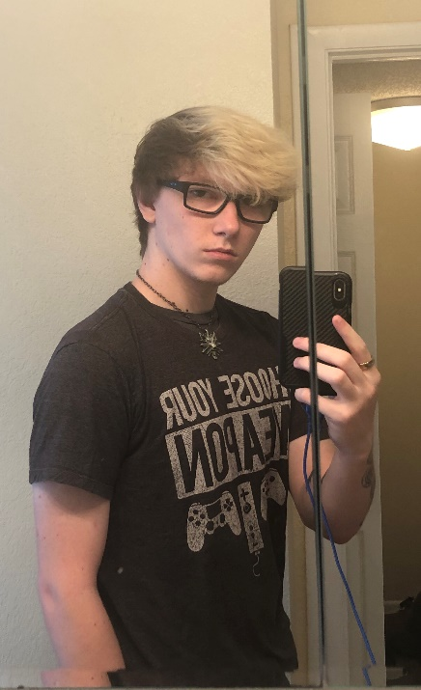
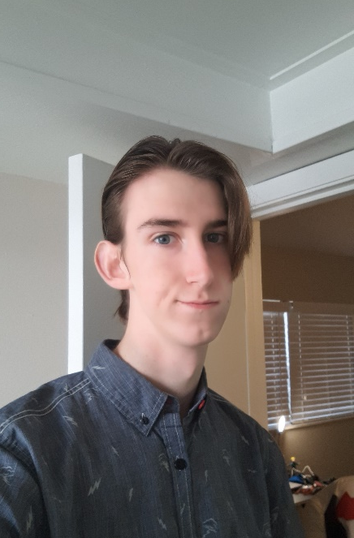

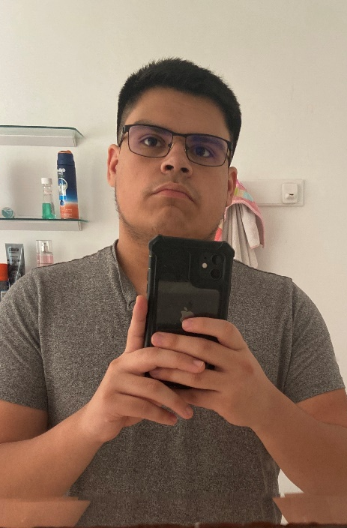
The Team
Griffin DesBles
Audio
Voice lines
Animations
Monster
Player Controller
Monolith
Shards
Tutorial Integration
Matthew Scott
Hazards
Promo material
Tutorial
Andrew Levans
Traps
Decorations
Tutorial
Gate Asset
Landon Ledbetter
Maze Creation
Monster Asset
Tutorial
Christian Chinchilla
Monster tracking
Audio
Player Model Asset
Tutorial

Slide 3
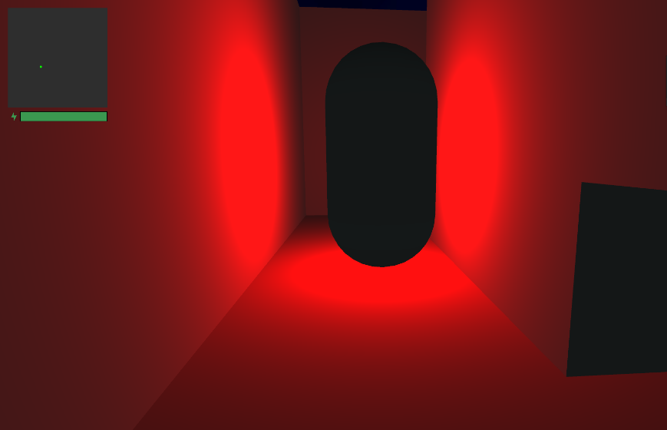
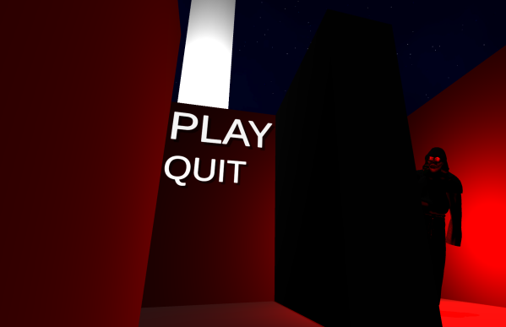
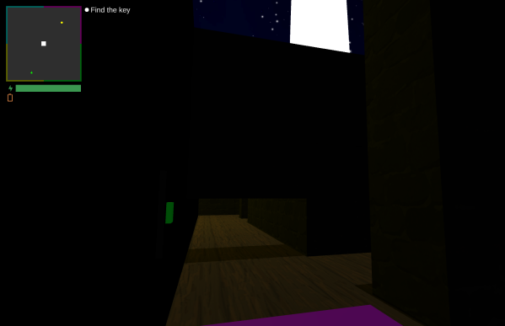
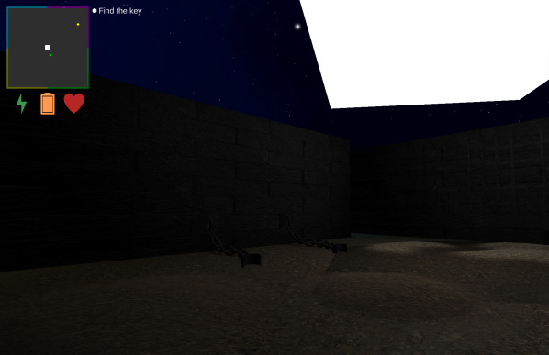
Progress
Prototype
Alpha
First Playable
Final
Notes:
Prototype = PP2 first milestone
First Playable = PP2 final milestone
Alpha = PP3 alpha milestone
Final = Game today

Slide 4
Tips/Tricks
Griffin DesBles
F-R-E-E that spells FREE credit report.com BABY. Prioritize making a good game, not getting a good grade.
Landon Ledbetter
Don’t procrastinate
Andrew Levans
Learn Unity
Matthew Scott
Don’t have outside job
Christian Chinchilla
Don’t Sleep

Slide 5
What Went Right
Monolith
Because Griffin finally got it to move in a circle
Camera Rotation
Because it took Griffin a lot of time to get the camera to rotate when the monster catches you
Capsule Boy Easter Egg
When we had the easter egg it was funny to see the capsule of the first monster being the size of a building .
Shards
Because each of them had their own perk and downside when they got activated and also how they interacted with the monolith.

Slide 6
What Went Wrong
Quantity over Quality
Trying to reach an expected quantity of work rather than an expected quality of work resulted in a lot of disappointment.
Wrongly design features
Having a vague and subjective review process resulted in a lot of features being designed specifically to pass the review process rather than fit fluidly and coherently in the game.
Maze Design
There was originally a set path from enter to exit. We cut the center area for the monolith and extra paths around the maze.
Sound Issues
A lot of the sound would not pause or quite down when they needed to be. Went back and debugged it and made it so that they do work.

