Slide 1

Reward and Recognition for Open Research Institutional self-assessment session Setting the scene
Test slide

Slide 2

Why recognize and reward open research practice?
“Assessment of scientific contribution and career progression rewarding good open science practices is needed for operationalization of open science.” (UNESCO, 2021)

Slide 3
What is open research?
2021 – adoption of UNESCO Recommendation on Open Science by 193 member states
Open Research/ Open Science:
- integrated concept of research governed by principles of inclusivity, collaboration, accessibility, transparency, reusability and reproducibility
- openness essential to the practices by which research is conducted, communicated, evaluated, validated and instrumentalised
Notes:
- 2021 – Adoption of UNESCO Recommendations on Open Science by 193 member states
Open Research or Open Science – an integrated concept of research governed by principles of inclusivity, collaboration, accessibility, transparency, reusability and reproducibility
- openness is integral to the practices by which research is conducted, communicated, evaluated, validated and instrumentalized
Benefits of open research:
- open research is held to have a direct relationship to research integrity (through transparency of methods and outputs), research quality (through the use of reproducible practices), and reach and impact (through the accessibility and reusability of outputs)
- the products of publicly funded research are public goods produced in the public interest and should be made available with as few restrictions and possible in a timely and responsible manner
- but change is slow to take effect, often limited to Open Access and management and sharing of data, with funders and research institutions mandating these
- other practices relatively sparce, and not incentivised, enforced, monitored or rewarded (by funders or institutions)

Slide 4
Why open research?
Open Research has a direct relationship to research integrity )through transparency of methods and outputs); research quality (through the use of reproducible practices); and reach and impact (through the accessibility and reusability of outputs)
The products of publicly funded research are public goods produced in the public interest and should be made available with as few restrictions as possible in a timely and responsible manner
Change is slow!
Open Research practices often limited to Open Access and management and sharing of data
Other practices relatively rare, and not mandated, monitored, incentivized or rewarded (by funders of institutions)
Notes:
Benefits of open research:
- open research is held to have a direct relationship to research integrity (through transparency of methods and outputs), research quality (through the use of reproducible practices), and reach and impact (through the accessibility and reusability of outputs)
- the products of publicly funded research are public goods produced in the public interest and should be made available with as few restrictions and possible in a timely and responsible manner
- but change is slow to take effect, often limited to Open Access and management and sharing of data, with funders and research institutions mandating these
- other practices relatively sparce, and not incentivised, enforced, monitored or rewarded (by funders or institutions)

Slide 5
Reward and recognition for open research
Currently:
Few institutions include reference to open research criteria (beyond OA) in their recruitment, promotion and appraisal frameworks
Little guidance, training and support related to open research for researchers and staff involved in assessment
Use of open research practices rarely evidenced or considered in formal assessment activities
Little systematic monitoring of open research practices
Notes:
At present, very few institutional recruitment, promotion and appraisal frameworks include reference to open research criteria or outputs other than research publications; standards and practices for evidencing a track record in open research are not well-established; and there is a lack of guidance, training and support related to open research for researchers and staff involved in assessment. In consequence, use of open research practices is rarely evidenced or considered in the formal assessment activities, and is not monitored by institutions

Slide 6
Reward and recognition for open research
For change to take place:
- open research expectations and incentives must be operationalized in the systems and processes by which research is produced/ managed
- universities to include open research criteria in recruitment, probation, promotion frameworks and development and research planning activities
Result:
- researchers will build track record in open research
- increased adoption of open research practices
- recruitment and promotion of staff who are valued for working in ways that increase the integrity, quality and impact of institution’s research output
Notes:
If there is to be significant cultural change, open research expectations and incentives must be operationalised in the systems and processes by which research is produced and managed. Universities play a critical role in the system of academic reward and recognition. It is in their power to include open research criteria in their recruitment specifications, probation objectives and promotion frameworks, in their performance and development review processes, and in their research planning activities. By this means researchers can be incentivised and supported to build a track record in open research and to present that track record in an assessment activity, while assessment practices can recognise and give credit for a record of open research practice. This in turn will drive increased adoption of open research practices, and, it is hoped, bear fruit in the recruitment and promotion of staff who are valued for working in ways that increase the integrity, quality and impact of the institution’s research output.

Slide 7

Developments in research assessment reform
Focus on publication metrics:
primarily concerned with research publications
recommends that institutions consider the value and impact of all research outputs (including datasets and software) and consider a broad range of impact measures including qualitative indicators of research impact (e.g., influencing policy)
no concept of open research that has developed in the years since its publication
The San Francisco Declaration on Research Assessment
Published in 2013
Notes:
- in the history of research assessment reform, the focus of effort has been almost entirely on the use of publication-related metrics (with acknowledgement that the full range of research activities and outputs should be recognized and rewarded)
- while DORA is primarily concerned with research publications but also recommends that institutions consider the value and impact of all research outputs (including datasets and software) in addition to research publications, and consider a broad range of impact measures including qualitative indicators of research impact (e.g., influencing policy) – but no concept of open research that has developed in the years since its publication (2013)
- other milestones: the Leiden Manifesto and the Metric Tide report (2015) also focused on publication metrics

Slide 8
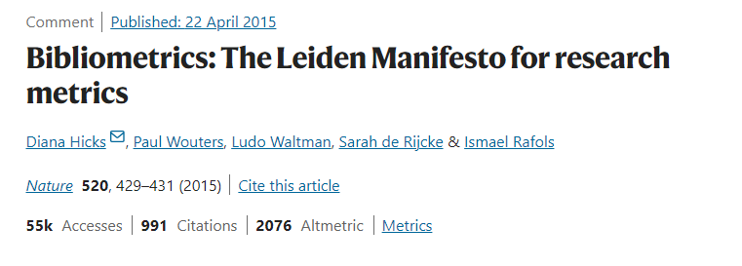
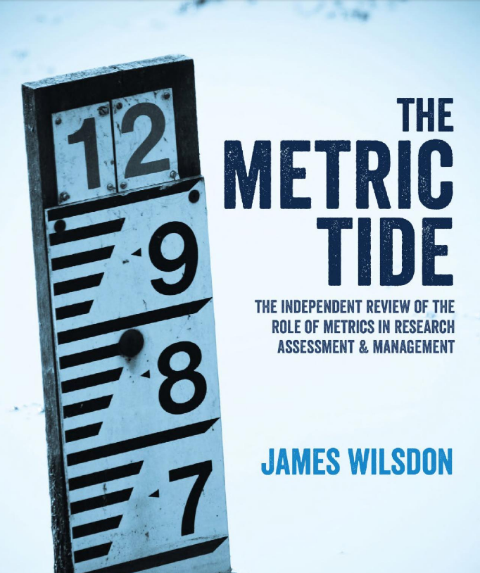
Developments in research assessment reform
Both published in 2015; also focused on publication metrics
Notes:
Subsequent milestones including the Leiden Manifesto6 and the Metric Tide report7 (both published in 2015) have been similarly focused on the use of publication metrics.

Slide 9
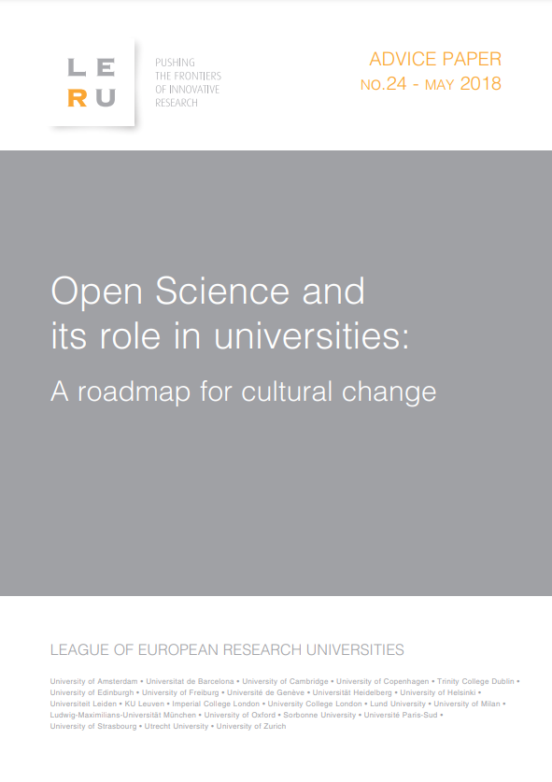
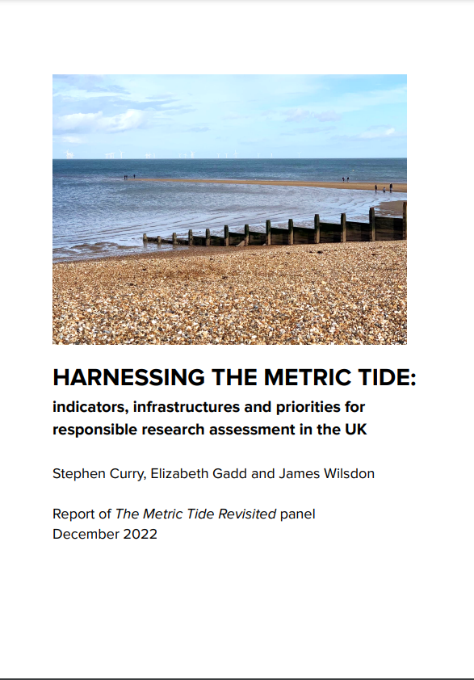
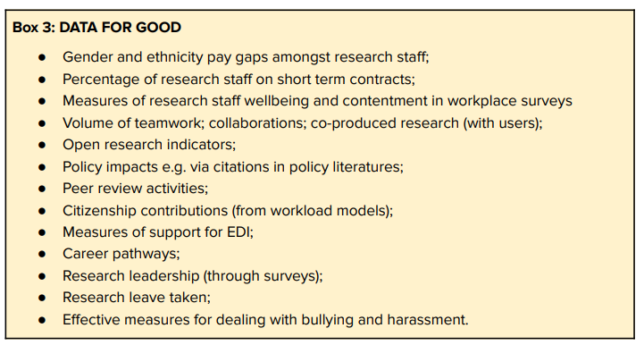
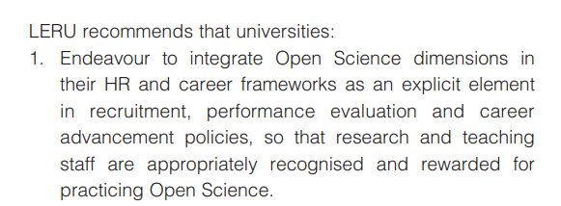
Development in research assessment reform: a shift
A shift from an agenda focused almost exclusively on the use of publication-based metrics:
Notes:
but recently there has been a shift from an agenda focused almost exclusively on the use of publication based metrics towards a broader framework of responsible research assessment; e.g., 2022 revisit of the Metric Tide report (increased attention to open research); a white paper from LERU (League of European Universities) (2018) recommended that the universities ‘[e]ndeavour to integrate Open Science dimensions in their HR and career frameworks as an explicit element in recruitment, performance evaluation and career advancement policies’.
- 2018 European Universities Association published the EUA Roadmap on Research Assessment in the Transition to Open Science (quote: Today, research assessment and reward systems generally do not reflect important Open Science contributions, such as curating and sharing datasets and collections, documenting and sharing software (source code), or devoting time and energy to high-quality peer review. New approaches to research assessment that take into account Open Science contributions need to be identified and thoroughly discussed by academic communities.¹⁶ )

Slide 10
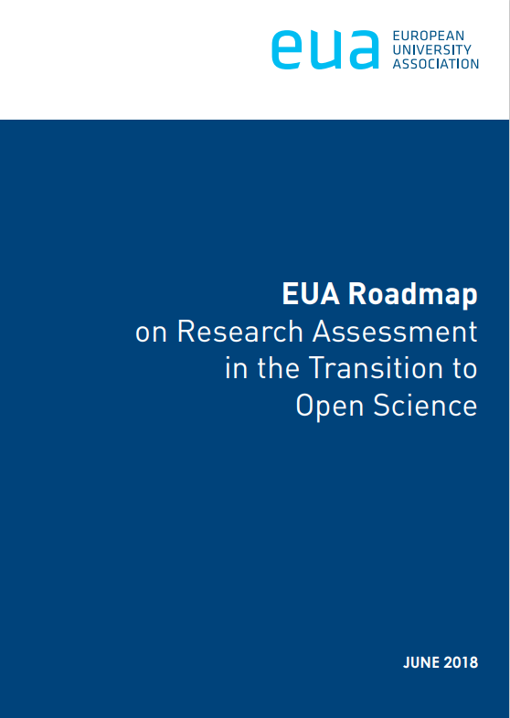
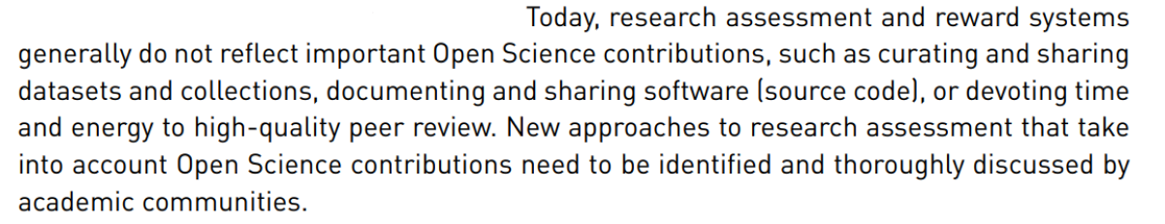
Development in research assessment reform: a shift
Notes:
- 2018 European Universities Association published the EUA Roadmap on Research Assessment in the Transition to Open Science (quote: Today, research assessment and reward systems generally do not reflect important Open Science contributions, such as curating and sharing datasets and collections, documenting and sharing software (source code), or devoting time and energy to high-quality peer review. New approaches to research assessment that take into account Open Science contributions need to be identified and thoroughly discussed by academic communities.¹⁶ )

Slide 11
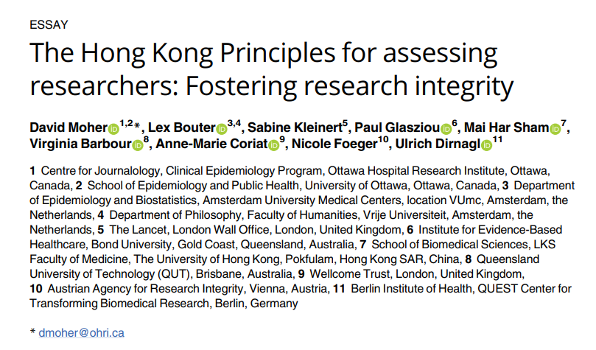
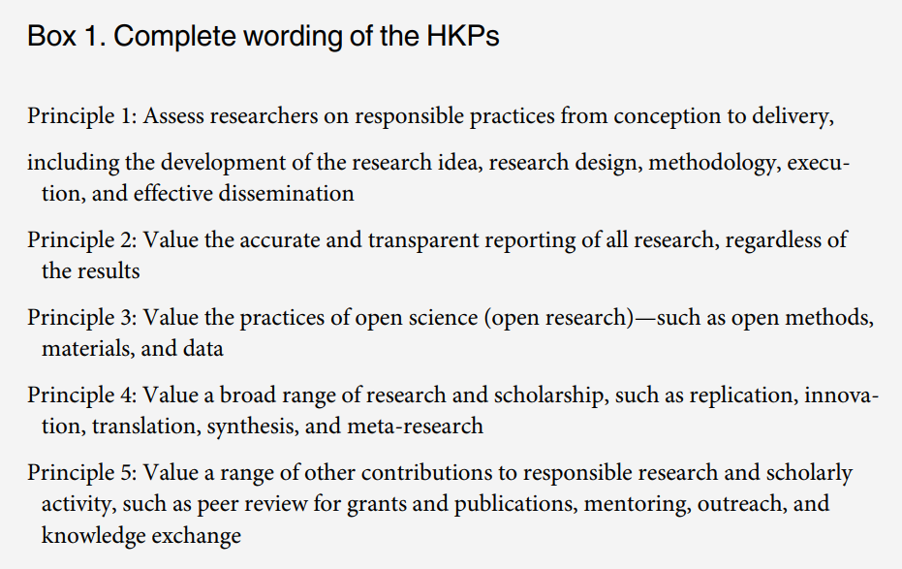
Development in research assessment reform: a shift
Notes:
- Hong Kong Principles for assessing researchers (2020) propounded by members of life sciences research communities, call for assessment to develop a much broader picture of a researcher’s contributions to research and society. One of its five principles is to ‘Reward the practice of open science (open research)’, and it makes a strong connection between research transparency and research integrity.¹⁷

Slide 12

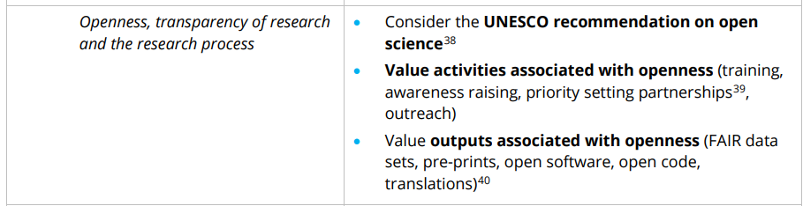
Development in research assessment reform: a shift
Notes:
Agreement on Reforming Research Assessment (2022) by Coalition for Advancing Research Assessment (CoARA) ‘openness’ is recognised as being integral to the practices by which research is conducted, communicated and validated, and is identified as a key dimension of research assessment. ‘Openness of research, and results that are verifiable and reproducible where applicable, strongly contribute to quality’ Consider […] the full range of research outputs, such as scientific publications, data, software, models, methods, theories, algorithms, protocols, workflows, exhibitions, strategies, policy contributions, etc., and reward research behaviour underpinning open science practices such as early knowledge and data sharing as well as open collaboration within science and collaboration with societal actors where appropriate.¹⁸
Many universities have policies or statements on the responsible use of metrics; few have yet developed responsible research assessment policies.¹⁹

Slide 13
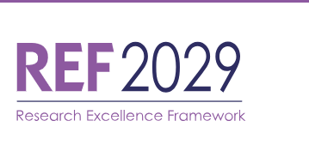

Open research and the REF2029
a greater emphasis on institutional research culture, including use of open research practices, in an expanded ‘People, Culture and Environment’ element
campaigning on a 5% manifesto: a target for HEIs to submit at least 5% of non-traditional research outputs
Notes:
Initial decisions for the 2029 REF indicate that it will place a greater emphasis on institutional research culture, including use of open research practices, in an expanded ‘People, Culture and Environment’ element, while the element ‘Contribution to Knowledge and Understanding’, renamed from ‘Outputs’ in REF 2021, will enable institutions to evidence a greater diversity of research activities and outputs.²⁰ It is worth mentioning in this context the Hidden REF initiative, which emerged in the runup to the 2021 REF. It highlighted the lack of representation in submissions for non-academic research contributors (such as data scientists, technicians and research software engineers) and for ‘non-traditional’ outputs (i.e. other than publications). Now that the UK is on track for REF 2029, the Hidden REF is campaigning on a 5% manifesto: a target for HEIs to submit at least 5% of non-traditional research outputs.²¹

Slide 14
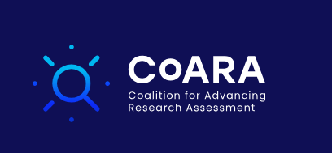

Making open research count
recognises open science as a strategic theme and a number of working groups are addressing aspects of its operationalization in research assessment
aims to develop and pilot with selected institutions a number of tools to support the development of research assessment systems that incentivize and reward researchers to take up open science practices
Notes:
- Models for the integration of open research into institutional research assessment and research planning are yet to be established
Some challenges:
- defining outputs which are not peer reviewed papers
- establishing standards for publication, preservation and citation of different kinds of output
- lack of research infrastructure and institutional systems will need to be developed to facilitate the production, transmission and collection of data about open research outputs
- no peer review process for some types of open research outputs
- difficult to obtain reliable, comparable quantitative information about the citation and use of many open research outputs
Some projects working on overcoming these difficulties:
in the Coalition for Advancing Research Assessment, open science is recognised as a strategic theme and a number of working groups are addressing aspects of its operationalisation in research assessment;²⁶
the EU-funded OPUS project aims to develop and pilot with selected institutions a number of tools to support the development of research assessment systems that incentivise and reward researchers to take up Open Science practices, including an updated version of OS-CAM and a set of Open Science indicators and metrics; ²⁷

Slide 15


Making open research count
aims to develop the infrastructure for the collection, validation and re-use of open research metrics and indicators
the UKRN Open Research Programme is undertaking work to define requirements for open research indicators to support institutional planning and development
Notes:
the GraspOS project, also EU-funded, aims to develop the infrastructure for the collection, validation and re-use of Open Science metrics and indicators, to enable their use in research assessment, and convenes a Community of Practice on Open Science and Responsible Research Assessment. ²⁸ The UKRN Open Research Programme is also undertaking work to define requirements for open research indicators to support institutional planning and development.²⁹

Slide 16
Conclusion
many countries, funders and research-performing organisations are joining the coalition for change and reviewing or planning to review their research assessment policies and procedures
operationalisation of open research incentives and expectations will signal that open practices are an essential part of how research is carried out
universities and other research-preforming organisations cannot afford to ignore the direction of travel in the sector towards the integration of open research into all aspects of research activity and the adoption of responsible research assessment practices
Notes:
With momentum for research assessment reform building globally, many countries, funders and research-performing organisations are joining the coalition for change and reviewing or planning to review their research assessment policies and procedures
- Operationalisation of open research incentives and expectations will signal that open practices are an essential part of how research is carried out. It will power the adoption of open research practices by researchers and lead to improvements in research integrity, quality and impact.
- Universities and other research-preforming organisations cannot afford to ignore the direction of travel in the sector towards the integration of open research into all aspects of research activity and the adoption of responsible research assessment practices. Aside from all other considerations, failure to act will put them at a competitive disadvantage within the sector and is likely to impact performance in REF 2029 with subsequent reputational and funding consequences.

