Slide 1

Forensic Suite
A suite containing ideas regarding criminal detection.
Team : Pneuma Ousia
Team Members: Rudraksh Gohil - Shorya Rawal - Aliya Singh

Slide 2
BRIEF
The suite consists of 3 modules which works in moderation with the police and forensic team.The basic idea behind the proposition of this suite is to ease up the process of checking and matching evidences which can lead to a suspect in case of a crime in a more digitalised way. This will not only make the work of the police and forensic team easier but also will help in the expansion of digital use in the field of forensics.The suit holds three main ideas which include:
fingerprint matching
facial recognition and
unified data verification which can help to detect a criminal using a limited information and less manual labour.

Slide 3
FINGERPRINT MATCHING
Basic forensic database
This idea is based on the idea of fingerprint matching as seen in forensic science. In case there are fingerprints collected from a particular crime scene, a proper collection of the criminal’s fingerprints can help to solve the case by examination and evaluation of the fingerprint to match a suspect’s fingerprints. This technology basically uses pattern matching which can be incorporated using python.All we require is a database containing all the information about the suspect (suspects) and the fingerprints that can be matched to that of the criminal’s using the database.

Slide 4
FACIAL RECOGNITION
Available database
In case there is an availability of CCTV cameras at the crime scene and we are able to retrieve then CCTV footage , this idea of facial recognition can prove to be of great help. This module plans on using the retrieved CCTV footage from the crime scene in order to detect the faces of the person (people) present there and help the police department detect the suspect with the help of a database and artificial intelligence models. This module also includes upgrading the database with modern machine learning models which again is a digital way, simplifying the work for the team and reducing physical stress.

Slide 5
AVAILABLE CRIMINAL RECORDS
This module is based on the idea of accessing criminal records which are already made available by the system database. These records should be stored in a database or software which should be accessible to all the police stations and other crime related branches on a global scale. If the information stored in this database matches the information of a suspect , a quicker action can be taken against the person(people) wherever they are and then start the further proceedings based on the prosecution precesses of their respective country. This is a more of a globalised form of making criminal records accessible to all crime related organisations.

Slide 6
TECHNOLOGY USED
 | Machine Learning Algorithms | Application Interface | User Interface Initialisation | Backend
1 | Classification Algorithm | Flutter | Figma | Logging System
2 | K-Mean Clustering | Firebase | Miro | Docker Implementation
3 | Decision Tree |  | Freeform | Cloud management
4 | K-Nearest Algorithm |  |  | Minor Command Line Interfacing
5 | Naive Based Algorithm
6

Slide 7
Features
The suite is a combination of multiple modules which includes fingerprint matching , facial recognition and criminal records which are used in a more digitalised way.
This is cost effective model which works on a lower budget . It thus saves money and a lot of time.
The suite can be implemented on workstations and can also be accessed via the mobile application with the help of cloud deployment.
The suite would be easy to use and have a better learning curve so this could be used by a large number of with little to no training required.
The modules also focuses on the digitalisation of old techniques that have been used by the forces. Thus, reducing manual labour.
The suit would be available in multiple regional languages.

Slide 8

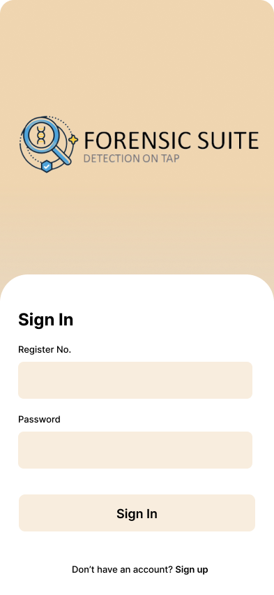
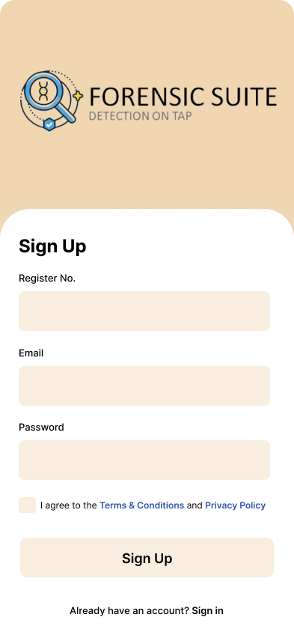

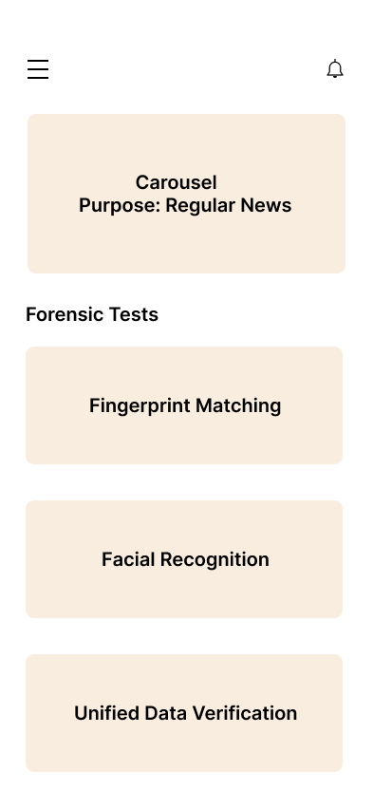
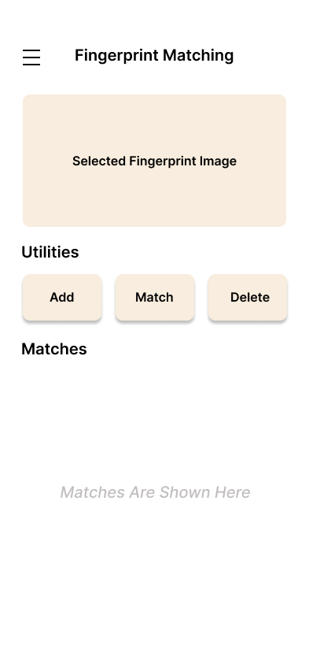
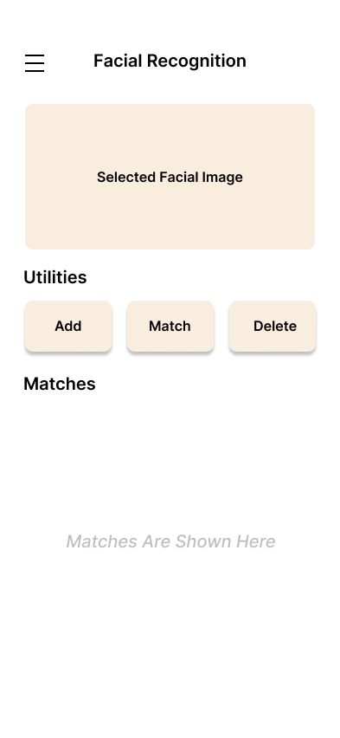
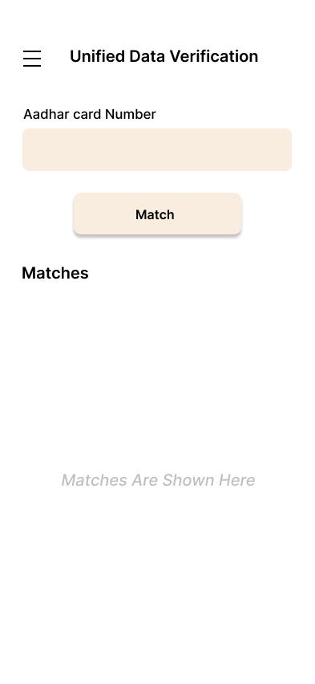
APPLICATION DESGIN
BASIC SAMPLE USER INTERFACE

Slide 9
BUSINESS LOGIC
PAY AS YOU GO MODEL
This module requires a Pay as you go subscription at the time of the product roll out.
Other expenses include Research and development cost and the Subscription model budget. The calculation log sheet of both of these models is attached along in this ppt.
SERVICES PROVIDED
The whole package includes 5 hours of free service regarding the modules.
Monthly data and security updates for the suite modules.
Quarterly application updates.

Slide 10
RESEARCH AND DEVELOPMENT COST
Category | Amount
Numbers of hours required | 160 hours
Cost per hour | 340
Hardware and software cost | 12,400Rs
Final Budget | 2,30,000Rs

Slide 11
PAY AS YOU GO MODEL
Module Test | Amount
Single Module Test | 55Rs
Full Module Test | 155Rs

Slide 12
ESTIMATED COST AFTER IMPLEMENTATION
Even after the implementation of this module, there is no huge cost outcome as it works on a Pay as You Go Model.
Cloud Storage Pay as You go Subscription.

Slide 13
THANK YOU

