Slide 1
Bank Customer Churn
Presented by: Shota Terajima
Last Updated: December 15th, 2025

Slide 2
Bank Customer Churn
-> Objective
-> Present Data
-> Conclusion

Slide 3
What are we talking about

Slide 4
Objectives
Identify which customer factors and segments are most strongly associated with churn.

Slide 5
Present Data

Slide 6
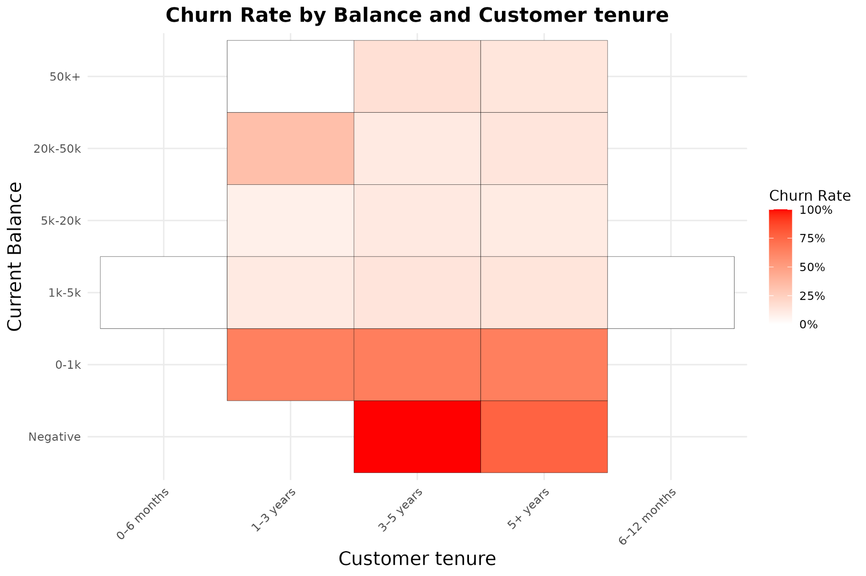
Balance and Customer tenure
Little relationship between churn rate and customer tenure.
Customers with balances below $1,000 have a high churn rate

Slide 7
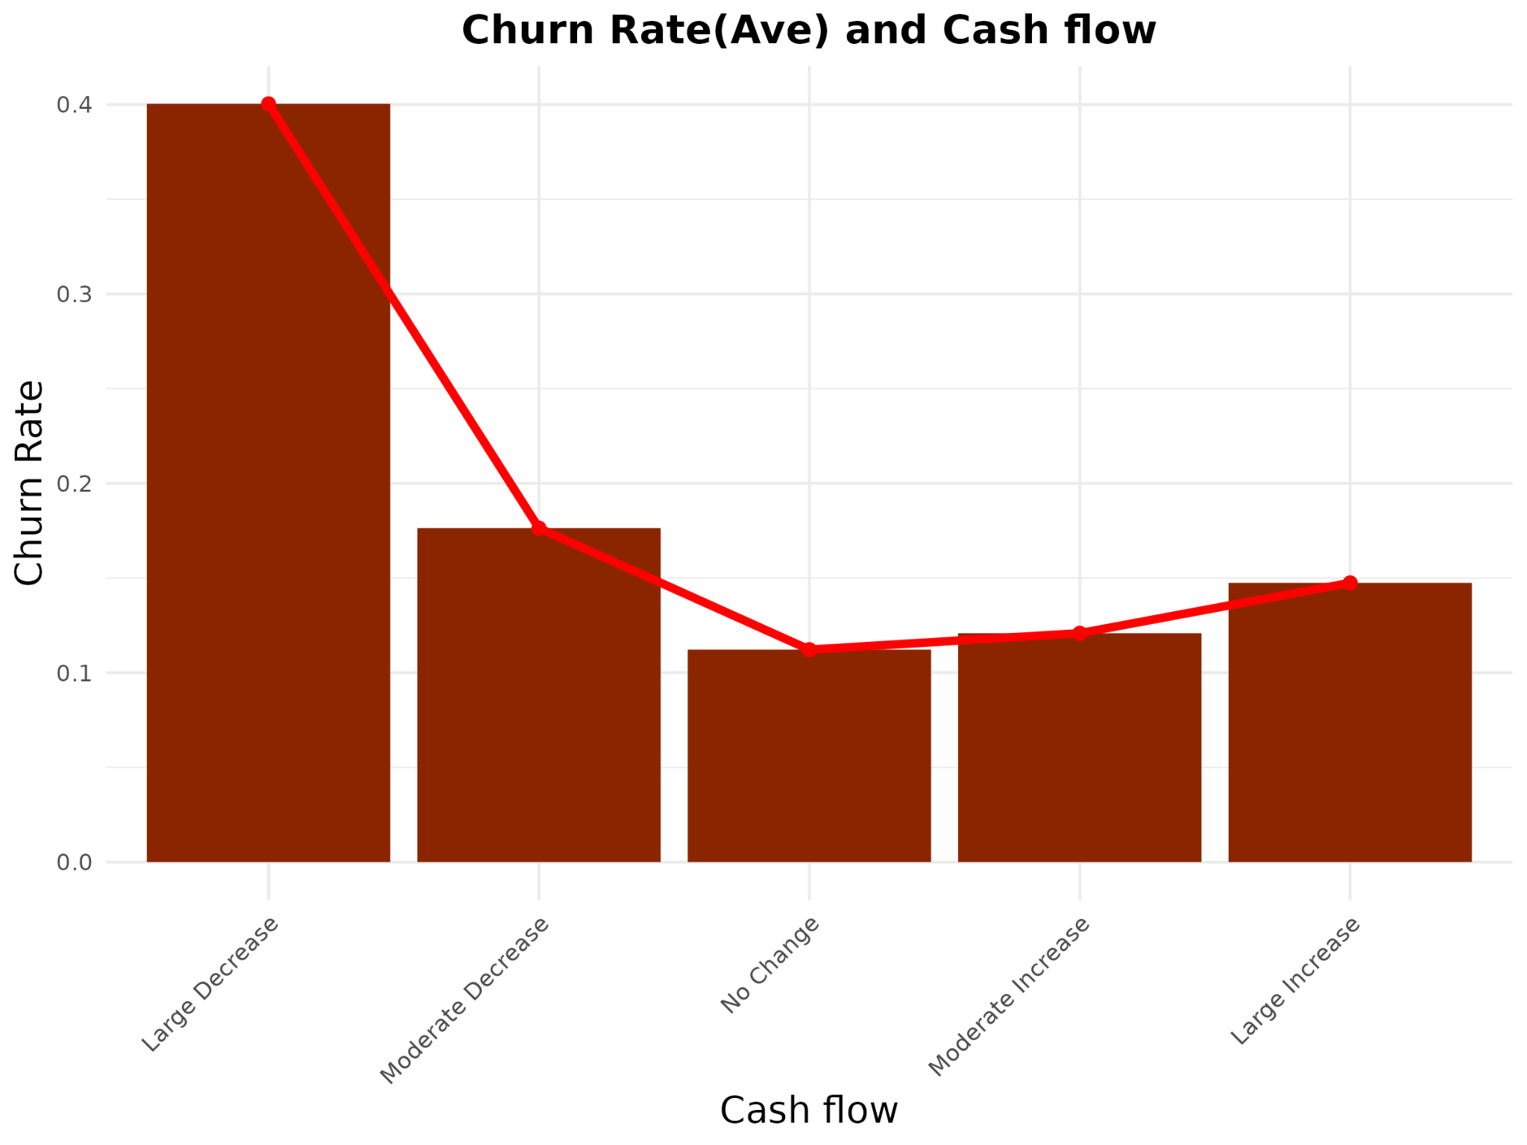
Cash flow
Customers with no decline in cash flow have a lower churn rate.
Customers with declining cash flow have a significantly higher churn rate.

Slide 8
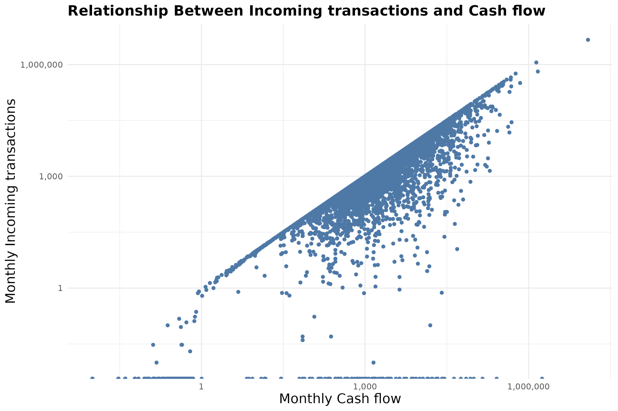
Cash flow and Incoming transactions
Positive correlation between cash flow and incoming transactions.

Slide 9
Conclusion

Slide 10
Conclusion
1
2
3
Customers with lower balances have a higher likelihood of churn.
Customers with lower incoming transactions tend to have weaker cash flow, which is associated with a higher churn rate.
Evidence suggests that current balance, cash flow, and incoming transactions are all related to customer churn.
*Further analysis needed

