Slide 1
Virtual Synthesizer Development in C++
William Sieber

Slide 2
Overview
Theory
Sound → Processing
Practical Application
UML Diagram
Specifics for VST3
Demo of Software + Uses
VST3PluginTestHost and DAWs
Future Work

Slide 3
Part 1 – Theory
How do we create a digital representation of sound?
What problems do we have to overcome?
What tools are available to solve these problems?

Slide 4
Discrete Signals
A sample is taken by measuring the amplitude of a wave at a point in time.
Floating point number [-1, 1]
Audio is represented digitally by taking samples at regular intervals.
Sample rate is the measurement of samples/second.
44.1 kHz, 48 kHz

Slide 5
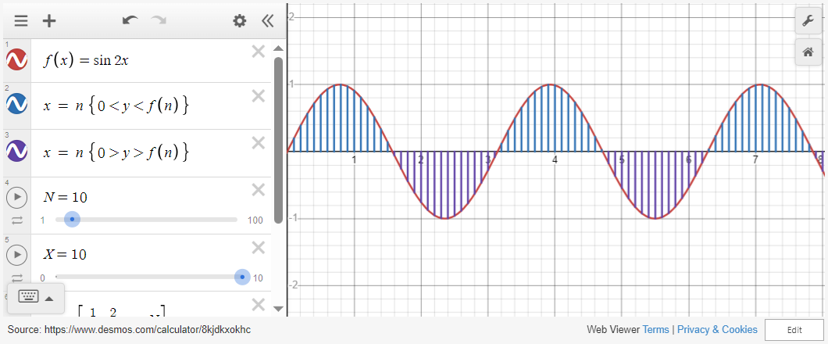
Discrete Signals - Example

Slide 6
Processing Digital Audio
Speakers, Microphones, etc.
Sound card
(Generally Integrated)
DAC (output to speaker)
ADC (input to audio interface)
Driver
Host Application (FL Studio, Cubase, Ableton, Logic, etc.)
Audio driver
(ASIO, Core Audio, etc.)
OS
(Windows, Mac, etc.)
Audio plug-in
(VST, AAX, CLAP, etc.)

Slide 7
Problems with real time audio
Processing has hard time requirements → audio stack waits for nothing.

Slide 8
All these things aren’t really an issue.

Slide 9
Reason 1 – Software Available
Various plugin frameworks:
Juce, iPlug2, dplug, DISTHRO, etc.
Various SDKs:
VST SDK, AAX SDK, etc.
Each make handling the digital audio stack easier.

Slide 10
Reason 2 – Computers are good
Realistically, it is difficult to reach the threshold at which unwanted audio artifacts occur.
(Maintaining good conventions, that is).

Slide 11
Part 2 – Practical Application
How are VST programs generally structured?
How do we obtain MIDI input?
How do we create basic waveforms?

Slide 12
Structure
Plugins are typically composed of three components:
A plugin controller file (myplugincontroller.cpp)
A plugin processor file (mypluginprocessor.cpp)
A plugin entry file (mypluginentry.cpp)
[].

Slide 13
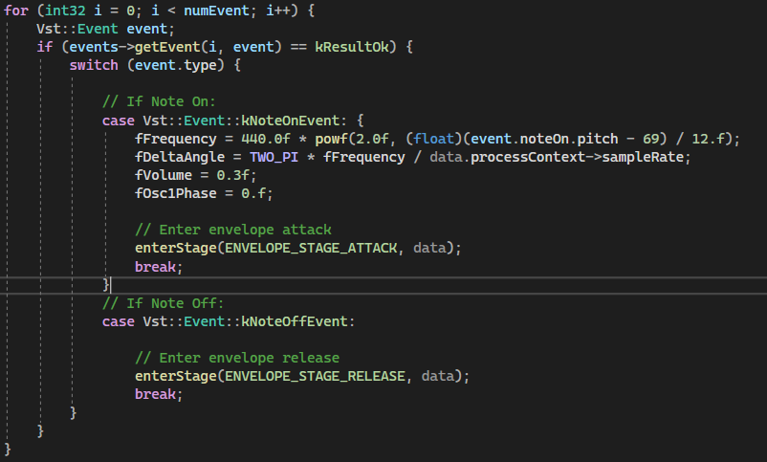
Obtaining MIDI Input
The Steinberg::Vst namespace contains a IEventList class which processes “events” (i.e. signals).
The provided MIDI note found in event.noteOn.pitch is used to calculate fFrequency in relation to a particular reference note (A4 → 440 Hz, MIDI # 69).

Slide 14
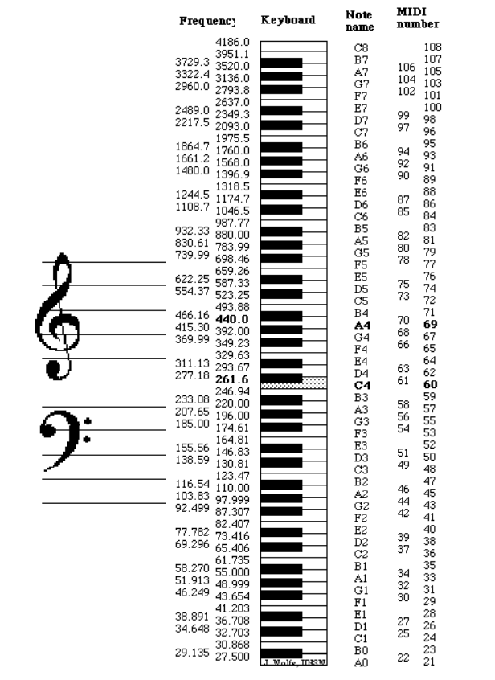
Obtaining MIDI Input (cont.)
Notes lower than our reference pitch will generate a power of 2 to a negative exponent (!)
This is expected as the resulting frequency will be lower than our reference pitch when multiplied.

Slide 15
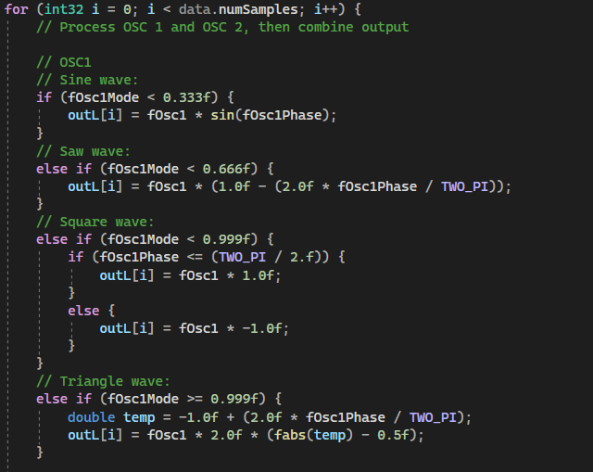
Creating Waveforms in Code
A for loop is used to iterate through each sample of the current buffer.
[].

Slide 16
Creating Waveforms in Code (cont.)

Slide 17
Part 3 – Program Demo

Slide 18
Future Work

Slide 19
Sources:
https://www.youtube.com/watch?v=boPEO2auJj4
https://www.youtube.com/watch?v=SJXGSJ6Zoro
https://newt.phys.unsw.edu.au/jw/notes.html

