Slide 1
Virtual Synthesizer Development in C++
William Sieber
May 2024

Slide 2
Overview
Theory
Processing Sound
Roadblocks + Issues
Practical Application
Structure + Specifics for VST3
MIDI Input
Waveform Creation
Demo of Software + Uses
VST3PluginTestHost and DAWs
Future Work

Slide 3
Part 1 – Theory
How do we create a digital representation of sound?
What problems do we have to overcome?
What tools are available to solve these problems?

Slide 4
Discrete Signals
A sample is taken by measuring the amplitude of a wave at a point in time.
Floating point number [-1, 1]
Audio is represented digitally by taking samples at regular intervals.
Sample rate is the measurement of samples/second.
44.1 kHz, 48 kHz

Slide 5
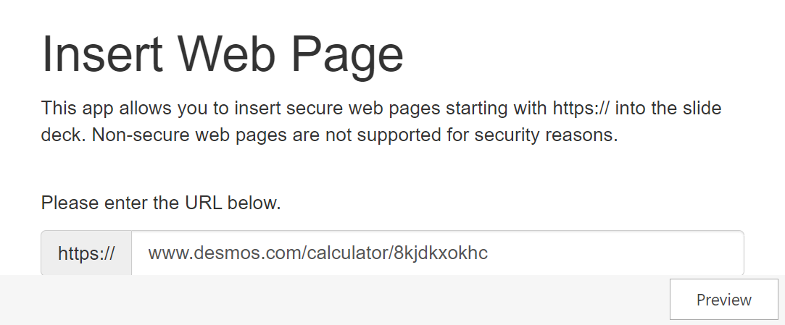
Discrete Signals - Example

Slide 6
Processing Digital Audio
Speakers, Microphones, etc.
Sound card
(Generally Integrated)
DAC (output to speaker)
ADC (input to audio interface)
Driver
Host Application (FL Studio, Cubase, Ableton, Logic, etc.)
Audio driver
(ASIO, Core Audio, etc.)
OS
(Windows, Mac, etc.)
Audio plug-in
(VST, AAX, CLAP, etc.)

Slide 7
Problems With Real Time Audio
A buffer is an array of samples sent to the audio driver.
Processing has hard time requirements → audio stack waits for nothing.
If buffers take too long to process, popping and clipping can occur in one’s audio output.
Example:
buffer
buffer
buffer
buffer
buffer
buffer
buffer
buffer
time:

Slide 8
Easier Than Expected
Software Available:
Various plugin frameworks:
Juce, iPlug2, dplug, DISTHRO, etc.
Various SDKs:
VST SDK, AAX SDK, etc.
Each make handling the digital audio stack easier.
Realistically, it is difficult to reach the threshold at which unwanted audio artifacts occur.
(Maintaining good conventions, that is – avoiding system calls).

Slide 9
Part 2 – Practical Application
How are VST programs generally structured?
How do we obtain MIDI input?
How do we create basic waveforms?

Slide 10
Structure
Plugins are typically composed of three components:
A plugin controller file (myplugincontroller.cpp)
A plugin processor file (mypluginprocessor.cpp)
A plugin entry file (mypluginentry.cpp)
A controller file handles GUI → myplugineditor.uidesc
.vst3 format is a repackaged DLL file → can be executed as a standalone application or within Digital Audio Workstations (DAWs).

Slide 11
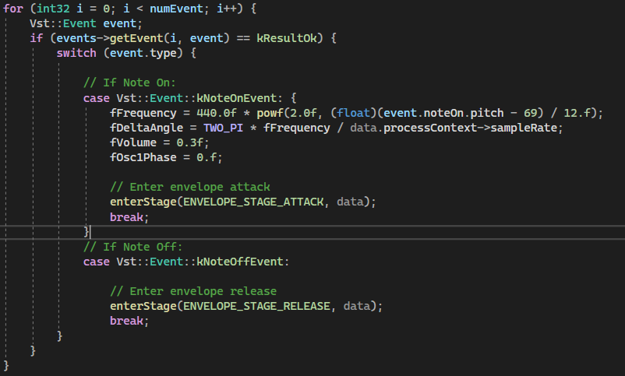
Obtaining MIDI Input
The Steinberg::Vst namespace contains a IEventList class which processes “events” (i.e. signals).
The provided MIDI note found in event.noteOn.pitch is used to calculate fFrequency in relation to a particular reference note (A4 → 440 Hz, MIDI # 69).

Slide 12
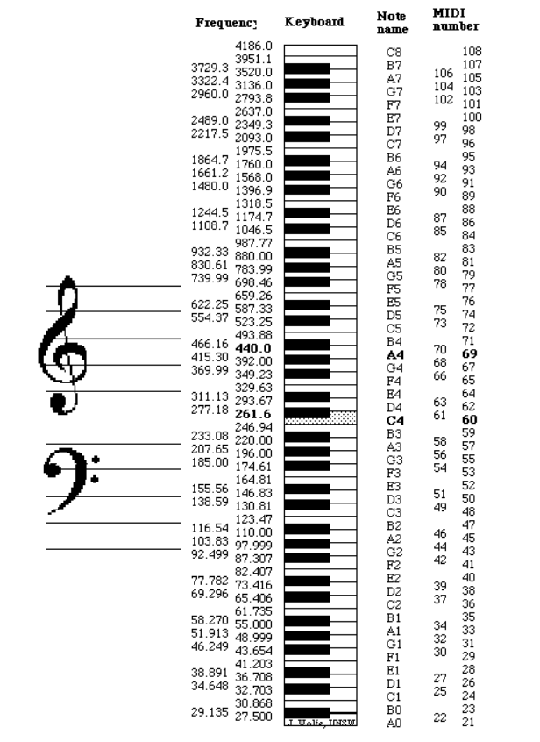
Obtaining MIDI Input (cont.)
Notes lower than our reference pitch will generate a power of 2 to a negative exponent (!)
This is expected as the resulting frequency will be lower than our reference pitch when multiplied.

Slide 13
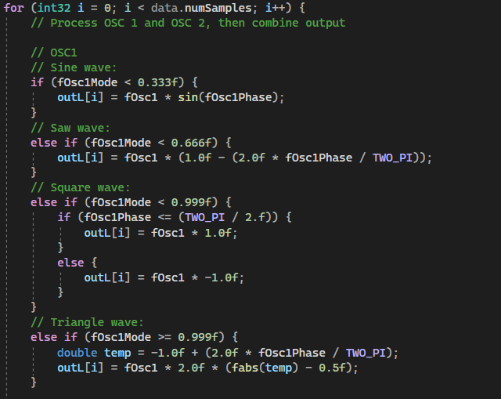
Creating Waveforms
A for loop is used to iterate through each sample of the current buffer.
fOsc1Mode determines which state the knob is in from the GUI → determines which waveform to generate in the buffer.

Slide 14
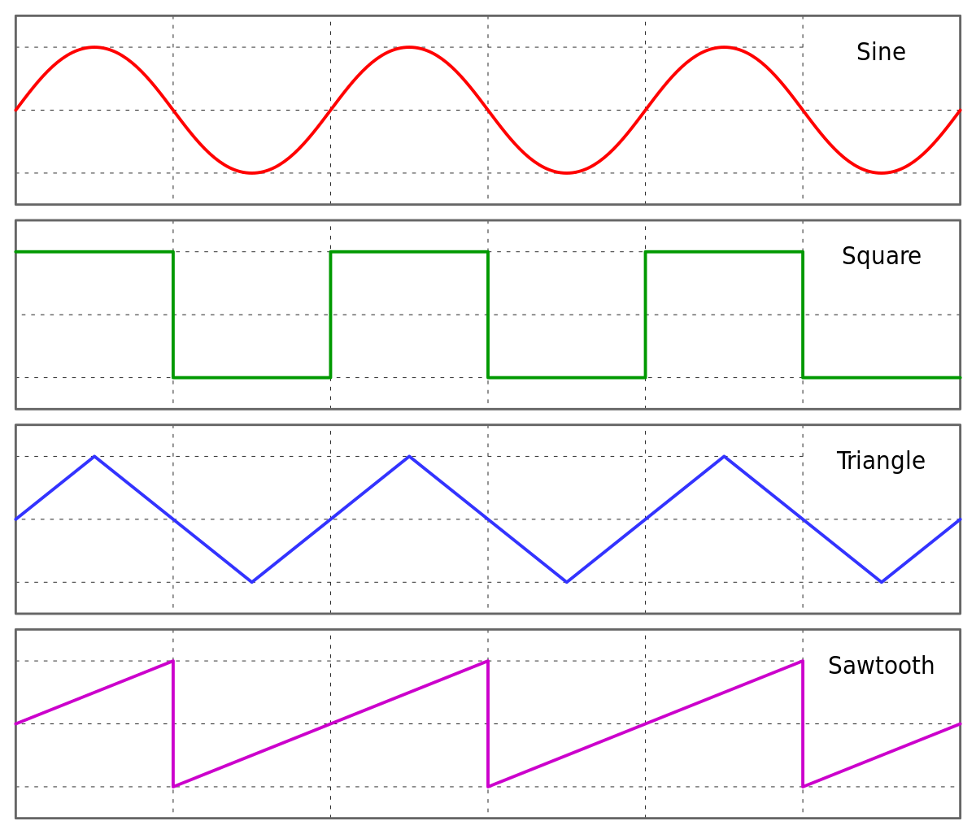
Creating Waveforms (cont.)
A for loop is used to iterate through each sample of the current buffer.
fOsc1Mode determines which state the knob is in from the GUI → determines which waveform to generate in the buffer.

Slide 15
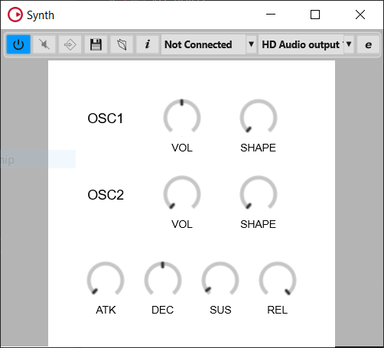
Part 3 – Program Demo

Slide 16
Future Work
In general: optimizations in code
Further Development:
Wavetable Synthesis
Effect Plug-ins

Slide 17
Sources:
https://www.youtube.com/watch?v=boPEO2auJj4
https://www.youtube.com/watch?v=SJXGSJ6Zoro
https://newt.phys.unsw.edu.au/jw/notes.html

