Slide 1
Jobs DB Project
A Skunkworks Project

Slide 2
1. Build the list of companies in the finance domain. 2. Web scrape the data for each of the companies for job details. 3. Automate the scraping. 4. Get relevant data from Glassdoor and LinkedIn. 5. Get data from two Social media sites – Twitter, YouTube 6. Clean and integrate data. 7. Build an ER diagram and model the db. 8. Build the dB schema and insert the data 9. Generate use cases. 10. Build UI for those use cases.

Slide 3
Project Status
Activity | Status
1. Build a list of Companies in Finance Domain | Done(04/02)
2. Web scrape the data for each of the companies for job details. | WIP
3. Automate the scraping | WIP
4. Get relevant data from Glassdoor and LinkedIn | WIP
5. Get data from two Social media sites – Twitter, Youtube | Done
6. Clean and integrate data | Pending
7. Build an ER diagram and model the dB | Pending
8. Build the dB schema and insert the data | Pending
9. Generate use cases | Pending
10. Build UI for those use cases. | Pending

Slide 4
List of Companies
Company | Link1
AXA | https://us.axa.com/about-axa/axa-careers/index.html
Berkshire hathway | https://www.bhhc.com/careers.aspx
Goldman Sachs | https://www.goldmansachs.com/careers/
Citi Bank | https://jobs.citi.com/search-jobs
Con Edison | https://www.coned.com/en/about-us/careers
Fannie mae | https://careers.fanniemae.com/main/?
BNY Mellon | https://www.bnymellon.com/us/en/careers/index.jsp
Bloomberg | https://www.bloomberg.com/careers/
Union Bank | https://www.ublocal.com/careers/
Evercore | https://www.evercore.com/join-our-team/
Tiffany&Co | https://www.tiffanycareers.com/job-search-results/
Moody's | https://careers.moodys.com/
CIT Group | https://www.cit.com/about-us/careers/
Morgan Stanley | https://www.morganstanley.com/people
Moelis&Company | https://www.moelis.com/careers/
Brown Brothers Harriman | https://www.bbh.com/en-us/careers
AIG | https://www.aig.com/careers
Tradeweb | https://www.tradeweb.com/who-we-are/careers/
Hartford Financial Services | https://www.thehartford.com/careers
Bristol-Myers Squibb | https://www.bms.com/job-seekers.html
Massmutual | https://www.massmutual.com/about-us/careers
UBS | https://www.ubs.com/global/en/careers.html
Bank Of America | http://careers.bankofamerica.com/us
LPL Financial | https://careers.lpl.com/
ZS Associates | https://jobs.zs.com/
Direct Supply | https://www.directsupply.com/careers/
TIAA | https://careers.tiaa.org/tiaa/jobs/search/312599
TD Ameritrade | http://careers.tdameritrade.com/
Lynden Incorporated | http://www.lynden.com/lint/about/employment.html
Charles Schwab | https://www.schwabjobs.com/
Holman group | https://www.holmancareers.com/
Rabobank | https://rabobank.jobs/en/

Slide 5
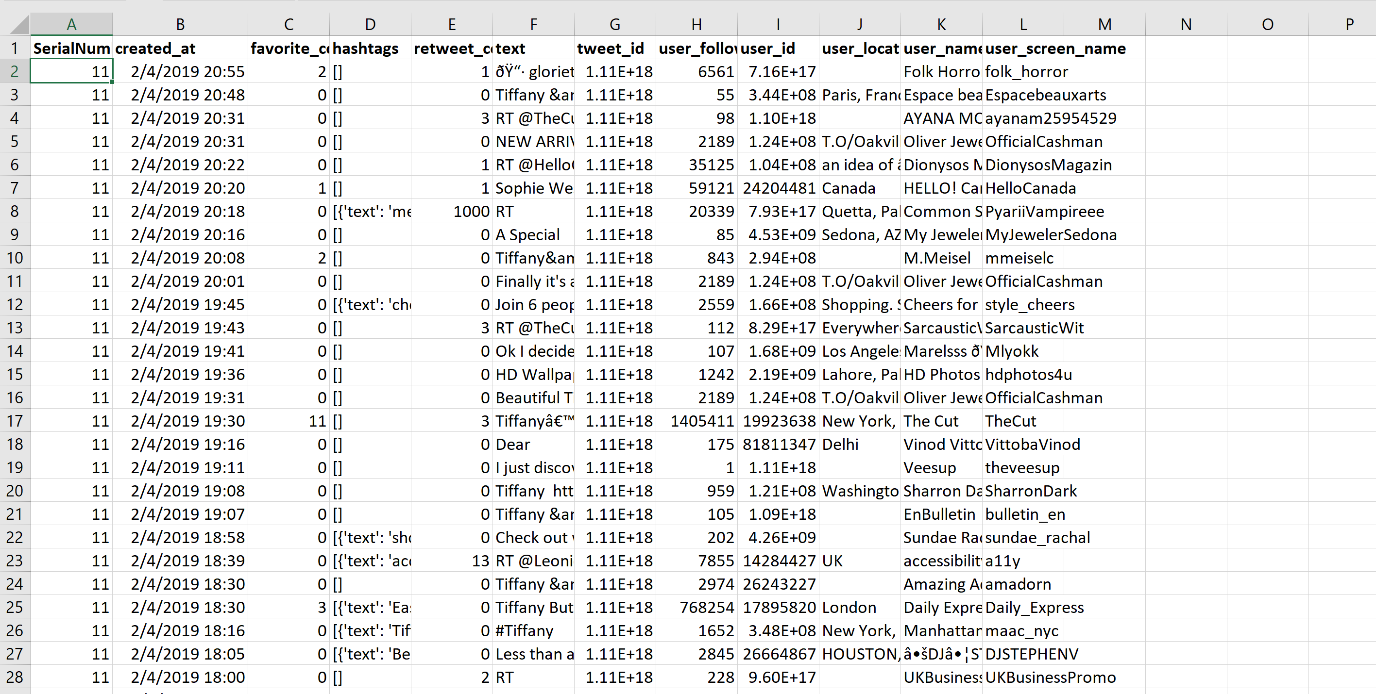
Tweet Data of Companies

Slide 6
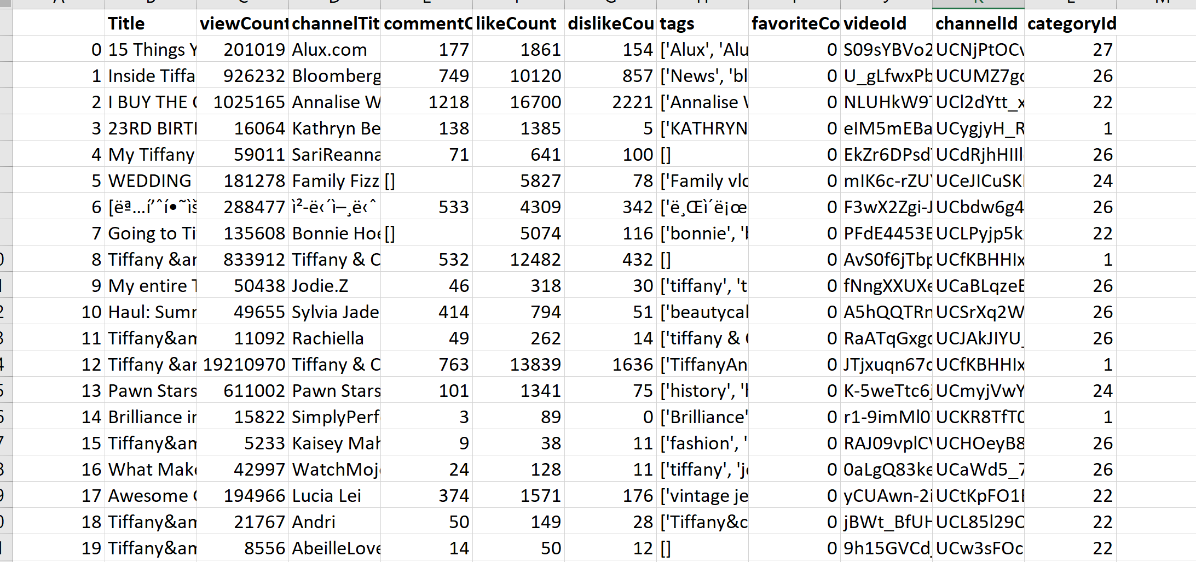
YouTube data of Companies

Slide 7
Glassdoor - Reviews
Review date
Employee position
Employee location
Employee status (current/former)
Review title
Employee years at company
Number of helpful votes
Pros text
Cons text
Advice to management text
Ratings for each of 5 categories
Overall rating

Slide 8
Glassdoor – Company Overview
Size
Head Quarters
Founded
Industry
Competitors
Part of
Type
Revenue

Slide 9
Company Overview People from company were hired Specialties Followers
LinkedIn Company About

Slide 10
Tables
JOBS_TBL
TWEETS_TBL
TWITTER_USRDATA_TBL
YOUTUBE_USRDATA_TBL
YOUTUBE_VIDEODATA_TBL
GLASSDOOR_REVIEWS_TBL
GLASSDOOR_OVERVIEW_TBL
LINKEDIN_DATA_TBL
GLASSDOOR_BENEFITS_TBL(If time permits)
GLASSDOOR_SALARY_TBL(If time permits)

