Slide 1

Machine Learning
Session 20 - T
Neural Networks
Ciência de Dados Aplicada
2023/2024

Slide 2
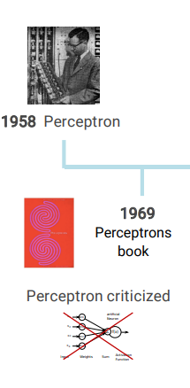
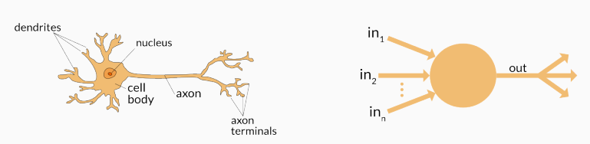
Perceptron
Support Vector Machines
Session 20

Slide 3
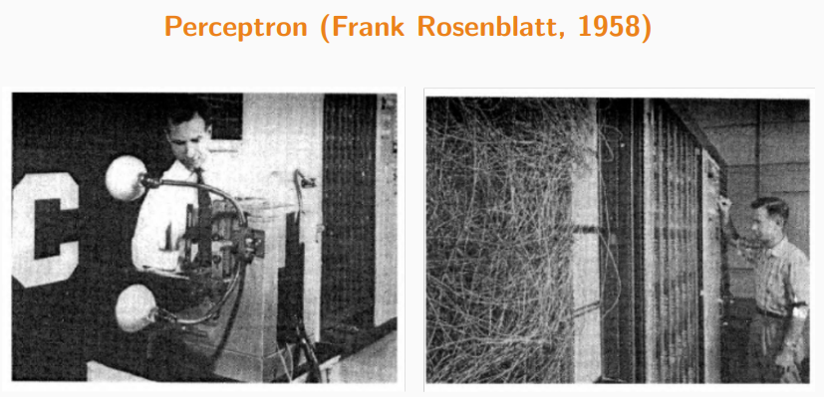
Perceptron
First binary classifier based on supervised learning;
Foundation of modern artificial neural networks;
Support Vector Machines
Session 20

Slide 4
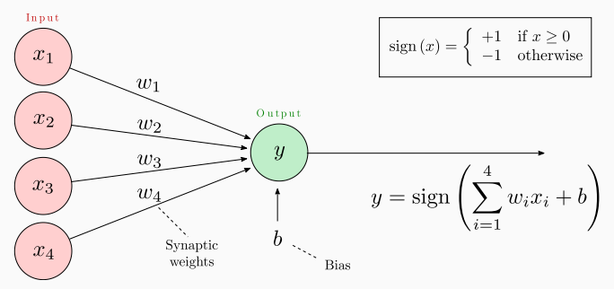
Representation of the Perceptron
Parameters of the perceptron:
w_{k}: weights
b: bias
Training → adjusting the weights and bias.
Activation function
Support Vector Machines
Session 20

Slide 5
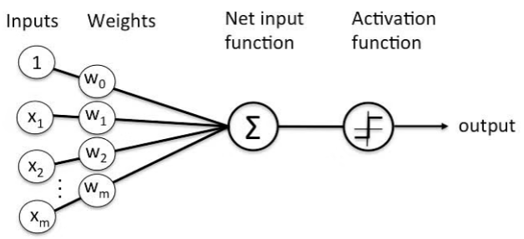
Alternative Representation of the Perceptron
Support Vector Machines
Session 20

Slide 6
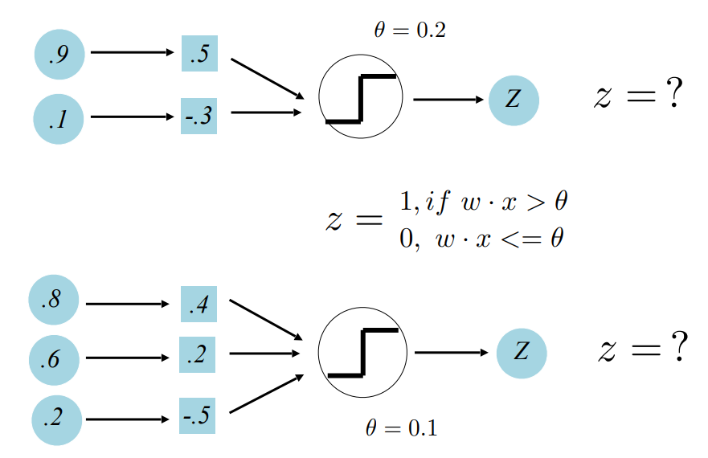
Perceptron Examples
Support Vector Machines
Session 20

Slide 7
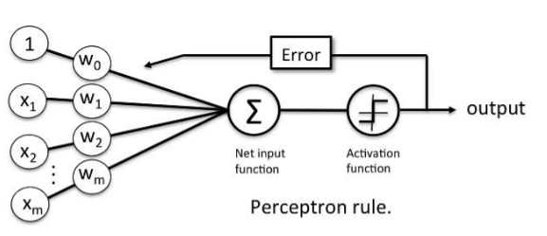
Perceptron Learning Rule
Suppose that x is a feature vector, y is the correct class label, and y' is the predicted class label computed using the current weights.
If y' = y, do nothing
Otherwise w_{i}^{new} = w_{i}^{old} + Δw_{i}^{old} , Δw_{i} = α (t - o)x_{i}
perceptron prediction
learning rate
real target value
Support Vector Machines
Session 20

Slide 8
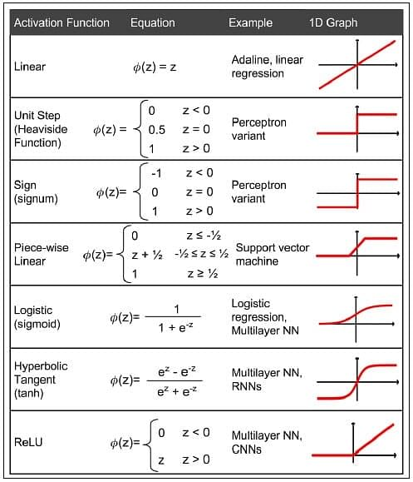
Activation Functions
Outputs the label given an input or a set of inputs
Support Vector Machines
Session 20

Slide 9
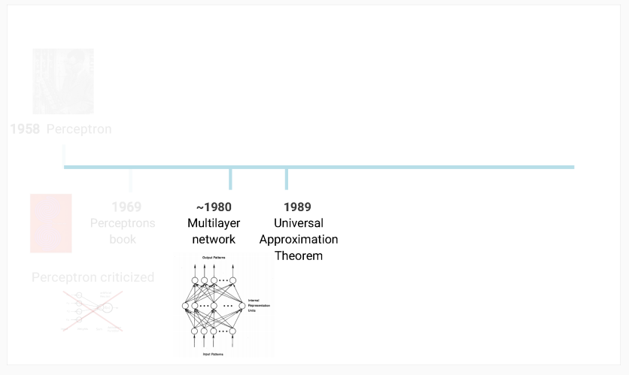
Multilayer Perceptron
Support Vector Machines
Session 20

Slide 10
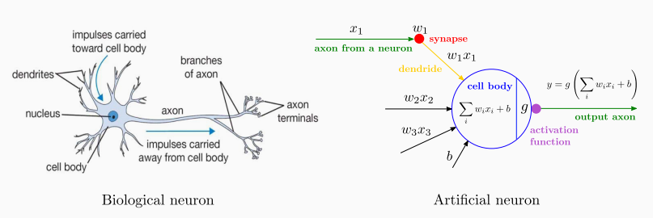
Mulilayer Perceptron
AKA Artificial Neural Networks
Artificial Neuron
Support Vector Machines
Session 20

Slide 11
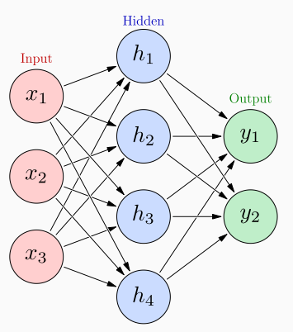
Artificial Neural Networks
Inter-connection of several artificial neurons (also called nodes or units);
Each "level" in the graph is called a lauer:
Input layer;
Hidden layer(s);
Output layer.
Each neuron in the hidden layers acts as a classifier / feature detector;
Fedforward neural network (no cycles):
First na simplest type of neural network;
Information moves in one direction.
Support Vector Machines
Session 20

Slide 12
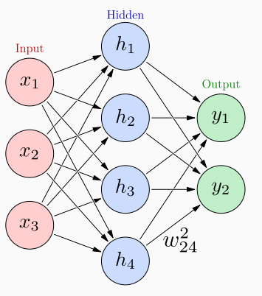
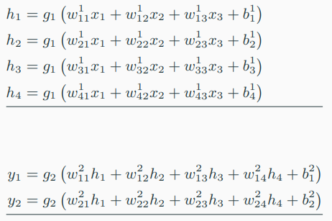
Artificial Neural Networks
w^{k}_{ij} weight between previous node j and next node i at layer k;
g_{k} is any activation function applied to each its input vector
Support Vector Machines
Session 20

Slide 13
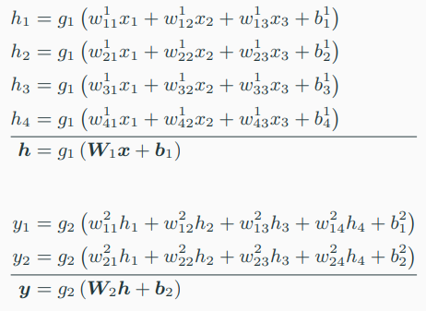
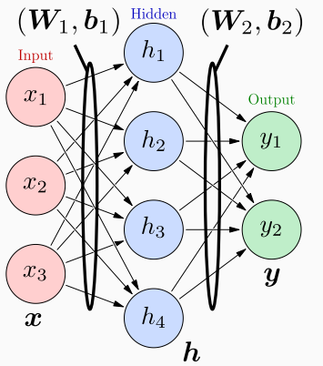
Artificial Neural Networks
The matrices W_{k} and biases b_{k} are learned from labeled training data.
Support Vector Machines
Session 20

Slide 14
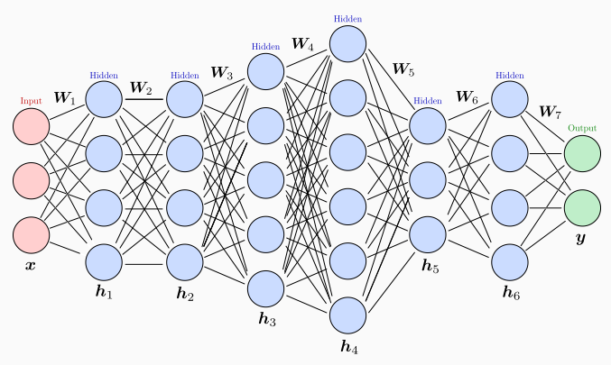
Artificial Neural Networks
It can have 1 hidden layer only (shallow network);
It can have more than 1 hidden layer (deep network);
Each layer can have a different size, and hidden and output layers often have different activation functions.
Support Vector Machines
Session 20

Slide 15
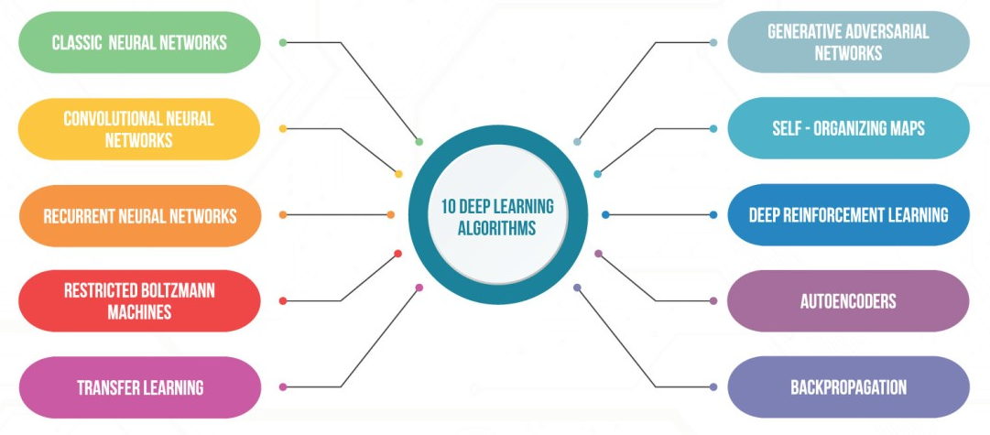
Deep Learning
Not covered in this curricular unit!
Support Vector Machines
Session 20

Slide 16
Resources
Rosenblatt, F. (1958). The perceptron: A probabilistic model for information storage and organization in the brain. In Psychological Review (Vol. 65, Issue 6, pp. 386–408). American Psychological Association (APA). https://doi.org/10.1037/h0042519
https://simplilearn.com/tutorials/deep-learning-tutorial/perceptron
Support Vector Machines
Session 20

