Slide 1
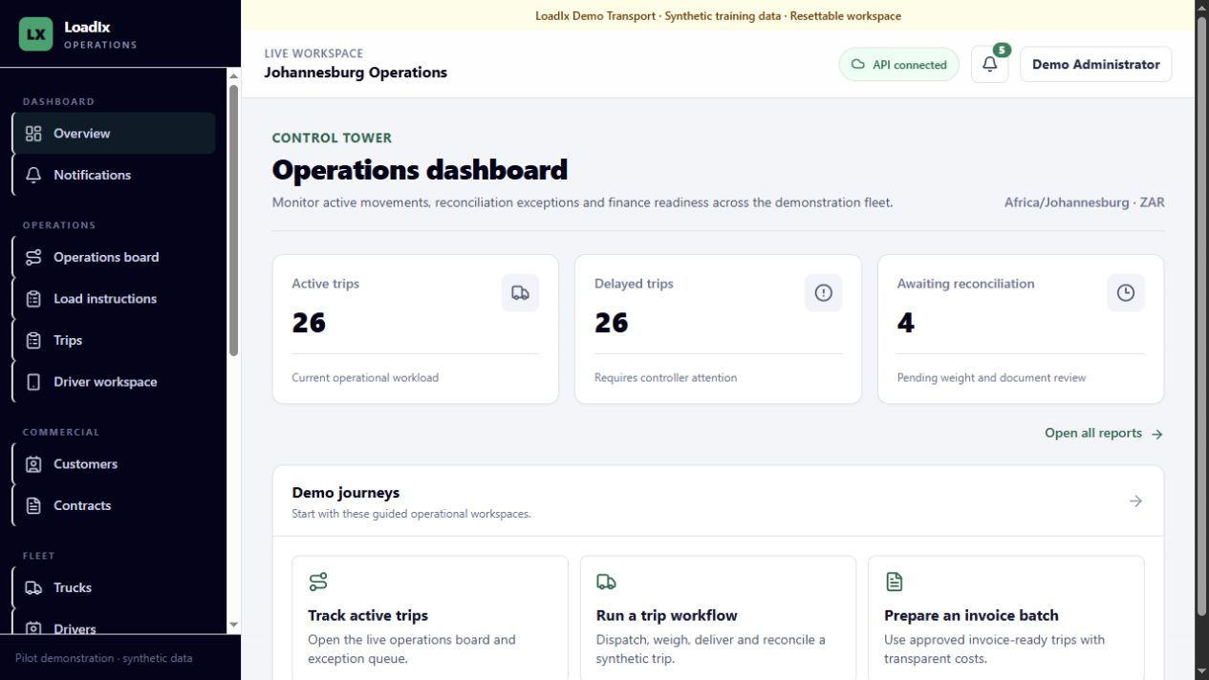
LOADIX
Initial user
training
A practical guide from tenant setup to invoice-ready operations
ADMIN • OPERATIONS • FLEET • FINANCE
Training environment: synthetic LoadIx Demo Transport tenant
Notes:
Set expectations: this is the first module. Demonstrate in the synthetic tenant and keep live customer data out of practice exercises.
[Sources]
- docs/product-scope.md
- docs/demo-guide.md
- Local LoadIx dashboard screenshot captured 2026-08-24

Slide 2
MODULE OVERVIEW
What you will be able to do
The module follows the same sequence as a real movement: configure, plan, execute, reconcile and prepare finance.
1
Find the right workspace
2
Prepare dependable master data
Use the sidebar, connection state, notifications and filters confidently.
Create and maintain customers, sites, commodities and fleet resources.
3
Create commercial work
4
Dispatch and control trips
Build an active contract, then plan a load instruction against it.
Assign eligible resources and move only through legal lifecycle actions.
5
Complete evidence and reconciliation
6
Hand work to finance
Capture weights, documents and reviewed exception decisions.
Approve eligible trips, build invoice batches and run operational reports.
LOADIX INITIAL USER TRAINING • SYNTHETIC DEMONSTRATION DATA
02
Notes:
Ask learners which outcomes match their role. Emphasize that permissions may hide actions they do not own.
[Sources]
- docs/product-scope.md
- docs/domain-glossary.md

Slide 3
SYSTEM FLOW
Every record supports one auditable movement
Work progresses from reusable setup through commercial planning, execution evidence and finance preparation.
1
2
3
4
5
6
7
Master data
Contract
Load instruction
Trips
Reconcile
Finance
Reports
customers • sites • fleet
route • rate • tolerance
quantity • windows • priority
assign • dispatch • execute
weights • variance • POD
costs • approve • batch
performance • exceptions
Key rule
Never skip ahead by editing status directly. Use the named action for the current state so the timeline, permissions and audit trail remain correct.
LOADIX INITIAL USER TRAINING • SYNTHETIC DEMONSTRATION DATA
03
Notes:
Use this slide as the mental model for the whole module. Each later slide zooms into one record or handoff.
[Sources]
- docs/product-scope.md
- docs/domain-glossary.md

Slide 4
ACCESS AND SECURITY
Sign in with your own role and tenant context
LoadIx is invitation-only. What you can view and change is controlled by tenant membership and permissions.
Start safely
Session habits
1
Open the approved LoadIx URL
1
Use one named account
Confirm the page says LoadIx and the expected environment.
Actions are actor-stamped; shared accounts destroy accountability.
2
Enter your work email and password
2
Keep browser data private
Use Forgot your password? when needed; never share credentials.
Do not paste tokens, documents or passwords into support tickets.
3
Confirm the workspace
3
Expect permission boundaries
Check company/branch context, your name and API connected status.
A missing or disabled action usually means role or state control.
4
Report unexpected access
4
Sign out on shared devices
Stop if another tenant, customer scope or role appears.
Logout clears the browser session and the driver's local queue.
LOADIX INITIAL USER TRAINING • SYNTHETIC DEMONSTRATION DATA
04
Notes:
Demonstrate sign-in only with the local synthetic account. Do not place training passwords on the slide or distribute them outside the controlled environment.
[Sources]
- README.md
- docs/product-scope.md
- docs/demo-guide.md

Slide 5
NAVIGATION
Use the shell to orient before you act
The sidebar chooses the business area; the header confirms context, connectivity and attention items.
1
Choose a business area
Operations, Commercial, Fleet, Sites, Finance and Administration are grouped in the sidebar.
2
Confirm workspace context
Read the branch/workspace label and synthetic/demo banner before editing.
3
Check API connected
If disconnected, pause mutations and follow the recovery path.
4
Open attention items
Use the notification bell and dashboard exception counts as your starting queue.
LOADIX INITIAL USER TRAINING • SYNTHETIC DEMONSTRATION DATA
05
Notes:
Invite learners to point to the current tenant, branch, connection state and notification count before navigating away.
[Sources]
- Local LoadIx dashboard screenshot captured 2026-08-24
- README.md

Slide 6
ROLES AND HANDOFFS
Ownership changes as work moves through LoadIx
Permissions protect high-impact actions; the next role receives a complete, traceable record rather than an informal message.
ROLE
PRIMARY RESPONSIBILITY
HANDOFF STANDARD
Tenant administrator
Company, branches, users, policies, pilot configuration
Configured tenant and authorised users
Commercial / controller
Customers, contracts, load instructions and trip generation
Dispatchable trips with frozen commercial context
Fleet / controller
Eligible drivers, trucks, trailers and assignments
A resource-valid assigned trip
Driver / controller
Milestones, weights, location evidence and POD
A delivery-complete evidence record
Operations manager
Exceptions, overrides and reconciliation decisions
Completed, reviewed trip
Finance user
Costs, approvals, invoice batches and exports
Auditable invoice-preparation package
LOADIX INITIAL USER TRAINING • SYNTHETIC DEMONSTRATION DATA
06
Notes:
Explain segregation of duties using one trip: planning, execution review and finance approval are distinct responsibilities even when a small team holds multiple roles.
[Sources]
- docs/product-scope.md
- docs/domain-glossary.md

Slide 7
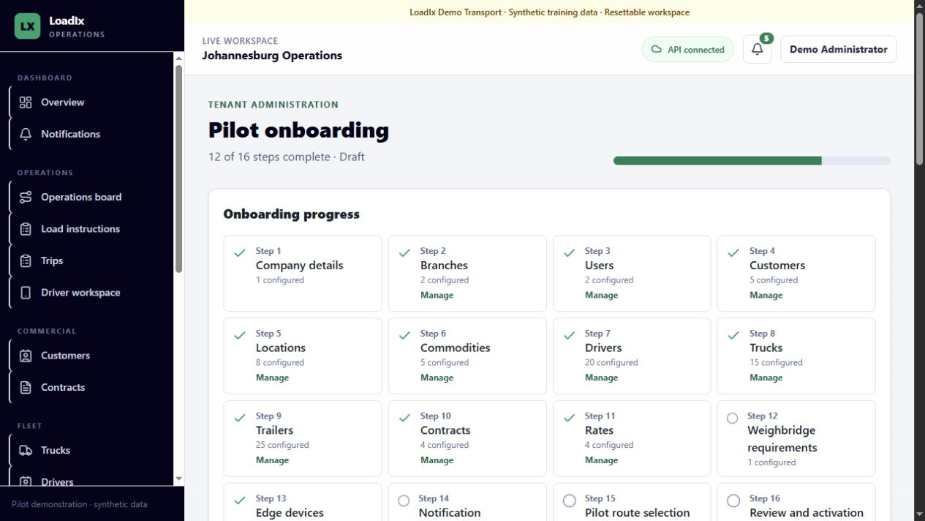
TENANT ADMINISTRATION
Complete onboarding in dependency order
The onboarding workspace groups 16 readiness steps and blocks activation until its checklist is satisfied.
1
Organisation
Company details, branches and users establish ownership and access.
2
Operational masters
Customers, locations, commodities and fleet records supply valid choices.
3
Configuration
Review weighbridge, Edge, notification, finance and document rules.
4
Scope and activate
Limit the pilot allow-list, review all gates, then activate once.
LOADIX INITIAL USER TRAINING • SYNTHETIC DEMONSTRATION DATA
07
Notes:
Demonstrate that each onboarding card links to its management screen. Explain dry-run imports: review all errors, then confirm an all-or-nothing import.
[Sources]
- Local LoadIx onboarding screenshot captured 2026-08-24
- apps/loadix-web/src/features/onboarding/onboarding-page.tsx
- docs/product-scope.md

Slide 8
MASTER DATA
Create master data before commercial work
Active contracts and trip assignments depend on clean, active records; deactivation protects history without deleting it.
1
2
3
4
5
Structure
Commercial
Movement
Fleet
Controls
Branches
Users and roles
Customers
Contacts
Locations
Commodities
Drivers
Trucks
Trailers
Statuses
Compliance
Availability
Data quality gate
Use business references people recognise—customer names, site codes, fleet numbers, registrations and licence numbers. Search before creating to avoid duplicates.
LOADIX INITIAL USER TRAINING • SYNTHETIC DEMONSTRATION DATA
08
Notes:
Explain that every tenant-owned record is isolated and status-controlled. Existing trip snapshots remain valid when future master data changes.
[Sources]
- README.md
- docs/product-scope.md
- docs/domain-glossary.md

Slide 9
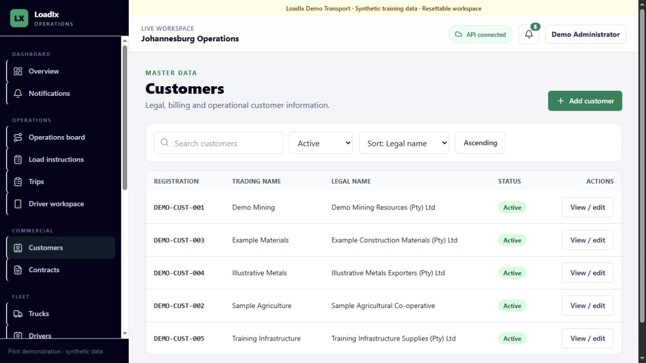
MASTER DATA
Search, verify, then add or edit a record
The same safe pattern applies across customers, locations, commodities, drivers, trucks and trailers.
1
Search first
Use reference/name and status filters; confirm the record does not already exist.
2
Add the minimum complete record
Enter the required legal/operational fields and a stable business reference.
3
Review and save
Correct validation errors; confirm the success state and list result.
4
Edit with the latest version
If a conflict appears, refresh and reapply only the intended change.
LOADIX INITIAL USER TRAINING • SYNTHETIC DEMONSTRATION DATA
09
Notes:
Open Customers, then repeat the pattern in one fleet screen. Stress that a 409 conflict protects another user's newer edit.
[Sources]
- Local LoadIx customers screenshot captured 2026-08-24
- README.md

Slide 10
CONTRACTS
A contract defines the commercial rules future trips will snapshot
Use the five-step guided flow; save a draft for review or activate only when every route and rate is valid.
1
2
3
4
5
Customer & details
Route
Commodity & quantity
Rates
Review
Number, name, period, currency, payment terms
Collection and delivery sites; weighbridge requirements
Permitted commodity, tolerance, manual-quantity policy
Typed pricing rule, effective dates, surcharge/minimum
Validate summary, save draft or save and activate
Activation check
The effective period must be valid, every route needs a non-overlapping effective rate, and measured pricing must have its required quantity source.
LOADIX INITIAL USER TRAINING • SYNTHETIC DEMONSTRATION DATA
10
Notes:
Clarify that active contract edits affect future trips only. Existing route/rate snapshots are historical evidence and cannot be destructively rewritten.
[Sources]
- docs/workflow-improvements.md
- docs/domain-glossary.md

Slide 11
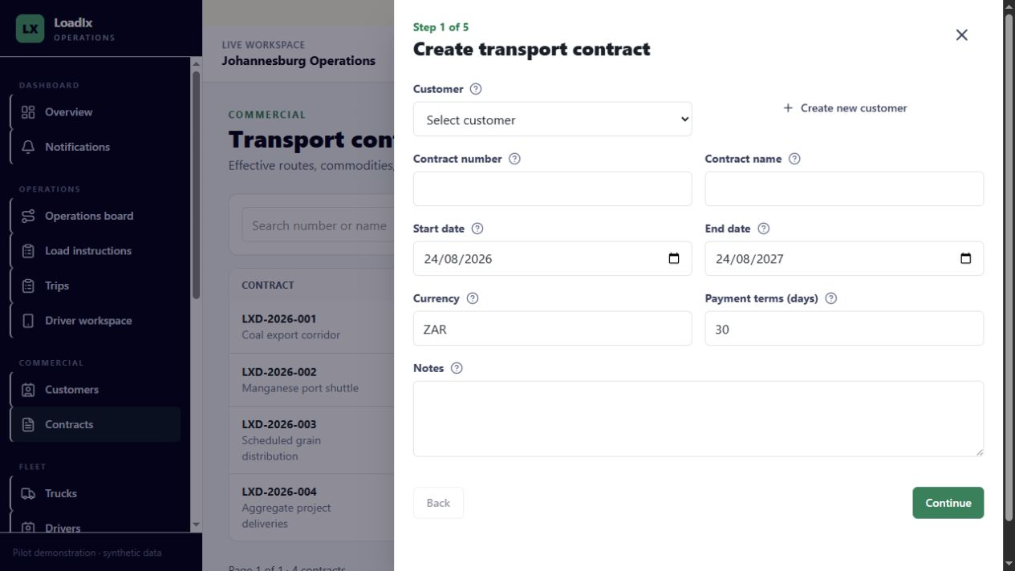
CONTRACTS
Build and activate a contract step by step
Inline creation keeps the wizard open when a permitted customer, location or commodity is missing.
1
Start in Contracts
Select New contract and choose the customer—or create it inline.
2
Complete each guided page
Route, commodity/quantity rules and rates must align with how the movement is weighed and billed.
3
Use review as a control
Check dates, currency, tolerance, quantity source, rounding and effective rates.
4
Choose the correct finish
Save as draft for incomplete review; Save and activate only when ready for load planning.
LOADIX INITIAL USER TRAINING • SYNTHETIC DEMONSTRATION DATA
11
Notes:
Demonstrate with Training Infrastructure, Demo Mine North to Midrand Customer Site, Aggregate, ZAR and a reconciled-tonne rate as described in the demo guide.
[Sources]
- Local LoadIx contract wizard screenshot captured 2026-08-24
- docs/workflow-improvements.md
- docs/demo-guide.md

Slide 12
LOAD INSTRUCTIONS
A load instruction turns customer demand into planned capacity
One active contract route and commodity anchor the request; one instruction can generate several trips.
1
2
3
4
Contract selection
Requirements
Operations
Review
Instruction number, active contract, route and commodity
Planned quantity, unit, trip guidance and windows
Customer PO/reference, priority and special instructions
Save draft or Plan load for trip generation
Planning rule
Draft remains editable. Plan load confirms the request. Generate trips only after quantity, windows, priority and references have been checked.
LOADIX INITIAL USER TRAINING • SYNTHETIC DEMONSTRATION DATA
12
Notes:
Explain the difference between customer demand (instruction) and execution units (trips). The instruction remains the fulfilment summary.
[Sources]
- docs/workflow-improvements.md
- docs/domain-glossary.md

Slide 13
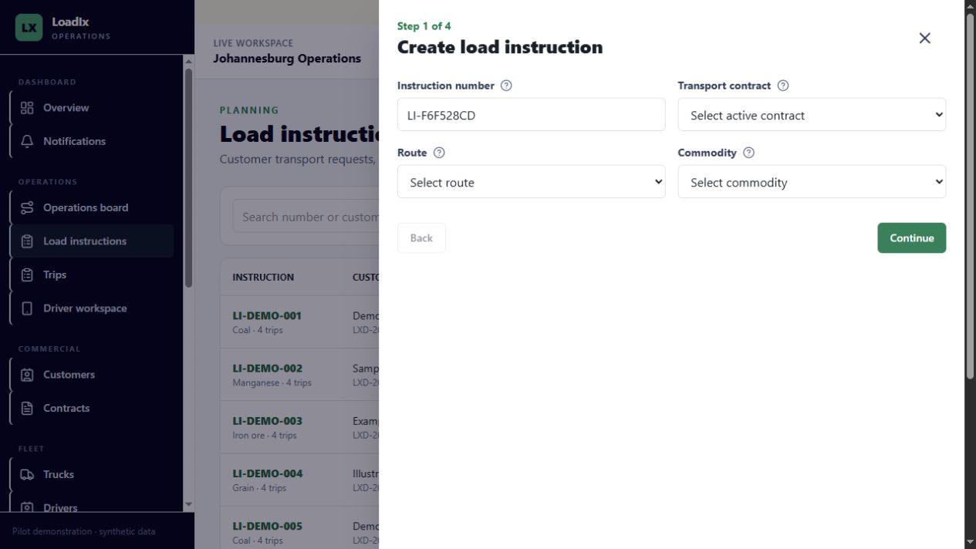
LOAD INSTRUCTIONS
Create a load instruction with complete operational context
The selected contract controls available routes, commodities and commercial rules.
1
Select the active contract
Choose its route and allowed commodity; do not substitute a similar record.
2
Enter quantity and timing
Use the explicit unit, realistic trip count and collection/delivery windows.
3
Add dispatch context
Capture customer reference, priority and actionable special instructions.
4
Review the plan
Save draft if uncertain; Plan load only when the request is authorised.
LOADIX INITIAL USER TRAINING • SYNTHETIC DEMONSTRATION DATA
13
Notes:
Use the demo guide example: 136 tonnes, four trips, fictional PO and current collection/delivery windows.
[Sources]
- Local LoadIx load instruction wizard screenshot captured 2026-08-24
- docs/workflow-improvements.md
- docs/demo-guide.md

Slide 14
LOAD INSTRUCTIONS
Plan first; generate trips once
Trip generation divides remaining quantity and creates stable operational references while protecting retries from duplicates.
Before generation
After generation
1
Open the instruction
1
Confirm references
Confirm status, requested quantity, unit and remaining quantity.
Generated trips appear under the instruction with stable LI-…-T… identifiers.
2
Review fulfilment inputs
2
Check planned totals
Check trip-count guidance, windows, priority and customer reference.
Requested, planned and remaining quantities must reconcile.
3
Select Plan load
3
Do not double-submit
This confirms the instruction for operational generation.
A repeated safe request returns the prior result; conflicting reuse is blocked.
4
Choose the trip count
4
Continue in Trips
Use capacity and shift realities; generated quantities total the remaining amount.
Assignments and execution now happen on each trip, not on the instruction.
LOADIX INITIAL USER TRAINING • SYNTHETIC DEMONSTRATION DATA
14
Notes:
Explain idempotency in plain language: retrying the same action should not create duplicate trips. If the first response is uncertain, refresh before trying a different count.
[Sources]
- README.md
- docs/product-scope.md
- docs/demo-guide.md

Slide 15
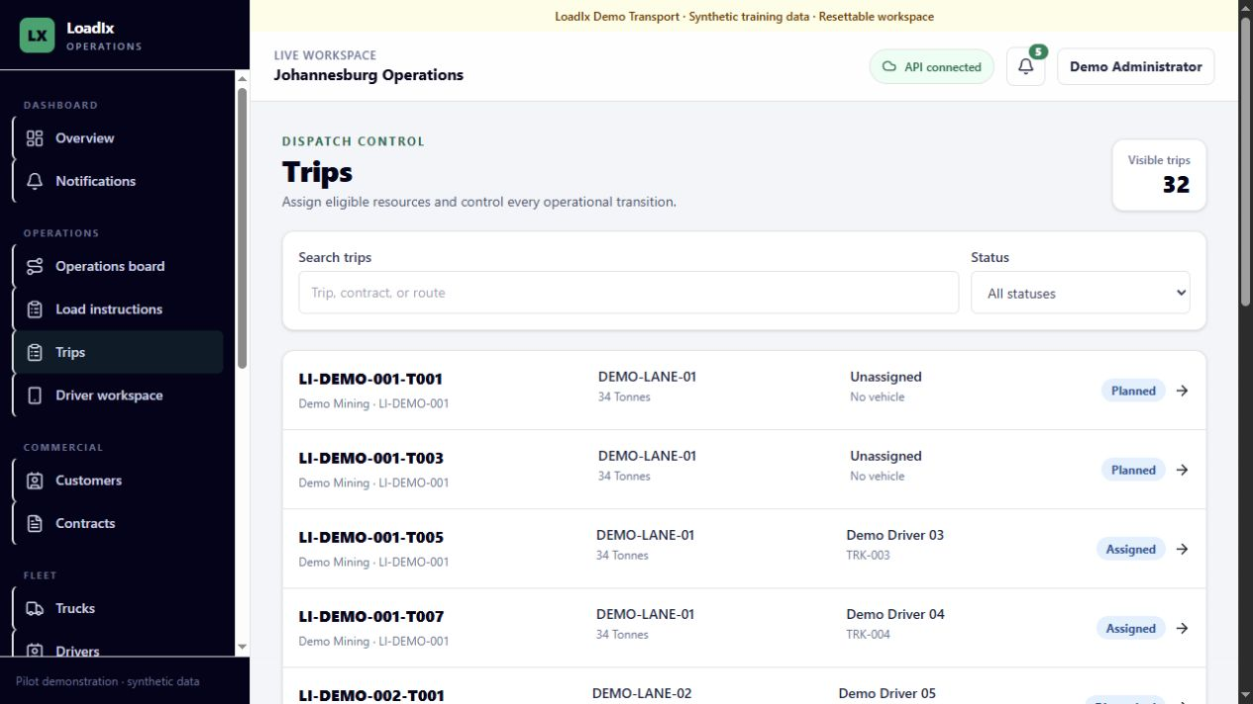
TRIPS
Dispatch only eligible resources
The system checks active, available and compliant drivers, trucks and up to two distinct trailers against overlapping work.
1
Filter to Planned
Search by trip, contract or route and open the correct operational record.
2
Assign resources
Select an eligible driver, truck and zero to two trailers; check the planned window.
3
Confirm the assignment
Verify names, registrations/fleet numbers and the audit/timeline update.
4
Dispatch
Use Dispatch only when the driver and equipment are genuinely ready to begin.
LOADIX INITIAL USER TRAINING • SYNTHETIC DEMONSTRATION DATA
15
Notes:
Demonstrate a planned synthetic trip. Do not use a post-dispatch reassignment to fix ordinary data-entry mistakes; it requires override permission and a reason.
[Sources]
- Local LoadIx trips screenshot captured 2026-08-24
- docs/workflow-improvements.md
- docs/demo-guide.md

Slide 16
TRIP EXECUTION
Use only the next legal lifecycle action
The API enforces the same state machine as the screen; cancellation and rejection are reasoned terminal branches.
Planned
Assigned
Dispatched
At collection
Loading
Collection complete
In transit
At delivery
Unloading
Delivery complete
Reconciliation required
Completed
CANCELLED — specific reason required
REJECTED — specific reason required
OVERRIDE — permission + reason + audit
LOADIX INITIAL USER TRAINING • SYNTHETIC DEMONSTRATION DATA
16
Notes:
Ask learners to name the next action from InTransit and from DeliveryComplete. Reinforce that status is never inferred only from timestamps.
[Sources]
- README.md
- docs/domain-glossary.md

Slide 17
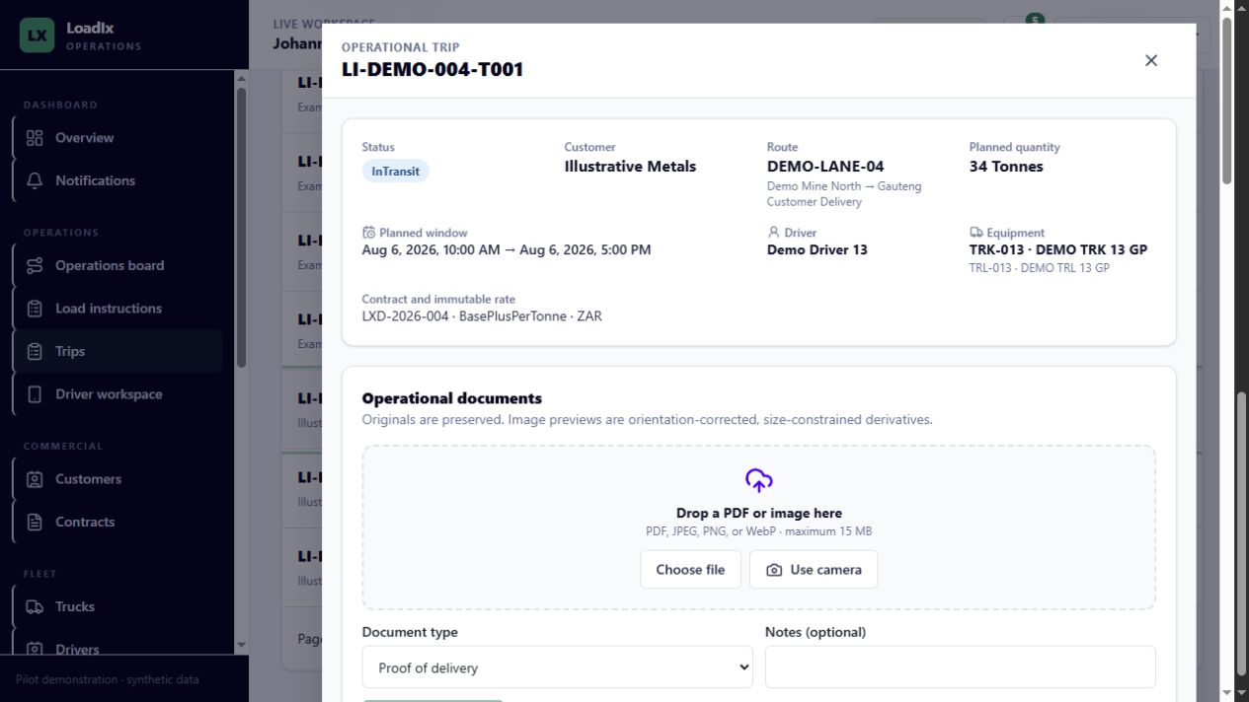
TRIP EXECUTION
Read the full trip before taking action
The workspace combines immutable context, documents, finance readiness, assignment controls, lifecycle actions and timeline evidence.
1
Confirm identity and status
Check trip reference, customer, route, planned window and current state.
2
Review assignment and rate snapshot
Verify driver/equipment and the contract/rate context frozen onto this trip.
3
Complete evidence panels
Documents, weights and reconciliation readiness must match the route requirements.
4
Use the named action
Then confirm the new state and actor-stamped timeline entry.
LOADIX INITIAL USER TRAINING • SYNTHETIC DEMONSTRATION DATA
17
Notes:
Scroll through the live trip dialog during delivery. Show that operational notes add context but do not replace structured milestones or captured weights.
[Sources]
- Local LoadIx trip detail screenshot captured 2026-08-24
- README.md

Slide 18
WEIGHTS AND RECONCILIATION
Capture weights exactly; reconcile the outcome visibly
Each trip snapshots whether collection weighing, delivery weighing, both or neither are required.
Both sites
One site
Neither site
Manual per-tonne
Compare source and destination net weights against tolerance.
The configured measured net becomes the reconciled quantity automatically.
Reconciliation is not applicable for fixed billing.
Requires contract opt-in, override permission, reason and audit evidence.
1
Record gross and tare
3
Compare and review
Use the correct checkpoint, unit, timestamp and weighbridge/ticket reference.
Within tolerance can complete normally; exceptions require evidence and a specific decision reason.
2
Verify net
4
Preserve captured facts
Net = gross − tare. Stop if the unit, sign or plausible quantity is wrong.
Approval records the decision—it does not rewrite the source or destination weights.
LOADIX INITIAL USER TRAINING • SYNTHETIC DEMONSTRATION DATA
18
Notes:
Demonstrate one within-tolerance trip and one seeded 1.250-tonne variance. Explain the trip's QuantitySource in reporting.
[Sources]
- docs/workflow-improvements.md
- docs/demo-guide.md
- docs/domain-glossary.md

Slide 19
OPERATIONAL DOCUMENTS
Attach the right evidence before completion
Documents are authorised by tenant and trip, validated on upload, and become immutable when the trip completes.
Upload procedure
Verification
1
Open Operational documents
1
Watch the upload state
Work from the correct trip so ownership is unambiguous.
Use retry only with the same intended file and stable key.
2
Choose the document type
2
Open the preview
Collection ticket, delivery ticket, proof of delivery, invoice support or Other.
Confirm orientation, legibility, document type and trip reference.
3
Select or capture the file
3
Correct before completion
PDF, JPEG, PNG or WebP; maximum 15 MB in the current configuration.
Delete/replace only while policy permits and the trip is not complete.
4
Add a useful note and upload
4
Confirm required evidence
Keep notes operational; never include passwords, tokens or unnecessary personal data.
POD and weight tickets must satisfy route/customer rules before completion.
LOADIX INITIAL USER TRAINING • SYNTHETIC DEMONSTRATION DATA
19
Notes:
The upload validates extension, declared type, file signature, size and malware policy. Original images are preserved; previews are metadata-stripped derivatives.
[Sources]
- README.md
- docs/product-scope.md

Slide 20
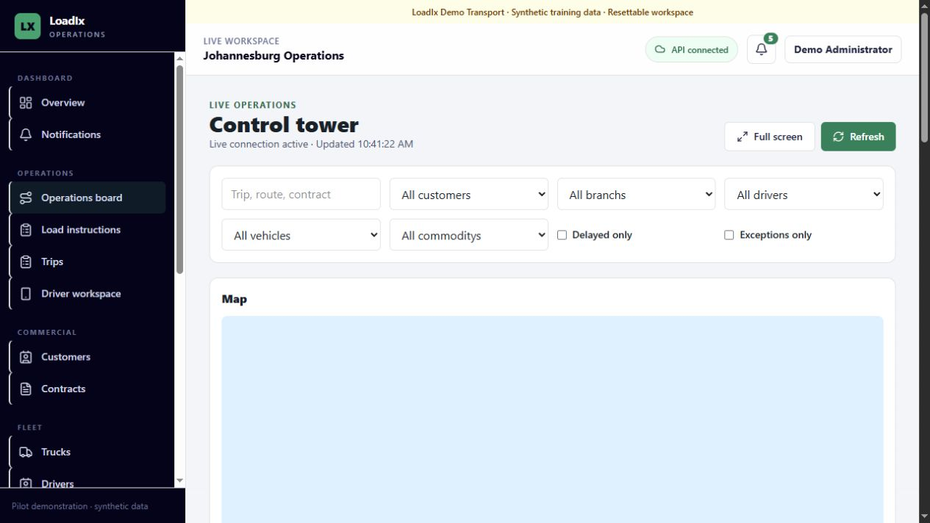
CONTROL TOWER
Run the shift from the Operations board
Use live state and filters to find work that is delayed, exceptional or stale—then open the authoritative trip record.
1
Confirm connection state
A reconnecting board refetches; disconnected state requires cautious manual refresh.
2
Filter the workload
Search plus customer, branch, driver, vehicle, commodity, delayed and exception filters.
3
Read freshness honestly
A stale location is shown as stale—not live. Never infer a milestone from map position alone.
4
Open the trip
Resolve the issue in its workspace so the action, reason and timeline are recorded.
LOADIX INITIAL USER TRAINING • SYNTHETIC DEMONSTRATION DATA
20
Notes:
Demonstrate delayed-only and exceptions-only filters. Point out the board is a monitoring surface; the trip remains authoritative.
[Sources]
- Local LoadIx operations screenshot captured 2026-08-24
- README.md
- docs/product-scope.md

Slide 21
DRIVER WORKFLOW
Drivers progress assigned work with visible sync state
The driver workspace is touch-first and supports intermittent connectivity without silently duplicating actions.
1
2
3
4
5
Open assigned trip
Record collection
Travel
Record delivery
Synchronise
Verify route, timing and directions.
Arrival, loading, source weights and ticket.
Depart and submit location only after an explicit action.
Arrival, unloading, destination weights and POD.
Review queued, failed or conflicted commands before completion.
Offline rule
A queued command is not yet confirmed by LoadIx Cloud. Reconnect, review sync state and resolve conflicts—do not repeat actions blindly.
LOADIX INITIAL USER TRAINING • SYNTHETIC DEMONSTRATION DATA
21
Notes:
If practical, demonstrate in a narrow viewport with the synthetic driver account. Logout clears the driver's local queue; commands older than seven days require review.
[Sources]
- README.md
- docs/demo-guide.md
- docs/product-scope.md

Slide 22
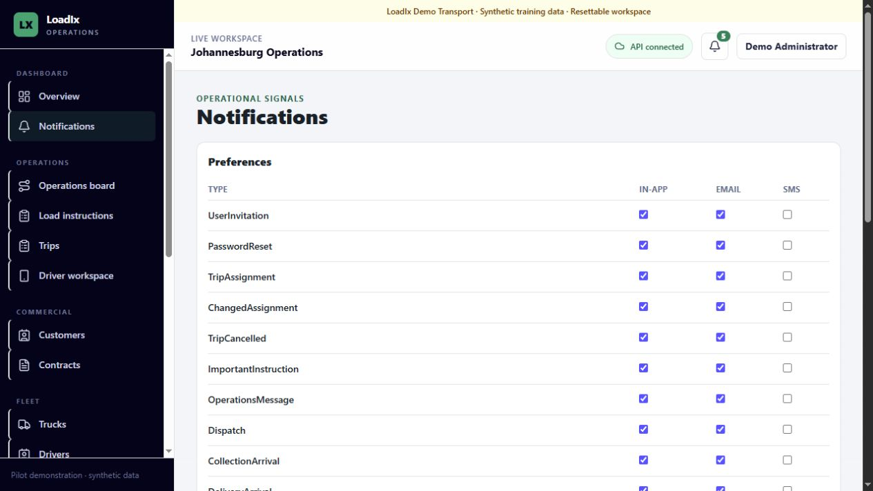
NOTIFICATIONS
Treat notifications as an attention queue, not the source of truth
Open the related record to verify current state; delivery retries and preferences are controlled separately.
1
Open the bell or Notifications
Prioritise operational and exception items relevant to your shift.
2
Read and navigate
Open the linked customer, instruction, trip or finance record before acting.
3
Mark read after review
Read status indicates attention handled, not that the business issue is resolved.
4
Manage delivery controls
Users set channel preferences; authorised users review failures and retry queues.
LOADIX INITIAL USER TRAINING • SYNTHETIC DEMONSTRATION DATA
22
Notes:
Explain that in-app notification remains the default operational channel. Local email/SMS behaviour in the demo is not production delivery.
[Sources]
- Local LoadIx notifications screenshot captured 2026-08-24
- README.md

Slide 23
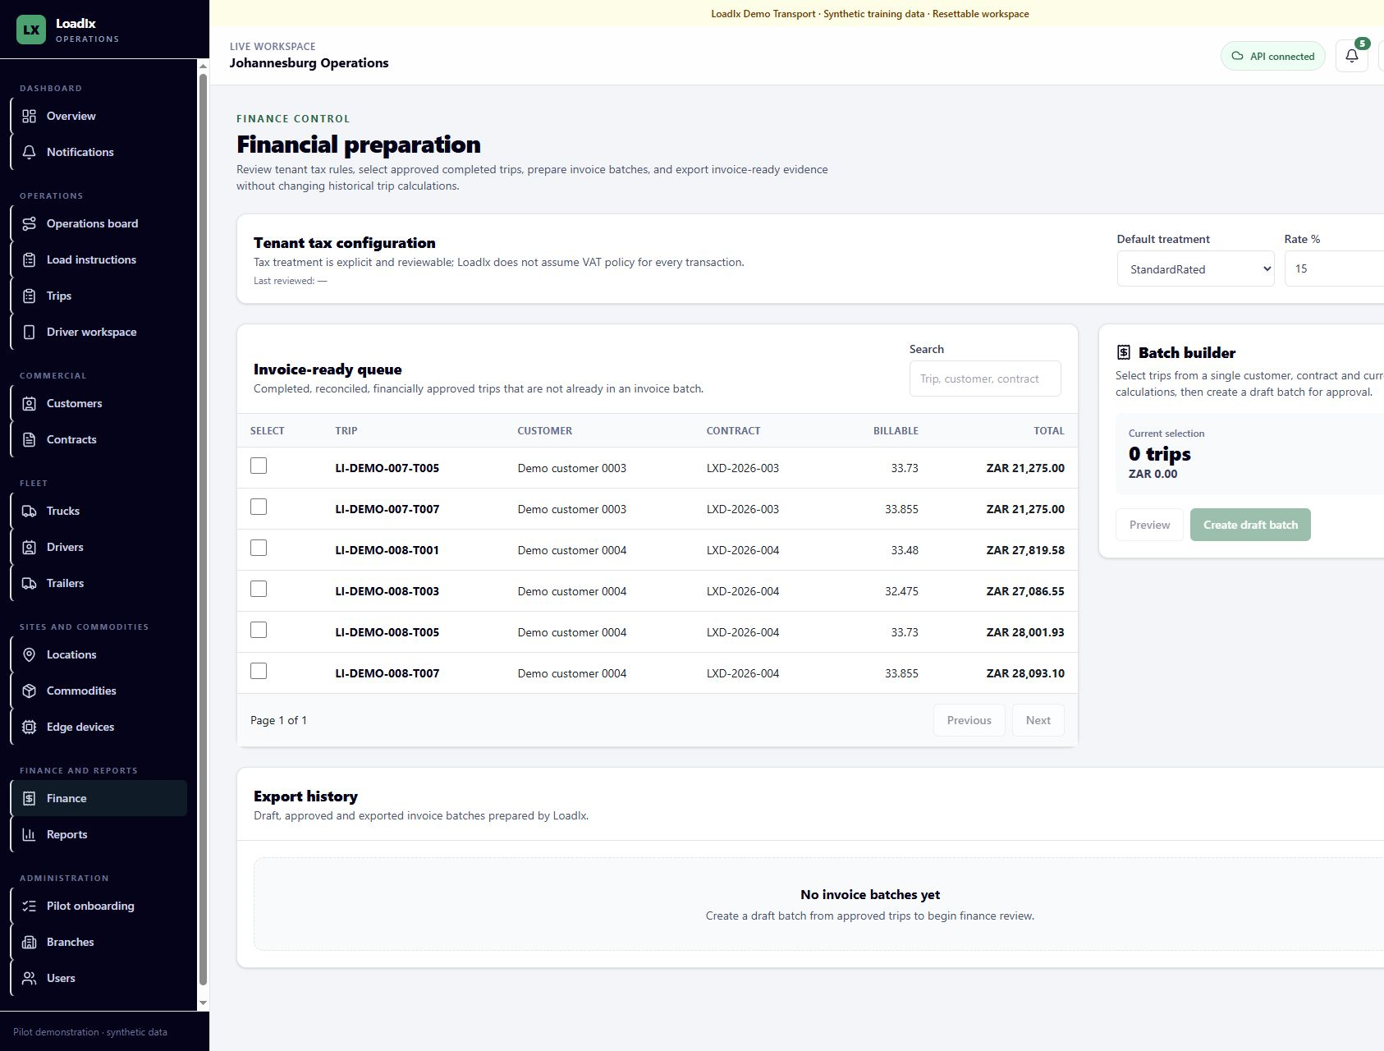
FINANCE
Prepare approved, documented trips for invoicing
LoadIx creates an auditable invoice-preparation batch; it does not issue a SARS tax invoice or post to an accounting ledger.
1
Review tax configuration
Finance calculations require a reviewed tenant tax setup.
2
Prepare the trip
Completed + reconciled + required documents; recalculate from the immutable rate snapshot.
3
Add and approve costs
Use the correct cost category; post-approval corrections become explicit adjustments.
4
Build the batch
Select approved invoice-ready trips for one customer/contract/currency, review, approve and export.
LOADIX INITIAL USER TRAINING • SYNTHETIC DEMONSTRATION DATA
23
Notes:
Use the canonical seed's six approved candidates. Show revenue, billable tonnes, tax treatment and costs before batch approval.
[Sources]
- Local LoadIx invoice-ready queue screenshot captured 2026-08-24
- README.md
- docs/demo-guide.md

Slide 24
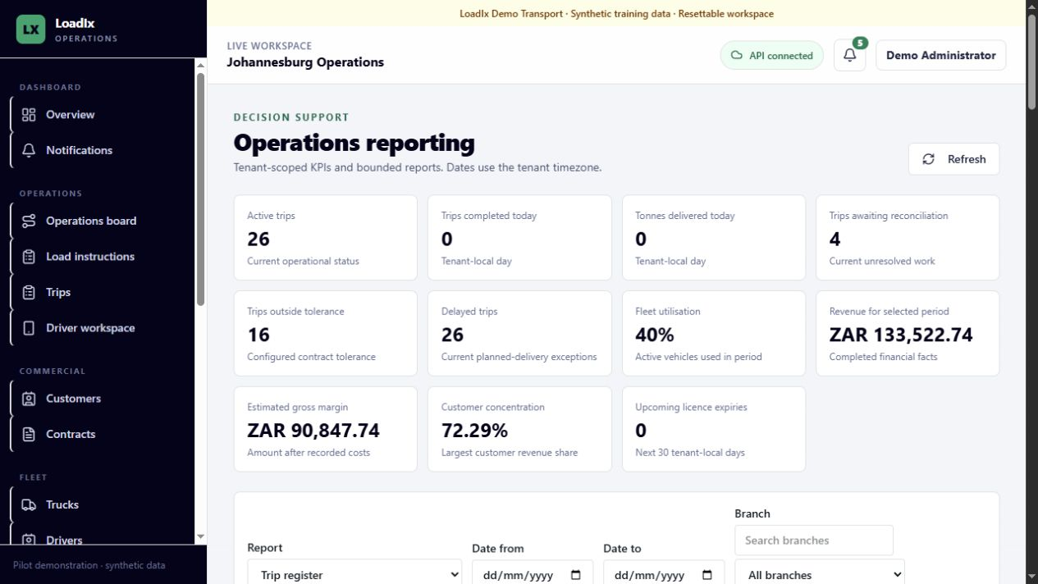
REPORTING
Use reports to explain performance and exceptions
Every report is tenant-scoped, date-filtered in the tenant time zone and returned with a freshness timestamp.
1
Set the reporting lens
Choose report, date range and branch/customer filters before interpreting totals.
2
Refresh and read freshness
Confirm the requested period and generation time.
3
Drill into the right view
Trip register, variance, contract performance, profitability and invoice status answer different questions.
4
Export deliberately
Current pages can export directly; larger extracts use queued export jobs.
LOADIX INITIAL USER TRAINING • SYNTHETIC DEMONSTRATION DATA
24
Notes:
Demonstrate at least variance and profitability. Explain that South African date selections are resolved to UTC boundaries by the server.
[Sources]
- Local LoadIx reports screenshot captured 2026-08-24
- README.md
- docs/demo-guide.md

Slide 25
DAILY OPERATING RHYTHM
A disciplined shift routine keeps the queue clean
Use repeatable checks at start, during the shift and before handover.
START OF SHIFT
DURING SHIFT
END / HANDOVER
1
Confirm tenant, branch and API connection
1
Dispatch only eligible resources
1
Review reconciliation-required work
2
Review notifications and dashboard counts
2
Monitor stage changes and stale locations
2
Confirm completed trips have required evidence
3
Filter Operations for delayed and exception trips
3
Resolve weight/document exceptions in the trip
3
Hand invoice-ready work to finance
4
Check today's planned/unassigned trips
4
Record specific reasons and operational notes
4
Record unresolved owner, reason and next action
LOADIX INITIAL USER TRAINING • SYNTHETIC DEMONSTRATION DATA
25
Notes:
Adapt the cadence to the operator's shift pattern. The handover standard is an owner plus next action, not a vague status message.
[Sources]
- docs/product-scope.md
- docs/demo-guide.md

Slide 26
EXCEPTIONS AND TROUBLESHOOTING
Respond to the control that stopped the action
Preserve data and context first; then follow the recovery path that matches the visible symptom.
SYMPTOM
SAFE RESPONSE
API disconnected
Pause new mutations; check connection state, refresh once, escalate with time and correlation reference.
409 conflict / stale version
Refresh the record, compare the newer change, then reapply only your intended update.
Permission denied
Verify role, tenant and record scope. Ask an administrator—do not use another person's account.
Resource unavailable
Check active/compliant status and overlapping work; choose another eligible resource or reschedule.
Weight exception
Verify units and ticket inputs; review tolerance and evidence; record a reasoned approval/override if authorised.
Upload rejected
Check allowed type, extension, size and signature; retry the same valid file without changing the business record.
Offline command conflict
Reconnect, review queued status and current trip state; do not repeat lifecycle actions blindly.
LOADIX INITIAL USER TRAINING • SYNTHETIC DEMONSTRATION DATA
26
Notes:
Support should never request passwords, tokens, credentials, document contents or raw personal-data exports. Capture tenant, workflow, time zone, impact and a safe screenshot/correlation reference.
[Sources]
- docs/support/customer-support-process.md
- README.md
- docs/product-scope.md

Slide 27
GUIDED EXERCISE
Practice the complete journey in the synthetic tenant
Work in pairs: one learner operates, the other verifies references, state and evidence before each handoff.
1
Create
2
Activate
Create a synthetic contract for Training Infrastructure and save it as a draft.
Review route, Aggregate commodity, tolerance and reconciled-tonne rate; activate.
3
Plan
4
Dispatch
Create a 136-tonne instruction with four trips, windows and a fictional PO; plan and generate.
Open a planned trip, assign eligible resources and dispatch it.
5
Execute
6
Complete
Advance collection, weights, transit and delivery using the next legal actions.
Attach required evidence, reconcile, complete, prepare finance and find it in a report.
SUCCESS = correct references • legal states • complete evidence • visible audit trail
LOADIX INITIAL USER TRAINING • SYNTHETIC DEMONSTRATION DATA
27
Notes:
Reset the demo after the cohort if required. Learners should narrate why each action is legal before clicking it.
[Sources]
- docs/demo-guide.md
- docs/workflow-improvements.md

Slide 28
KNOWLEDGE CHECK
Ready for supervised live use
Before using customer data, each learner should answer these questions and complete the guided exercise without unsafe shortcuts.
1
What makes a contract available for load planning?
4
Does approving a reconciliation exception change captured weights?
2
Where do you assign a driver, truck and trailers?
5
What does invoice preparation not do?
3
What should you do after a 409 conflict?
NEXT STEP • complete role-specific coaching and obtain local supervisor sign-off
LOADIX INITIAL USER TRAINING • SYNTHETIC DEMONSTRATION DATA
28
Notes:
Answer key: 1) Save and activate after all validation. 2) In the Trip workspace. 3) Refresh, compare and reapply the intended change. 4) No; approval records the decision. 5) It does not issue a SARS tax invoice or post to an accounting ledger.
Close by assigning the practice lab and the operator's local SOP/policy module.
[Sources]
- docs/workflow-improvements.md
- README.md
- docs/product-scope.md

