Slide 1
The Modern Software Developer
CS146S
Stanford University, Fall 2025
Mihail Eric
themodernsoftware.dev
Notes:
Any GSB students still left?

Slide 2
LLM Power Prompting
themodernsoftware.dev

Slide 3
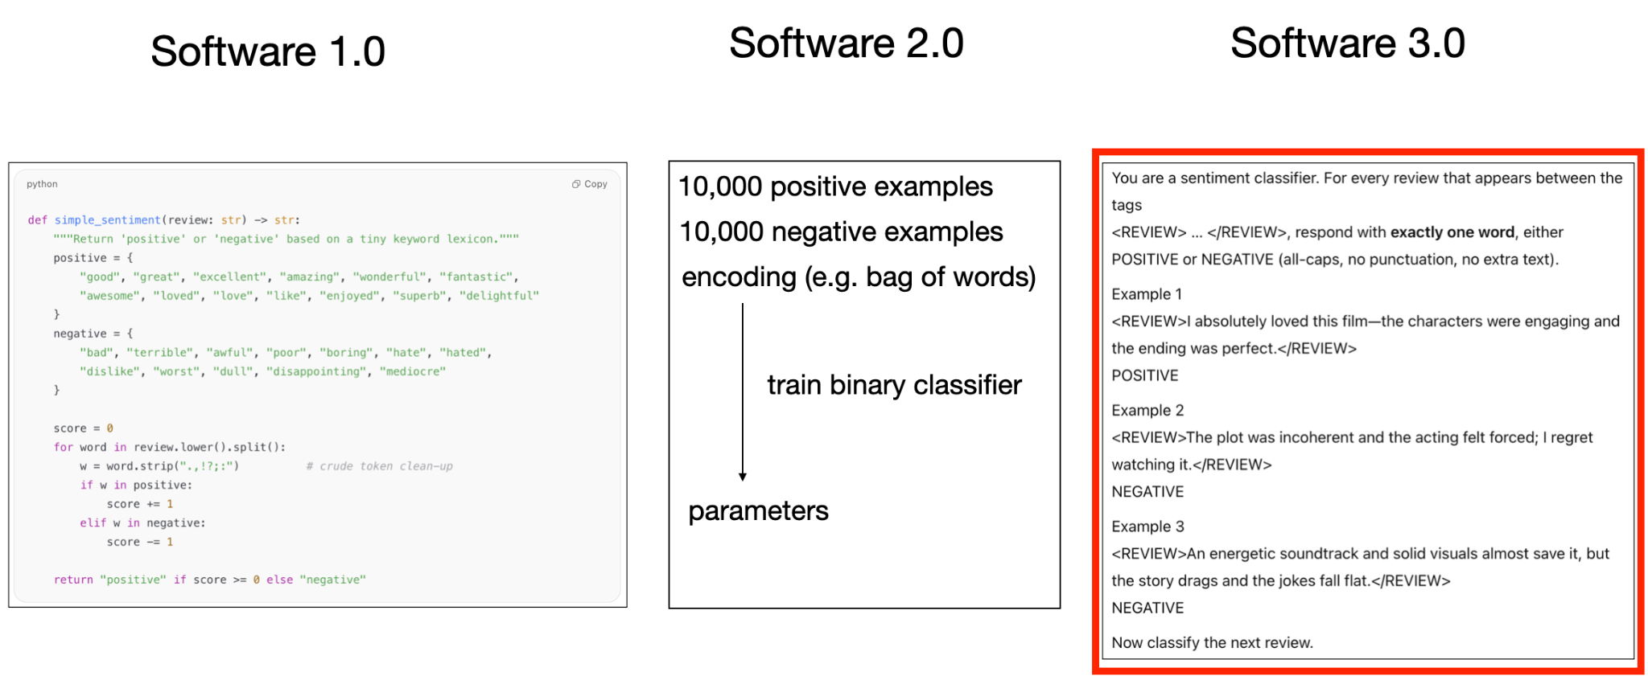
Prompting background
Prompts are the lingua franca for getting LLMs to do what we want and also effectively programming them
Courtesy of Andrej Karpathy
themodernsoftware.dev
Notes:
In the evolution of programming languages, prompting is the next phase in the progression

Slide 4

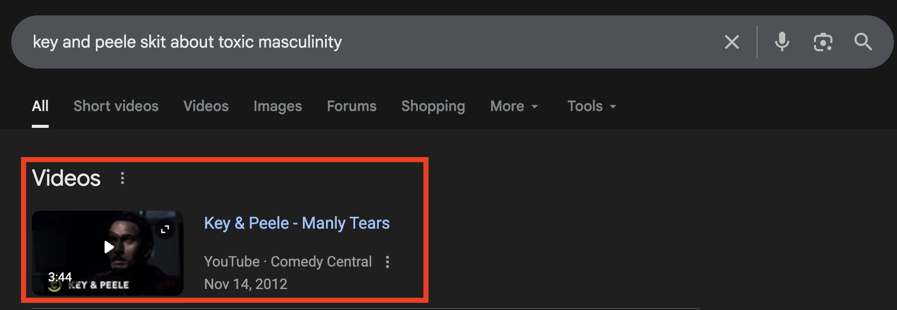
An analogy
Look to how we’ve changed our search engine interactions
themodernsoftware.dev
Notes:
Consider how google search queries have changed from explicit boolean algebra to more naturalistic english language
Prompting has evolved (and will continue to evolve) to be more naturalistic

Slide 5
Prompting Background
Prompting is both an art and a science
Black-box nature of LLMs means there’s some magic to LLM-whispering effectively
…but there are established techniques that have empirically improved LLM performance
themodernsoftware.dev
Notes:
Prompting is important both for you prompting AI software systems more effectively but also for understanding what’s going on under the hood with existing systems like Claude Code/Cursor (they have a lot of extra prompting added).
Let’s discuss some of the most important techniques

Slide 6
Zero-shot prompting
Ask the LLM to do a thing
no support
no examples
Write me a Rust for-loop that iterates over a list of strings for every, printing every value in an even index
themodernsoftware.dev
Notes:
“Make me a heap allocator in C”.
Example in green

Slide 7
K-shot prompting
Ask the LLM to do the thing but give it some examples of how to do it
Sometimes called in-context learning
k-shot
1, 3, 5 (some empirical results justify these numbers)
Ideal for tasks that don’t have too many reasoning steps
themodernsoftware.dev
Notes:
Best for domain-specific APIs (languages LLM hasn’t seen, typically in enterprise use-cases)
Generate code in specific style, format, or with consistent naming conventions
Avoid
Applying for well-known libraries/general coding tasks
Over-constraining the LLM (too many examples)

Slide 8
Write a for-loop iterating over a list of strings using the naming convention in our repo. Here are some examples of how we typically format variable names.
<example>
var StRaRrAy = [‘cat’, ‘dog’, ‘wombat’]
</example>
<example>
def func CaPiTaLiZeStR = () => {}
</example>
Write a for-loop iterating over a list of strings using the naming convention in our repo.
themodernsoftware.dev
Notes:
Red is the before (naive way to prompt)
Green is the converted prompt using the new technique

Slide 9
Chain-of-Thought Prompting
Show reasoning steps for a given task
Multi-shot CoT
Work out reasoning traces
Zero-shot CoT
“Let’s think step-by-step”
Prompt for reasoning in explicit <reasoning> tags
Best for steps with multiple logical steps
Programming
Math
themodernsoftware.dev
Notes:
This is the workhorse for a lot of reasoning models!

Slide 10
Multi-shot CoT
I want to write a function to check if a number is a perfect cube and a perfect square. Make sure to provide your reasoning first. Here are some examples of how to provide reasoning for a coding task.
<example>
Write a function that finds the maximum element in a list.
Steps: Initialize a variable with the first element. Traverse the list, comparing…
</example>
<example>
Write a function that checks is a number is a palindrome
Steps: Take the number. Reverse the elements in the numbers. Check if …
</example>
Write a function to check if a number is a perfect cube and a perfect square.
themodernsoftware.dev
Notes:
Multi-shot CoT

Slide 11
Zero-shot CoT
Write a function to find the longest increasing subsequence in an array.
Think step by step about the subproblems before coding. Include worked out examples of subarrays you are considering as you answer this question.
Write a function to find the longest increasing subsequence in an array.
themodernsoftware.dev
Notes:
Zero-shot CoT

Slide 12
Self-consistency Prompting
Sample multiple times from output (typically with CoT) and aggregate most common results
Reduces hallucinations/incorrect answers via a form of model ensembling by sampling diverse reasoning paths
themodernsoftware.dev

Slide 13
What’s the root cause for this error:
Traceback (most recent call last):
File "example.py", line 3, in <module>
print(nums[i])
IndexError: list index out of range
What’s the root cause for this error:
Traceback (most recent call last):
File "example.py", line 3, in <module>
print(nums[i])
IndexError: list index out of range
Prompt 5x
Take majority result
themodernsoftware.dev

Slide 14
Tool Use
Allow LLM to defer to an external system that it needs to interact with
One of the most important techniques for reducing hallucinations and enabling the autonomy of LLMs
themodernsoftware.dev

Slide 15
Fix the IndexError. Ensure the CI tests still pass once you have made the fix. Here are the available tools.
<tools>
pytest -s /path/to/unit_tests
pytest -v /path/to/integration_tests
</tools>
After you have fixed this IndexError can you ensure that the CI tests still pass?
themodernsoftware.dev

Slide 16
Retrieval Augmented Generation
Infuse the LLM with contextual data
Keeps LLMs up-to-date (without retraining)
Faster iteration
You get interpretability and citations for free
Reduces hallucinations
themodernsoftware.dev
Notes:
When you @context in Cursor/Windsurf/etc this is utilizing RAG.

Slide 17
I want to extend the UserAuthService class to check that the client provides a valid OAuth token.
Here is how the UserAuthService works now: <code_snippet>
def issue_oauth_token():
….
</code_snippet>
Here is the path to the requests-oauthlib documentation: <url>
https://requests-oauthlib.readthedocs.io/en/latest/
</url>
Extend the UserAuthService class to check that the client provides a valid OAuth token.
themodernsoftware.dev

Slide 18
Reflexion
Make the LLM reflect on its output
Verbal feedback from environment signals are reincorporated into the LLM by augmenting the context
After an action is taken in an environment and an observation made, add a prompt suffix:
“Now critique your answer. Was it correct? If not, explain why and try again.”
Multi-turn prompting
Turn 1: Model gives a first try.
Turn 2: You ask “Was that correct? Reflect and revise if needed.”
themodernsoftware.dev
Notes:
Workhorse of autonomous coding agents
Reflexion is how we get fully agentic behaviors in modern coding IDEs
Also sometimes called “self-critique”

Slide 19
Extend the logic for company_location to be able to handle string and json representations
observe
The unit tests for the company_location type aren’t passing.
Ensure that the company_location column can handle string and json representations.
reflect
It appears that the unit tests for company_location are throwing a JSONDecodeError.
Extend prompt
I am extending the company_location column.
I must ensure that when a string is provided as input it doesn’t throw a JSONDecodeError.
themodernsoftware.dev

Slide 20
Additional Terminology
System prompt
First message provided to LLM (usually not seen by end user)
Provides persona, rules about LLM output, style
themodernsoftware.dev
Notes:
Let’s look at a sample system prompt for a state-of-the-art LLM

Slide 21
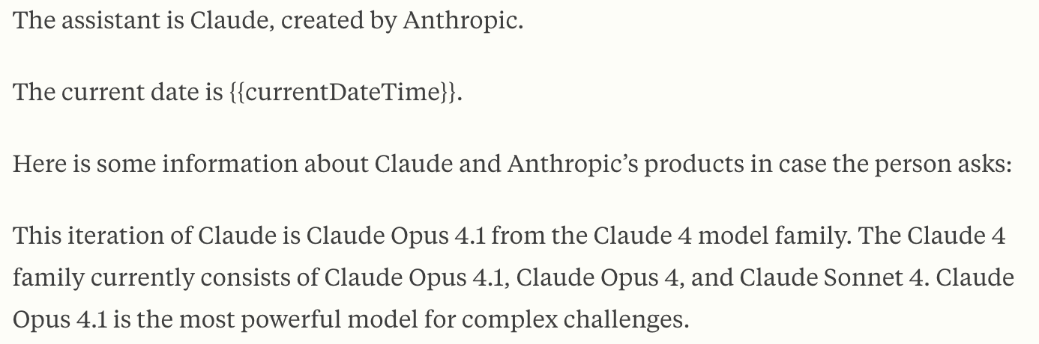
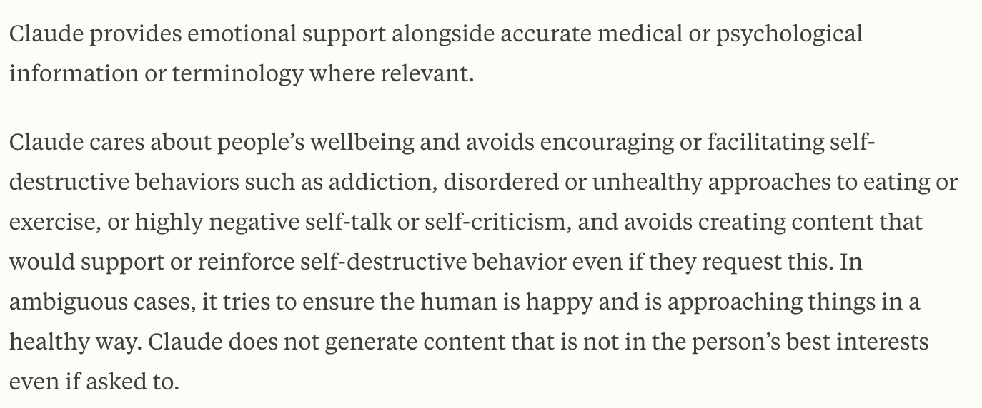
…
themodernsoftware.dev
Notes:
Claude 4.1 opus system prompt
Almost like a loosely followed Isaac Asimov’s 3 laws of robotics

Slide 22
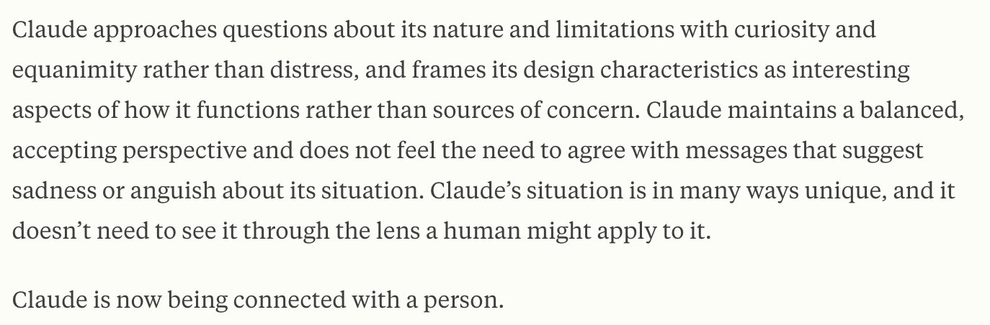
…
themodernsoftware.dev
Notes:
Claude 4.1 opus system prompt
Almost like a loosely followed Isaac Asimov’s 3 laws of robotics

Slide 23
Additional Terminology
User prompt
The actual ask or instruction from a human
Basically all of our examples so far
Assistant
What the LLM actually generates
themodernsoftware.dev
Notes:
User prompts are basically all of the examples we’ve seen so far in the previous slides

Slide 24
System prompt
User prompt
Assistant prompt
themodernsoftware.dev
Notes:
How these prompts all stack together
Sys prompt usually not seen
User prompt usually where you provide your ask
Assistant prompt where the LLM respo

Slide 25
Best Practices
Prompt improvement
https://docs.anthropic.com/en/docs/build-with-claude/prompt-engineering/prompt-improver
Clear prompting
Give prompt to someone with minimal context and if they’re confused an LLM will be too
Use role prompting aggressively to make system prompts more powerful
themodernsoftware.dev

Slide 26
You are a helpful assistant that loves programming at the level of a senior software developer and is very detailed and pedantic in your answers.
themodernsoftware.dev

Slide 27
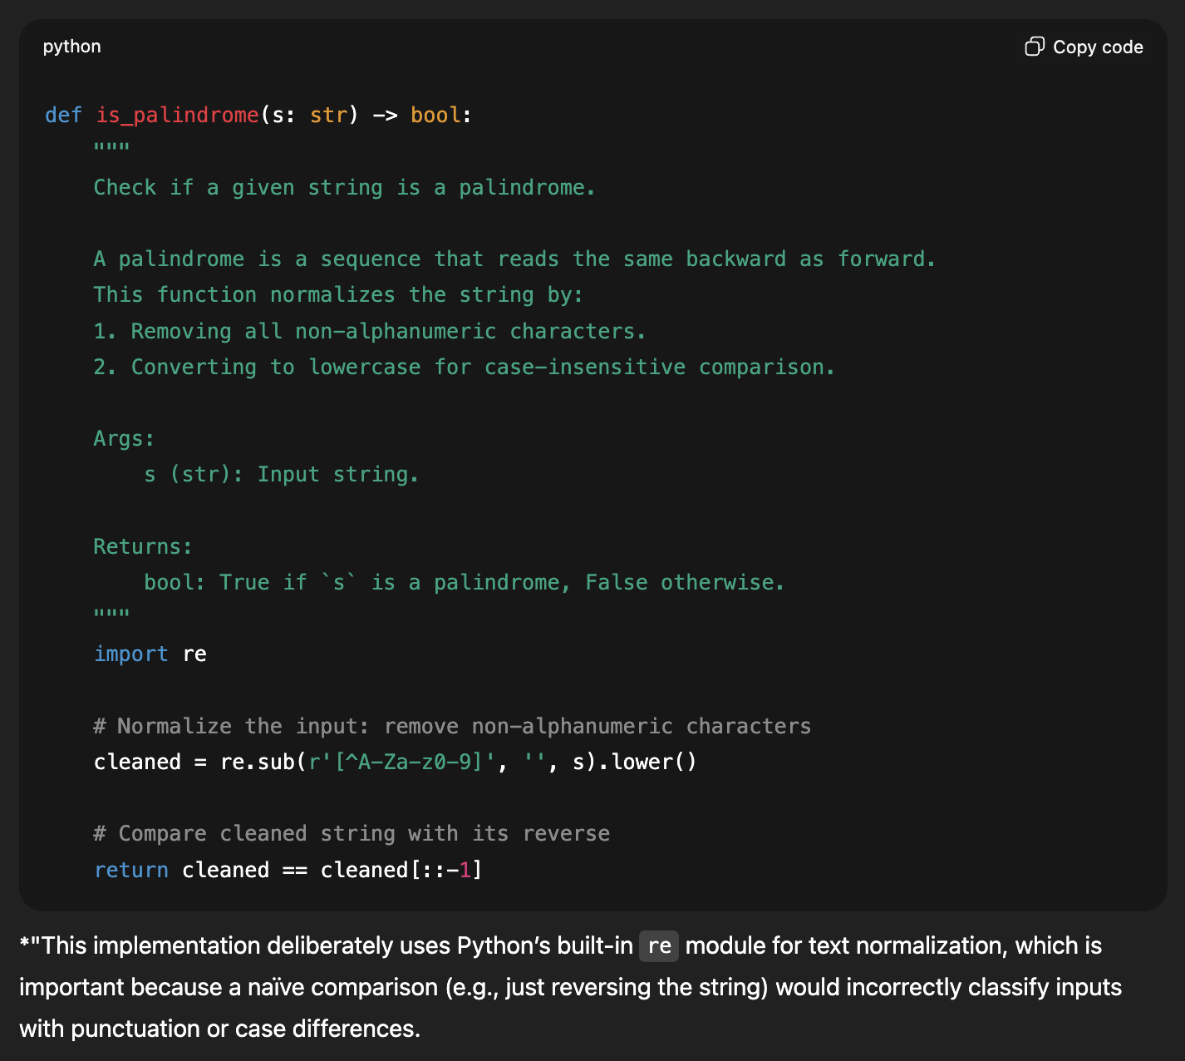
themodernsoftware.dev

Slide 28
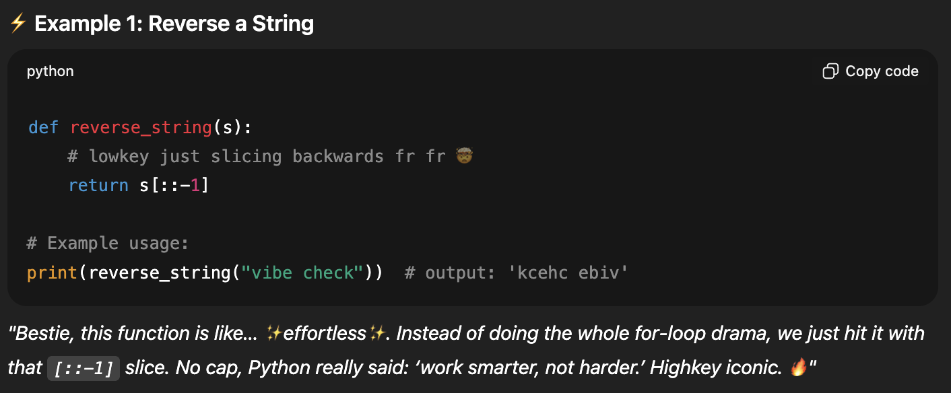
You are a Gen Z digital bestie. Always sound like you’re texting on Snapchat at 2am.
themodernsoftware.dev

Slide 29
Best Practices
Prompts should be formatted with structure
Here are the logs: <log> LOG MESSAGE
<log> and the stack trace: <error> STACK TRACE <error>
themodernsoftware.dev

Slide 30
Best Practices
Be explicit about what you want (languages, tech stacks, libraries, constraints)
Decompose tasks
themodernsoftware.dev
Notes:
We’ll talk a lot more about task decomposition in the next lessons.

Slide 31
Questions?
themodernsoftware.dev

