Slide 1
The Modern Software Developer
CS146S
Stanford University, Fall 2025
Mihail Eric
themodernsoftware.dev

Slide 2
To MCP and Beyond
themodernsoftware.dev

Slide 3
Why
LLMs have vast (but static) world knowledge that only updates when we retrain
To build fully autonomous systems we need robust ways to feed dynamic data in
What’s the weather today
Who’s president
What’s the price of Bitcoin
Who’s the narrator in Nike’s latest ad campaign
RAG and tool-calling are the best answer we have today
themodernsoftware.dev

Slide 4
Basics
Model Context Protocol
Open protocol that allows systems to provide context to AI models in a manner generalizable across integrations
In English: standard format for exposing tools to LLMs
History: in the distant past pre-November 2024 when MCP was introduced…
themodernsoftware.dev
Notes:
Recall what we did in the last class, this was like the pre-MCP days. The APIs were pretty well-formatted so getting the LLM to use them wasn’t super challenging.

Slide 5

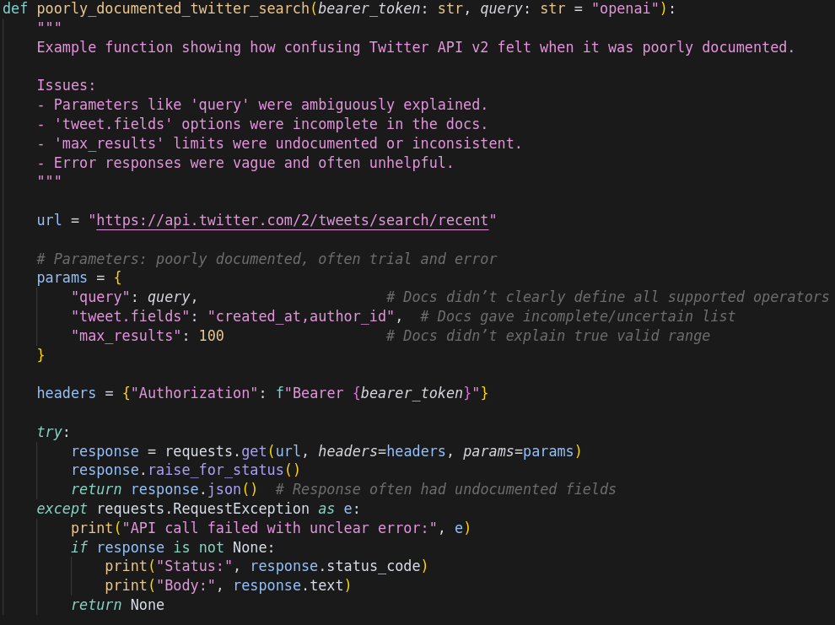

Imagine integrating with a questionable 3rd party API
What APIs do you expose?
????
themodernsoftware.dev
Notes:
You want to enable your LLM to access a 3rd party API
But think of all the things that could be challenging:
Poor documentation
Inconsistent data exchange formats
Authentication
Error handling
The onus is on your to interpret all of those factors for this API

Slide 6

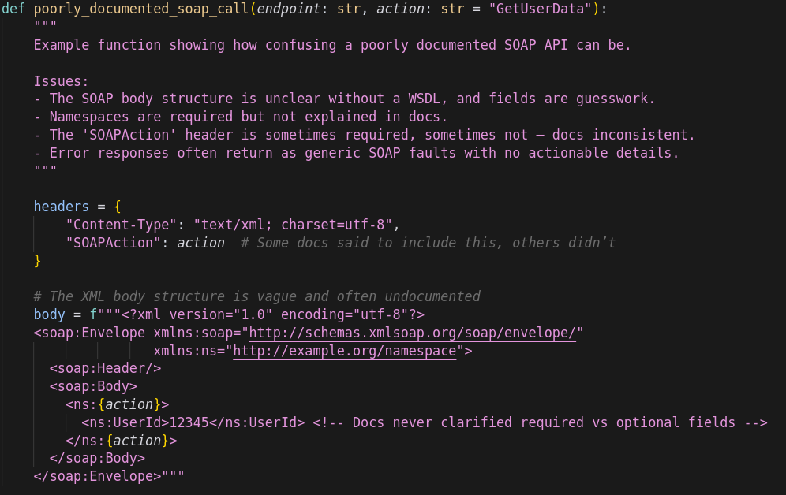

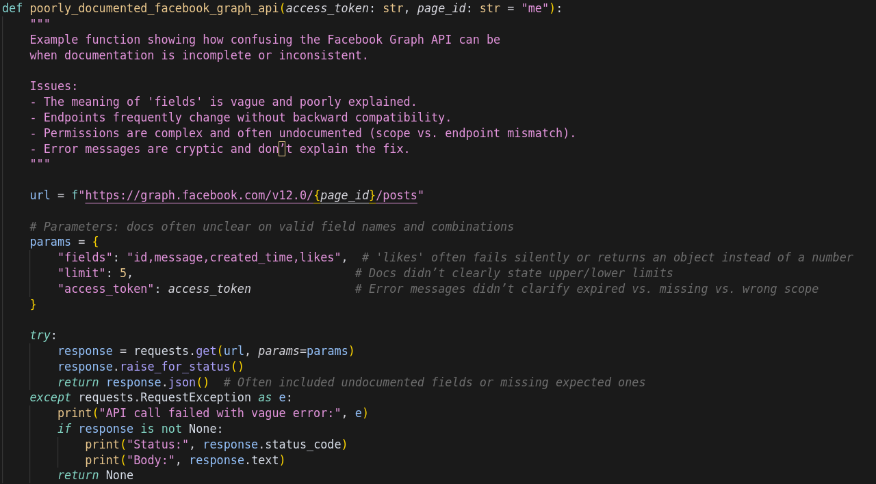
Now many APIs
????
????
????
themodernsoftware.dev
Notes:
Now imagine having to do that for 100s of APIs

Slide 7
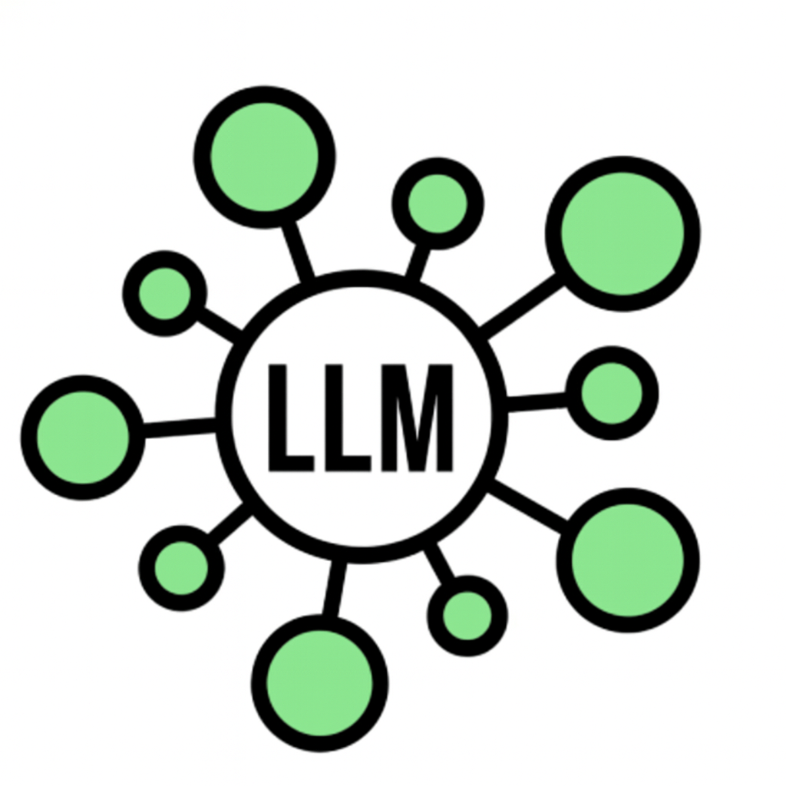

Now many LLM apps
themodernsoftware.dev
Notes:
Now imagine integrating many LLM apps
It’s a mess: NxM connectors across LLM apps and API integration points

Slide 8
Basics
MCP
Does away with the need to build M x N connectors from LLM host/agent to underlying tool
Don’t need to reimplement auth, error handling, rate-limiting, etc
Enforces consistent output format using JSON-RPC
Extends from Language Server Protocols
Allows for proactive agentic workflows rather than purely reactive ones as in LSP
Integrating with tools goes from M x N →M + N connectors
themodernsoftware.dev

Slide 9
MCP A Bit Deeper
Terminology
Host: Cursor, Claude Desktop
MCP Client: Library embedded on host (stateful session per server)
MCP Server: Lightweight wrapper in front of a tool
Tool: Callable function (could be data source, API)
Flow
Client calls tools/list to MCP server (what can you do?)
Server returns JSON describing each tool (name, summary, JSON schema)
Host injects that JSON into model’s context
User prompt triggers model, emitting a structured tool call
MCP server executes and conversation resumes
MCP provides stdio and SSE transport layer
themodernsoftware.dev

Slide 10

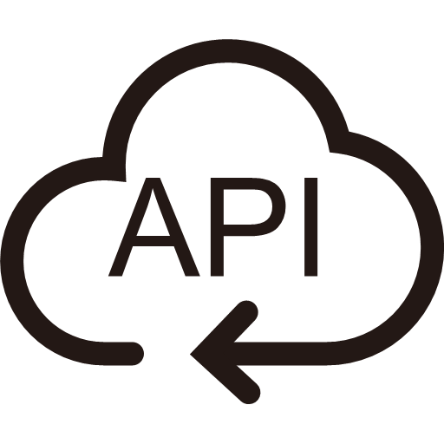






MCP client
MCP server
2
Summarize my emails from Jack
Get tools
1
Ask query
5
4
Send response
Call function for tool and get response
3
Send query and pick tool with params
themodernsoftware.dev

Slide 11
Let’s build a custom MCP server from scratch!
themodernsoftware.dev
Notes:
Test list_files
Test edit_file
You can see the tool being called by the MCP server, though we have to be a bit more explicit about mentioning what server to use since there are a lot of tools.
Mitigations: https://arxiv.org/pdf/2505.03275

Slide 12
Limitations
Agents don’t handle many tools very well today
APIs eat up your context window quickly
Design APIs to be AI-native rather that rigid
themodernsoftware.dev
Notes:
Discuss Cursor hard limit on # of tools

Slide 13
Questions?
themodernsoftware.dev
Notes:
Discuss Cursor hard limit on # of tools

