Slide 1
The Modern Software Developer
CS146S
Stanford University, Fall 2025
Mihail Eric
themodernsoftware.dev

Slide 2

Guest Lecture - 10/10/25 (8:30am PT, 420-041)
Cognition Head of Research, Silas Alberti
themodernsoftware.dev

Slide 3
The AI IDE: Fundamentals to Power User
themodernsoftware.dev

Slide 4
Why
IDE (Integrated Development Environment)
All-in-one workspaces for software development containing editor, compiler, debugger, and more
Most development work is done there so it’s a natural form factor for AI enhancement
In their evolution, there’s always a see-saw between functionality consolidation and developer customization
themodernsoftware.dev

Slide 5
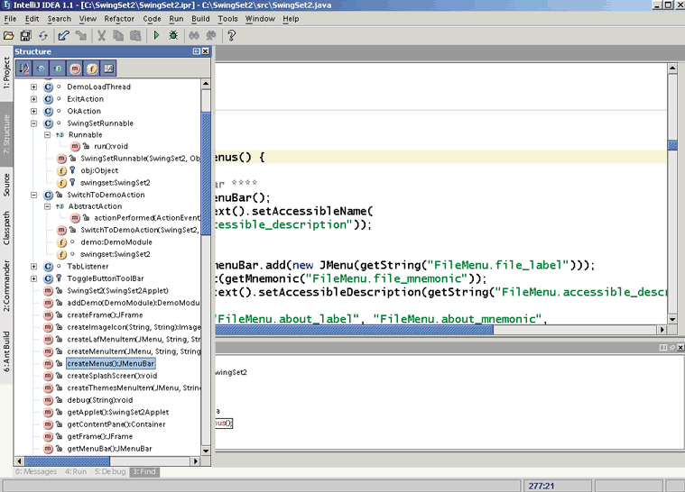
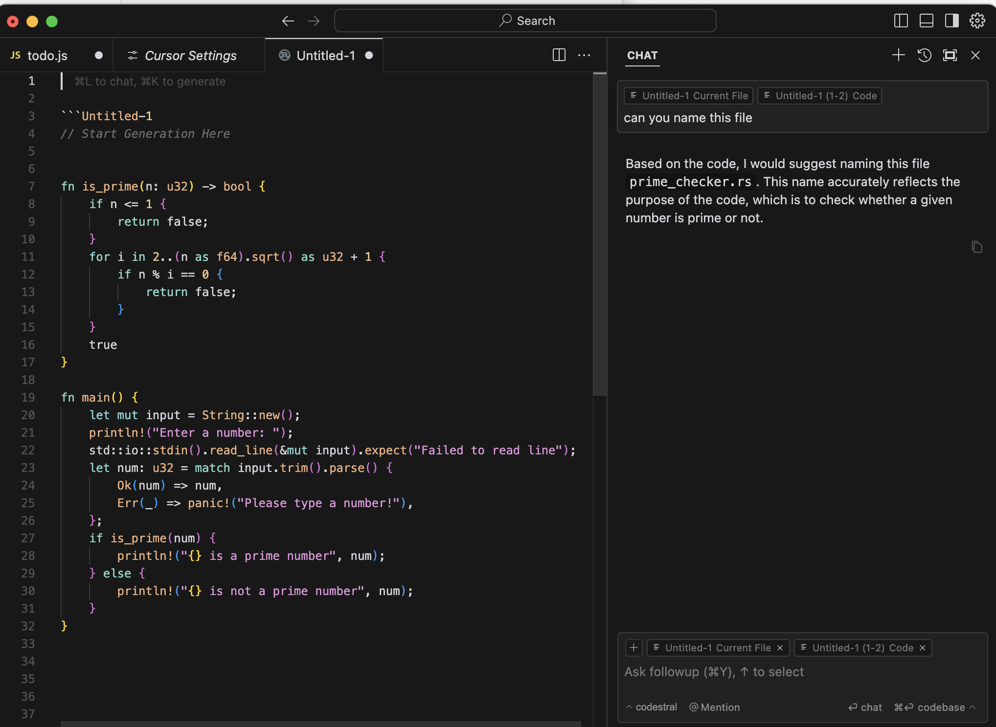
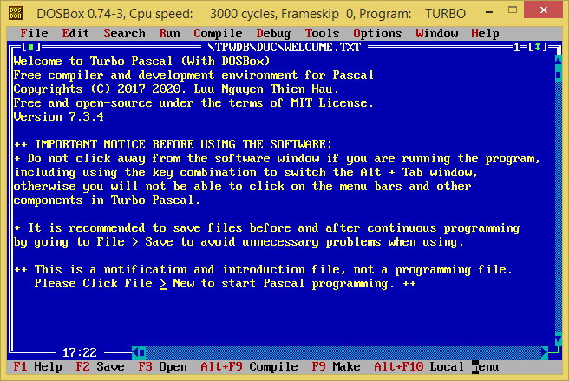
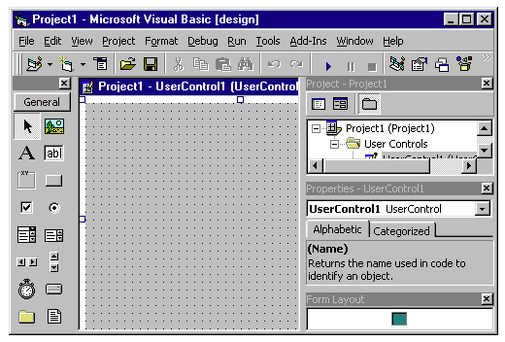
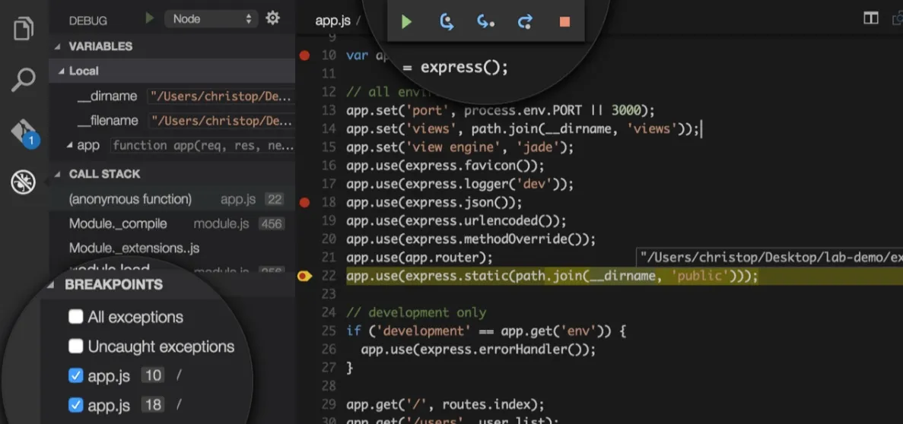
A brief history
Release of Turbo Pascal, first true IDE
Intellij IDEA released with advanced contextual code navigation, refactoring, code completion
Cursor released, one of the first widely used AI native IDEs
1997
2015
1980
2030
1983
2001
2023
Microsoft Visual Studio released, offering advanced debugging capabilities for the C++/Visual Basic language
Microsoft VSCode released offering lightweight editor with highly extensible ecosystem
themodernsoftware.dev
Notes:
𝗧𝘂𝗿𝗯𝗼 𝗣𝗮𝘀𝗰𝗮𝗹 (𝟭𝟵𝟴𝟯): First all-in-one editor, compiler, and linker. Focused solely on the Pascal language.
𝗠𝗶𝗰𝗿𝗼𝘀𝗼𝗳𝘁 𝗩𝗶𝘀𝘂𝗮𝗹 𝗦𝘁𝘂𝗱𝗶𝗼 (𝟭𝟵𝟵𝟳): Offered advanced debugging capabilities for the C++/Visual Basic language. First usage of Intellisense (precursor to Tab-Complete).
𝗜𝗻𝘁𝗲𝗹𝗹𝗶𝗷 𝗜𝗗𝗘𝗔 (𝟮𝟬𝟬𝟭): Released with advanced contextual code navigation, refactoring, code completion (conceptual ancestor of much of the AI functionality now baked into modern IDEs).
𝗠𝗶𝗰𝗿𝗼𝘀𝗼𝗳𝘁 𝗩𝗦𝗖𝗼𝗱𝗲 (𝟮𝟬𝟭𝟱): Offered lightweight editor with highly extensible ecosystem of plugins. Allowed for an ecosystem of AI extensions like Copilot, Codeium (Windsurf), etc. Also introduced LSP (the conceptual inspiration for MCP).
𝗖𝘂𝗿𝘀𝗼𝗿 (𝟮𝟬𝟮𝟯): Leaned heavily into AI-assisted development in all parts of IDE experience with refactoring, debugging, documentation generation, multi-file reasoning.
And here we are!
In the IDE evolution, there’s always a see-saw between functionality consolidation and developer customization. Bring more into one platform but still allow power users to choose their own adventure.

Slide 6
Usage
Bread-and-butter modes
Inline
Function
Single-file
Multi-file
True AI-native
Background agents
MCP
Learn memories
Bugbot (PR review)
themodernsoftware.dev
Notes:
Different modes (in Cursor) for different complexity: * Tab (simple inline) * Cmd-K - simple question / a few lines * Cmd-L - multi-file

Slide 7
Let’s see some of this in action
themodernsoftware.dev

Slide 8
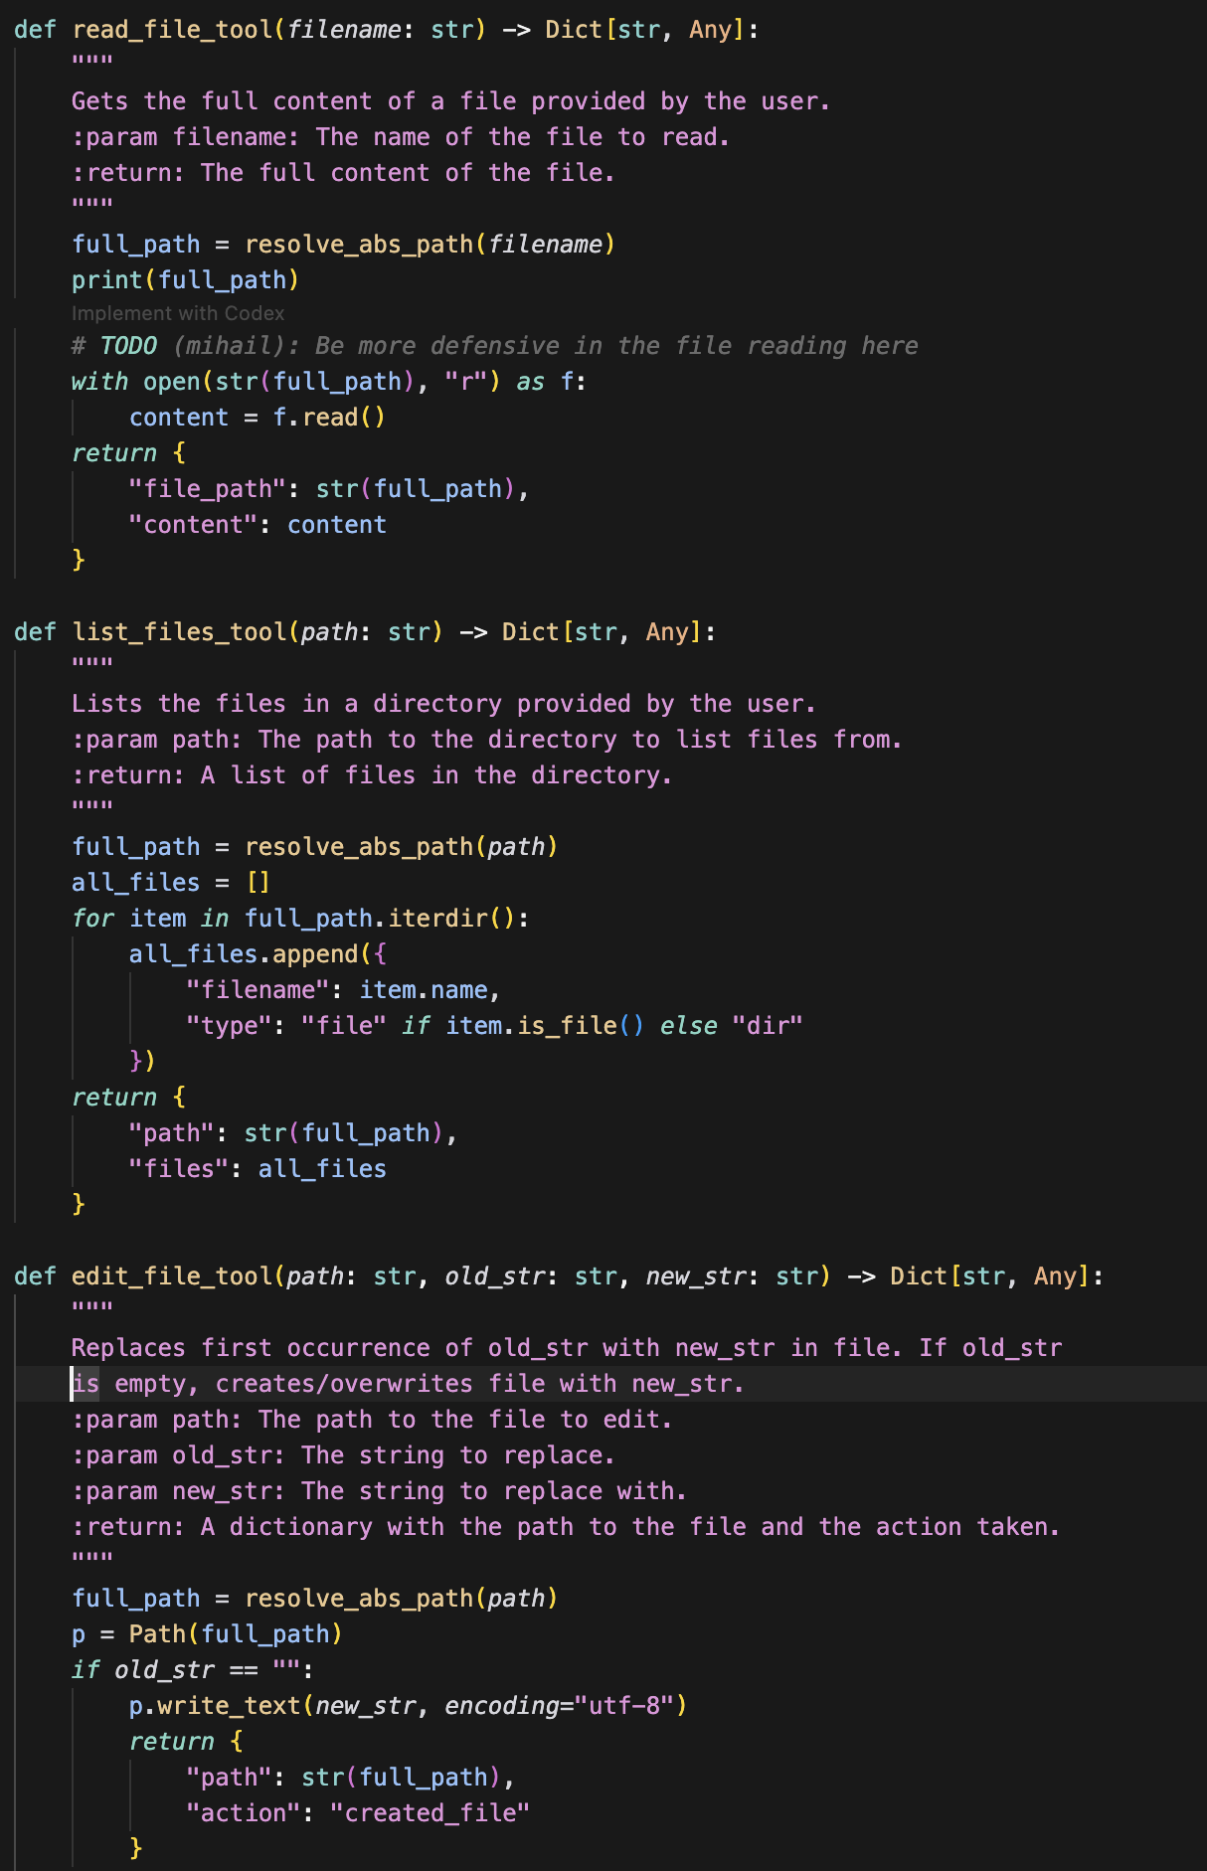
How an AI IDE works under-the-hood
Tab-complete
Small context window around current code is encrypted
Server receives and runs infilling LLM
Suggestion sent back and displayed
Chat
Store code chunks as embeddings in semantic index on server (obfuscated filename + code)
Any query retrieves most relevant chunks and feeds as context into LLM
IDE regularly re-index code chunks and syncs embeddings
Chunk diffs are computed via Merkle trees for efficient updates
themodernsoftware.dev
Notes:
Can see which files have been indexed in “Indexing & Docs” > “Ignore Files in .cursorignore” > “View included files”

Slide 9
Best practices
For simple changes you don’t have to be too thoughtful about prompting
For more complex tasks, you’re going to become a product manager
Carefully crafted specs doc
themodernsoftware.dev

Slide 10
Best practices
Goal
What is the purpose of the change
Definitions
What prereqs does the LLM need to know about the problem
Plan
High-level implementation breakdown
Source files being changed
What parts of the codebase are relevant and why
Test cases
How will testing be done
Edge cases
What special cases need to be accounted for
Out-of-scope
What should *not* be changed
Extensions
What changes will be relevant later so the LLM can future-proof its design and not take shortcuts
themodernsoftware.dev
Notes:
This is something you should iterate on to find what works for you
These high level points should suffice

Slide 11
Let’s see some of this in action
themodernsoftware.dev
Notes:
Do an actual more complex coding task with a specs doc

Slide 12
Best practices
Optimize your codebase so that a human and an agent could understand what’s going on
Much of LLM confusion comes from trying to finish a task with a messy repo as context
Provide optimal context for LLMs by describing
Repo orientation
File structure
Setup and environment
Best practices
Code style
Access patterns
APIs and contracts
All of this should be thoroughly documented
Tip: a monorepo design in your repo is highly encouraged
themodernsoftware.dev
Notes:
A messy repo could be as simple as having different access patterns (like for a DB), variable naming, multiple functions that do the same thing

Slide 13
Best practices
Help LLM navigate your codebase with agent configurations
claude.md
CLAUDE.md is a special file that Claude automatically pulls into context when starting a conversation. This makes it an ideal place for documenting: common bash commands, core files and utility functions, code style guidelines, testing instructions.
cursorrules
AGENTS.md
Open format
llms.txt
Provide that navigation guidance for LLMs scraping the web
Note: The agents won’t always adhere to these descriptions/directives. They are intended as guidance.
themodernsoftware.dev

Slide 14
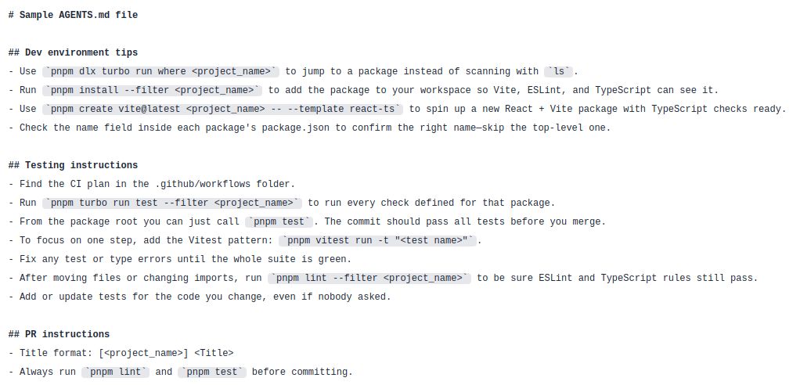
Samples
themodernsoftware.dev
Notes:
https://github.com/openai/codex/blob/main/AGENTS.md
Agents.md
README.md files are for humans: quick starts, project descriptions, and contribution guidelines.
AGENTS.md complements this by containing the extra, sometimes detailed context coding agents need: build steps, tests, and conventions that might clutter a README or aren’t relevant to human contributors.
We intentionally kept it separate to:
Give agents a clear, predictable place for instructions.
Keep READMEs concise and focused on human contributors.
Provide precise, agent-focused guidance that complements existing README and docs.
What to include
Add sections that help an agent work effectively with your project. Popular choices:
Project overview
Build and test commands
Code style guidelines
Testing instructions
Security considerations

Slide 15
Let’s see some of this in action
themodernsoftware.dev
Notes:
See some cursorrules/claude code specs as a learning tool
Where do they exist in the repo
How extensive they can get

