Slide 1
IDE ❤️ Agents
An opinionated guide to AI coding in 2025
CS146S: The Modern Software Developer – Oct 10, 2025

Slide 2


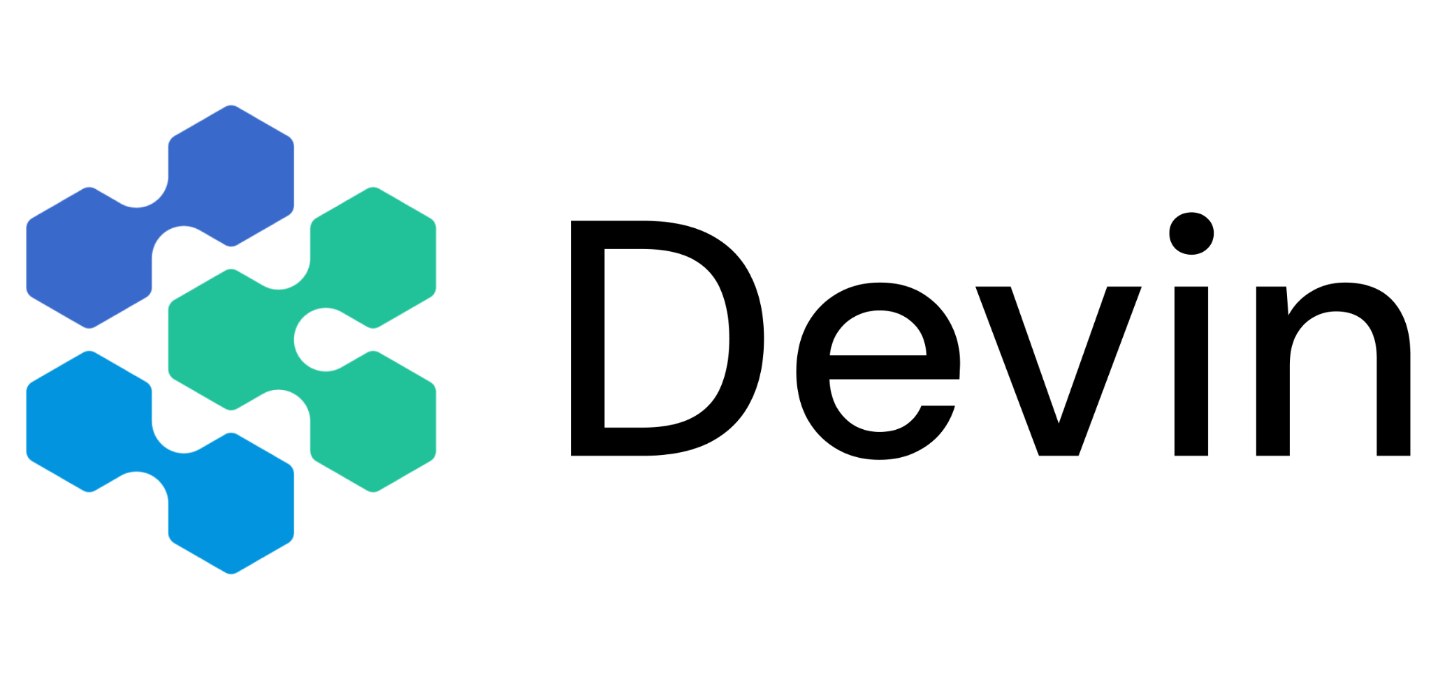
Silas Alberti
Founding Team @ Cognition Prev: Stanford PhD Student

Slide 3
Agenda
Overview of the AI tooling landscape
Synchronous vs. asynchronous tools
The 2025 coding workflow
When to hand-off from sync to async?
How to combine tools like Devin & Windsurf
Where are we headed?

Slide 4

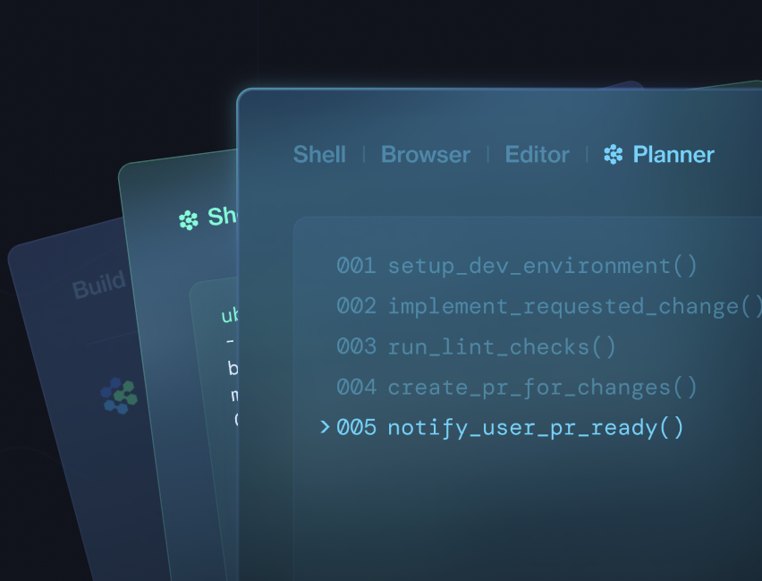
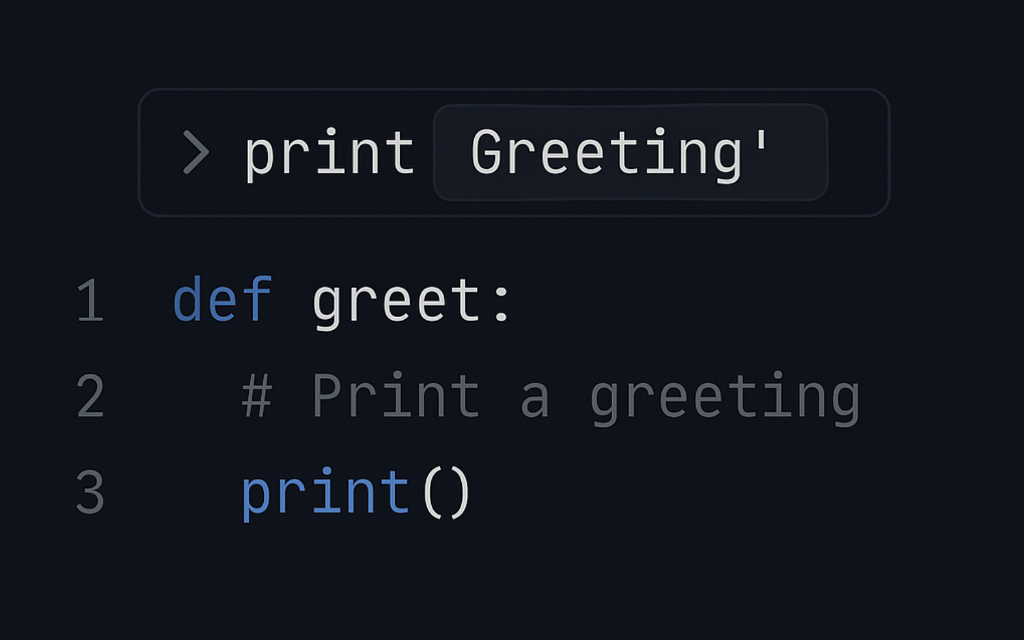
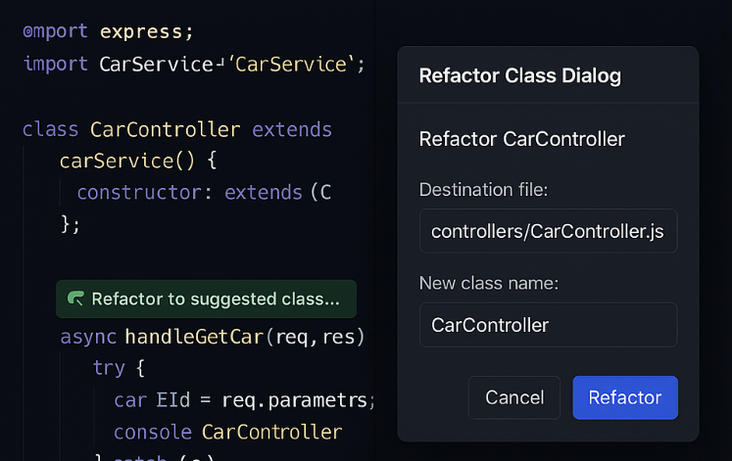

Overview
Three Eras of AI Coding Tools
3
Local Development ⇒ Collaborative Cloud Agents
AI agents: scale workflows in parallel
AI Software Engineer
1
2
GitHub Copilot: speed up coding
AI IDEs: single-player task completion
Code Completion
IDE Automation
Image 2

Slide 5





Overview
Three Eras of AI Coding Tools
6-12x efficiency gain
3
Local Development ⇒ Collaborative Cloud Agents
AI agents: scale workflows in parallel
AI Software Engineer
1
~10% efficiency gain
2
~20% efficiency gain
Cloud, Asynchronous
GitHub Copilot: speed up coding
AI IDEs: single-player task completion
Code Completion
IDE Automation
Image 2
Local, Synchronous

Slide 6
Synchronous vs. Asynchronous
sync: single-threaded, human-in-the-loop, your attention is focused on one task => AI agent works for 20 seconds - 1.5 minutes

Slide 7
Synchronous vs. Asynchronous
sync: single-threaded, human-in-the-loop, your attention is focused on one task => AI agent works for 20 seconds - 1.5 minutes
async: multi-threaded, human delegates to AI, switches attention between multiple tasks => AI agent works for 10 minutes - multiple hours

Slide 8
Sync
Async
Local
Cloud

Slide 9


Sync
Async
Local
Cloud

Slide 10

Sync
Async
Local
Cloud

Slide 11
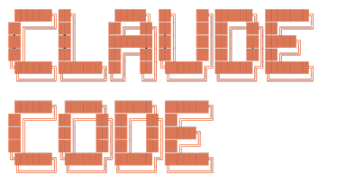
Sync
Async
Local
Cloud
DeepWiki

Slide 12



Overview
Cloud + Async enables 10x parallelism
Local AI IDEs
Cloud AI Agents
Boost individual speed.
Unlimited Devins for parallel capacity.
Users
Users
Laptops
Devins
Env
Local IDE
Local IDE
Local IDE
Env
In VPC
Local • Synchronous • 1-to-1 • Isolated Knowledge
Cloud • Asynchronous • 1-to-Many • Organizational Knowledge
Notes:
How Devin delivers workflow autonomy
Plan — engineer in the loop • Ask Devin questions in Search / Wiki to surface the right files, APIs, tests • Clarify scope → Devin writes a step-by-step plan • Time cost ≈ minutes
Build — Devin in the loop • Devin spins up its isolated workspace (shell + editor + browser) • Plans → executes → tests → iterates until the task is green • Runs fully async; you move on to other work
Review — engineer back in the loop • Devin opens a clean PR with passing tests and a change summary • You review, comment, or merge — Devin can revise on request • Human effort ≲ 15 % of the original task
Result: one clear hand-off, 6-12× engineer leverage, zero IDE disruption.

Slide 13
Using async agents is a hard but learnable skill
Managing async agents can unlock 10x gains… …but most people use sync agents.

Slide 14
Using async agents is a hard but learnable skill
Managing async agents can unlock 10x gains… …but most people use sync agents.
Why?
Turns out management & delegation is a difficult skill to master – whether it’s humans or agents.
Requires ability to cycle between multiple tasks and quickly understanding new context

Slide 15
Semi-Async: The awkward middle
Flow Barrier
Sync
“Semi-Async”
Async
5s 10s 30s 1m 3m 5m 10m 1h 3h

Slide 16
Semi-Async: The awkward middle
Flow Barrier
Avoid! Too slow for staying in flow. Too short for multi-tasking.
Sync
“Semi-Async”
Async
5s 10s 30s 1m 3m 5m 10m 1h 3h

Slide 17
Semi-Async: The awkward middle
Flow Barrier
Avoid! Too slow for staying in flow. Too short for multi-tasking.
Sync
“Semi-Async”
Async
Make faster to preserve flow
Trade time for higher intelligence
5s 10s 30s 1m 3m 5m 10m 1h 3h

Slide 18
Planning
Coding
Testing

Slide 19
sync
async
sync
Planning
Coding
Testing

Slide 20
Planning with Windsurf & Devin
DeepWiki
Ask Devin
Codemaps
DeepWiki in Windsurf

Slide 21

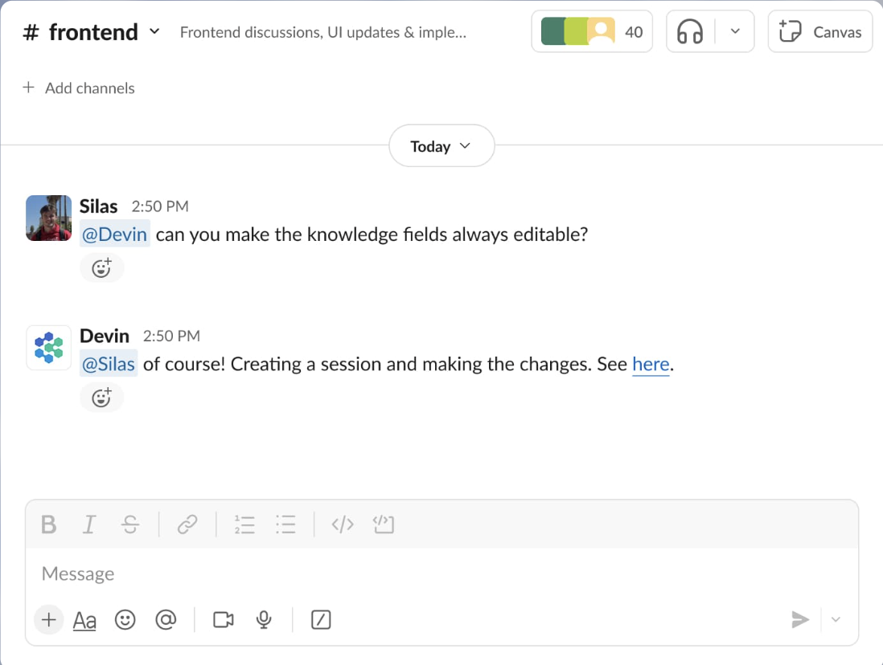
Delegate the coding to the agent

Slide 22

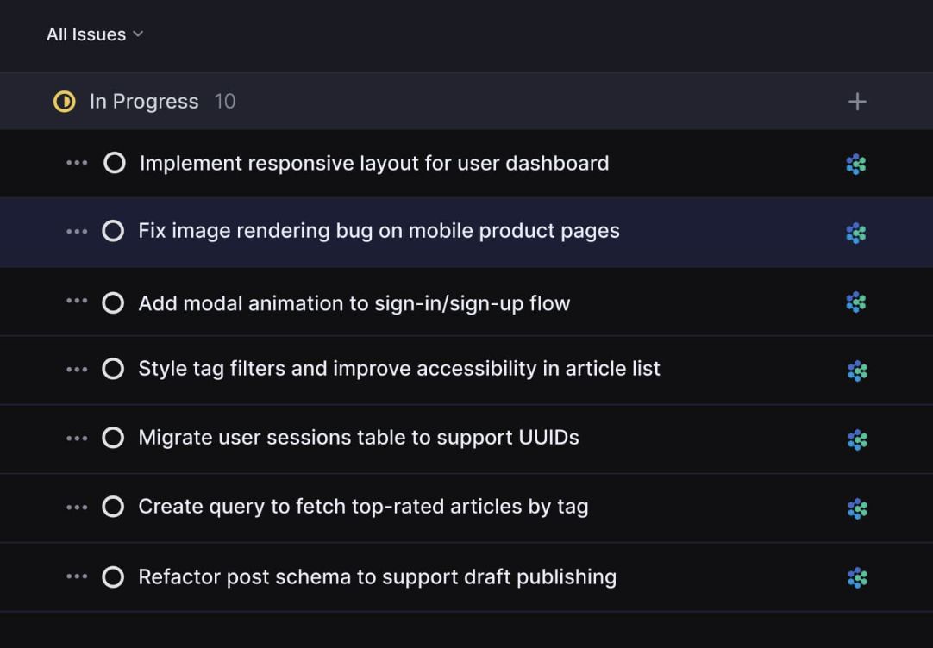
Delegate the coding to the agent

Slide 23
Testing the agent’s changes
Common workflow: 1. Delegate task to Devin (async) 2. Test & refine changes in Windsurf (sync)

Slide 24
Testing the agent’s changes
Common workflow: 1. Delegate task to Devin (async) 2. Test & refine changes in Windsurf (sync)
Future outlook: If async agents could test autonomously, the leverage increases. This is slowly starting to become a reality.

Slide 25
Where are we headed?
Today:
Planning
Coding
Testing

Slide 26
Where are we headed?
Today:
Planning
Coding
Testing
Future:
Planning
Coding
Testing

Slide 27
Where are we headed?
The human engineer as the agent manager
Leveraging sync tools to solve the most difficult problems
Leveraging async tools to achieve 10x leverage

Slide 28
Where are we headed?
The human engineer as the agent manager
Leveraging sync tools to solve the most difficult problems
Leveraging async tools to achieve 10x leverage
Valuable skills for the future:
Delegation & multi-threading
Code reading
Planning, scoping, architecting

Slide 29
Thank you!

