Slide 1
Essay Type 1: Compare & Contrast Essay
Language needed
How to organise your comparison and contrast points
Examples

Slide 2
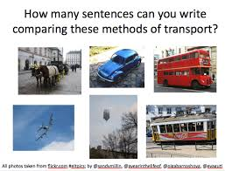
Comparing & Contrasting
Comparing - similarities
Contrasting – differences.

Slide 3

In class exercise
1. Make a list of all the ways in which university is different to high school.
2. Make a list of the ways in which your ENG 101 Lecturer is different to your other lecturers.

Slide 4
Communication differences
Together in groups read the text about the differences between American and Japanese communication styles on pages 148 & 149.
Answer the questions on Page 150.
What are some noticeable differences and similarities between Saudi and UK/USA conversation styles? Brainstorm all the differences and similarities.

Slide 5

Some observations from me
Lack of eye contact
Lack of polite gratitude
Possibly too much gratitude from UK people?
Women to women – more non verbal gestures than in the UK
More reference to religion. Style very much influenced by religion e.g opening conversation here – How are you? How are your family?
UK people ask about the weather!

Slide 6
Points to consider
The purpose of a comparison and contrast essay is NOT only to point out similarities and differences, but also to persuade, explain or inform.
LIMITING THE POINTS YOU MAKE:
Your points should be limited to avoid a situation where you simply list all possible similarities and differences without expanding, explaining or developing them.
For a 300-500 word essay you should have between 2-4 points of comparison. These points are central to your essay.

Slide 7
Key words 1
Similar to – use for comparison
In contrast to – use for contrast
Unlike – use for contrast
Coordinating conjunctions
And is for comparison
But/Yet for contrast
Subordinating conjunctions – just as (similarity)
Whereas (contrasting/differences).

Slide 8
Key words 2
Expressions between sentences
Likewise/Similarly (Comparison/Similarity)
On the other hand, however, in contrast (differences).
GRAMMAR HOMEWORK: P.310 Reading & Ex.24 P.311
Ex. 25 P.312.

Slide 9
Vocabulary & Language focus
When comparing use synonyms (words with a similar meaning).
When contrasting use antonyms (words with an opposite meaning).
Exercise 1. Matching (P.153)
Group A – display & emerge
Group B – objectively & adapt
Previous S: prior & preceding A: Successive & Subsequent
Homework: Exercise 2 – Page 154 for the next class.

Slide 10
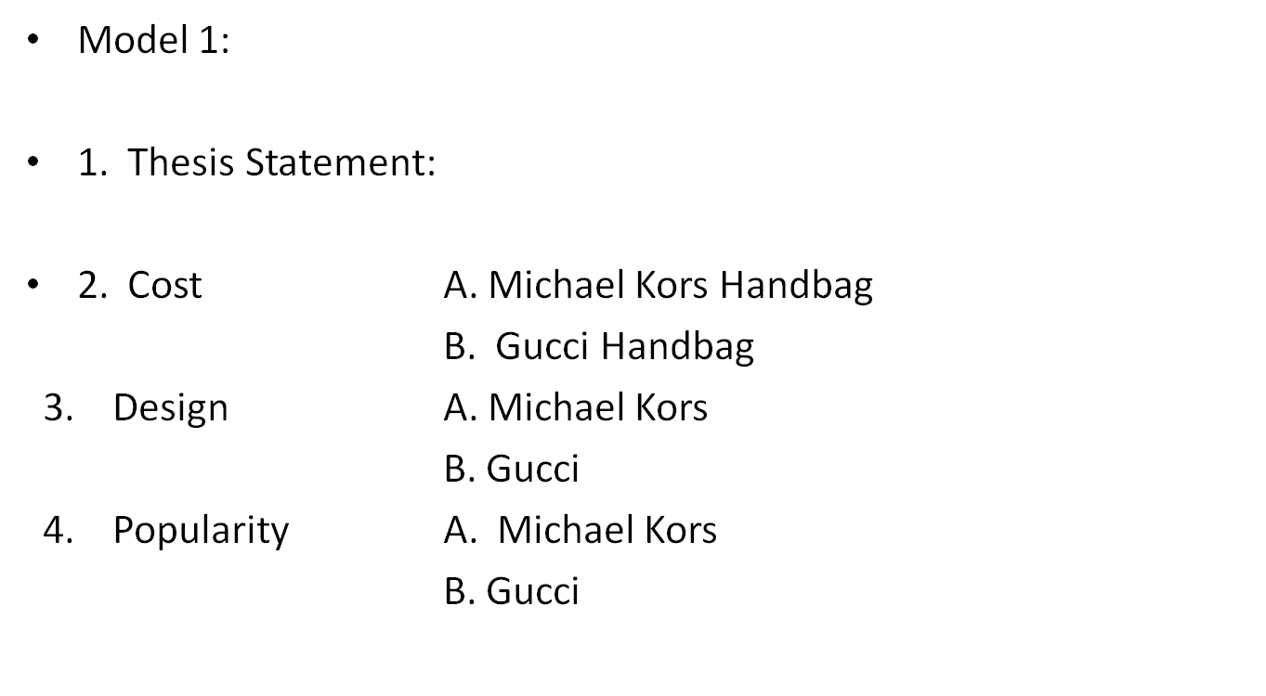
Organising your points - Models

Slide 11
Model 2 – All of one/One of the other
1. Michael Kors
A. cost
B. design
C. popularity
2. Gucci
A. cost
B. design
C. popularity

Slide 12
Models – Which to use
Model 1 where you compare and contrast together is useful when you have a complex topic possibly with a lot of points to consider.
Model 2 where you compare and contrast separately is useful when you have a limited topic.
Homework Exercise: Ex 5 & Questions on Pg 161.
In class Exercise 7 on page 161 and questions on page 163.

Slide 13
Writing Assignment – In class
Time: 1 class
See separate handout for details. Should be at least 500 words in length.

Slide 14
Final homework assignment
See separate handout. The essay must be typed with your name, section and ID number present on all sheets of paper. The sheets of paper must be stapled or enclosed in a plastic wallet.
Your essay should be at least 500 words in length.

