Slide 1

ENG103 Research Writing Techniques
AS2, G5: Survey Development

Slide 2
Lesson Outline
Survey Development Guide – G5
Developing Survey questions
Creating a Google Questionnaire

Slide 3
Survey Development Guide – G5 Developing Survey questions
Before drafting questions, it is necessary to clearly identify the objective of the research and how questions can contribute to achieve the research objective.
For example, if we wanted to undertake research to determine student attitudes towards online learning what are the different dimensions of this enquiry?
What are the questions we could ask related to each dimensions?

Slide 4
Survey Development Guide – G5 Developing Survey questions
For example, we could focus on the following three dimensions:
questions to determine student attitudes towards the effectiveness of online learning
questions to determine student attitudes regarding the impact of online learning on their grades
questions to ascertain if students believe online learning improves their interactions with other students

Slide 5
Survey Development Guide – G5 Developing Survey questions
After determining the different dimensions, we can then formulate questions for each dimension. For example, related to how online learning is an effective mode of teaching the following questions using the Likert scale design can be formulated:
I can retain more information when taught online.
When a subject is taught online it is clearer to me.
I can focus better on what the teacher is saying when taught online.
Likert Scale answers:
Strongly agree
Somewhat agree
Neutral
Somewhat disagree
Strongly disagree

Slide 6
Survey Development Guide – G5 Developing Survey questions
Attitudes related to how online learning affects student grades
Questions:
Online learning helps me get better grades in my midterm exams.
Online learning helps me get better grades in my final exams.
Online learning helps me get better grades in my coursework.
Likert Scale answers:
Strongly agree
Somewhat agree
Neutral
Somewhat disagree
Strongly disagree

Slide 7
Survey Development Guide – G5 Developing Survey questions
Attitudes related to how online effects student social interactions
Questions:
Online learning helps me communicate better with other students.
Online learning helps me make friends with other students.
Online learning helps me with my social life.
Likert Scale answers:
Strongly agree
Somewhat agree
Neutral
Somewhat disagree
Strongly disagree

Slide 8

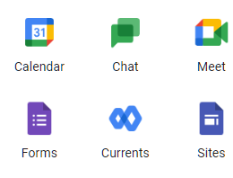
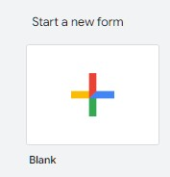
Survey Development Guide – G5 Creating a Google Questionnaire
Once you have drafted your questions and answers you can create an online survey using Google Forms.
1) To access Google Forms log into your Google Drive and click on the 9 dots located in the top left-hand corner
2) Select Forms
3) Choose the option to start a new form

Slide 9
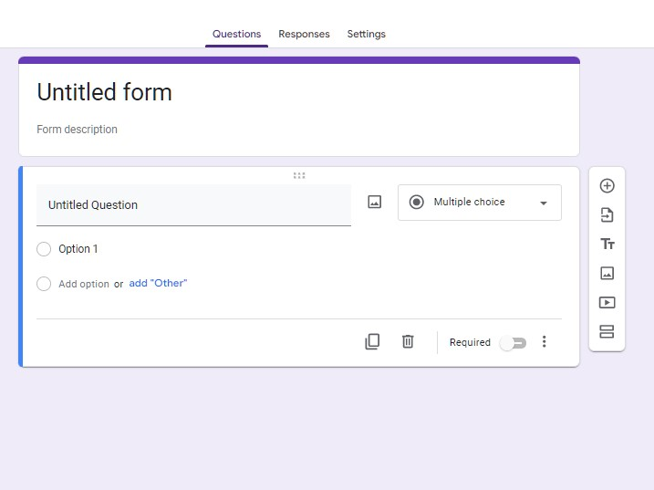
Survey Development Guide – G5 Creating a Google Questionnaire
4) Add a title here
5) Add a description of your research here
6) You first question should be used to gain consent from your participant. To add your consent text, click on untitled question and type or paste your consent text
7) The answers to the consent question should be: “I accept” and “I do not accept”. To add the answers, click on Option1 and type or paste “I accept” and then click on Add option to add “I do not accept”.
8) Click on required

Slide 10
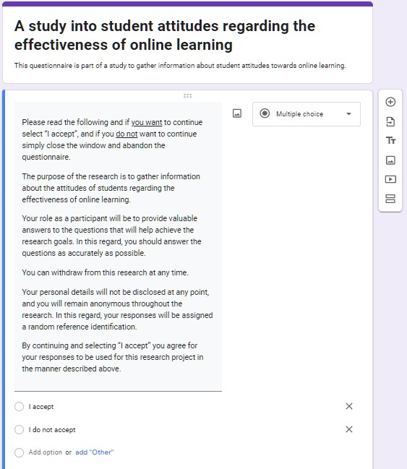
Survey Development Guide – G5 Creating a Google Questionnaire
Once complete, your form should be similar to this.
9) You can no move on to your next questions by clicking the + icon here.

Slide 11
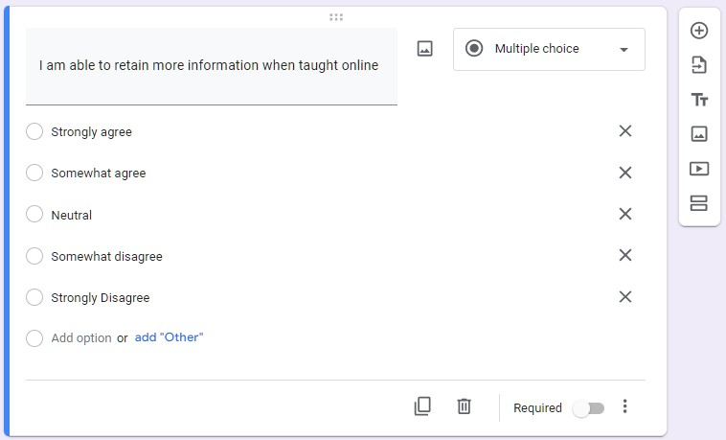
Survey Development Guide – G5 Creating a Google Questionnaire
10) You can change the type of questions here, but if you are using the Likert Scale use the Multiple choice option.
11) Remember to select required for all your questions.

Slide 12
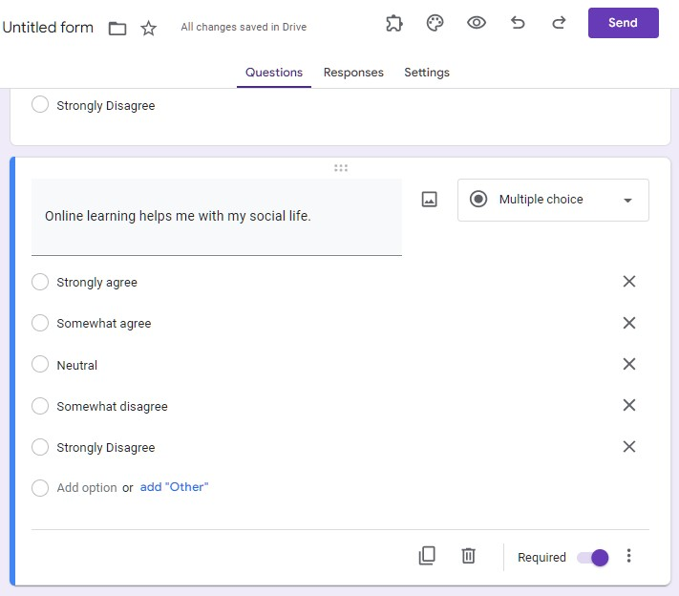
Survey Development Guide – G5 Creating a Google Questionnaire
12) Once your questions are complete you can preview them by pressing the eye icon.
13) Once you are ready to send your questionnaire to your participants click on send.

Slide 13
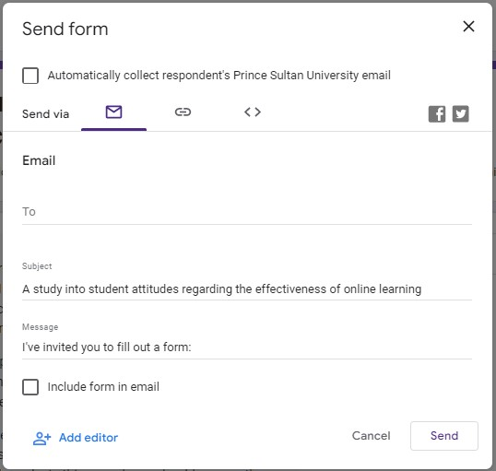
Survey Development Guide – G5 Creating a Google Questionnaire
14) You can use Google Forms to email your participants directly by adding their emails here and clicking on send.
15) Alternatively, you can copy the link for the questionnaire from here and send it yourself by email or through other means, e.g., WhatsApp.

Slide 14
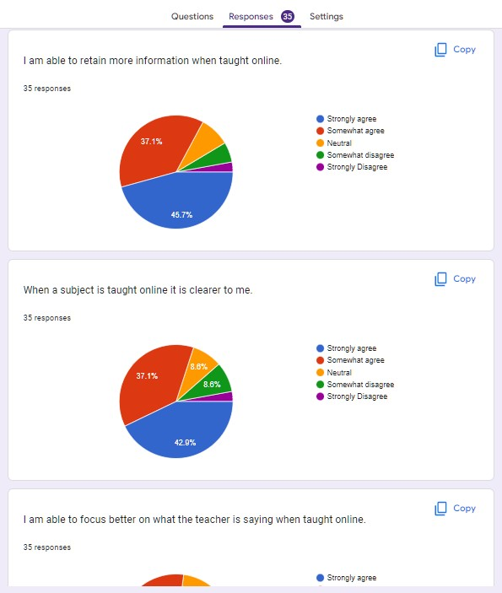
Survey Development Guide – G5 Creating a Google Questionnaire
16) To view the responses, click here.
17) You can also copy the graph for each question by clicking on copy. The graph can then be pasted into a Google or MS word document.

