Slide 1






ENG103: Research Writing Techniques
Participant Oriented Research, Samples, and Surveys

Slide 2
Lesson outline
Participant Oriented Research
Representative Samples & Sampling Errors Surveys
Questionnaires
Question types
Questionnaire Design

Slide 3
Participant Oriented Research
Participant-oriented research is the gathering of data from people rather than the things they produce or the things that affect them.
In addition, participant-oriented research can take the form of quantitative research (e.g., large scale structured surveys) or qualitative research (e.g., unstructured interviews).
Moreover, participant-oriented research can be used for inductive research as a means to produce hypotheses or it can be used for deductive research to test existing hypotheses.

Slide 4
Representative Samples & Sampling Errors
In everyday life we rely on samples to make decisions about aggregates.
Similarly, when we need to reach decisions about a research population, we can conduct participant-oriented research through which we only need to test a sample of participants.
Ruane (2005) suggests that “samples, then, offer a practical solution to the daunting task of studying entire populations. We can use samples to "stand in" for a larger population. In this sense, samples can be very efficient devices – they allow us to look at the "few" in order to know about the many” (p. 105).
However, sample groups that are not representative of the population under investigation can lead to sampling errors. Leavy (2017) suggests that “in survey research it is important to consider sampling error when you draw your sample. Sampling error occurs when you have a biased sample” (p. 110).

Slide 5
Representative Samples & Sampling Errors
Individuals in populations are heterogenous (not the same as each other ) in multiple ways. What ways do you think people are different from each other in a population?
It is very rare to find individuals in populations that are homogeneous (the same as each other). Why do you think homogeneous populations are rare?
Thus, a key characteristic of a sample is that it is representative of the population. In short, the sample should be a scaled down version of the population.
A way to ensure the sample will be representative of the population is to establish a sampling frame before forming the sample. Essentially, a sample frame is the collection of detailed information about the research population. This information can be then used to ensure the sample is representative of the population. For example, if you we were conducting research on a sample to reach a decision about the population of Prince Sultan University’s students what information would we need to know about the student population?
Regarding the importance of a sampling frame Ruane (2005) suggests that
A sampling frame refers to an exhaustive listing of all the elements that make up a research population. The sampling frame is an essential ingredient for probability sampling. Indeed, it is the sampling frame that enables the researcher to "know" the probability of elements being selected for a sample. If a researcher knows that a sampling frame contains 1,000 elements, then the researcher also knows that any one element has one chance in 1,000 of being selected for the sample. Without this total listing of all the population elements, probability sampling is impossible (p. 110).

Slide 6
Representative Samples & Sampling Errors
Samples that are not representative of the population can lead to sampling errors. Leavy (2017) suggests that “in survey research it is important to consider sampling error when you draw your sample. Sampling error occurs when you have a biased sample” (p. 110).
A famous example of a sampling error is in the predictions surrounding the 1936 US presidential election.
1936 elections in U.S.: Franklin D. Roosevelt vs. Alf Landon
The magazine, Literary Digest, sent out about 10 million questionnaires to a list of subscribers to the magazine, and of people with telephones, cars, and various club memberships.
About 25 % responded: Sample size of 2,4 million
The magazine predicted Landon victory with 57 % of the vote. Actual result: Roosevelt: 61 %, Landon: 37 %.
George Gallup's American Institute of Public Opinion predicted Roosevelt vote at 56 % of the vote with a sample size of 50,000.
Literary Digest went bankrupt in a couple of years.
Why do you think Literary Digest’s results were so wrong despite the large sample size?

Slide 7
Surveys
Surveys are a method to collect and analyze standardized information from participants. Leavy (2017) explains that:
Surveys rely on asking people standardized questions that can be analyzed statistically. They allow researchers to collect a breadth of data from large samples and generalize to the larger population from which the sample was drawn (p. 101).
There are two main types of survey design, which are cross-sectional and longitudinal
Cross-sectional: “Cross-sectional designs seek information from a sample at one point in time” (Leavy, 2017, p.101). For example, a survey to collect and analyze data in relation to how a population rate the taste of a new diet food product.
Longitudinal: “Longitudinal designs occur at multiple times in order to measure change over time” (Leavy, 2017, p. 101). For example, a survey to collect and analyze data in relation to how a new diet food product impacts people's health over a ten-year period.

Slide 8
Questionnaires
As mentioned, surveys involve the collection and analysis of data, but a questionnaire is limited just to the collection phase of data. For example, Leavy (2017) explains that “questionnaires are the primary data collection tool in survey research. A questionnaire is also referred to as the survey instrument” (p.101). Also, Matthews and Ross (2010) define a questionnaire as follows:
(1) a list of questions each with a range of answers; (2) a format that enables standardized, relatively structured, data to be gathered about each of a (usually) large number of cases (cited in Saldanha and O'Brien 2014 pg. 151).
A questionnaire has several advantages over interviews:
A questionnaire can reach many participants
The data is easy to collate, especially with forced-choice questions
The data results are, theoretically, easy to reproduce
However, a questionnaire has several inherent disadvantages:
Constrained responses (sometimes forced-choice questions do not tell the full story)
Finding appropriate participants
Low response rate

Slide 9
Questionnaires
Questionnaire design
Before drafting questions, it is necessary to clearly identify the objective of the research and how questions can contribute to achieve the research objective.
Leavy (2017) explains that “here must be clear and justifiable links between your indicators (questions) and the concepts you say you are measuring in order to produce a valid instrument” (p. 101)
Leavy (2017) gives the example of research to determine if there is a link between students’ satisfaction with their college roommate and their overall satisfaction with their college experience. However, as Leavy notes these are both multidimensional concepts.
For example, what would be the variables of satisfaction with a college roommate? That is to say, what are factors you would measure satisfaction with a college roommate?
Leavy (2017) explains that “let’s say you come up with the following three dimensions of “cleanliness”: personal items kept orderly, communal items kept orderly, and personal hygiene. You would then come up with several questions to measure each of those dimensions of “cleanliness.” All of those questions together measure the concept of “cleanliness.”” (pp. 102-103.)
Moreover, Leavy (2017) asserts that “the more multidimensional a variable concept is, the more questions you will likely ask in regard to that specific variable” (Leavy, 2017, p. 103).

Slide 10
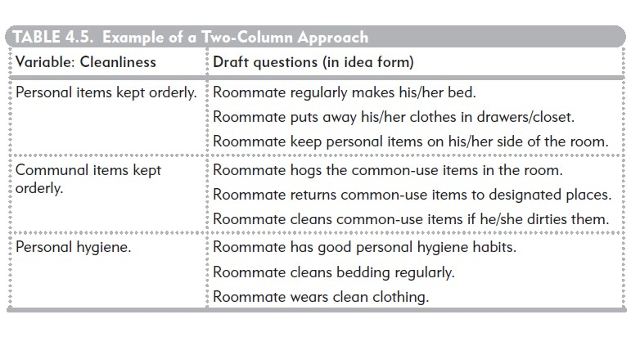
Questionnaires
Leavy, 2017, p. 103.

Slide 11
Question types
There are two main types of questions that can be used in a survey:
1) Open-ended questions: the participant is free to answer the question in anyway. The advantage of this approach is that it can yield unexpected responses. The disadvantage is that the answers are difficult to process in a quantitative study as the data will not be structured.
2) forced-choice: the participant is forced to answer the question in accordance with a limited number of potential answers. The advantage of this approach is that it can yield structured information that is easy to process in a quantitative study. The disadvantage is that it may miss unexpected responses (unknown unknowns).
Regarding forced-choice Leavy (2017) suggests that “different types of forced-choice questions include, but are not limited to, multiple choice, dichotomous, checklists, and scales (rating scale, Likert scale) […]” (p. 104).”
o produce a valid instrument” (p. 101)

Slide 12
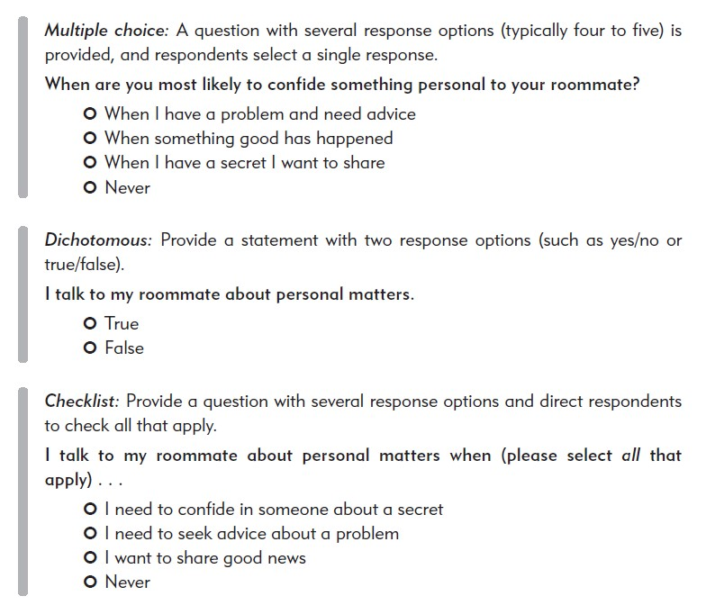
Question types
Leavy, 2017, p. 104.

Slide 13
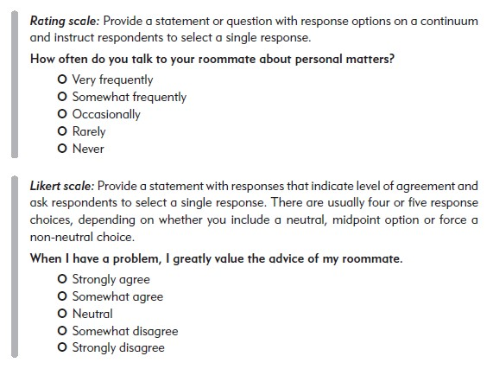
Question types
Leavy, 2017, p. 105.

Slide 14
Question types
Also, in regard to a Likert Scale Saldanha and O'Brien (2014) suggest that:
A very common device in questionnaires is the ‘Likert scale’, which was developed by the American psychologist Rensis Likert. A Likert scale commonly offers a series of five, seven or nine responses along a continuum of ‘strongly agree to strongly disagree’. Some researchers favour an even-numbered scale which, they believe, prevents respondents from conveniently selecting the mid-point on the scale (usually ‘neither agree nor disagree’ or ‘not sure’) (pp. 157-58).

Slide 15
Response choices
When formulating response choices in a questionnaire it is important that they are distinct from each other and thus do not overlap.
For example, Leavy (2017) argues that:
Response choices must be mutually exclusive and exhaustive. Mutually exclusive means that there is no overlap in response items, and exhaustive means that all of the possible responses a respondent might wish to select are available (p. 106).

Slide 16
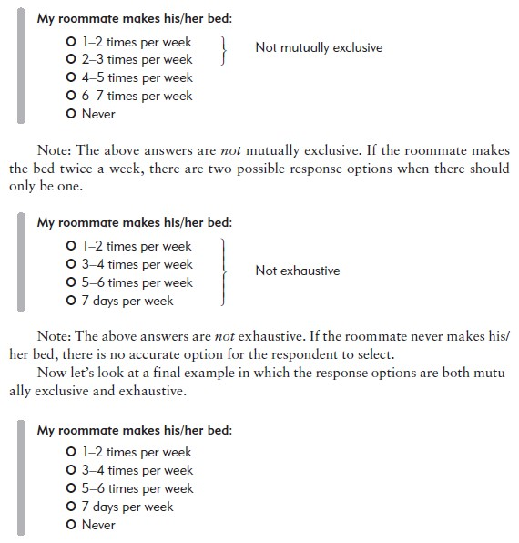
Response choices
Leavy, 2017, p. 106.

Slide 17
Questionnaire Design
The first step in designing a survey is to be clear on the goals of the research.
The second step is to formulate questions that are beneficial to achieving those research goals. Moreover, the questions should not be excessive.
A wrongly designed questions can jeopardize the entire research project. Therefore, the following points should be adhered to when formulating a questionnaire:
The avoidance of controversial questions, which may jar with the participant.
The avoidance of ambiguous language.
The use of neutral wording so not to prompt a response.
Also, before sending your questionnaire to your participants it is important to undertake preliminary research, which is a way to test your questionnaire and identify any issues. This can be undertaken by sending your questionnaire to:
Fellow academics
A sample group of participants
An ethics committee
The responses should be used to improve your questionnaire design.

Slide 18
Questionnaire Distribution
The participants’ answers to the questionnaire can be sought through various means, but the main methods are:
the researcher asking participants to complete the questionnaire in their presence.
An organized event, which participants attend
The direct canvassing of participants without prior notification
the researcher asking participants to complete the questionnaire in their absence.
Using online means such as Google forms
Emailing the questionnaire to participants

Slide 19
References
Leavy, P. (2017). Research Design: Quantitative, Qualitative, Mixed Methods, Arts-Based, and Community-Based Participatory Research Approaches. The Guilford Press.
Ruane, J. M. (2005). Essentials of Research Methods A Guide to Social Science Research. Blackwell Publishing.

