Slide 1
Chapter 1
Introduction to Psychology

Slide 2
MODULE 1—Psychologists at Work
What is the science of psychology?
What are the major specialties in the field of psychology?

Slide 3
Psychologists at Work
Psychology: the scientific study of behavior and mental processes.
Psychologists try to describe, predict, and explain human behavior and mental processes using scientific methods to find answers.

Slide 4
Subfields of Psychology 1
Behavioral genetics.
Clinical psychology.
Cognitive psychology.
Counseling psychology.
Cross-cultural Psychology
Industrial/organizational psychology.
Personality psychology.

Slide 5
Subfields of Psychology 2
Developmental psychology.
Educational psychology.
Experimental psychology.
Forensic psychology.
Health psychology.
Social psychology.
Sport psychology.

Slide 6
The Education of a Psychologist
Most psychologists have a doctorate degree.
A PhD (doctor of philosophy) is a research degree that requires a dissertation based on an original investigation.
A PsyD (doctor of psychology) is obtained by psychologists who want to focus on the treatment of psychological disorders.
Note, psychologists are distinct from psychiatrists—doctors who have a medical degree to specialize in the diagnosis and treatment of psychological disorders.

Slide 7
MODULE 2—A Science Evolves: The Past, the Present, and the Future
What are the origins of psychology?
What are the major approaches in contemporary psychology?
What are psychology’s key issues and controversies?

Slide 8
The Roots of Psychology
Structuralism: a focus on uncovering the fundamental mental components of consciousness, thinking, and other kinds of mental states and activities.
A perspective developed by Wilhelm Wundt.
Introspection: a procedure used to study the structure of the mind in which subjects are asked to describe in detail what they are experiencing when they are exposed to a stimulus.
Functionalism: an approach that concentrates on what the mind does and the role of behavior in allowing people to adapt to their environments.
Developed by William James.

Slide 9
Today’s Five Major Perspectives
Those who laid the foundations of psychology shared a common goal: to explain and understand behavior using scientific methods.
Today’s perspectives emphasize different aspects of behavior and mental processes.
Each takes our understanding of behavior in a somewhat different direction.

Slide 10
The Neuroscience Perspective: Blood, Sweat, and Fears
Neuroscience perspective: the approach that views behavior from the perspective of the brain, the nervous system, and other biological functions.

Slide 11
The Psychodynamic Perspective: Understanding the Inner Person
Psychodynamic perspective: the approach based on the view that behavior is motivated by inner forces and conflicts about which we have little awareness or control.
Its origins are linked to Sigmund Freud.

Slide 12
The Behavioral Perspective: Observing the Outer Person
Behavioral perspective: the approach that suggests that the focus should be on external behavior that can be objectively measured and observed.
John B. Watson was the first to use this approach.
It was championed by B. F. Skinner, a pioneer in the field.

Slide 13
The Cognitive Perspective: Identifying the Roots of Understanding
Cognitive perspective: the approach that focuses on how people think, understand, and know about the world.
For many psychologists who adhere to this perspective, thinking is information processing.

Slide 14
The Humanistic Perspective: The Unique Qualities of the Human Species
Humanistic perspective: suggests individuals naturally strive to grow, develop, and be in control of their lives and behavior.
Carl Rogers and Abraham Maslow were central figures in the development of this perspective.
The emphasis is on free will.
The notion of free will stands in contrast to determinism.

Slide 15
Psychology’s Key Issues and Controversies 1
Issue 1: Nature (heredity) versus nurture (environment).
How much of people’s behavior is due to their genetically determined nature?
How much is due to nurture—the influences of the physical and social environment in which a child is raised?
What is the interplay between heredity and environment?

Slide 16
Psychology’s Key Issues and Controversies 2
Issue 2: Conscious versus unconscious causes of behavior.
Issue 3: Observable behavior versus internal mental processes.
Issue 4: Free will versus determinism.
Issue 5: Individual differences versus universal principles

Slide 17
MODULE 3—Research in Psychology
What is the scientific method?
What role do theories and hypotheses play in psychological research?
What research methods do psychologists use?
How do psychologists establish cause-and-effect relationships in research studies?

Slide 18
The Scientific Method
Scientific method: an approach through which psychologists systematically acquire knowledge and understanding about behavior and other phenomena of interest.

Slide 19
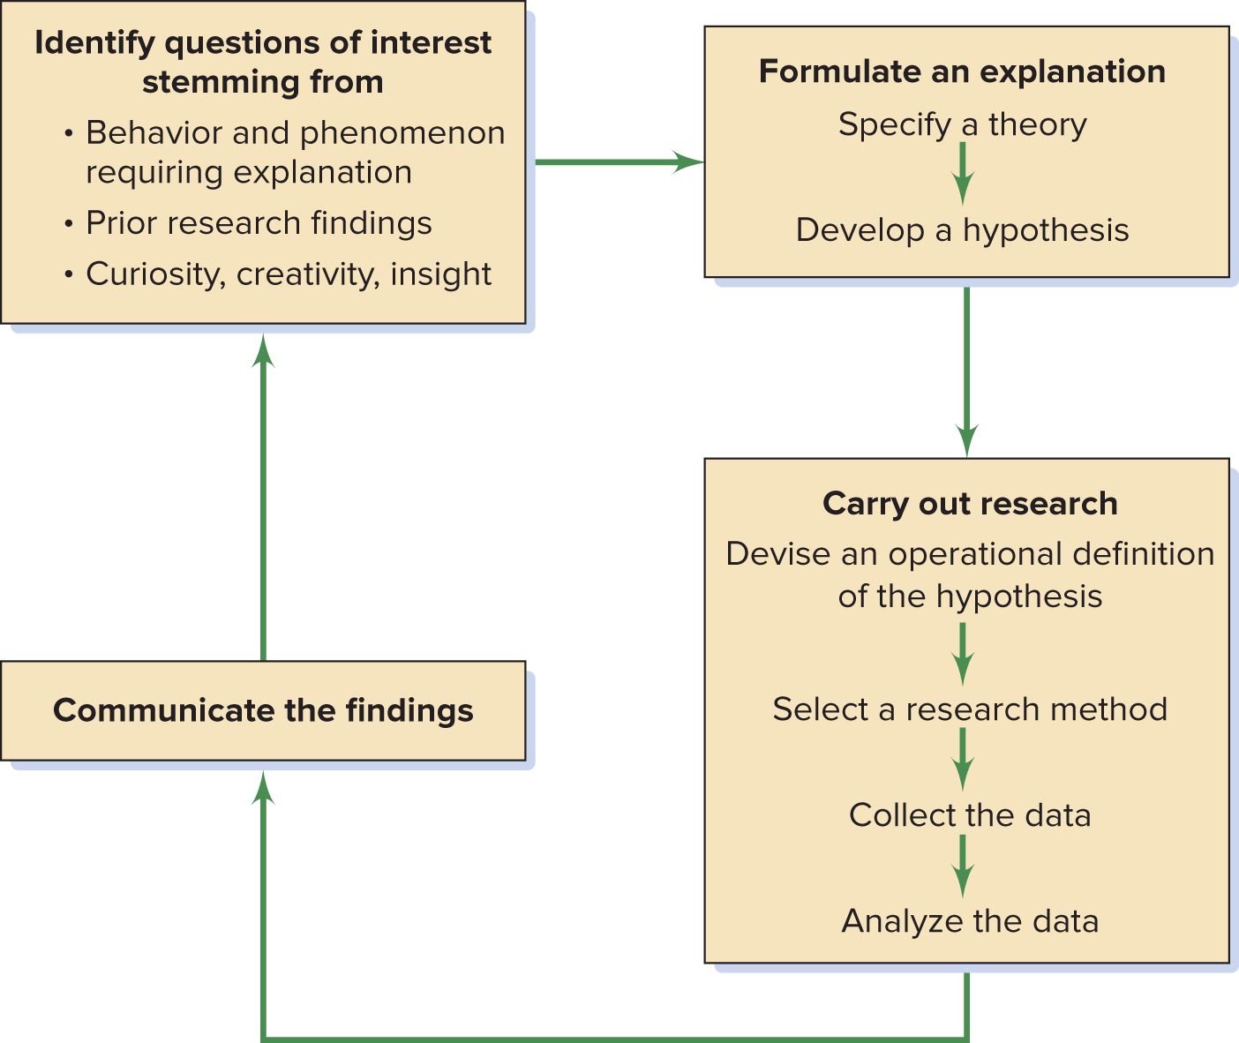
MODULE 3 FIGURE 1
The scientific method, which encompasses the process of identifying, asking, and answering questions, is used by psychologists and researchers from every other scientific discipline to come to an understanding about the world.
Access the text alternative for slide images.

Slide 20
Theories: Specifying Broad Explanations
Theories: broad explanations and predictions concerning observations of interest.
Theories provide a framework for understanding the relationships among a set of unorganized facts or principles.

Slide 21
Hypotheses: Crafting Testable Predictions 1
Hypothesis: a prediction, stemming from a theory, stated in a way that allows it to be tested.
For example: The more people who witness an emergency situation, the less likely it is that help will be given to a victim.
Operational definition: the translation of a hypothesis into specific, testable procedures that can be measured and observed.

Slide 22
Psychological Research
Research is systematic inquiry aimed at the discovery of new knowledge and is a central ingredient of the scientific method in psychology.
It provides the key to understanding the accuracy of hypotheses and theories.

Slide 23
Naturalistic Observation
Naturalistic observation: an investigator observes some naturally occurring behavior and does not make a change in the situation.
Significantly, the researcher simply records what occurs.
Advantage: obtains a sample of what people do in their natural habitat.
Disadvantage: the inability to control any factors of interest.

Slide 24
Survey Research
Survey research: people chosen to represent a larger population are asked a series of questions about their behavior, thoughts, or attitudes.
Advantage: if the sample is representative, make it possible to infer how a larger group would respond.
Disadvantages:
Results will be largely inconsequential if the sample is not representative.
Survey respondents may not be truthful about their attitudes or may be unaware of their true attitudes.

Slide 25
The Case Study
Case study: an in-depth, intensive investigation of an individual or a small group of people.
Might include psychological testing, where a carefully designed set of questions is used to gain some insight into the personality of the individual or group.
Advantage: insights can improve our understanding of people in general.
Disadvantage: small samples or unique individuals make it impossible to make valid generalizations about a larger population.

Slide 26
Correlational Research 1
Variables: behaviors, events, or other characteristics that can change, or vary, in some way.
Correlational research: the relationship between two sets of variables is examined to determine whether they are associated or correlated.
Disadvantage: correlational research cannot demonstrate cause-and-effect relationships.

Slide 27
Correlational Research 2
Positive correlation: as the value of one variable increases, so will the value of the other variable.
Negative correlation: as the value of one variable increases, value of the other variable will decrease.

Slide 28
Experimental Research
Experiment: the investigation of the relationship between two (or more) variables by deliberately producing a change in one variable in a situation and observing the effects on the second variable.
Experimental manipulation: the change that an experimenter deliberately produces in a situation.
Advantage: the only way psychologists can establish
cause-and-effect relationships.
Disadvantage: to be valid, requires careful controls.

Slide 29
Experimental Groups and Control Groups
Treatment: the manipulation implemented by the experimenter.
Experimental group: any group participating in an experiment that receives a treatment.
Control group: a group participating in an experiment that receives no treatment.
By employing both experimental and control groups, researchers are able to rule out the possibility that something other than the experimental manipulation produced the results.

Slide 30
Independent and Dependent Variables
Independent variable: the variable that is manipulated by an experimenter.
Dependent variable: the variable that is measured in an experiment.
It is expected to change as a result of the experimenter’s manipulation of the independent variable.

Slide 31
Random Assignment of Participants
Random assignment to condition: a procedure in which participants are assigned to different experimental groups or “conditions” on the basis of chance alone.
This elegant procedure is the solution to the endless list of characteristics a group of participants can have in an experiment.

Slide 32
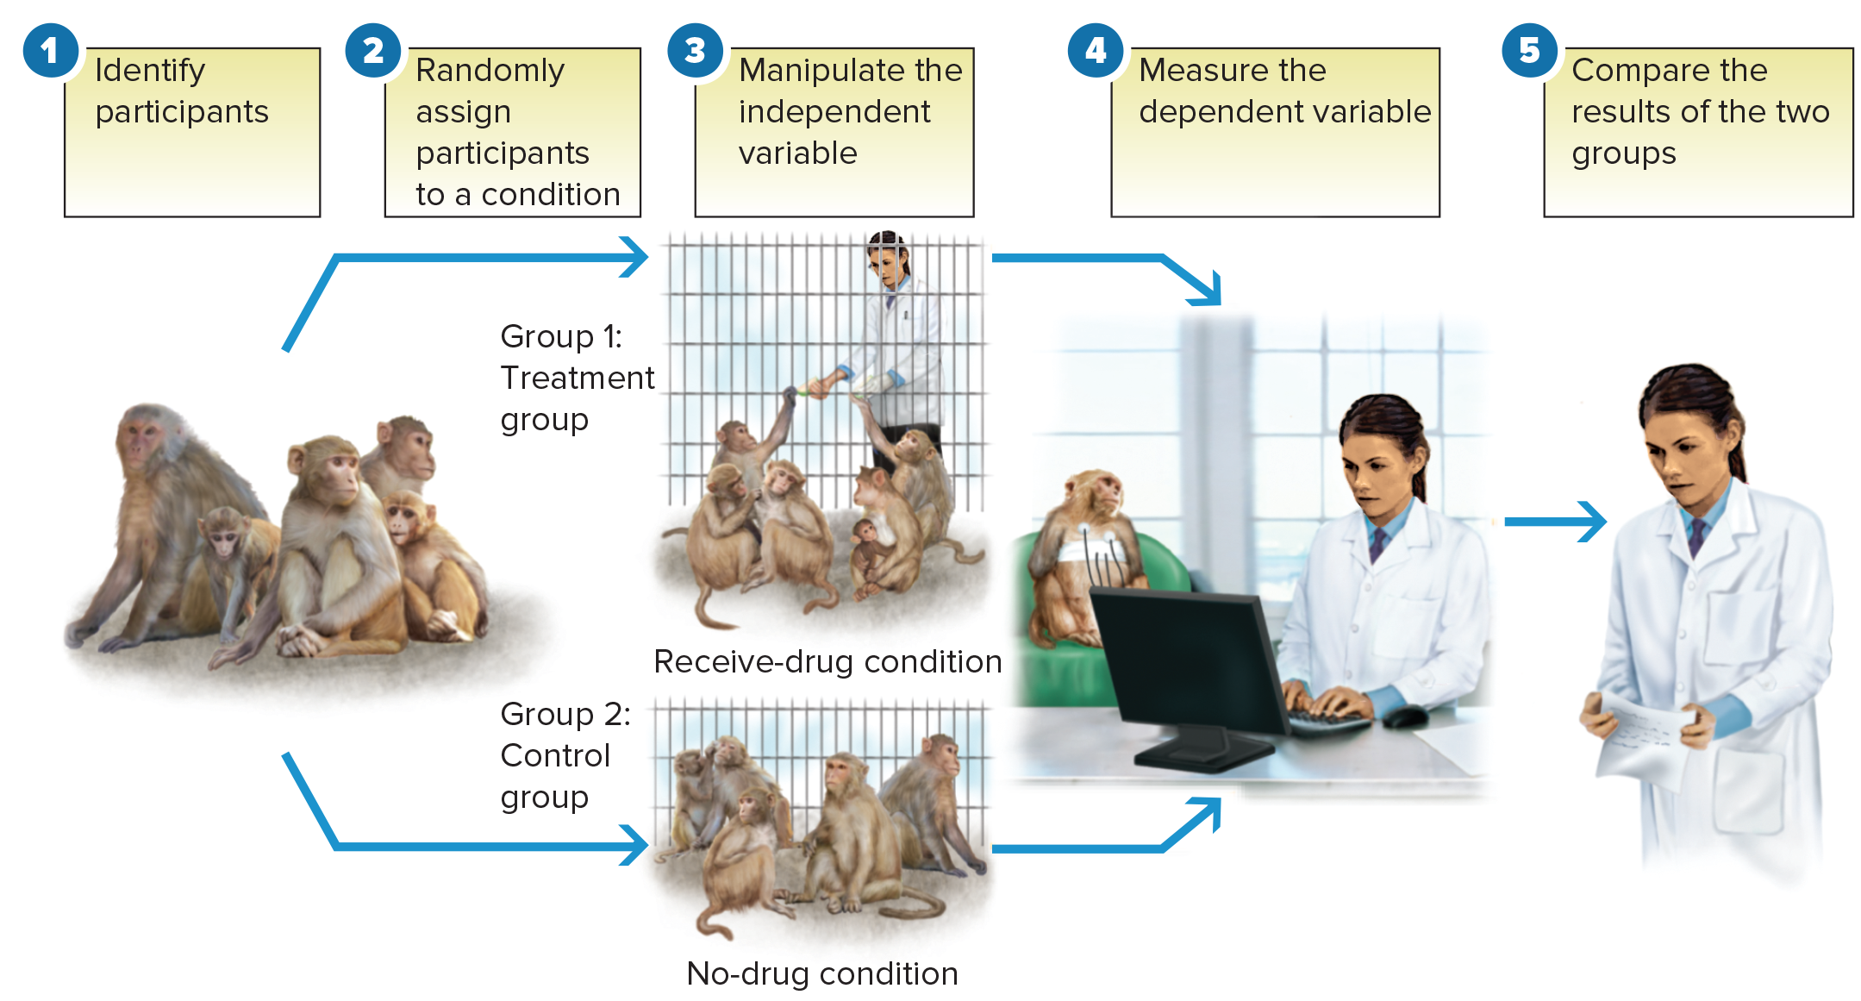
MODULE 3 FIGURE 3
In this depiction of a study investigating the effects of the drug propranolol on heart disease, we can see the basic elements of all true experiments.
Access the text alternative for slide images.
Source: Kaplan & Manuck, 1989.

Slide 33
MODULE 4—Critical Research Issues
What major issues confront psychologists conducting research?

Slide 34
The Ethics of Research 1
Guidelines that protect participants:
Protection of participants from physical and mental harm.
The right of participants to privacy regarding their behavior.
The assurance that participation in research is completely voluntary.
The necessity of informing participants about the nature of procedures before their participation in the experiment.
All experiments must be reviewed by an independent panel before being conducted.

Slide 35
The Ethics of Research 2
Informed consent: a document signed by participants affirming that they have been told about the basic outlines of the study and are aware of what their participation will involve.
Debriefing: after a participation in a study, participants receive an explanation of the study and the procedures that were involved.
The only time informed consent and debriefing can be eliminated is when risks are minimal, as in a purely observational study in a public place.

