Slide 1
Chapter 2
Neuroscience and Behavior

Slide 2
MODULE 5—Neurons: The Basic Elements of Behavior
Why do psychologists study the brain and the nervous system?
What are the basic elements of the nervous system?

Slide 3
The Structure of the Neuron 1
Behavioral neuroscientists, or biopsychologists: psychologists who specialize in considering the ways in which the biological structures and functions of the body affect behavior.
Neurons: nerve cells, the basic components of the nervous system.
Neurons have a cell body that contains a nucleus, incorporating the hereditary material that determines how a cell will function.

Slide 4
The Structure of the Neuron 2
In contrast with most other cells, neurons can:
Communicate with other cells.
Transmit information across relatively long distances.
The messages, or impulses, generally move in one direction.
Dendrites: a cluster of fibers at one end of a neuron that receives messages from other neurons.
Axon: carries messages received by the dendrites to other neurons.
Terminal buttons: the part of the axon that sends messages to other neurons.

Slide 5
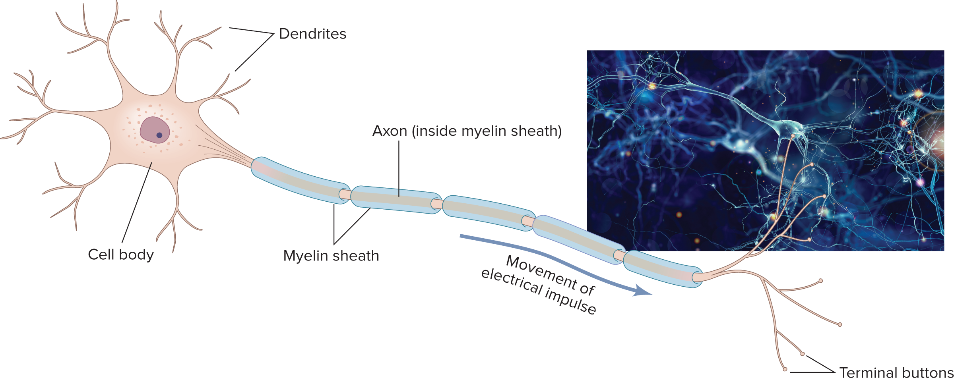
MODULE 5 FIGURE 1
The primary components of the neuron, the basic element of the nervous system. A neuron has a cell body and structures that conduct messages: the dendrites, which receive messages from other neurons, and the axon, which carries messages to other neurons or body cells. As with most neurons, this axon is protected by the sausagelike myelin sheath.
Access the text alternative for slide images.
(Photo): Whitehoune/Shutterstock

Slide 6
Mirror Neurons
Mirror neurons: specialized neurons that fire not only when a person enacts a particular behavior but also when they simply observe another individual carrying out the same behavior.
The discovery of mirror neurons suggests that humans’ capacity to imitate others may be an inborn behavior.
It also helps explain how and why humans have the capacity to understand others’ intentions.

Slide 7
Where Neurons Meet: Bridging the Gap 1
Synapse: the space between two neurons where the axon of a sending neuron communicates with the dendrites of a receiving neuron by using chemical messages.
Neurotransmitters: chemicals that carry messages across the synapse to the dendrite (and sometimes the cell body) of a receiving neuron.

Slide 8
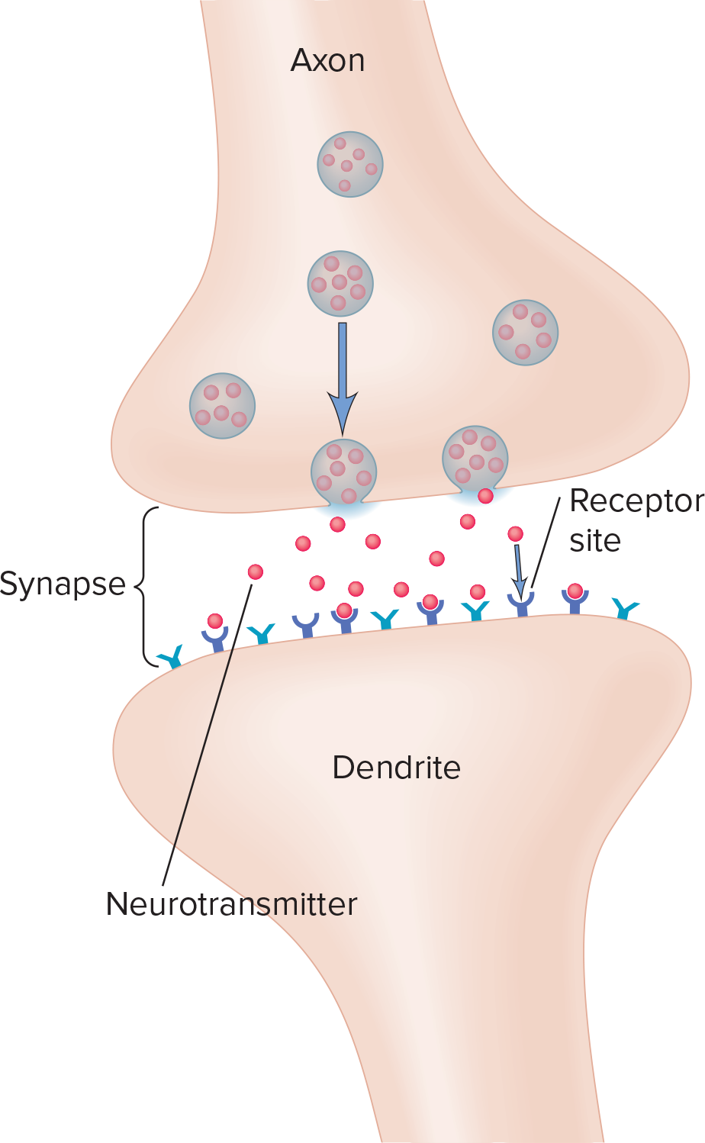
MODULE 5 FIGURE 4b
(b) Just as the pieces of a jigsaw puzzle can fit in only one specific location in a puzzle, each kind of neurotransmitter has a distinctive configuration that allows it to fit into a specific type of receptor cell (Johnson, 2000).
Access the text alternative for slide images.

Slide 9
Neurotransmitters: Multitalented Chemical Couriers
Neurotransmitters are a particularly important link between the nervous system and behavior.
Important for maintaining vital brain and body functions.
Deficiency or excess can produce severe behavior disorders.
More than a hundred chemicals have been found to act as neurotransmitters.
Neuroscientists believe that more may ultimately be identified.

Slide 10
MODULE 5 FIGURE 5: MAJOR NEUROTRANSMITTERS
Neurotransmitter Name | Location | Effect | Function
Acetylcholine (ACh) | Brain, spinal cord, peripheral nervous system, especially some organs of the parasympathetic nervous system. | Excitatory in brain and autonomic nervous system; inhibitory elsewhere. | Muscle movement, cognitive functioning.
Glutamate | Brain, spinal cord. | Excitatory. | Memory.
Gamma-amino butyric acid (G A B A) | Brain, spinal cord. | Main inhibitory neurotransmitter. | Eating, aggression, sleeping.
Dopamine (D A) | Brain. | Inhibitory or excitatory. | Movement control, pleasure and reward, attention.
Serotonin | Brain, spinal cord. | Inhibitory. | Sleeping, eating, mood, pain, depression.
Endorphins | Brain, spinal cord. | Primarily inhibitory, except in hippocampus. | Pain suppression, pleasurable feelings, appetites, placebos.
The following content is arranged like a table. Table divided into 4 columns . The column headers are marked as: "Neurotransmitter Name , Location, Effect , Function ".

Slide 11
MODULE 6—The Nervous System and the Endocrine System: Communicating Within the Body
How are the structures of the nervous system linked?

Slide 12
The Nervous System: Linking Neurons
Because each neuron can be connected to 80,000 other neurons, the total number of possible connections is enormous.
The human nervous system uses two basic structures:
Central nervous system.
Peripheral nervous system.

Slide 13
Central and Peripheral Nervous Systems 1
Central nervous system (CNS): the part of the nervous system that includes the brain and spinal cord.
Spinal cord: the bundle of neurons that leaves the brain and runs down the length of the back.
Main means for transmitting messages between the brain and the body.
Controls simple behaviors on its own, without any help from the brain.

Slide 14
Central and Peripheral Nervous Systems 2
Reflex: an automatic, involuntary response to an
incoming stimulus.
Kinds of neurons involved in reflexes:
Sensory (afferent) neurons: transmit information from the perimeter of the body to the nervous system and brain.
Motor (efferent) neurons: communicate information from the brain and nervous system to the muscles and glands.

Slide 15
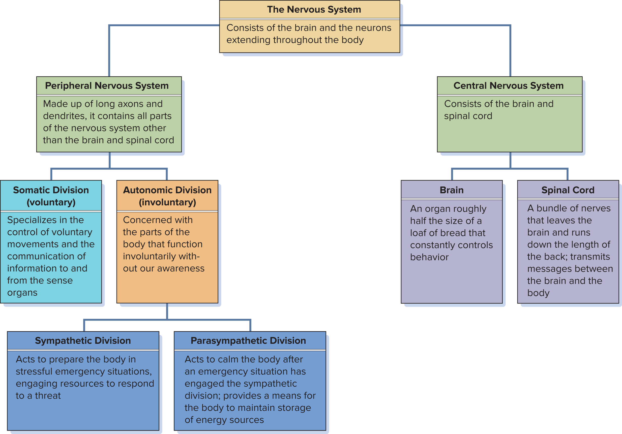
MODULE 6 FIGURE 1
A schematic diagram of the relationship of the parts of the nervous system.
Access the text alternative for slide images.

Slide 16
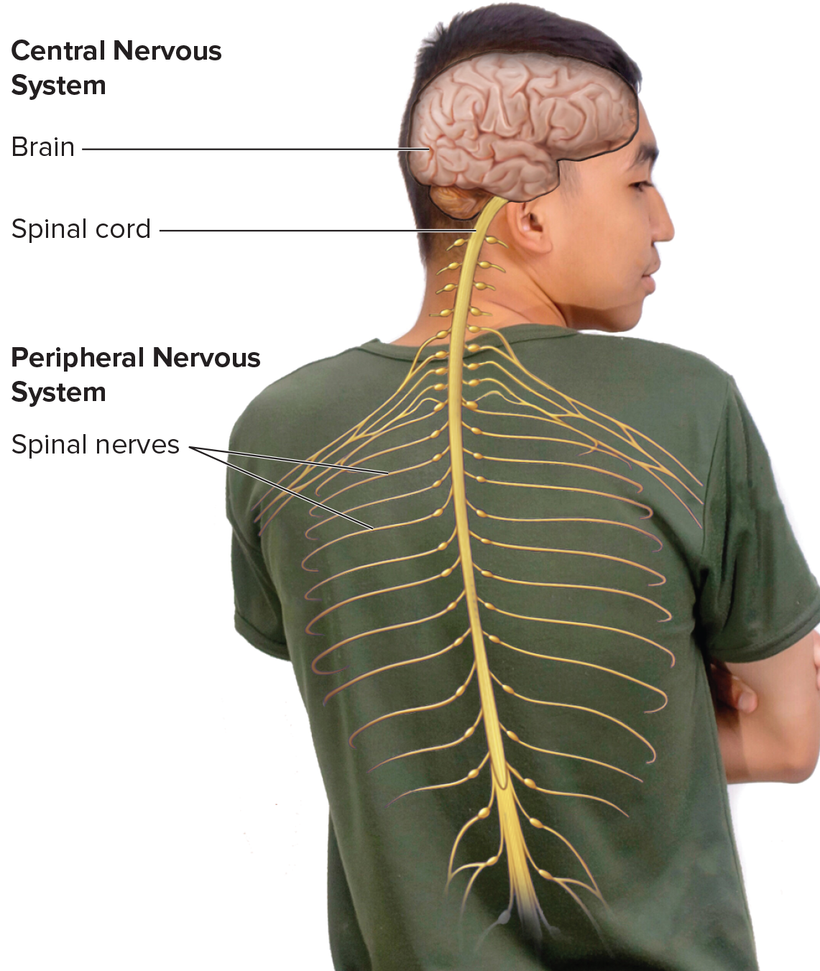
MODULE 6 FIGURE 2
The central nervous system consists of the brain and spinal cord, and the peripheral nervous system encompasses the network of nerves connecting the brain and spinal cord to other parts of the body.
Access the text alternative for slide images.
(Photo): Thiti Sukapan/Alamy Stock Photo

Slide 17
Central and Peripheral Nervous Systems 3
Peripheral nervous system: the part of the nervous system that includes the autonomic and somatic subdivisions.
Made up of neurons with long axons and dendrites, it branches out from the spinal cord and brain and reaches the extremities of the body.
Somatic division: specializes in the control of voluntary movements and the communication of information to and from the sense organs.
Autonomic division: controls the involuntary movement of the heart, glands, lungs, and other organs.

Slide 18
Activating the Divisions of the Autonomic Nervous System
The autonomic division is further subdivided:
Sympathetic division: prepares the body for action in stressful situations, engaging all the organism’s resources to respond to a threat.
Often called the “flight-or-fight” response.
Parasympathetic division: acts to calm the body after an emergency has ended.
The sympathetic and parasympathetic divisions work together to regulate many functions of the body.

Slide 19
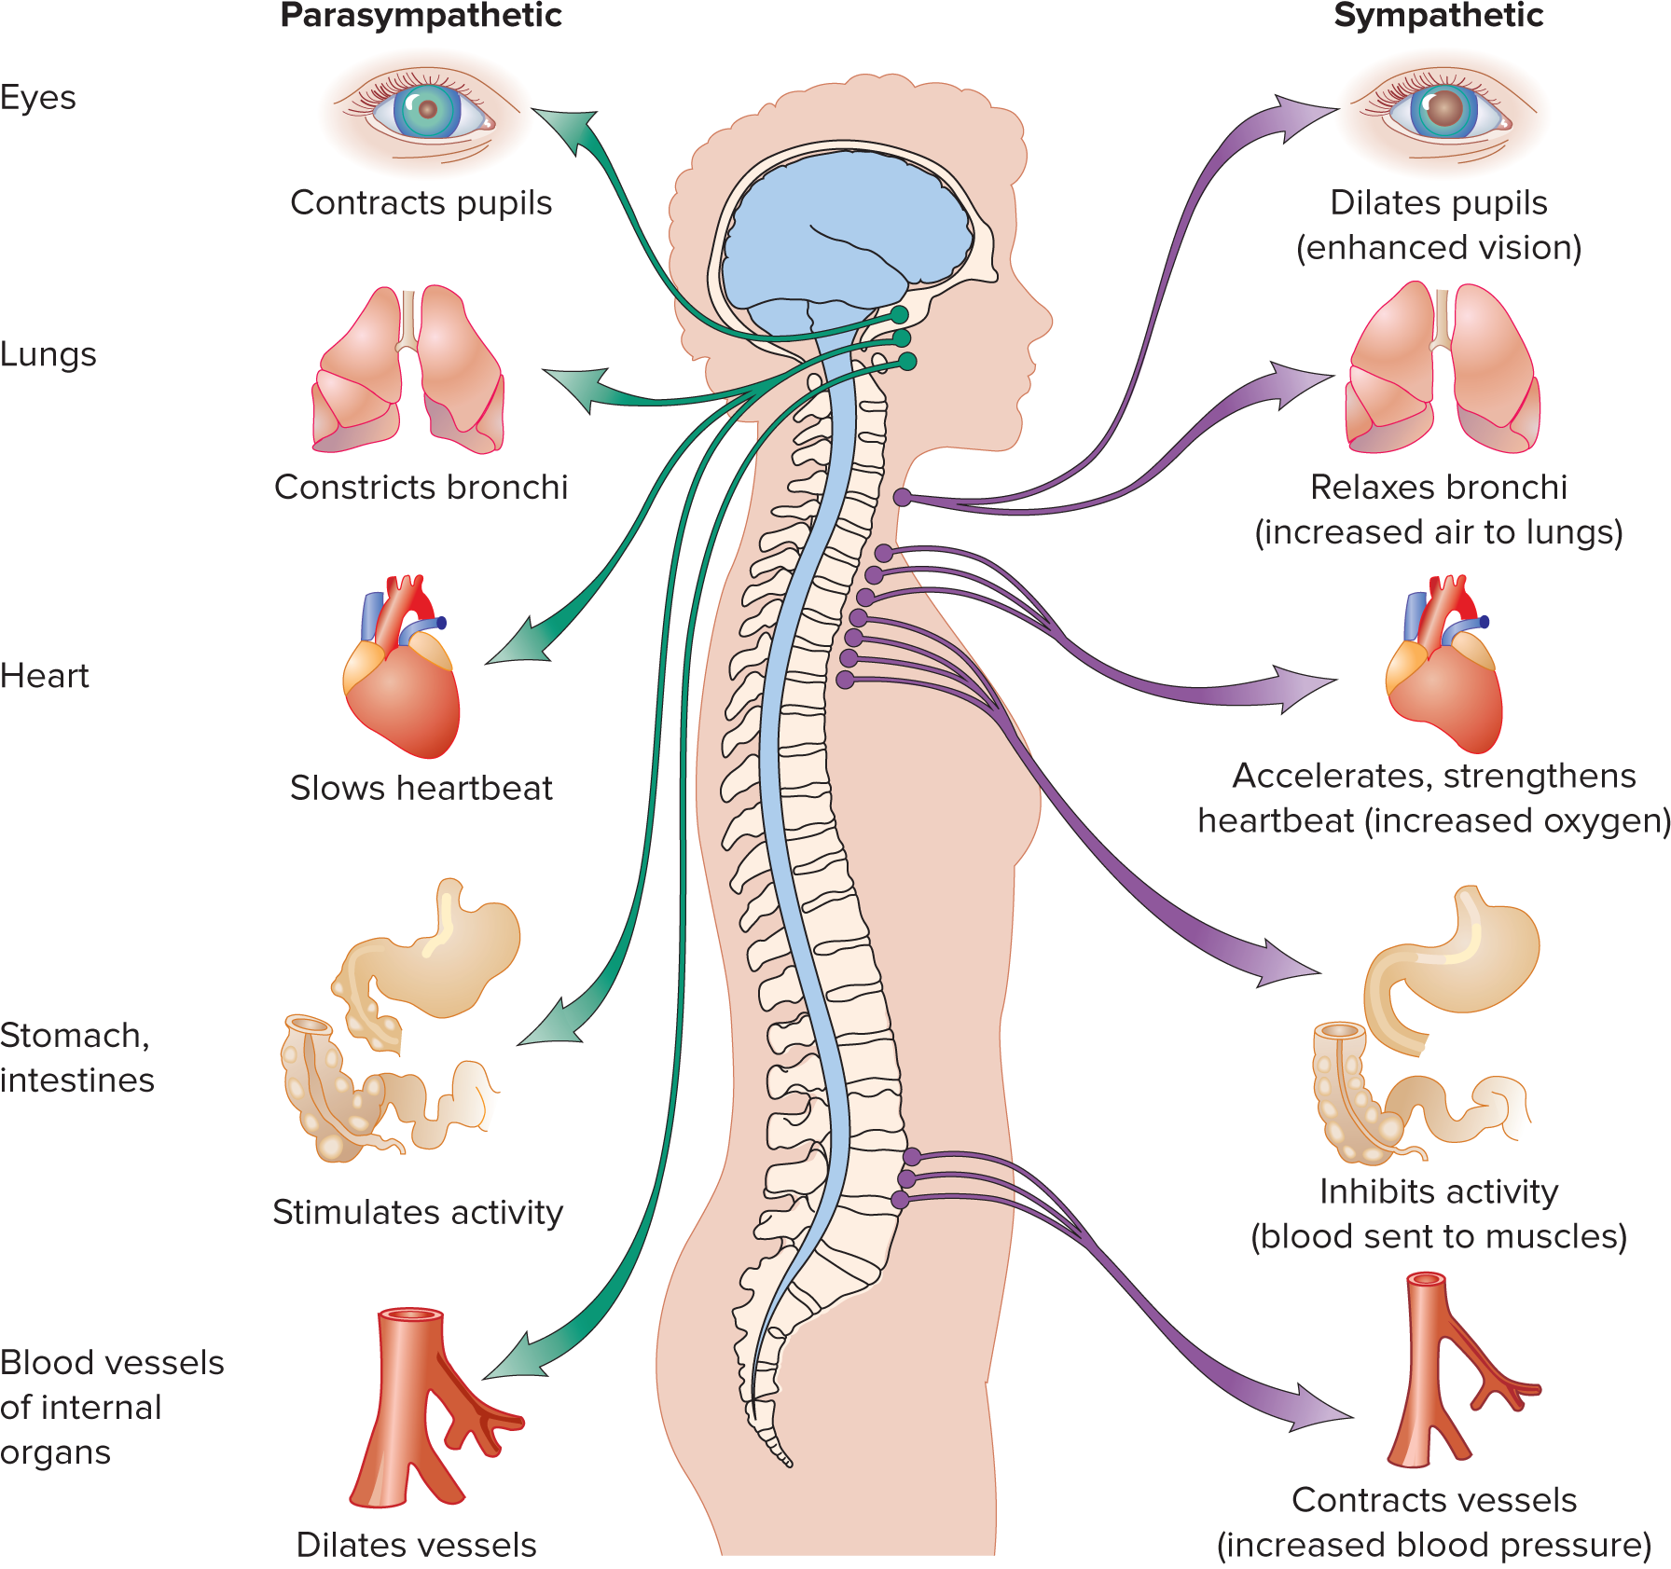
MODULE 6 FIGURE 3
The major functions of the autonomic nervous system. The sympathetic division acts to prepare certain organs of the body for stressful situations, and the parasympathetic division acts to calm the body after the emergency has passed.
Access the text alternative for slide images.

Slide 20
Neuroplasticity and the Brain
Neuroplasticity: the brain’s ability to change throughout the life span through the addition of new neurons, new interconnections between neurons, and the reorganization of information-processing areas.
Neurogenesis, the creation of new neurons, is now known to occur in certain areas of the brain in adulthood.

