Slide 1
Chapter 4
States of Consciousness

Slide 2
MODULE 12—Sleep and Dreams
What are the different states of consciousness?
What happens when we sleep, and what are the meaning and function of dreams?
What are the major sleep disorders, and how can they be treated?

Slide 3
Consciousness
Consciousness: the awareness of the sensations, thoughts, and feelings being experienced at a given moment.
In waking consciousness, we are awake and aware.
All other states of consciousness are considered altered states of consciousness.
  Sleeping and dreaming occur naturally.
  Drug use and hypnosis are methods of deliberately altering one’s state of consciousness.

Slide 4
The Stages of Sleep
Stage 1 sleep: the state of transition between wakefulness and sleep.
  Characterized by relatively rapid, low-amplitude brain waves.
Stage 2 sleep: a sleep deeper than that of stage 1.
  Characterized by a slower, more regular wave pattern.
  Includes momentary interruptions of “sleep spindles.”
Stage 3 sleep: the deepest stage of sleep, during which we are least responsive to outside stimulation.

Slide 5
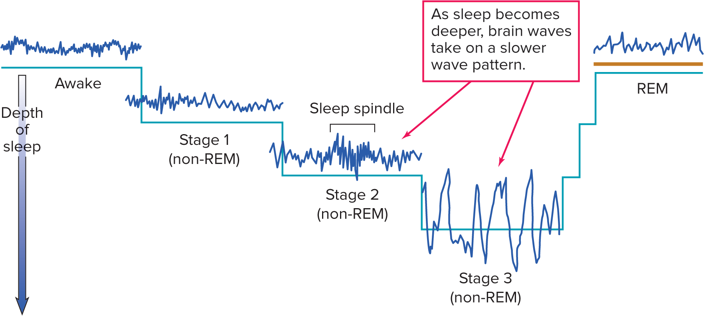
MODULE 12 FIGURE 2
Brain-wave patterns (measured by an E E G apparatus) vary significantly during the different stages of sleep. As sleep moves from stage 1 through stage 3, brain waves become slower. During R E M sleep, however, the fast wave patterns are similar to relaxed wakefulness.
Access the text alternative for slide images.
Sources: Hobson, 2007 and Jawabri & Raja, 2021.

Slide 6
R E M Sleep: The Paradox of Sleep
Rapid eye movement, or R E M, sleep: the period of sleep characterized by quick, back-and-forth eye movements.
  Increased heart rate, blood pressure, and breathing rate.
  Experience of dreaming is more likely.
R E M sleep may play a role in learning and memory.
  Allows us to rethink and restore information and emotional experiences.

Slide 7
Why Do We Sleep, and How Much Sleep Is Necessary? 1
Sleep is a requirement for normal human functioning.
Today, scientists suggest four reasons why sleep is a requirement for life:
  Conserve energy at night.
  Restoration and replenishment for the brain and body.
  Reverse learning: eliminating unnecessary information that accumulates throughout the day.
  Assists physical growth and brain development in children.

Slide 8
Why Do We Sleep, and How Much Sleep Is Necessary? 2
Most people sleep between 7 and 8 hours per night.
  Individuals vary widely, but for most, the more sleep they get, the greater their sense of well-being.
  Sleep patterns differ between men and women.
Sleep deprivation experiments:
  Weariness, irritability, difficulty concentrating, loss of creativity, even after only mild deprivation.
  There are typically no lasting effects, rebounding after a few days of regular sleep.

Slide 9
Psychoanalytic Explanations of Dreams
Unconscious wish fulfillment theory: Sigmund Freud’s theory that dreams represent unconscious wishes that dreamers desire to see fulfilled.
For Freud, the manifest content—what we remember and report—disguises the latent content, our actual underlying wishes.

Slide 10
Neuroscience Explanations of Dreams
Activation-synthesis theory: Hobson’s theory that the brain produces random electrical energy during R E M sleep that stimulates memories stored in the brain.

Slide 11
Sleep Disturbances
At one point or another, almost every person has difficulty sleeping—known as insomnia.
  Unable to fall asleep easily; or frequent waking.
  More common in women and older adults.
  Research has also found racial disparities in insomnia.
Some people who think they have sleeping problems are actually mistaken.
Sleep apnea: the person has difficulty breathing while sleeping.
  Lack of oxygen triggers a waking response.
  In infants, may play a role in sudden infant death syndrome, or S I D S, sometimes called sudden unexpected infant death (SUID).

Slide 12
Sleep Disturbances: Slumbering Problems 2
Night terrors: sudden awakenings from non-R E M sleep accompanied by extreme fear, panic, and strong physiological arousal.
Narcolepsy: uncontrollable sleeping for short periods while a person is awake.
Sleeptalking and sleepwalking are usually harmless.
  Occur during stage 3 sleep.
  More common in children.

Slide 13
MODULE 14—Drug Use: The Highs and Lows of Consciousness
What are the major classifications of drugs, and what are their effects?

Slide 14
Drugs 1
Psychoactive drugs: those that influence a person’s emotions, perceptions, and behavior.
  Vary widely in their effects.
  Affect the nervous system in very different ways.

Slide 15
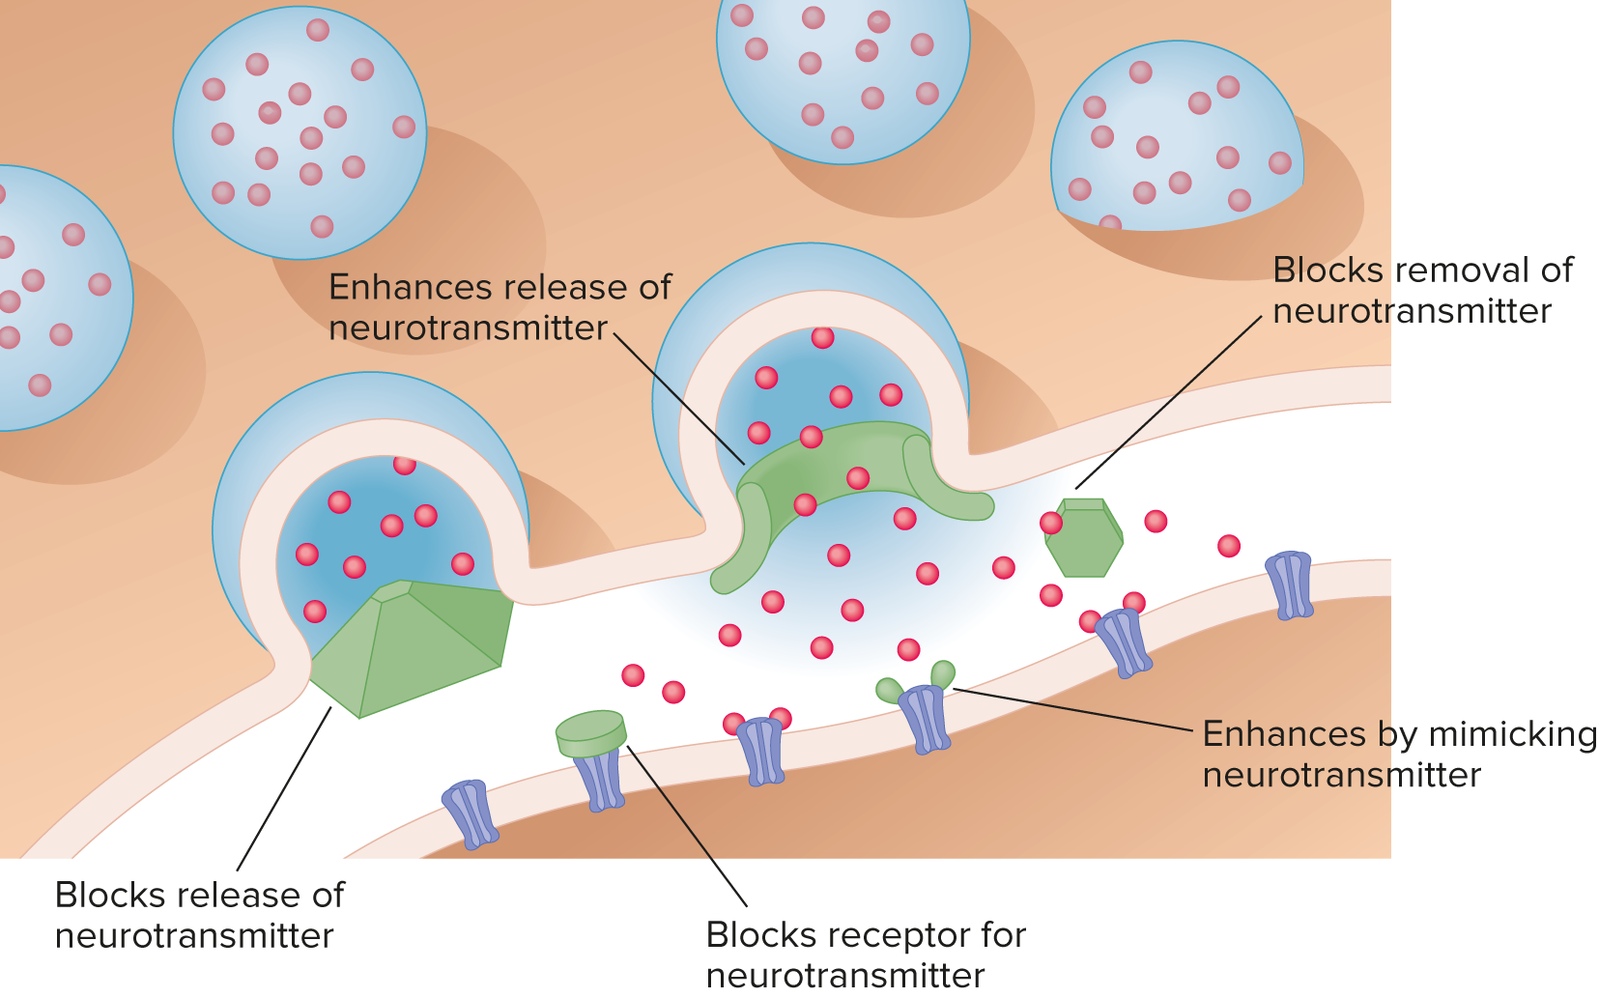
MODULE 14 FIGURE 2
Different drugs affect different parts of the nervous system and brain, and each drug functions in one of these specific ways.
Access the text alternative for slide images.

Slide 16
Drugs 2
Addictive drugs: those that produce a biological or psychological dependence in the user.
Tolerance: Requiring higher doses of drugs for the same effect.
  Withdrawal from them leads to a craving for the drug that, in some cases, may be nearly irresistible.
  In biological drug dependence, the body cannot function without it.
  In psychological drug dependence, people believe they need the drug to respond to daily stress.
Pleasure, escape, peer pressure, and genetics are among the factors that lead people to take drugs.

Slide 17
Stimulants: Drug Highs
Stimulants: drugs that have an arousal effect on the central nervous system.
  Cause a rise in heart rate, blood pressure, and muscular tension.
Caffeine produces several reactions, and individuals can build up a biological dependence.
Nicotine is found in cigarettes, and smokers develop a dependence.

Slide 18
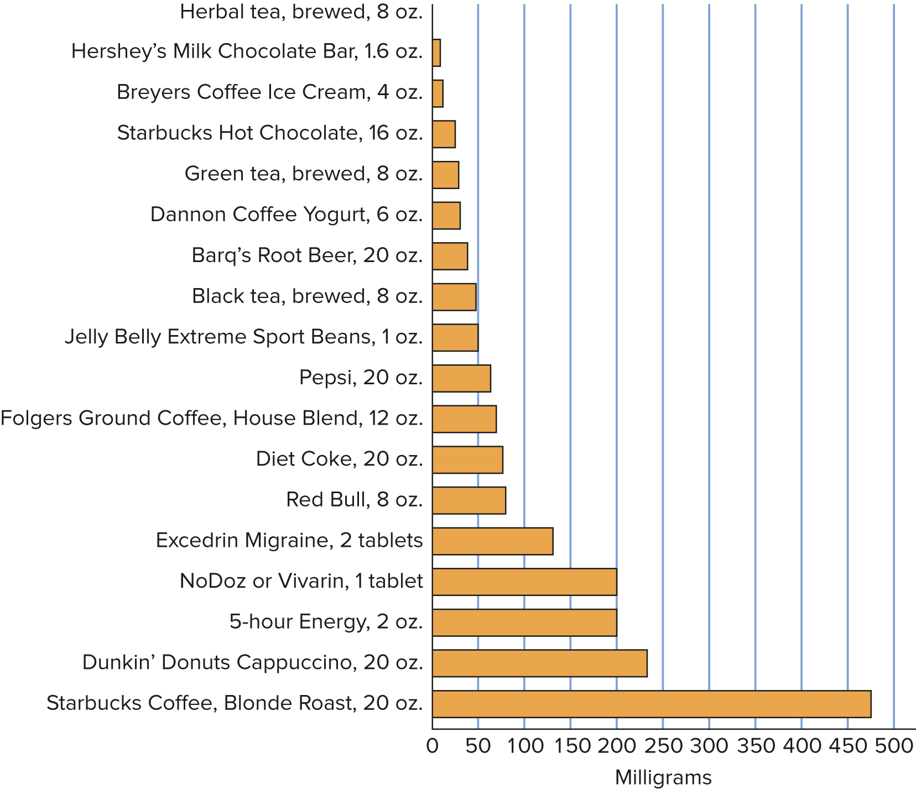
MODULE 14 FIGURE 3
This chart shows the range of caffeine found in common foods, drinks, and legal drugs.
Access the text alternative for slide images.
Source: Center for Science in the Public Interest, n.d.

Slide 19
Amphetamines
Amphetamines, such as those popularly known as speed, have several effects.
Methamphetamine, or “meth,” is a white, crystalline drug that produces a strong, lingering high.
  Long-term use can lead to brain damage.
Adderall was developed to help those who suffer from A D H D, but it is often abused.
Bath salts are an amphetamine-like stimulant that can produce euphoria but also paranoia and agitation.

Slide 20
Cocaine
The stimulant cocaine, and its derivative crack, is rapidly absorbed into the body and takes effect almost immediately.
  Acts on the neurotransmitter dopamine.
  Can rewire the brain and create psychological and physical addiction.
  Over time, users deteriorate mentally and physically.
  Ultimately, overdose can lead to death.

Slide 21
Depressants: Drug Lows
Depressants: drugs that slow down the nervous system.
Small doses result in at least temporary feelings of intoxication—drunkenness—along with euphoria.
With large doses, speech becomes slurred, motion becomes difficult, and users may lose consciousness.

Slide 22
Alcohol 1
The most common depressant is alcohol, used by more people than any other drug.
One trend is the high frequency of binge drinking.
  Five or more drinks in one sitting for men.
  Four or more drinks in one sitting for women.
Women are typically lighter drinkers than men; and there are cultural and ethnic differences in alcohol consumption.

Slide 23
Barbiturates
Barbiturates are a form of central nervous system depressant.
  They produce a sense of relaxation and are frequently prescribed by physicians.
  At larger doses, they produce altered thinking, faulty judgment, and sluggishness.
  When combined with alcohol, they can be deadly.

Slide 24
Narcotics, Opiates, and Opioids: Relieving Pain and Anxiety 1
Narcotics: drugs that increase relaxation and relieve pain and anxiety.
  Two of the most powerful are morphine and heroin, both derived from the poppy seed pod.
  Heroin users usually inject the drug and experience a “rush” in some ways similar to orgasm.
Opiates refer to narcotics derived from natural substances—morphine, heroin, and codeine.

Slide 25
Hallucinogens: Psychedelic Drugs 1
Hallucinogens: drugs that are capable of producing alterations in perception, thoughts, and feelings.
Marijuana is the most common hallucinogen in widespread use today.
  Heavy use may have long-term negative effects; it can have effects on children exposed prenatally; and smoking it damages the lungs.
  It has several medical uses and is increasingly being made legal both for medical uses and as a recreational drug.

Slide 26
Hallucinogens: Psychedelic Drugs 2
M D M A (Ecstasy or Molly) produces feelings of increased energy, euphoria, and empathy; but may contribute to memory and intellectual problems.
L S D produces vivid hallucinations and is one of the most powerful mind-altering chemicals.
  Experiences can be terrifying.
  Flashbacks may occur long after use of the drug.
  .

