Slide 1
Chapter 6
Memory

Slide 2
MODULE 18—The Foundations of Memory
What is memory?
Are there different kinds of memory?
What are the biological bases of memory?

Slide 3
The Foundations of Memory
Memory: the process by which we encode, store, and retrieve information.
Encoding: recording information in a form usable to memory.
Storage: the maintenance of material saved in memory.
Retrieval: locating material and bringing it into awareness so that it can be used.

Slide 4
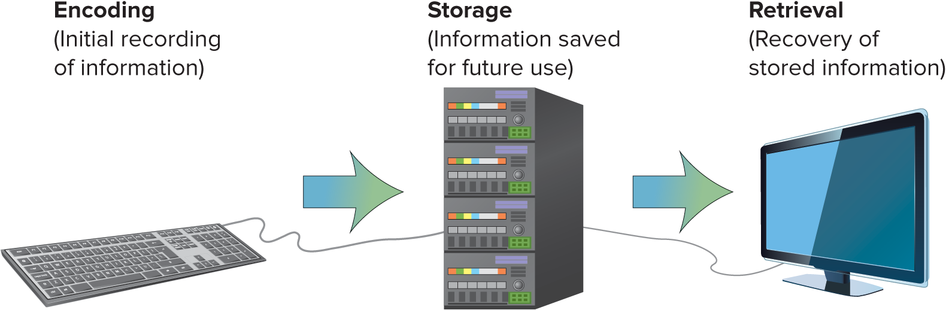
MODULE 18 FIGURE 1
Memory is built on three basic processes—encoding, storage, and retrieval—that are analogous to a computer’s keyboard, hard drive, and software to access the information for display on the screen. The analogy is not perfect; however, because human memory is less precise than a computer.
Access the text alternative for slide images.

Slide 5
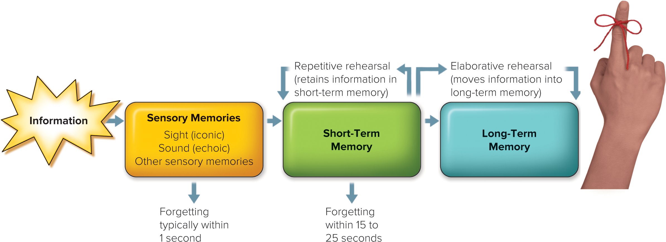
MODULE 18 FIGURE 2
In this three-stage model of memory, information initially recorded by the person’s sensory system enters sensory memory, which momentarily holds the information. The information then moves to short-term memory, which stores it for 15–25 seconds. Finally, the information can move into long-term memory, which is relatively permanent. Whether the information moves from short-term to long-term memory depends on the kind and amount of rehearsal of the material that is performed.
Access the text alternative for slide images.
(Photo): Squared Studios/Getty Images

Slide 6
Sensory Memory
Sensory memory: the initial, momentary storage of information, lasting only an instant.
The first storehouse of information.
Operates as a kind of snapshot that stores information for a brief moment in time.
Iconic memory reflects information from the visual system.
Echoic memory stores auditory information coming from the ears.
If sensory memory does not pass into short-term memory, it is lost for good.

Slide 7
Short-Term Memory
Short-term memory: memory that holds information for 15–25 seconds.
We can hold up to seven items, or “chunks,” of information in short-term memory, with variations up to plus or minus 2 chunks.
Chunk: a group of separate pieces of information stored as a single unit in short-term memory.
For example: P B S F O X C N N A B C C B S M T V N B C can be chunked as PBS, F O X, CNN, ABC, CBS, MTV, NBC.

Slide 8
Rehearsal
Rehearsal: the repetition of information that has entered short-term memory.
Maintains information in short-term memory when repeated.
Allows transfer of information into long-term memory.
Elaborative rehearsal occurs when information is considered and organized in some fashion.
Mnemonics are strategies for organizing information in a way that makes it more likely to be remembered.

Slide 9
Working Memory 1
Working memory: a memory system that holds information temporarily while actively manipulating and rehearsing that information.
It contains a central executive processor that is involved in reasoning, decision making, and planning.
It also has three subsystems:
The visual store;
The verbal store; and
The episodic buffer—which contains information that represents events and occurrences.

Slide 10
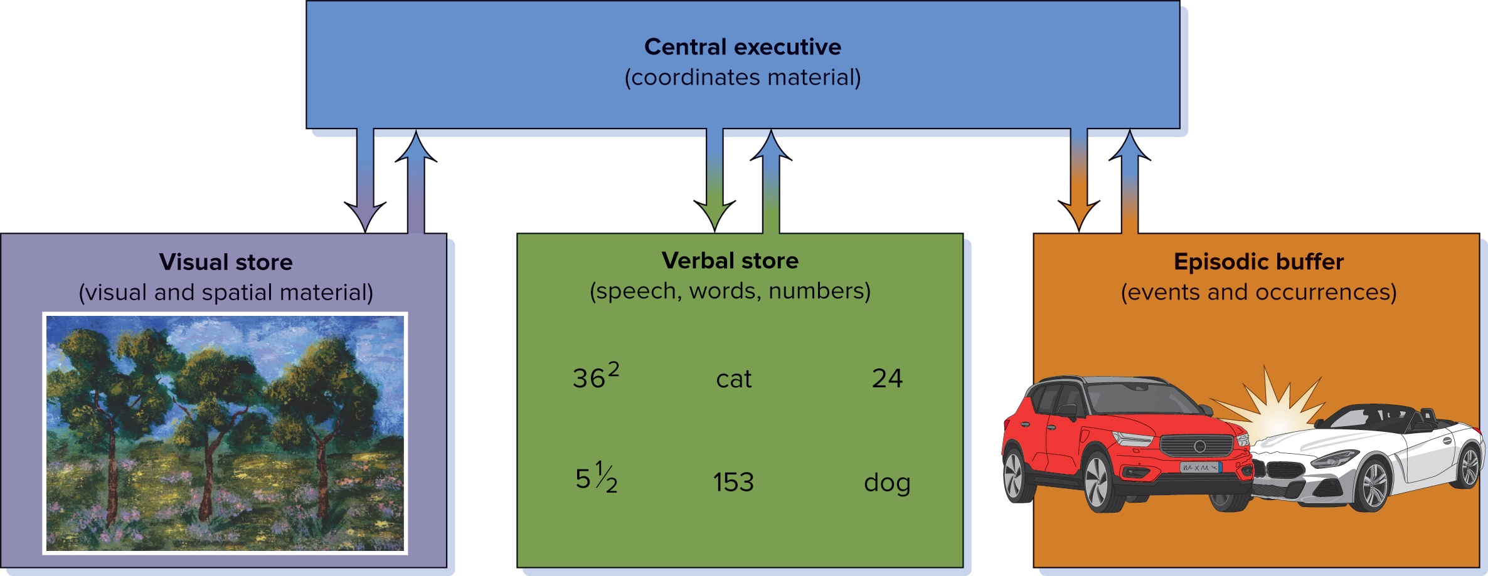
MODULE 18 FIGURE 4
Working memory is an active “workspace” in which information is retrieved and manipulated and in which information is held through rehearsal. Working memory includes a central executive processor that coordinates the visual store, verbal store, and episodic buffer.
Access the text alternative for slide images.
Source: Adapted from Lexcellent, 2019.

Slide 11
Working Memory 2
Working memory allows us to keep information in an active state so we can do something with it.
As it processes information, it uses cognitive resources; and the number of chunks that can be held and processed is limited.
Finally, stress can reduce the capacity of working memory.

Slide 12
Long-Term Memory
Long-term memory: stores information on a relatively permanent basis, although it may be difficult to retrieve.
Almost unlimited capacity.
Evidence for long-term memory:
People with certain kinds of brain damage may have poor memory performance.
Results of laboratory memory studies.
The ability to recall information in a list depends on where in the list an item appears.
Primacy effect: best remembered are items that come early.
Recency effect: best remembered are items presented late.

Slide 13
Long-Term Memory Modules
As with short-term memory, long-term memory appears to have several components.
Declarative memory: refers to factual information; it is sometimes called explicit memory, and is further subdivided into:
Semantic memory: for general knowledge; and
Episodic memory: for events that occur in a particular time, place, or context.
In contrast with declarative memory, procedural memory refers to memory for skills and habits.
Also referred as nondeclarative memory or implicit memory.

Slide 14
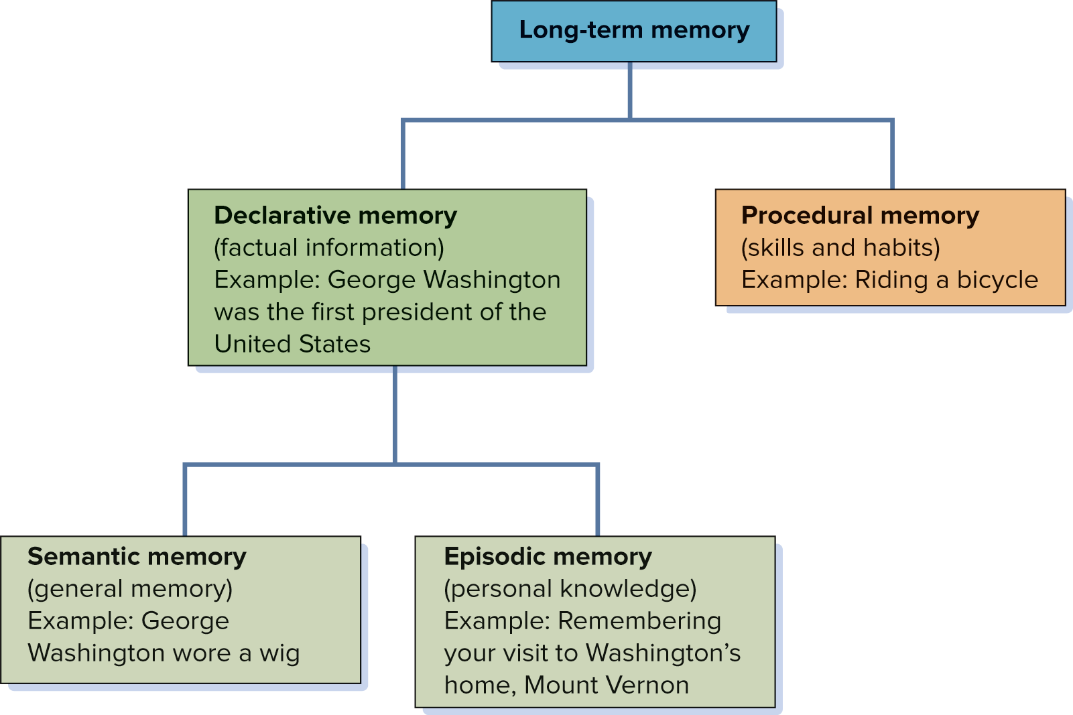
MODULE 18 FIGURE 5
Long-term memory can be subdivided into several types. What type of long-term memory is involved in your recollection of the moment you first arrived on your campus at the start of college? What type of long-term memory is involved in remembering the lyrics to a song, compared with the tune of a song?
Access the text alternative for slide images.

Slide 15
Semantic Networks
Semantic networks: mental representations of clusters of interconnected information.
Activating one memory triggers the activation of related memories in a process known as spreading activation.

Slide 16
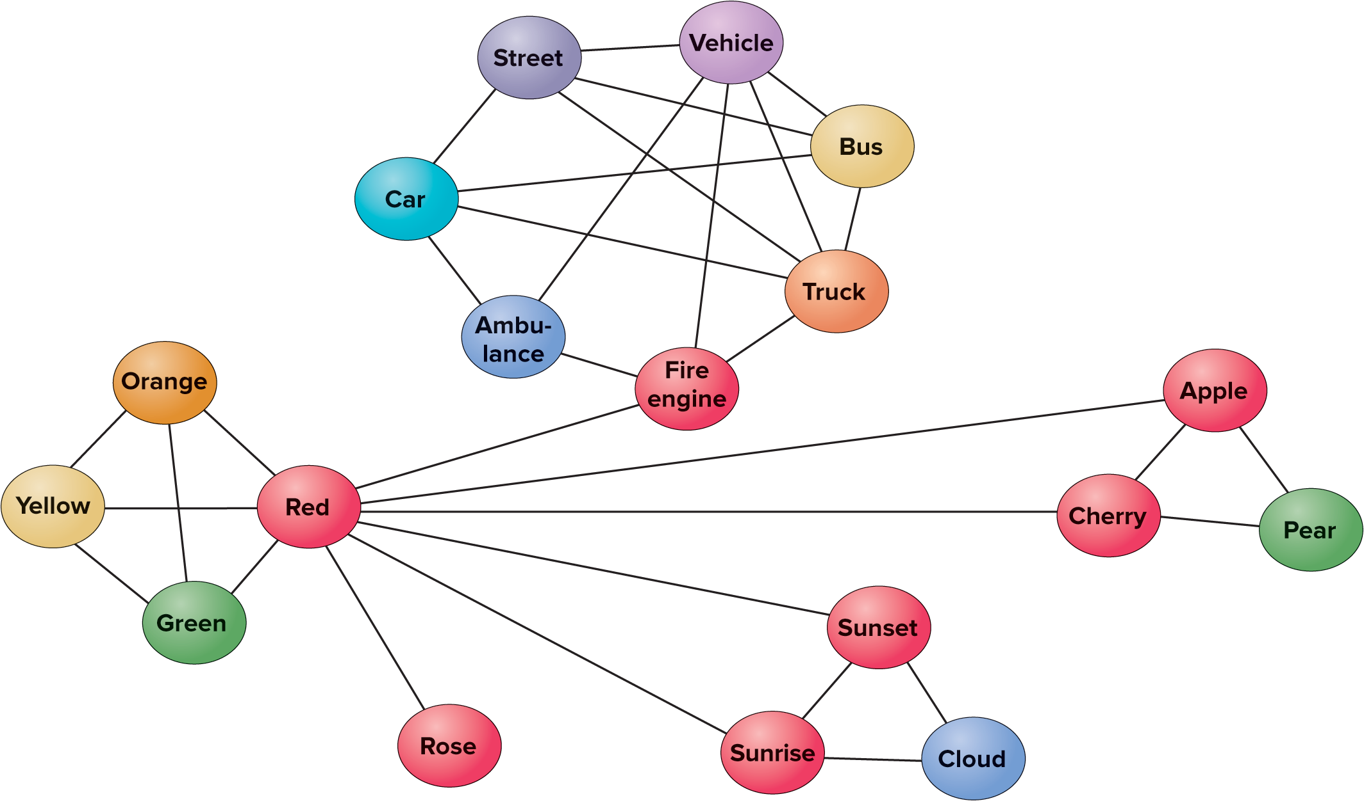
MODULE 18 FIGURE 6
Semantic networks in memory consist of relationships between pieces of information, such as those relating to the concept of a fire engine. The lines suggest the connections that indicate how the information is organized within memory. The closer together two concepts are, the greater the strength of the association.
Access the text alternative for slide images.
Source: Adapted from Lexcellent, 2019.

Slide 17
The Neuroscience of Memory 1
Engram: the physical memory trace in the brain that corresponds to a memory.
Hippocampus: a part of the brain’s limbic system, it plays a central role in the consolidation of memories.
Amygdala: a part of the brain’s limbic system, it is involved with memories involving emotion.

Slide 18
MODULE 19—Recalling Long-Term Memories
What causes difficulties and failures in remembering?

Slide 19
Memory Tasks
One common occurrence is the tip-of-the-tongue phenomenon: the temporary inability to recall information that one is certain one knows.
It occurs as a result of the difficulty of retrieving information from long-term memory.
Retrieval cues are stimuli that allow us to more easily recall information that is in long-term memory.
Recall: memory task in which specific information must be retrieved.
Recognition: memory task in which individuals are presented with a stimulus and asked whether they have been exposed to it in the past or to identify it from a list of alternatives.

Slide 20
Levels of Processing
Levels-of-processing theory: a theory of memory that emphasizes the degree to which new material is mentally analyzed.
At shallow levels, information is processed merely in terms of its physical and sensory aspects.
At the deepest level of processing, information is analyzed in terms of its meaning.

Slide 21
Explicit and Implicit Memory
Explicit memory: intentional or conscious recollection of information.
Implicit memory: memories of which people are not consciously aware.
Can affect subsequent performance and behavior.
Closely related to the prejudice and discrimination people can exhibit without being aware of their underlying beliefs.
Priming: occurs when exposure to a word or concept (called a prime) later makes it easier to recall related information.

Slide 22
Flashbulb Memories
Flashbulbs memories: memories of a specific, important, or surprising emotionally significant event that are recalled easily and with vivid imagery.
Source amnesia occurs when an individual has a memory for some material but cannot recall where they encountered it.

Slide 23
Autobiographical Memory
Autobiographical memory: our recollection of our own life experiences.
Encompasses episodic memories we hold about ourselves.
The same constructive processes that make us inaccurately recall the behaviors of others also reduce the accuracy of autobiographical memories.
We tend to forget information that is incompatible with the way in which we currently see ourselves.
Particular periods of life are remembered more easily than others: In late adulthood, people tend to best remember the periods in which they experienced major transitions.

Slide 24
MODULE 20—Forgetting: When Memory Fails
Why do we forget information?
What are the major memory impairments?

Slide 25
Memory Failures
There are benefits to forgetting.
Memory failure is essential to remembering important information.
Forgetting helps keep unwanted information from interfering with retrieving information that is wanted.
Forgetting also permits us to form general impressions and recollections.
Forgetting forces our brain to relearn and remember better in the future.

Slide 26
Why We Forget
One reason we forget is a failure of encoding.
We may not have paid attention in the first place.
When material has been encoded, failures may be cases of decay, interference, or cue-dependent forgetting.
Decay: the loss of information through its nonuse.
Assumes that memory traces, the physical changes when new material is learned, simply disintegrate over time.
Interference: information in memory disrupts the recall of other information.
Cue-dependent forgetting: occurs when a person has insufficient retrieval cues to rekindle information in memory.

Slide 27
Proactive and Retroactive Interference: The Before and After of Forgetting
Proactive interference: information learned earlier disrupts the recall of newer material and progresses in time.
Retroactive interference: material that was learned later disrupts the retrieval of information that was learned earlier and retrogresses in time.
Proactive interference progresses in time; retroactive interference retrogresses in time, working backward.

Slide 28
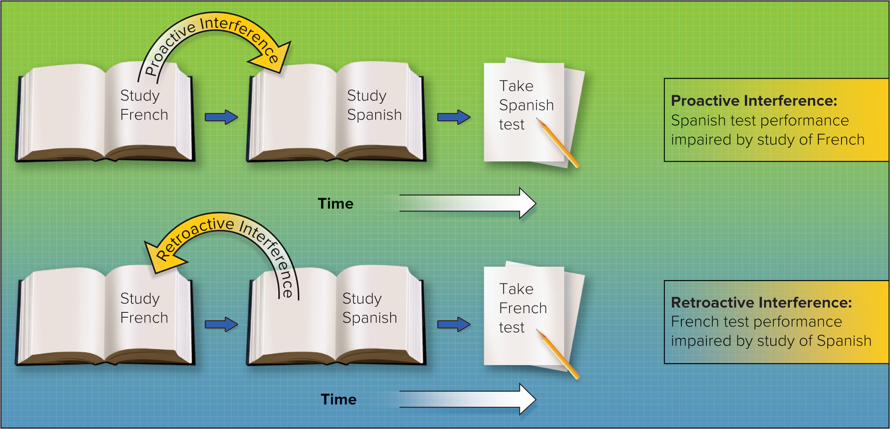
MODULE 20 FIGURE 3
Proactive interference occurs when material learned earlier interferes with the recall of newer material. In this example, studying French before studying Spanish interferes with performance on a Spanish test. In contrast, retroactive interference exists when material learned after initial exposure to other material interferes with the recall of the first material. In this case, retroactive interference occurs when recall of French is impaired because of later exposure to Spanish.
Access the text alternative for slide images.

Slide 29
Memory Dysfunctions: Afflictions of Forgetting
Alzheimer’s disease: a progressive brain disorder that leads to a gradual and irreversible decline in cognitive abilities.
Sixth-leading cause of death among adults in the United States.
Older non-Hispanic blacks and Hispanic Americans are more likely to have Alzheimer’s than older whites to have Alzheimer’s disease.
Amnesia: memory loss without other mental difficulties.
Retrograde amnesia: memory is lost for occurrences prior to a certain event, but not for new events.
Anterograde amnesia: memory is lost for events that follow an injury.
Wernicke–Korsakoff’s syndrome: a disease that afflicts long-term alcoholics.
Includes memory loss, hallucinations, and tendency to repeat stories.

