Slide 1
Chapter 7
Thinking and Intelligence

Slide 2
MODULE 21—Thinking
What is thinking?
What processes underlie reasoning and decision making?
How do people approach and solve problems?
What are the major obstacles to problem solving?

Slide 3
Cognitive Psychology
Cognitive psychology: the branch of psychology that focuses on the study of higher mental processes.
Thinking.
Language.
Memory.
Problem solving.
Knowing.
Reasoning.
Judging.
Decision making.

Slide 4
Thinking
No other species contemplates, analyzes, recollects, or plans the way humans do.
Thinking: brain activity in which people mentally manipulate information including words, visual images, sounds, or other data.

Slide 5
Mental Images: Examining the Mind’s Eye
Mental images: representations in the mind of an object or event.
Every sensory modality produces corresponding mental images.
Mental images have properties of the actual stimuli they represent.
Production of mental images improves various skills.
Example: athletic training.

Slide 6
Concepts: Categorizing the World
Concepts: the mental groupings of similar objects, events, or people.
Enable us to organize complex phenomena into cognitive categories that are easier to understand and remember.

Slide 7

Algorithms and Heuristics
Algorithms: a rule that, if applied appropriately, guarantees a solution to a problem.
Example:
Heuristic: a thinking strategy that may lead to a solution but may sometimes lead to errors.
Availability heuristic: we judge the likelihood of an event occurring on the basis of how easily we can bring to mind examples of the event.
Familiarity heuristic: leads us to prefer familiar objects, people, and things to those that are unfamiliar or strange to us.
Present bias: the tendency to more heavily weigh options that are closer to the present than ones further away.

Slide 8
Solving Problems
The way people go about solving puzzles helps illuminate how people solve complex, real-life problems.
Psychologists have found that problem solving typically involves three steps:
Preparing to create solutions;
Producing solutions; and
Evaluating the solutions that have been generated.

Slide 9
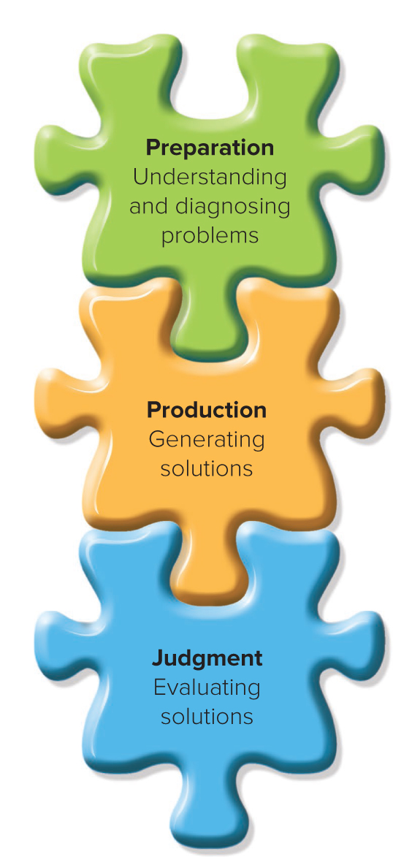
MODULE 21 FIGURE 4
Steps in problem solving.
Access the text alternative for slide images.

Slide 10
Preparation: Understanding and Diagnosing Problems
Well-defined problem: the nature of the problem and the information needed to solve it are available and clear.
Ill-defined problem: the nature of the problem and the information needed to solve it are unclear.

Slide 11
Production: Generating Solutions 1
In place of trail and error, complex problem solving often involves the use of heuristics and cognitive shortcuts that generate solutions.
Means–ends analysis: a strategy in which a problem solver considers the ultimate goal (the end) and determines the best strategy for attaining the goal.
Each step brings the problem solver closer to a resolution.
Another heuristic commonly used is to divide a problem into subgoals, and then solve each of those steps.

Slide 12
Production: Generating Solutions 2
Insight: a sudden awareness of the relationships among various elements that had previously appeared to be unrelated to one another.
The phenomenon was demonstrated in a classic study by psychologist Wolfgang Köhler, who examined learning and problem-solving processes in chimpanzees.
Subsequent research has shown that prior experience
and trial-and-error practice in problem solving must precede “insight.”

Slide 13
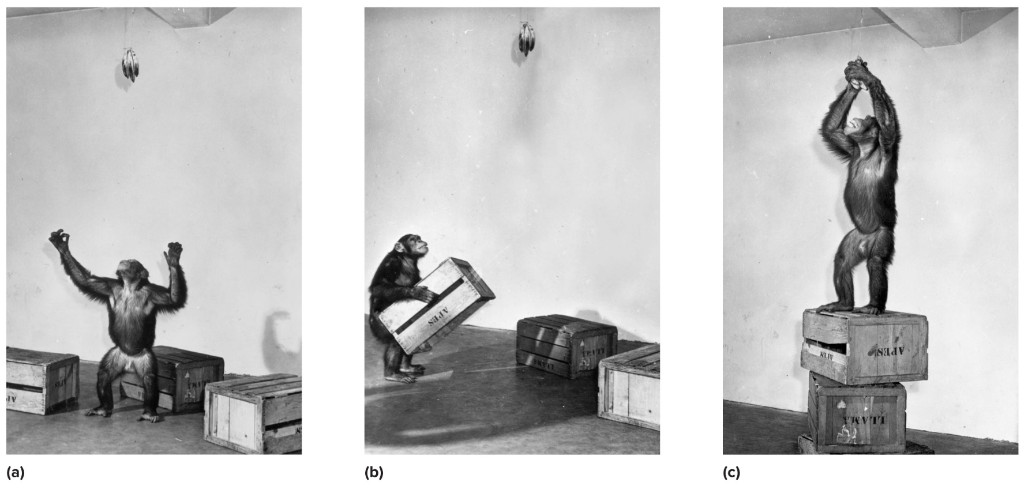
MODULE 21 FIGURE 8
(a) In an impressive display of insight, Sultan, one of the chimpanzees in Köhler’s experiments in problem solving, sees a bunch of bananas that is out of reach. (b) He then carries over several crates, stacks them, and (c) stands on them to reach the bananas.
(all): 3LH/SuperStock

Slide 14
Judgment: Evaluating Solutions
If there is no single correct solution, evaluating solutions can be difficult.
Theoretically, if we rely on appropriate heuristics and valid information, we can make accurate choices among alternative solutions.
However, several kinds of obstacles bias the decisions and judgments we make.

Slide 15
Impediments to Solutions: Why Is Problem Solving Such a Problem? 1
Difficulties encountered in solving problems often stem from how the problems are presented.
The presentation of a problem can mislead you at the preparation stage.

Slide 16
Impediments to Solutions: Why Is Problem Solving Such a Problem? 2
The impediment to solving the candle problem is functional fixedness: the tendency to think of an object only in terms of its typical use.
A related concept is mental set: the tendency to solve problems in a certain way, based on past experience.
Hinders our ability to come up with other solutions.
Can prevent us from seeing beyond the apparent constraints of a problem.

Slide 17
Impediments to Solutions: Why Is Problem Solving Such a Problem? 3
Confirmation bias: occurs when people are motivated to interpret evidence as supportive of their existing beliefs or theories.
Confirmation bias occurs for several reasons:
Rethinking a problem that appears to be solved already takes extra cognitive effort.
We tend to give greater weight to subsequent information that supports the initial position, compared to information that is not supportive of the initial position.

Slide 18
Evaluating Others’ Conclusions:
The Science of Fake News
Sometimes we draw erroneous conclusions because others have actively attempted to mislead us.
Fake news: fabricated information that is made to look and sound like legitimate news.
The intent to persuade readers/viewers to accept false information.
Illusory truth effect: simply repeating misinformation may lead people to remember that information and forget it may be false.
Cognitive immunization: resistance to fake news, misinformation, and other falsehoods is created by providing accurate information before someone is exposed to false information.

Slide 19
Creativity and Problem Solving 1
Creativity: the ability to generate original ideas or solve problems in novel ways.
Creative individuals show divergent thinking and also cognitive complexity in their thinking.
Divergent thinking: thinking that generates multiple and novel responses to problems or questions.
Convergent thinking: thinking in which a problem is viewed as having a single answer.

Slide 20
MODULE 23—Intelligence
What are the different definitions and conceptions of intelligence?
What are the major approaches to measuring intelligence, and what do intelligence tests measure?
How can extremes of intelligence be characterized?
To what degree is intelligence influenced by the environment and to what degree by heredity?

Slide 21
What Is Intelligence?
Intelligence: the capacity to understand the world, think rationally, and use resources effectively when faced with challenges.

Slide 22
Theories of Intelligence: Are There Different Kinds of Intelligence? 1
g or g-factor: the single, general factor for mental ability assumed to underlie intelligence in some early theories of intelligence.
Fluid intelligence: reflects the ability to think logically, reason abstractly, solve problems, and find patterns.
Crystallized intelligence: the accumulation of information, knowledge, and skills that people have learned through experience and education.
It reflects the facts we have learned and the information that resides in our long-term memory.

Slide 23
Theories of Intelligence: Are There Different Kinds of Intelligence? 2
Theory of multiple intelligences: psychologist Howard Gardner’s intelligence theory that proposes there are eight distinct spheres of intelligence.
Each person has the same eight kinds of intelligence, in different degrees.
There may be more than eight, such as existential intelligence—involving identifying and thinking about the fundamental questions of human existence.

Slide 24
MODULE 23 FIGURE 1
Kind of Intelligence | Description
Musical intelligence | Skills in tasks involving music
Bodily kinesthetic intelligence | Skills in using the whole body or various portions of it in the solution of problems or in the construction of products or displays, exemplified by dancers, athletes, actors, and surgeons
Logical-mathematical intelligence | Skills in problem solving and scientific thinking
Linguistic intelligence | Skills involved in the production and use of language
Spatial intelligence | Skills involving spatial configurations, such as those used by artists and architects
Interpersonal intelligence | Skills in interacting with others, such as sensitivity to the moods, temperaments, motivations, and intentions of others
Intrapersonal intelligence | Knowledge of the internal aspects of oneself; access to one’s own feelings and emotions
Naturalist intelligence | Ability to identify and classify patterns in nature
The following content is arranged like a table. Table divided into 2 columns. The column headers are marked as: "Kind of Intelligence, Description".
Howard Gardner describes eight major kinds of intelligences, corresponding to abilities in different domains.

Slide 25
Practical and Emotional Intelligence: Toward a More Intelligent View of Intelligence
Practical intelligence: according to psychologist Robert Sternberg, intelligence related to overall success in living.
Analytical intelligence: focuses on the traditional types of problems measured on IQ tests.
Creative intelligence: involves the generation of novel ideas and products.
Emotional intelligence: a set of skills that underlie the accurate assessment, evaluation, expression, and regulation of emotions.

Slide 26
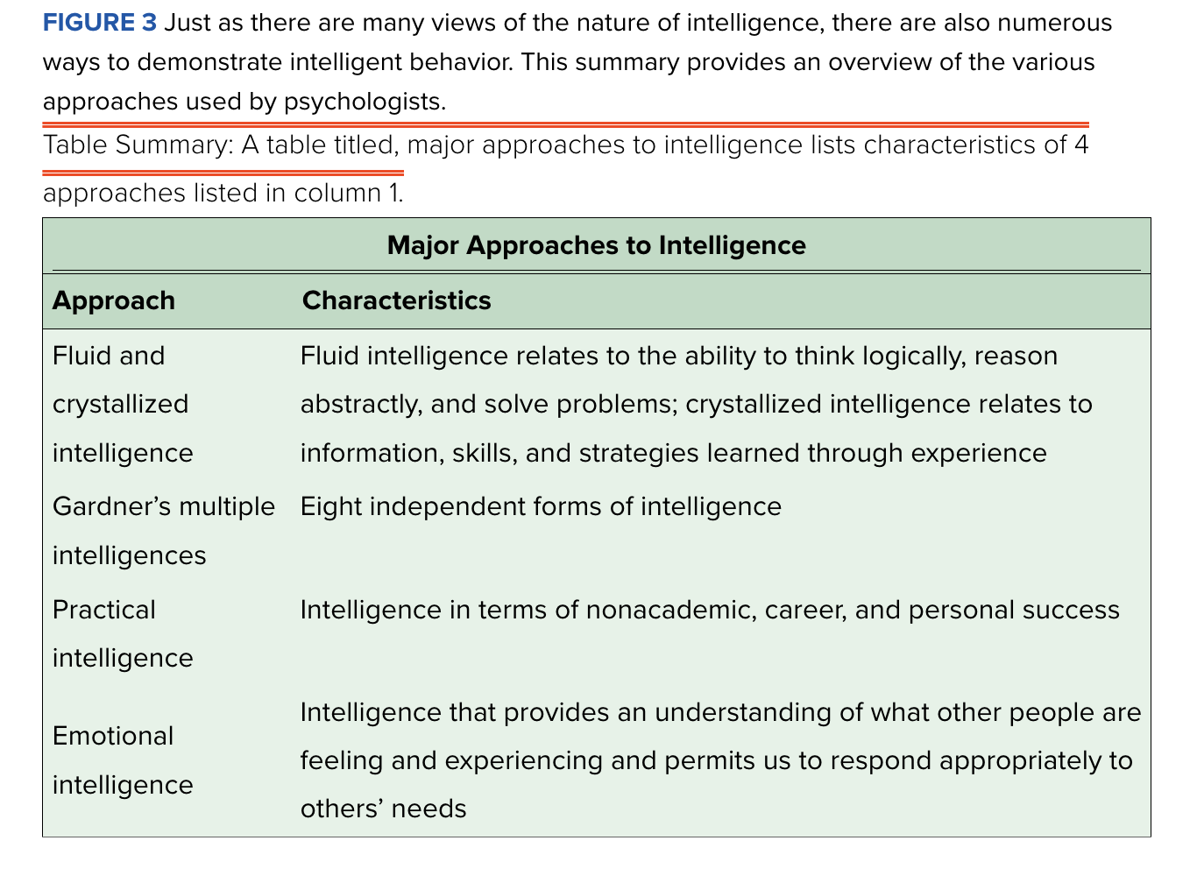
MODULE 23 FIGURE 3
Approach | Characteristics
Fluid and crystallized intelligence | Fluid intelligence relates to the ability to think logically, reason abstractly, and solve problems; crystallized intelligence relates to information, skills, and strategies learned through experience
Gardner's multiple intelligences | Eight independent forms of intelligence
Practical intelligence | Intelligence in terms of nonacademic, career, and personal success
Emotional intelligence | Intelligence that provides an understanding of what other people are feeling and experiencing and permits us to respond appropriately to others’ needs
The following content is arranged like a table. Table divided into 2 columns The column headers are marked as: "Approach, Characteristics".
The major approaches to intelligence. Just as there are many views of the nature of intelligence, there are also numerous ways to demonstrate intelligent behavior. This summary provides an overview of the various approaches used by psychologists.

Slide 27
Assessing Intelligence
Intelligence tests: tests devised to quantify a person’s level of intelligence.
These have proved of great benefit in identifying students in need of special attention in school; diagnosing specific learning difficulties; and helping people make the best educational and vocational choices.

Slide 28
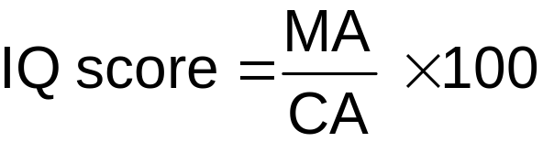
Binet and the Development of IQ Tests
French psychologist Alfred Binet developed the first real intelligence test.
Mental age: age for which a given level of performance is average.
Intelligence quotient (IQ): takes into account an individual’s mental age (M A) and chronological age (CA).

Slide 29
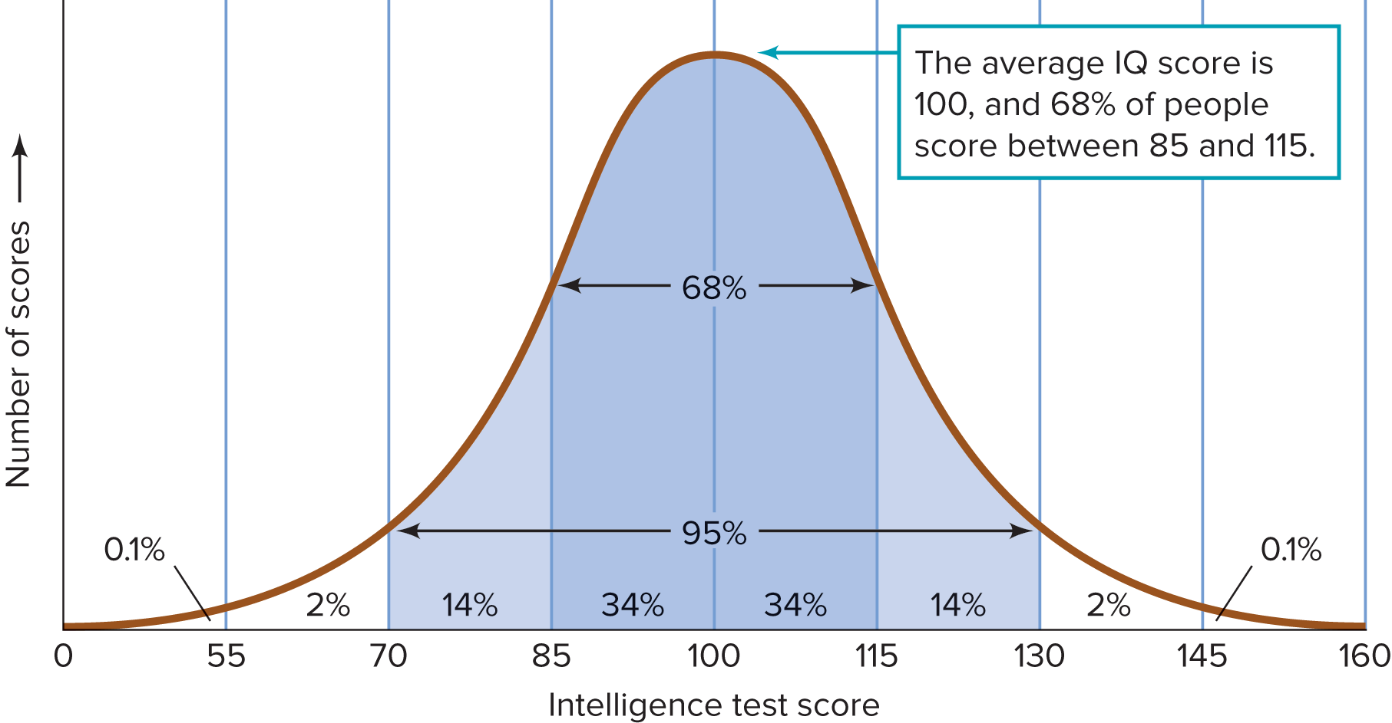
MODULE 23 FIGURE 4
The average and most common IQ score is 100, and 68% of all people are within a 30-point range centered on 100. Some 95% of the population have scores that are within 30 points above or below 100, and 99.8% have scores that are between 55 and 145.
Access the text alternative for slide images.

Slide 30

Contemporary IQ Tests: Gauging Intelligence 1
The Stanford-Binet Intelligence Scale consists of a series of items that vary according to the age of the person being tested.
The IQ tests most frequently used in the United States are the Wechsler Adult Intelligence Scale-IV (W A I S-IV) and the Wechsler Intelligence Scale for Children-5 (W I S C-5).

Slide 31
Reliability and Validity: Taking the Measure of Tests
Reliability: the consistency of a test in measuring what it is trying to measure.
Validity: the degree to which a test actually measures what it is supposed to measure.
Both are prerequisites for accurate assessment of intelligence.
Norms: standards of test performance that permit the comparison of one person’s score on a test with the scores of other individuals who have taken the same test.
Tests for which there are norms are standardized tests.

Slide 32
Variations in Intellectual Ability
Intellectual disability: a disability characterized by significant limitations both in intellectual functioning and in adaptive behavior, which covers many everyday social and practical skills.
Degrees of intellectual disability:
Mild = IQ of 55–69, constituting 90% of all people with intellectual disabilities.
Moderate = IQ of 40–54.
Severe = IQ of 25–39.
Profound = IQ below 25.

Slide 33
Identifying the Roots of Intellectual Disabilities
Fetal alcohol spectrum disorder: the most common cause of intellectual disability in newborns, occurring when the mother uses alcohol during pregnancy.
Down syndrome: another major cause, in which a person is born with 47 chromosomes instead of the usual 46.
In most cases, there is an extra copy of the 21st chromosome, which leads to problems in how the brain and body develop.
Familial intellectual disability: intellectual disability in which no apparent biological or genetic problems exist, but there is a history of intellectual disability among family members.

Slide 34
The Intellectually Gifted
Intellectually gifted: the 2–4% segment of the population who have IQ scores greater than 130.
Despite some negative stereotypes, most are often outgoing,
well-adjusted, healthy, popular—and able to do things better than the average person.
Terman’s study of the intellectually gifted in the 1920s resulted in an overall successful group; but note, not every member of the study was successful.
High intelligence is not a homogeneous quality or universal guarantee of success.
Special programs for the gifted are designed to provide enrichment that allows participants’ talents to flourish.

Slide 35
IQ and Heritability: The Relative Influence of Genetics and the Environment 1
Heritability: the degree to which a characteristic is related to genetic, inherited factors.
When racial gaps exist in cultures, the economically disadvantaged groups have lower scores.
Suggests a lack of compelling evidence that racial differences in IQ are due to genetic factors.
The greatest discrepancies in IQ scores occur when comparing individuals, not when comparing mean IQ scores of different groups.

