Slide 1
Chapter 8
Motivation and Emotion

Slide 2
MODULE 24—Explaining Motivation
How does motivation direct and energize behavior?

Slide 3
Explaining Motivation
Motivation: factors that direct and energize the behavior
of humans and other organisms.
Includes behavioral, cognitive, and social aspects.
Studied with a variety of approaches, all seeking to explain the energy that guides behavior in specific directions.

Slide 4
Instinct Approaches: Born to Be Motivated
Instincts: the inborn patterns of behavior that are biologically determined rather than learned.
Instinct approaches to motivation: the explanation of motivation that suggests people and animals are born preprogrammed with sets of behaviors essential to survival.

Slide 5
Drive-Reduction Approaches: Satisfying Our Needs 1
Drive-reduction approaches to motivation: theories suggesting that a lack of some basic biological need produces a drive to push an organism to satisfy that need.
Drive: motivational tension, or arousal, that energizes behavior to fulfill a need.
Primary drives: related to biological needs of the body or of the species as a whole.
Secondary drives: related to behavior that fulfills no obvious biological need.

Slide 6
Drive-Reduction Approaches: Satisfying Our Needs 2
Homeostasis: the body’s tendency to maintain a steady internal state.
Underlies primary drives.
Uses feedback loops.
Operates the need for food, water, stable body temperature, and sleep.

Slide 7
Arousal Approaches: Beyond Drive Reduction
Arousal approaches to motivation: the belief that people try to maintain a steady level of stimulation and activity.
These approaches suggest that if stimulation and activity levels become too high, we try to reduce them; and if stimulation and activity levels become too low, we seek out ways to increase them.
People vary in the optimal level of arousal they seek out; some look for especially high levels of arousal.
Daredevil sportsmen, criminals.

Slide 8
Incentive Approaches: Motivation’s Pull
Incentive approaches to motivation: theories suggesting that motivation stems from the desire to attain external rewards, known as incentives.
Fail to provide a complete explanation of motivation, as organisms sometimes seek to fulfill needs even with no apparent incentives.
Many psychologists believe drives and incentives may actually work together in motivating behavior.
“Push”: the internal drives proposed by drive-reduction theory.
“Pull”: the external incentives of incentive theory.

Slide 9
Cognitive Approaches: The Thoughts Behind Motivation
Cognitive approaches to motivation: theories suggesting that motivation is a result of people’s thoughts, beliefs, expectations, and goals.
Cognitive theories draw a key distinction between intrinsic and extrinsic motivation.
Intrinsic motivation causes individuals to participate in an activity for their own enjoyment rather than for any actual or concrete reward.
Extrinsic motivation causes individuals to do something for money, a grade, or some other actual, concrete reward.
Hindrance stressors are seen as outside their control and thus, as a barrier to good performance.
Challenge stressors are seen as something to overcome.

Slide 10
Maslow’s Hierarchy: Ordering Motivational Needs 1
Psychologist Abraham Maslow proposed a model of motivation that places motivational needs in a hierarchy.
Before meeting sophisticated, higher order needs, certain primary needs must be satisfied.
Self-actualization: a state of self-fulfillment in which people realize their highest potential in their own way.

Slide 11
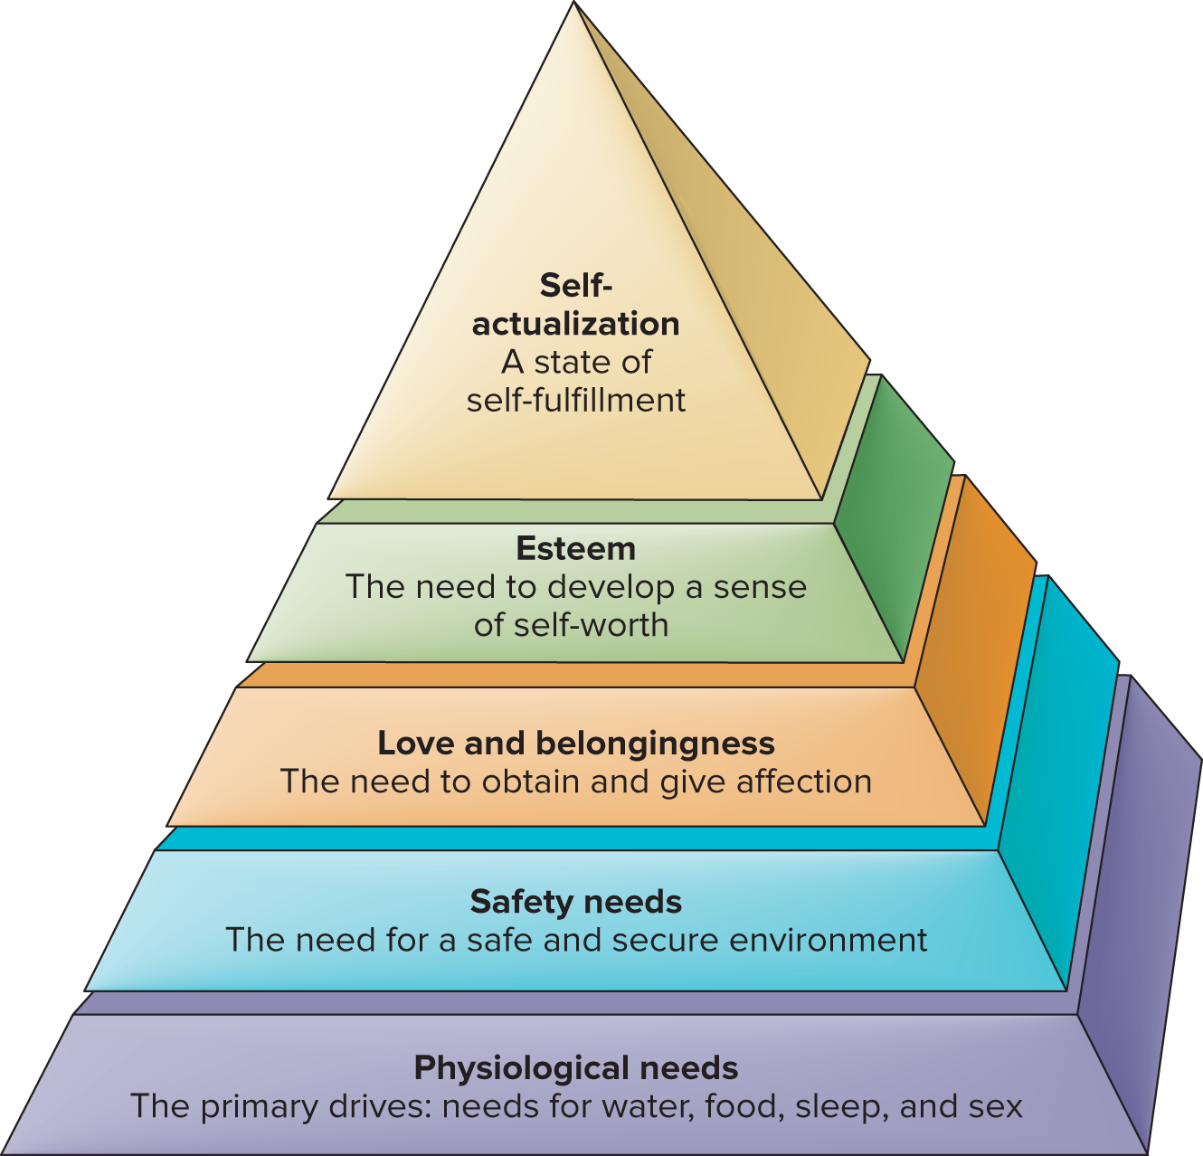
MODULE 24 FIGURE 2
Maslow’s hierarchy shows how our motivation progresses up the pyramid from the broadest, most fundamental biological needs to higher order ones.
Access the text alternative for slide images.
Source: Adapted from Maslow, 1970.

Slide 12
MODULE 25—Human Needs and Motivation: Eat, Drink, and Be Daring
What biological and social factors underlie hunger?
How are needs relating to achievement and affiliation exhibited?

Slide 13
Biological Factors in the Regulation of Hunger 1
Complex biological mechanisms tell organisms whether they require food or should stop eating.
One important factor is changes in the chemical composition of the blood.
Changes in levels of glucose, a kind of sugar, regulate feelings of hunger.
The hormone insulin leads the body to store excess sugar in the blood.
The hormone ghrelin communicates feelings of hunger to the brain.

Slide 14
Biological Factors in the Regulation of Hunger 2
The brain’s hypothalamus monitors glucose levels.
Increasing evidence suggests the hypothalamus carries the primary responsibility for monitoring food intake.
The exact way the hypothalamus operates is still unclear.
One hypothesis suggests that injury to the hypothalamus may affect the weight set point: the particular level of weight that the body strives to maintain.
Metabolism: the rate at which food is converted to energy and expended by the body.
It was previously thought that this remained relatively constant throughout life, but new research has found four distinct stages.

Slide 15
Social Factors in Eating
Internal biological factors do not fully explain our eating behaviors.
External social factors are involved:
Societal rules.
What we have learned about appropriate eating behavior.
Cultural influences.
Systemic racism.
Individual habits also play a role, along with what we may have learned through classical and operant conditioning about food and its association with our comfort.

Slide 16
Eating Disorders 1
Anorexia nervosa: a severe eating disorder in which
people may refuse to eat while denying that their behavior and appearance—which can become skeleton-like—are unusual.
Bulimia: a disorder in which a person binges on large quantities of food, followed by efforts to purge the food through vomiting or other means.

Slide 17
The Need for Achievement: Striving for Success 1
Need for achievement: a person’s desire to strive for and achieve challenging accomplishments.
People with a high need for achievement are selective in picking their challenges:
Tend to avoid situations in which success will come too easily or where success is highly unlikely.
Generally choose tasks that are of intermittent difficulty.
People with low achievement motivation tend to be motivated primarily by a desire to avoid failure.

Slide 18
Growth Mindset and Achievement
Growth mindset: the belief that individual characteristics, such as intelligence, talent, and motivation, can be developed through hard work.
Grit is the perseverance and passion for a long-term goal.
Fixed mindset: the erroneous belief that individual characteristics, such as intelligence, talent, and motivation, are set at birth and vary little throughout the life span.
Individuals with a fixed mindset do not work as hard as others which can lead to failure and self-defeat.
It is possible to develop a growth mindset and avoid a fixed mindset.

Slide 19
The Need for Affiliation: Striving for Friendship
Most people have a need for affiliation: an interest in establishing and maintaining relationships with other people.
People with higher affiliation needs tend to be with their friends more, and alone less.
However, gender is a greater determinant of how much time is actually spent with friends.
Regardless of their affiliative orientation, female students spend significantly more time with their friends than male students do.

Slide 20
MODULE 26—Understanding Emotional Experiences
What are emotions, and how do we experience them?
What are the functions of emotions?
What are the explanations for emotions?
How does nonverbal behavior relate to the expression of emotions?

Slide 21
Emotions
Emotions: feelings that generally have both physiological and cognitive elements and that influence behavior.
Some psychologists argue there are two systems at work, one governing emotional responses to a given situation and the other governing the cognitive reactions to them.
Some suggest we first experience an emotional response, and later try to make sense of it.
Others suggest we develop cognitions about a situation, then react emotionally.

Slide 22
The Functions of Emotions
Emotions allow us to experience the depths of despair, depression, and remorse, but also happiness, joy, and love.
Beyond making life interesting, emotions perform several important functions in our daily lives:
Preparing us for action.
Shaping our future behavior.
Helping us interact more effectively with others.

Slide 23
Determining the Range of Emotions: Labeling Our Feelings
Most researchers suggest that a list of basic emotions would include happiness, anger, fear, sadness, and disgust.
Other lists are broader, including surprise, contempt, guilt, and joy.
Substantial differences exist in descriptions of emotions among various cultures, however.

Slide 24
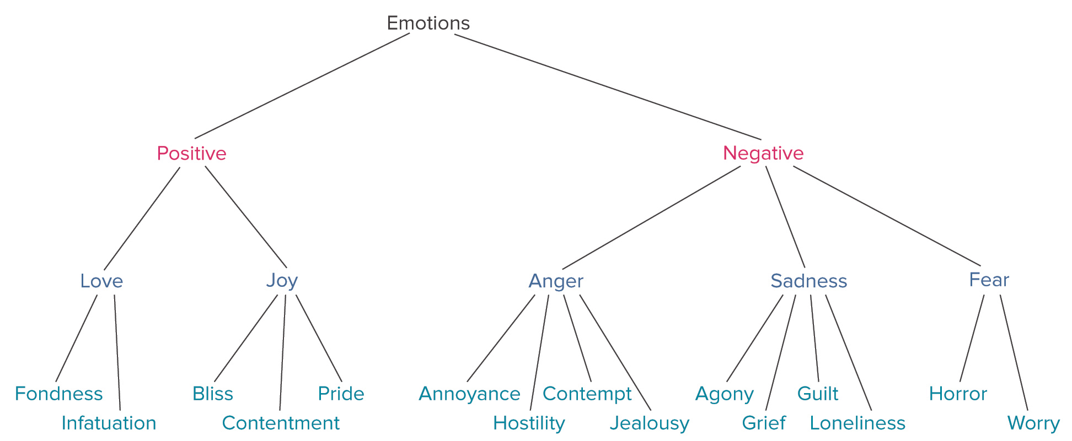
MODULE 26 FIGURE 1
One approach to organizing emotions is to use a hierarchy, which divides emotions into
increasingly narrow subcategories.
Access the text alternative for slide images.
Source: Adapted from Fischer et al., 1990.

Slide 25
The James-Lange Theory: Do Gut Reactions Equal Emotions?
James-Lange Theory of emotion: emotional experience is a reaction to bodily events occurring as a result of an external situation.
“I feel sad because I am crying.”
The theory has some shortcomings:
Visceral changes would have to occur relatively quickly.
Physiological arousal does not invariably produce an emotional experience.

Slide 26
The Cannon-Bard Theory: Physiological Reactions as the Result of Emotions
The Cannon-Bard theory of emotion: both physiological arousal and emotional experience are produced simultaneously by the same nerve stimulus.
After we perceive an emotion-producing stimulus, the thalamus is the initial site of the emotional response.
The thalamus sends responses to the autonomic nervous system and the cortex.

Slide 27
The Schachter-Singer Theory: Emotions as Labels
The Schachter-Singer theory of emotion: emotions are determined jointly by a nonspecific kind of physiological arousal and its interpretation, based on environmental cues.
Supports a cognitive view of emotion.
Although later research has found that arousal is more specific than Schachter and Singer believed, research supports the idea that we may look to our surrounding to determine the source of physiological arousal.

Slide 28
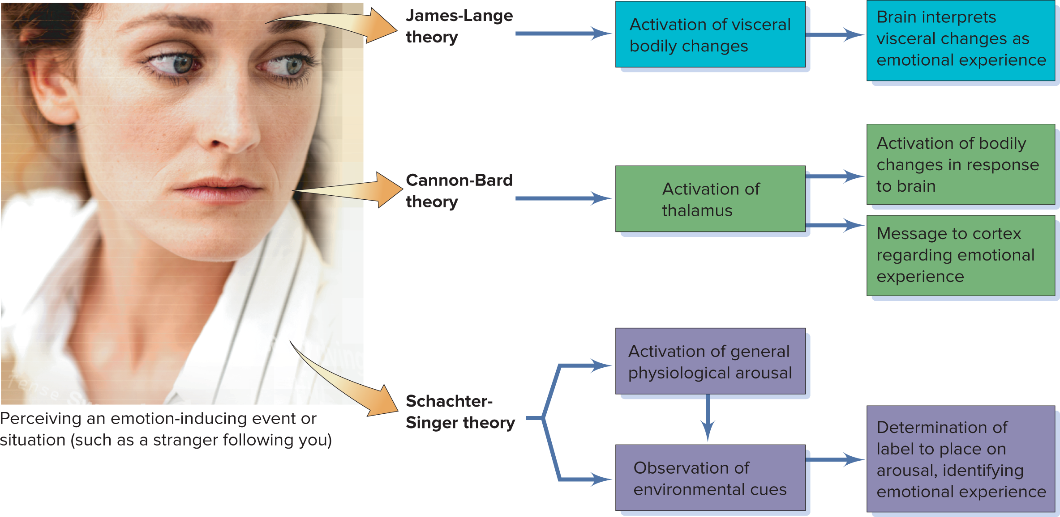
MODULE 26 FIGURE 2
A comparison of three theories of emotion.
Access the text alternative for slide images.
(Photo): Stockbyte/Getty Images

Slide 29
Contemporary Perspectives on the Neuroscience of Emotions
Different emotions produce activation of different portions of the brain.
The amygdala plays an important role in the experience of emotions.
Provides a link between the perception of an emotion-producing stimulus and the recall of that stimulus later.
Neural pathways connect the amygdala, visual cortex, and hippocampus.
Indicates that emotion-related stimuli can be processed and responded to almost instantaneously.

Slide 30
Making Sense of the Multiple Perspectives on Emotion
Emotions are complex phenomena, encompassing biological and cognitive aspects.
No single theory has been able to fully explain all the facets of the emotional experience.

Slide 31
Facial Affect and Facial Feedback
People across cultures express emotions similarly.
Facial-affect program: the theory that a set of nerve impulses produce a facial display reflecting an emotion that is universal across cultures.
Facial-feedback hypothesis: the hypothesis that facial expressions not only reflect emotional experience but also help determine how people experience and label emotions.

Slide 32






MODULE 26 FIGURE 4
These photos demonstrate six of the primary emotions: happiness, sadness, disgust, anger, surprise, and fear.
(top left): fizkes/Shutterstock; (top rightt): Anderson Piza/Alamy Stock Photo; (middle left): Master1305/ Shutterstock; (middle right): Rachata Teyparsit/ Shutterstock; (bottom left): Daniel Ernst/Alamy Stock Photo; (bottom right): samuel wordley/Alamy Stock Photo

