Slide 1
Chapter 9
Development

Slide 2
MODULE 27—Nature and Nurture: The Enduring Developmental Issue
How do psychologists study the degree to which development is an interaction of hereditary and environmental factors?
What is the nature of development before birth?
What factors affect a child during the mother’s pregnancy?

Slide 3
The Nature–Nurture Issue
Nature–nurture issue: the issue of the degree to which environment and heredity influence behavior.
Developmental psychology: the branch of psychology that studies the patterns of growth and change that occur throughout life.
Developmental psychologists use several approaches.
One is to observe animals with identical genetic backgrounds in varied environments.
Identical twins: twins who are genetically identical.
Source of information about the relative effects of genetic and environmental factors

Slide 4
The Earliest Development 1
Zygote: a new cell formed by the union of an egg and sperm.
The first 2 weeks are known as the germinal period.
Week 2 through week 8 is known as the embryonic period.
Embryo: a developed zygote that has a heart, a brain, and other organs.
Organs are clearly recognizable, despite being at a primitive stage of development.
Fetus: a developing individual from 8 weeks after conception until birth.
Movements become strong enough for the mother to sense them.

Slide 5
Prenatal Environmental Influences
Teratogens: environmental agents such as a drug, chemical, virus, or other factor that produce a birth defect.
Among the major prenatal environmental influences are:
Mother’s nutrition;
Mother’s illness;
Mother’s emotional state;
Mother’s use of drugs, alcohol, and/or nicotine.
Even mothers who use small amounts of alcohol during pregnancy place their child at risk of fetal alcohol syndrome disorder (F A S D)—now the primary preventable cause of intellectual disability.

Slide 6
MODULE 28—Infancy and Childhood
What are the major competencies of newborns?
What are the milestones of physical and social development during childhood?
How does cognitive development proceed during childhood?

Slide 7
The Extraordinary Newborn
Neonate: a newborn child.
Reflexes: unlearned, involuntary responses that occur automatically in the presence of certain stimuli.
Critical for survival, many infant reflexes unfold naturally.
Rooting reflex: turning of the head toward things that touch their cheeks.
Sucking reflex: prompts infants to suck at things that touch their lips.
Gag reflex: clearing of the throat.

Slide 8
Development of Social Behavior: Taking On the World 1
Attachment: the positive emotional bond that develops between a child and a particular individual.
Harry Harlow studied attachment with infant monkeys.
Gave infant monkeys the choice of cuddling a wire “monkey” that provided milk, or a soft, terry-cloth “monkey” that was warm but did not provide milk.
Milk alone was insufficient to create attachment.

Slide 9
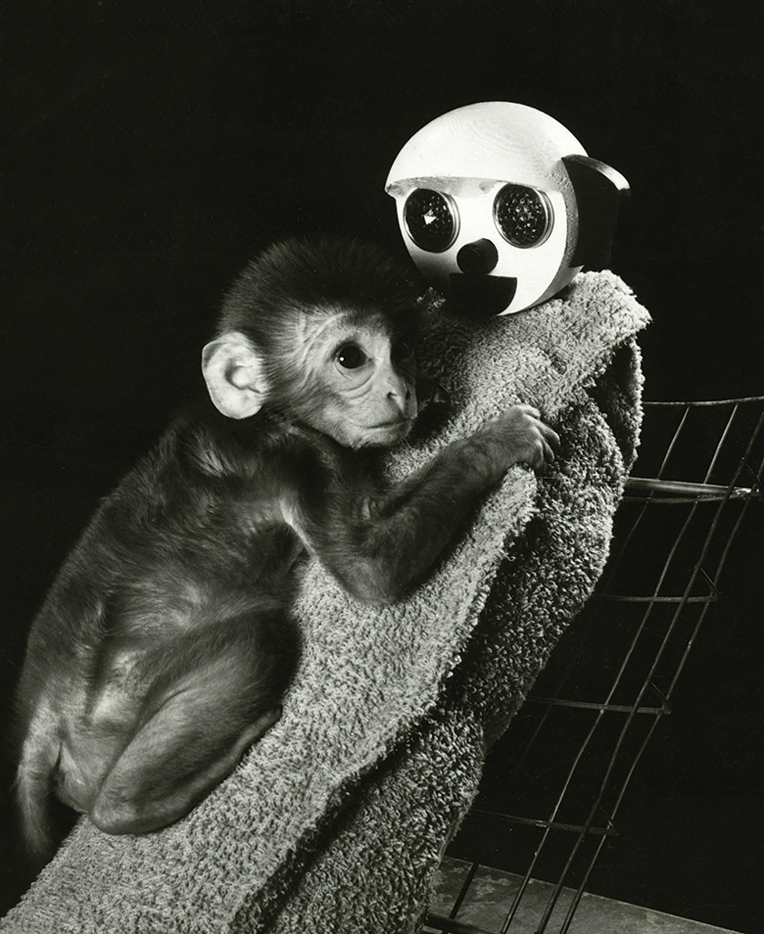
MODULE 28 FIGURE 5
Although the wire “mother” dispensed milk to the hungry infant monkey, the infant preferred the soft, terry-cloth “mother.”
Science History Images/Alamy Stock Photo

Slide 10
Development of Social Behavior: Taking On the World 2
Mary Ainsworth devised a method of measuring attachment.
Ainsworth strange situation: a sequence of events involving a child and (typically) their mother.
Securely attached children employ the mother as a home base from which they explore; when she leaves, they are distressed; when she returns, they go to her.
Avoidant children.
Ambivalent children.
Disorganized–disoriented children.

Slide 11
Parenting Styles and Social Development 1
Diana Baumrind’s classic research identified four main categories in parenting styles:
Authoritarian parents: those who are rigid and punitive and value unquestioning obedience from their children.
Permissive parents: those who give their children relaxed or inconsistent direction and, although they are warm, require little of them.
Authoritative parents: those who are firm, set clear limits, reason with their children, and explain things to them.
Uninvolved parents: those who show little interest in their children and are emotionally detached.

Slide 12
MODULE 28 FIGURE 7
Parenting Style | Parent Behavior | Type of Behavior Produced in Child
Authoritarian | Rigid, punitive, strict standards (e.g., “If you don’t clean your room, I’m going to take away your iPhone for good and ground you.”) | Unsociable, unfriendly, withdrawn
Permissive | Lax, inconsistent, undemanding (e.g., “It might be good to clean your room, but I guess it can wait.”) | Immature, moody, dependent, low self-control
Authoritative | Firm, sets limits and goals, uses reasoning, encourages independence (e.g., “You’ll need to clean your room before we can go out to the restaurant. As soon as you finish, we’ll leave.”) | Good social skills, likable, self-reliant, independent
Uninvolved | Detached emotionally, sees role only as providing food, clothing, and shelter (e.g., “I couldn’t care less if your room is a pigsty.”) | Indifferent, rejecting behavior
The following content is arranged like a table. Table divided into 3 columns The column headers are marked as: " Parenting Style, Parent Behavior, Type of Behavior Produced in Child".
According to developmental psychologist Diana Baumrind (19 71), four main parenting styles characterize child rearing.
Gary John Norman/Digital Vision/Getty Images

Slide 13
Erikson’s Theory of Psychosocial Development 1
Psychoanalyst Erik Erikson developed one of the more comprehensive theories of social development, described as a series of eight stages of psychosocial development.
Psychosocial development: the development of individuals’ interactions and understanding of each other and of their knowledge and understanding of themselves as members of society.

Slide 14
Erikson’s Theory of Psychosocial Development 2
Trust-versus-mistrust stage: infants between birth to age 1½ develop feelings of trust or lack of trust.
Autonomy-versus-shame-and-doubt stage: toddlers aged 1½ to 3 develop independence and autonomy if exploration and freedom are encouraged; or shame and self-doubt if they are restricted and overprotected.
Initiative-versus-guilt stage: children aged 3–6 experience conflict between independence of action and sometimes negative results of that action.
Industry-versus-inferiority stage: children aged 6–12 may develop positive social interactions with others or may feel inadequate and become less social.

Slide 15
Cognitive Development: Children’s Thinking About the World 1
Cognitive development: the process by which a child’s understanding of the world changes as a function of age and experience.
No theory has had more impact than that of psychologist Jean Piaget, who suggested children proceed through a series of four stages in a fixed order.
Sensorimotor stage: the stage from birth to 2 years, during which a child has little competence in representing the environment by using images, language, or other symbols.
They lack object permanence: an awareness that objects—and people—continue to exist even if they are out of sight.

Slide 16
Cognitive Development: Children’s Thinking About the World 2
Preoperational stage: the period from 2 to 7 years of age that is characterized by language development.
Preoperational children tend to use egocentric thought and have not yet developed the ability to comprehend the principle of conservation.
Egocentric thought: a way of thinking in which a child views the world entirely from their own perspective.
Principle of conservation: the knowledge that quantity is unrelated to the arrangement and physical appearance of objects.

Slide 17
Cognitive Development: Children’s Thinking About the World 3
Concrete operational stage: the period from 7 to 12 years of age that is characterized by logical thought and a loss of egocentrism.
Their thinking is, however, largely bound to the concrete, physical reality of the world.
Formal operational stage: the period from age 12 to adulthood that is characterized by abstract thought.
It appears that many individuals never reach this stage at all.

Slide 18
MODULE 28 FIGURE 8
Cognitive Stage | Approximate Age Range | Major Characteristics
Sensorimotor | Birth to 2 years | Development of object permanence, development of motor skills, Stranger anxiety
Preoperational | 2–7 years | Development of language and symbolic thinking, egocentric thinking, Theory of Mind, Pretend play
Concrete operational | 7–12 years | Development of conservation, mastery of the concept of reversibility
Formal operational | 12 years to adulthood | Development of logical and abstract thinking
The following content is arranged like a table. Table divided into 3 columns The column headers are marked as: " Cognitive Stage, Approximate Age Range, Major Characteristics".
According to Piaget, all children pass through four stages of cognitive development.

Slide 19
Vygotsky’s View of Cognitive Development: Considering Culture
According to developmental psychologist Lev Vygotsky, cognitive development occurs as a consequence of social interactions.
Children work with others to jointly solve problems.
Scaffolding: support for learning and problem solving that encourages independence and growth.

Slide 20
MODULE 29—Adolescence: Becoming an Adult
What major social and cognitive transitions characterize adolescence?

Slide 21
Physical Development: The Changing Adolescent
Adolescence: the developmental stage between childhood and adulthood.
Physical changes at the start of adolescence are dramatic.
Growth spurt, around age 10 for girls and 12 for boys.
Development of breasts in girls, deepening voices in boys,
Puberty: the period at which maturation begins - about age 11 or 12 for girls and 13 or 14 for boys.

Slide 22
Moral and Cognitive Development: Distinguishing Right from Wrong 2
According to psychologist Lawrence Kohlberg, changes in moral reasoning can be understood best as a three-level sequence
Level 1, preconventional morality: the main considerations are the avoidance of punishment and the desire for rewards.
Level 2, conventional morality: membership in society becomes important; people behave in ways that will win the approval of others.
Level 3, postconventional morality: people accept that there are certain broad principles of morality that should govern our actions; and these principles are more critical than the particular laws in a society.

Slide 23
Social Development: Finding One’s Self in a Social World
In the teenage years, certain questions assume special significance for adolescents:
“Who am I?”
“How do I fit into the world?”
“What is life all about?”

Slide 24
Erikson’s Theory of Psychosocial Development: The Search for Identity 1
Identity: the distinguishing character of the individual:
who each of us is, what our roles are, and what we are capable of.
Identity-versus-role confusion stage: according to Erikson, a time in adolescence of major testing to determine one’s unique qualities.
Intimacy-versus-isolation stage: a period during early adulthood that focuses on developing close relationships.

Slide 25
Erikson’s Theory of Psychosocial Development: The Search for Identity 2
Notably, Erikson’s theory suggests that development does not stop at adolescence or even early adulthood.
Generativity-versus-stagnation stage: a period in middle adulthood during which we take stock of our contributions to family and society.
Ego-integrity-versus-despair stage: a period from late adulthood until death during which we review life’s accomplishments and failures.

Slide 26
MODULE 29 FIGURE 3
Stage | Approximate Age | Positive Outcomes | Negative Outcomes
1. Trust-versus-mistrust | Birth to 1½ years | Feelings of trust from environmental support | Fear and concern regarding others
2. Autonomy-versus-shame-and-doubt | 1½ to 3 years | Self-sufficiency if exploration is encouraged | Doubts about self, lack of independence
3. Initiative-versus-guilt | 3 to 6 years | Discovery of ways to initiate actions | Guilt from actions and thoughts
4. Industry-versus-inferiority | 6 to 12 years | Development of sense of competence | Feelings of inferiority, no sense of mastery
5. Identity-versus-role confusion | Adolescence | Awareness of uniqueness of self, knowledge of role to be followed | Inability to identify appropriate roles in life
6. Intimacy-versus-isolation | Early adulthood | Development of close friendships | Fear of relationships with others
7. Generativity-versus-stagnation | Middle adulthood | Sense of contribution to continuity of life | Trivialization of one’s activities
8. Ego-integrity-versus-despair | Late adulthood | Sense of unity in life’s accomplishments | Regret over lost opportunities of life
The following content is arranged like a table. Table divided into 4 columns The column headers are marked as: " Stage, Approximate Age, Positive Outcomes, Negative Outcomes".
Erikson’s stages of psychosocial development. According to Erikson, people proceed through eight stages of psychosocial development across their lives. He suggested that each stage requires the resolution of a crisis or conflict and may produce both positive and negative outcomes.

Slide 27
Module 30—Adulthood
What are the principal kinds of physical, social, and intellectual changes that occur in early and middle adulthood, and what are their causes?
How does the reality of late adulthood differ from the stereotypes about that period?
How can we adjust to death?

Slide 28
Physical Development: The Peak of Health 1
Emerging adulthood: the period beginning in the late teenage years and extending into the mid-20s.
For most people, early adulthood marks the peak of physical health.
The body becomes slightly less efficient and more susceptible to disease.
Gradual changes become more evident in middle adulthood.
These signs of aging can be psychologically challenging in a society that highly values youth.
The major biological change that occurs in middle adulthood pertains to reproductive capabilities.

Slide 29
Physical Development: The Peak of Health 2
Menopause: the period when women stop menstruating and are no longer fertile, usually in the late 40s or early 50s.
Symptoms may be treated with hormone therapy (H T), but this poses several significant risks to the woman’s health.
Women’s reactions to menopause vary significantly across cultures.
For men, aging is more subtle.
No male menopause exists

Slide 30
Social Development: Working at Life
People typically launch themselves into careers, marriage, and families during this period.
The midlife transition is the period when people may begin to question their lives.
The idea that life will end at some point can become more influential in their thinking.
Although some suggest physical aging and dissatisfaction with one’s life mark a “midlife crisis,” there is little evidence for such a “crisis.”
During the last stages of adulthood, people become more accepting of others and of themselves.

Slide 31
Physical Changes in Late Adulthood: The Aging Body
The aging process brings many physical changes.
The most obvious are those of appearance, but subtler changes also occur in the body’s biological functioning.
Genetic preprogramming theories of aging: our D N A genetic code includes a built-in time limit to the reproduction of human cells and that they are no longer able to divide after a certain time.
Wear-and-tear theories of aging: the mechanical functions of the body simply stop working efficiently.

Slide 32
Cognitive Changes: Thinking About—and During—Late Adulthood
Intellectual decline is often not evident in healthy older adults; and patterns of decline are not uniform.
Skills relating to fluid intelligence (information-processing skills) typically show declines in late adulthood.
Skills relating to crystallized intelligence (accumulated knowledge) remain steady and in some cases improve.
People are often able to compensate for any decline.
Learning may just take more time.

Slide 33
Memory Changes in Late Adulthood: Are Older Adults Forgetful?
Most evidence suggests that memory change is not an inevitable part of the aging process.
For cases of memory decline accompanied by other cognitive difficulties, senility is now considered imprecise.
Alzheimer’s disease: a progressive brain disorder that leads to a gradual and irreversible decline in cognitive abilities.
The brain shrinks, neurons die, and areas of the hippocampus and frontal and temporal lobes deteriorate.

Slide 34
Adjusting to Death
For those who are fully aware that they are dying and have the time to evaluate their impending death, Elisabeth Kübler-Ross proposed five broad stages:
  Denial.
  Anger.
  Bargaining.
  Depression.
  Acceptance.
Not everyone experiences each stage in the same way; and a variety of life factors have an impact on how an individual responds to death.

