Slide 1
Angular 14
By Shoukat Malik

Slide 2
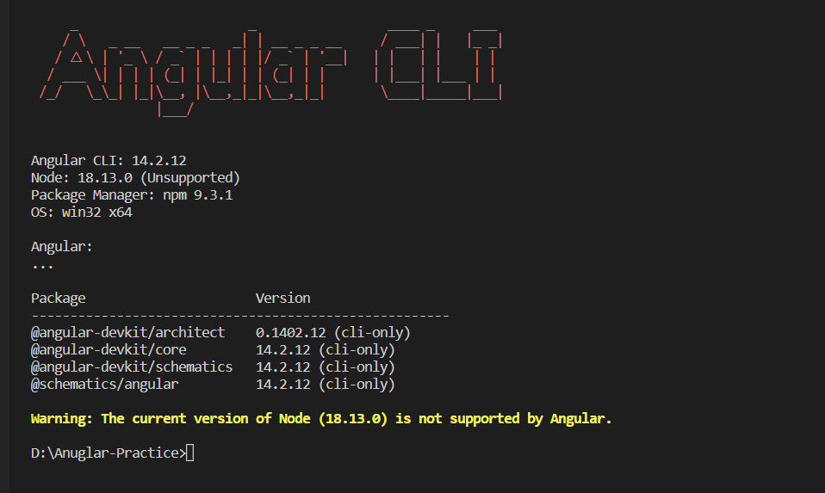
How to install Angular 14 Cli
npm install -g @angular/cli@14 ng –version (for version checking)

Slide 3
Components
Basic Components
ng g c name
Components inline style
ng g c name –inline-style
Components inline Templates
ng g c name –inline-template
Stand Alone Component
ng g c name --standalone

Slide 4
Routing
Basic Routing
Routes –this is the place for mapping path and component.
routerLink this is directive for navigate different routes
Router-outlet –this is place for display the matched route.
Child routing (Group Routing)
Module Routing
Lazy Loading
Redirect 404 page if route not found
Get Route Values

