Slide 1
Introduction To C Programming
Prepared By : Shoukat Malik BS(Software Engineering SSUET Karachi)

Slide 2
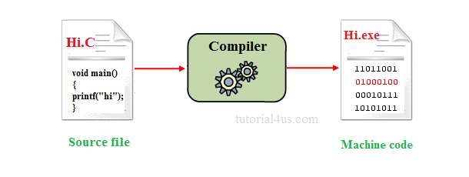
Language Translators
Compiler
A compiler is system software which converts programming language code into binary format in single steps.

Slide 3
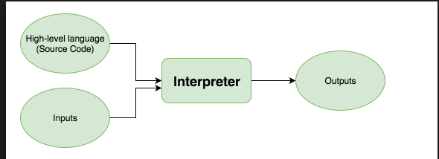
Interpreter
It is system software which is used to convert programming language code into binary format in step by step process

Slide 4
Assembler
An assembler is system software which is used to convert the assembly language instruction into binary format in step by step process. An assembler is system software which is used to convert the assembly language instruction into binary format.
Machine Code
Assembly Code
Assembler

Slide 5
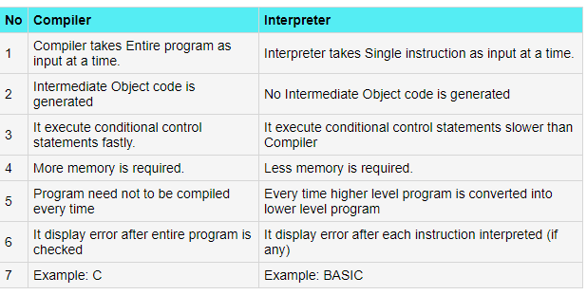
Compiler Vs Interpreter

Slide 6


Slide 7
Overview of C
C is a computer programming language developed in 1972 by Dennis M. Ritchie at the Bell Telephone Laboratories to develop the UNIX Operating System. C is a simple and structure oriented programming language.
C is also called mother Language of all programming Language.
It is the most widely use computer programming language.
This language is used for develop system software and Operating System.
All other programming languages were derived directly or indirectly from C programming concepts.

Slide 8
Where we use C Language
C Language is mainly used for;
Design Operating system
Design Language Compiler
Design Database
Language Interpreters
Utilities
Network Drivers
Assemblers

Slide 9
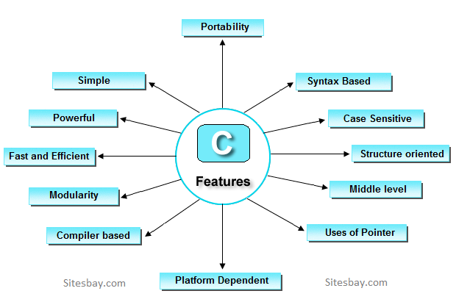
Features of C

Slide 10
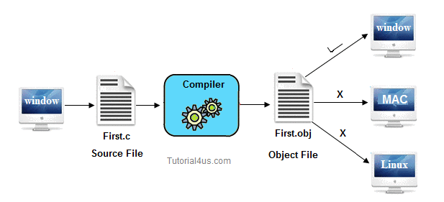
Simple
Portability
Powerful
Platform dependent
Structure oriented
Case sensitive
Compiler based
Modularity
Middle level language
Syntax based language
Use of Pointers

Slide 11
Applications of C
C programming language can be used to design the system software like operating system and Compiler.
To develop application software like database and spread sheets.
For Develop Graphical related application like computer and mobile games.
To evaluate any kind of mathematical equation use c language.
C programming language can be used to design the compilers.
UNIX Kernel is completely developed in C Language.

Slide 12
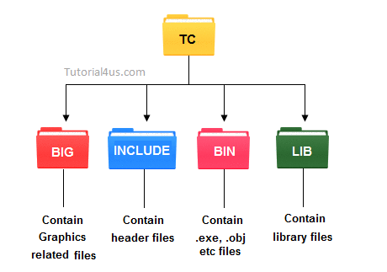
Installation of TC
Installation of TC is very simple just download turbo C or C++ and run .exe files.
When you install the Turbo C compiler on your system, then TC directory is created on the hard disk and various sub directories such as INCLUDE, and LIB etc. are created under TC.

Slide 13
INCLUDE :Contain the header files of C.
LIB: Contain the library files of C.
BGI: Contain Graphics related files.
BIN: Contain .exe, .obj etc files.

Slide 14
Source Code Vs Object Code
Source Code
Source code is in the form of Text form.
Source code is Human Readable Code.
Source code is Generated by Human or Programmer.
Source code is receive Compiler as a Input.
Object Code
Object Code is in the form of Binary Numbers.
Object Code is in Machine Readable formats.
Object Code is Generated by Compiler.
Object Code is Generated by Compiler as a Output.

Slide 15
Comments in C
Generally Comments are used to provide the description about the Logic written in program. Comments are not display on output screen.
When we are used the comments, then that specific part will be ignored by compiler.
In 'C' language two types of comments are possible
Single line comments
// This is a single line comment
Multiple line comments
/*
This is a multiple line Comments
*/

Slide 16
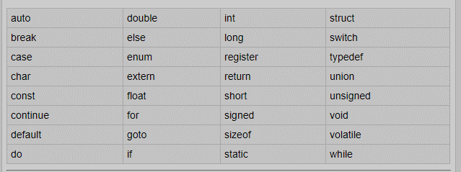
Keywords
Keyword is a predefined or reserved word in C library with a fixed meaning and used to perform an internal operation. C Language supports 32 keywords.
Every Keyword exists in lower case latter like auto, break, case, const, continue, int etc.

Slide 17
Types of Constant in C
It is an identifier whose value can not be changed at the execution time of program. In general constant can be used to represent as fixed values in a C program. Constants are classified into following types.
If any single character (alphabet or numeric or special symbol) is enclosed between single cotes ' ' known as single character constant.
If set of characters are enclosed between double cotes " " known as string character constant.

Slide 18
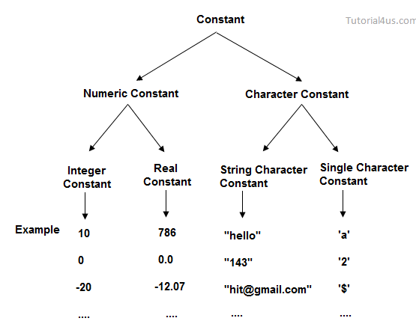

Slide 19
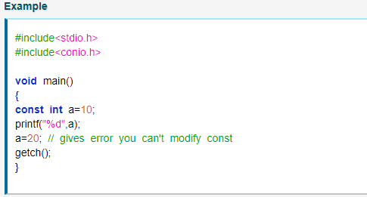
Declare constant

Slide 20
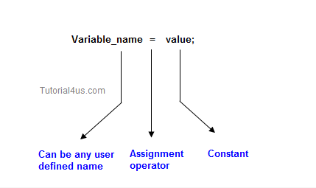
Variable
Variable is an identifier which holds data or another one variable. It is an identifier whose value can be changed at the execution time of program. It is used to identify input data in a program.

Slide 21
Rules to declare a Variable
To Declare any variable in C language you need to follow rules.
Every variable name should start with alphabets or underscore (_).
No spaces are allowed in variable declaration.
Except underscore (_) no other special symbol are allowed in the middle of the variable declaration (not allowed -> roll-no, allowed -> roll no).
Maximum length of variable is 8 characters depend on compiler and operation system.
Every variable name always should exist in the left hand side of assignment operator (invalid -> 10=a; valid -> a=10;).
No keyword should access variable name (int for <- invalid because for is keyword)

Slide 22
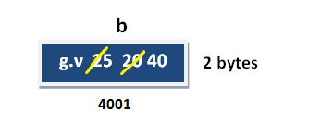
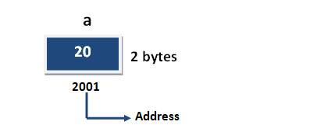
Variable initialization
int a= 20;
It is the process of allocating sufficient memory space with user defined values.
Datatype nariable_name=value;
Variable assignment
It is a process of assigning a value to a variable.
Variable_Name = value
Example : int a = 20;

Slide 23
Scope of variable
Difference between Local variable and Global variable
In C language, a variable can be either of global or local scope.
Global variable
Global variables are defined outside of all the functions, generally on top of the program. The global variables will hold their value throughout the life-time of your program.
Local variable
A local variable is declared within the body of a function or a block. Local variable only use within the function or block where it is declare.

Slide 24
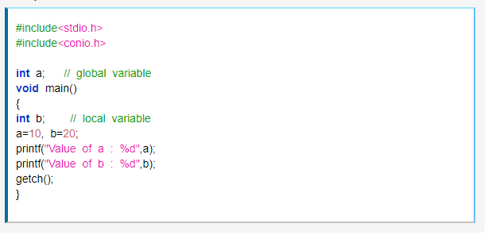
Example of Global and Local variable

Slide 25
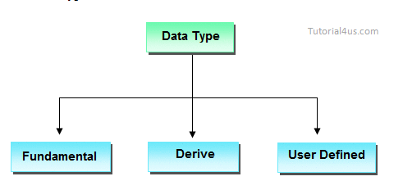
Datatype in C Language
Data types are used for representing the input of the user in the main memory (RAM) of the computer.
In general every programming language is containing three categories of data types.

Slide 26
Operators
Operator is a special symbol that tells the compiler to perform specific mathematical or logical Operation.
Arithmetic Operators
Relational Operators
Logical Operators
Bitwise Operators
Assignment Operators
Ternary or Conditional Operators

Slide 27
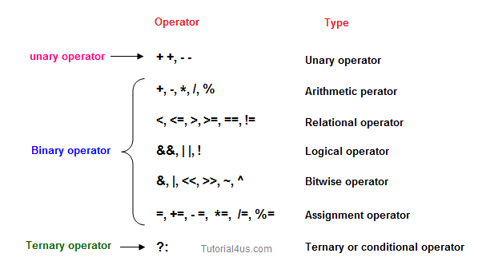

Slide 28
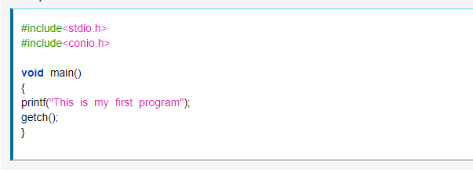

First Program

Slide 29
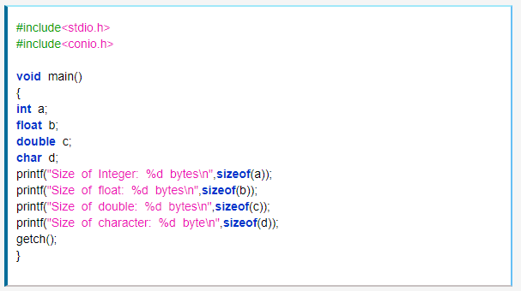
sizeof operator
The sizeof operator is used to calculate the size of data type or variables. This operator returns the size of its variable in bytes.

Slide 30
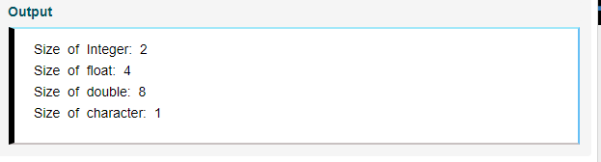

Slide 31
Error
Error is a abnormal condition whenever it occurs execution of the program is stopped these are mainly classified into following types.
Compile time error
Run time error

