Slide 1
Logical Database Design and the Relational Model (part 2)
CS263 Lecture 6

Slide 2
Step 5: map unary relationships
Unary relationships are relationships between the instances of a single entity type
They are also called recursive relationships
The approach to mapping is different for the two types one-to-many and many-to-many

Slide 3
Unary one-to-many (1:N) relationships
A foreign key attribute is added within the same relation that references the primary key values (this foreign key must have the same domain as the primary key)
A recursive foreign key is a foreign key in a relation that references the the primary key values of that same relation
The following Fig. shows a unary one-to-many relationship ‘Manages’ that associates each employee with another employee who is their manager. Each employee has exactly one manager, and a given employee may manage zero to many employees

Slide 4
Unary one-to-many (1:N) relationships
The recursive foreign key in the relation is named Manager_ID
This attribute has the same domain as the primary key Employee_ID
Each row of this relation stores the following:
Employee_ID, Birthdate and Manager_ID. Notice that as it is a foreign key, Manager_ID references Employee_ID

Slide 5
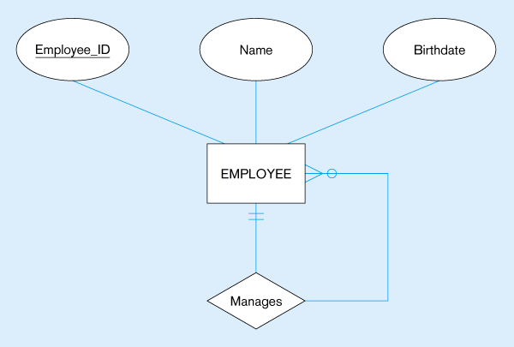

Mapping a unary 1:N relationship
(a) EMPLOYEE entity with Manages relationship
(b) EMPLOYEE relation with recursive foreign key

Slide 6
Unary many-to-many (M:N) relationships
Here two relations are created, one to represent the entity type in the relationship and another representing the M:N relationship itself
The primary key of the associative relation consists of two attributes, both taking their values from the primary key of the other relation
Any non-key attribute of the relationship is included in the associative relation
The following Fig. illustrates this

Slide 7
Unary many-to-many (M:N) relationships
Here a bill-of-materials relationship among items that are assembled from other items or components is shown.
The relationship ‘Contains’ is M:N since a given item can contain numerous component items, and conversely an item can be used as a component in numerous other items

Slide 8
Unary many-to-many (M:N) relationships
The ITEM relation is mapped directly from the same identity type
COMPONENT is an associative relation whose primary key consists of two attributes that are arbitrarily named Item_No and Component_No
The attribute ‘Quantity’ is a nonkey attribute of this relation that for a given item records the quantity of a particular component used in the item
Notice that both Item_No and Component_No reference the primary key (Item_No) of the ITEM relation

Slide 9


Mapping a unary M:N relationship
(a) Bill-of-materials relationships (M:N)
(b) ITEM and COMPONENT relations

Slide 10
Unary many-to-many (M:N) relationships
We can easily query the above relation to determine the components of a given item
The following SQL query will list the immediate components (and their quantity) for an item number 100:
SELECT Component_No, Quantity
FROM COMPONENT
WHERE Item_No = 100

Slide 11
Step 6: map ternary (and n-ary) relationships
It is best to convert a ternary relationship to an associative entity in order to represent participation constraints more accurately. Firstly, we create a new associative relation. The default primary key of this relation consists of the three primary key attributes for the participating entities (sometimes additional attributes are required to form a unique primary key)
These attributes then act in the role of foreign keys that reference the individual primary keys of the participating entity types . Any attributes of the associative entity type become attributes of the new relation

Slide 12
map ternary (and n-ary) relationships
The following Fig. Represents a PATIENT receiving a TREATMENT from a PHYSICIAN
The associative entity type PATIENT_Treatment has the attributes Date, Time and Results and values of these are recorded for each instance of patient treatment
The primary key attributes Patient_ID, Physician_ID and Treatment_Code become foreign keys in PATIENT_TREATMENT – these are components of its primary key but do not uniquely identify a given treatment, since a patient may receive the same treatment from the same physician on more than one occasion

Slide 13
map ternary (and n-ary) relationships
Does including the attribute ‘Date’ as part of the primary key (along with the other 3 attributes) result in a primary key?
This would be so if a patient only receives one treatment from a given physician on a given date
If this is not the case, we include Time as part of the primary key, which now consists of five attributes: Patient_ID, Physician_ID, Treatment_Code, Date and Time

Slide 14
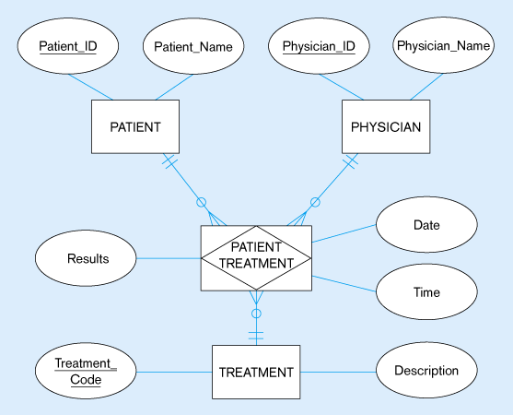
Mapping a ternary relationship
Ternary relationship with associative entity

Slide 15
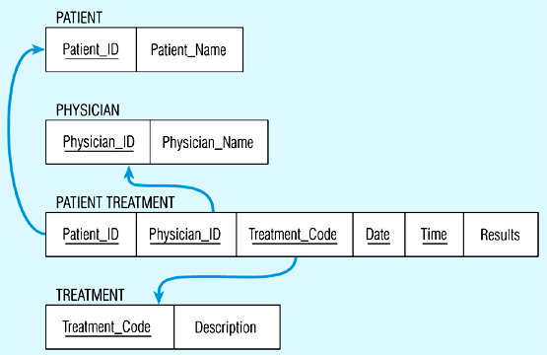
Mapping the ternary relationship
Remember that the primary key MUST be unique

Slide 16
Step 7: Map supertype/subtype relationships
Strategies to represent these in the relational model:
1: Create a separate relation for each supertype and for each of its subtypes
2: Assign to the relation created for the supertype the attributes that are common to all members of the supertype, including the primary key
3: Assign to the relation for each subtype the primary key of the supertype, and only those attributes that are unique to that subtype
4: Assign one (or more) attributes of the supertype to function as the subtype discriminator

Slide 17
Map supertype/subtype
The following 2 Figs. Show the supertype EMPLOYEE with subtypes HOURLY_EMPLOYEE, SALARIED_EMPLOYEE and CONSULTANT. The primary key of employee is Employee_Number and the attribute Employee_Type is the subtype discriminator
There is one relation for the supertype EMPLOYEE and one for each of the three subtypes, with the primary key for each of the four relations being Employee_Number.
A prefix is used to distinguish each of the primary keys, e.g. S_Employee_Number is the primary key the relation SALARIED_EMPLOYEE

Slide 18
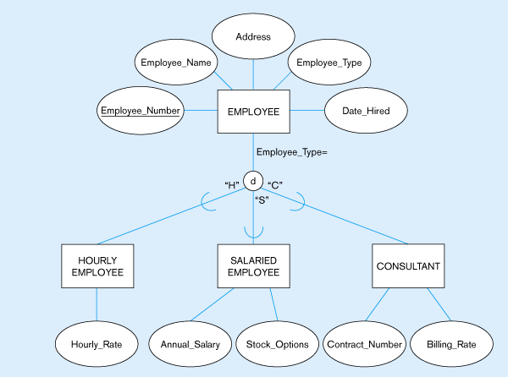
Figure 5-20: Supertype/subtype relationships

Slide 19
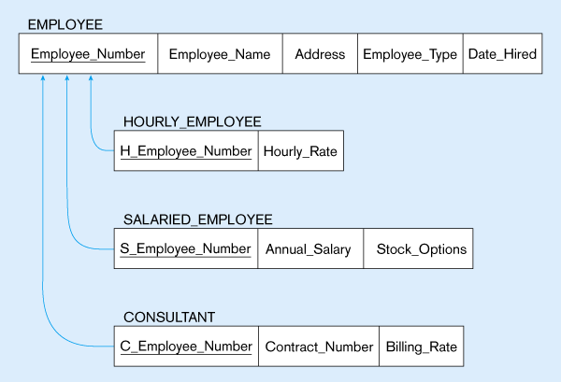
Figure 5-21:
Mapping Supertype/subtype relationships to relations

Slide 20
Map supertype/subtype
Each of these attributes is a foreign key that references the supertype primary key, as indicated by the arrows in the diagram. Each subtype relation contains only those attributes peculiar to the subtype
For each subtype a relation can be produced that contains all of the attributes (both specific and inherited). Supposing we want to display a table containing all the attributes of SALARIED_EMPLOYEE:
SELECT *
FROM EMPLOYEE, SALARIED EMPLOYEE
WHERE Employee_Number = S_Employee_Number;

Slide 21
Introduction to normalisation
Normalisation = a formal process for deciding which attributes should be grouped together in a relation
It is the primary tool to validate and improve a logical design so that it satisfies certain constraints that avoid unnecessary duplication of data
Normalisation is the process of decomposing relations with anomalies to produce smaller, well-structured relations

Slide 22
Steps in normalisation
A normal form is a state of a relation that results from applying simple rules regarding functional dependencies (relationships between attributes) to that relation
First normal form: Any multivalued attributes (repeating groups) have been removed, so there is a single value (possibly null) at the intersection of each row and column of the table
Second normal form: Any partial functional dependencies have been removed
Third normal form: Any transitive dependencies have been removed

Slide 23
Steps in normalisation
Boyce/Codd normal form: Any remaining anomalies that result from functional dependencies have been removed
Fourth normal form: Any multivalued dependencies have been removed
Fifth normal form: Any remaining anomalies have been removed
Usually only bother with First to third
Following Fig shows process:

Slide 24
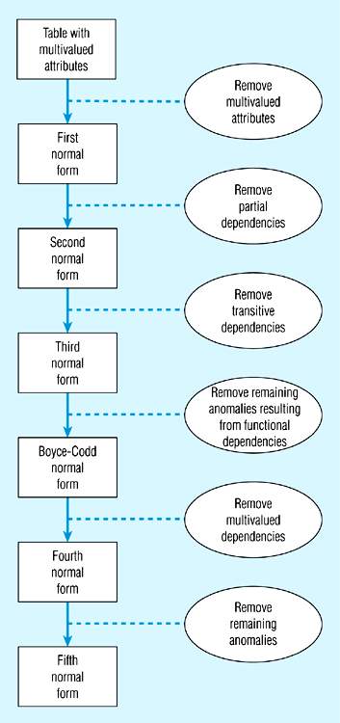
Steps in normalization

Slide 25
Functional dependencies and keys
Functional dependency = a constraint between two attributes or two sets of attributes
For a relation R, attribute B is functionally dependent on attribute A if for every valid instance of A, that value of A uniquely defines the value of B
If B is functionally dependent on A we write A → B
The attribute on the left-hand side of the arrow is called a determinant

Slide 26
Functional dependencies and keys
An attribute may be functionally dependent on two or more attributes
e.g., the relation EMP_COURSE (Emp_ID, Course_Title, Date_Completed) can have its functional dependencies described as:
Emp_ID, Course_Title → Date_Completed
i.e., the date a course is completed is completely determined by the identity of the employee and the title of the course

Slide 27
Functional dependencies and keys
Other examples:
VIN → Make, Model, Colour, i.e. the make, model and colour of a vehicle are functionally dependent on the vehicle identification number
ISBN → Title, First_Author_Name, i.e. the title of a book and the name of the first author are functionally dependent on the book’s ISBN

Slide 28
Candidate keys
Candidate key = an attribute or combination of attributes that uniquely identifies a row in a relation. Must satisfy the following properties:
Unique identification – for every row the value of the key must uniquely identify that row. This property implies that each nonkey attribute is functionally dependent on that key.
Nonredundancy – no attribute in the key can be deleted without destroying the property of unique identification

Slide 29
Candidate keys
Considering the previously-discussed EMPLOYEE1 (Emp_ID, Name, Dept_Name, Salary) relation, Emp_ID is the only determinant in this relation, and all the attributes are functionally dependent on it
Therefore Emp-ID is a candidate key, and since there are no other candidate keys it is also the primary key
For the relation EMPLOYEE2 (Following Figs.) note that Emp_ID does not uniquely identify a row in the relation
There are two functional dependencies in this relation:
Emp_ID → Name, Dept_Name, Salary
Emp_ID, Course_Title → Date_Completed

Slide 30

The EMPLOYEE2 relation
Question – Is this a relation?
Answer – Yes: unique rows and no multivalued attributes
Question – What’s the primary key?
Answer – Composite: Emp_ID, Course_Title

Slide 31
Candidate keys
The functional dependencies indicate that the combination of Emp_ID and Course_Title is the only candidate (composite) key (and therefore the primary key) for EMPLOYEE2, as neither uniquely identifies a row in this relation
We represent the functional dependencies in this relationship in the following Fig. (note here that Date_Completed is the only attribute that is functionally dependent on the full primary key consisting of the attributes Emp_ID and Course_Title)

Slide 32
Relationship between determinants and candidate keys
A candidate key is always a determinant, whilst a determinant may or may not be a candidate key
A candidate key is a determinant that uniquely identifies the remaining (nonkey) attributes in a relation
A determinant may be a candidate key, part of a composite candidate key or a nonkey attribute

Slide 33
First normal form (1NF)
First normal form = contains no multivalued attributes
Usually, when you map ER diagrams into relations, you remove multivalued attributes from entity types on the ER diagram, so there should not be any multivalued attributes remaining
However, many old legacy systems supported multivalued attributes, so we must understand how to get rid of them

Slide 34
Second normal form (2NF)
2NF = already in 1NF and every nonkey attribute is fully functionally dependent on the primary key – thus no nonkey attribute is functionally dependent on part (but not all) of the primary key. If in 1NF will be in 2NF if any one of the following conditions applies:

Slide 35
2NF
The primary key consists of only one attribute(such as Emp_ID in EMPLOYEE1)
No nonkey attributes exist in the relation (thus all of the attributes in the relation are components of the primary key)
Every nonkey attribute is functionally dependent on the full set of primary key attributes

Slide 36
2NF
EMPLOYEE2 is an example of a relation that is not in 2NF
The primary key for this relation is the composite key Emp_ID and Course_Title.
Therefore the nonkey attributes Name, Dept_Name and Salary are functionally dependent on part of the primary key (Emp_ID) but not on Course_Title (see Fig.)

Slide 37
Functional Dependencies in EMPLOYEE2
Dependency on entire primary key
EmpID
CourseTitle
Name
DeptName
Salary
DateCompleted
Dependency on only part of the key
EmpID, CourseTitle ➔ DateCompleted
EmpID ➔ Name, DeptName, Salary
Therefore, NOT in 2nd Normal Form!!

Slide 38
Well-Structured Relations
A relation that contains minimal data redundancy and allows users to insert, delete, and update rows without causing data inconsistencies
Goal is to avoid anomalies
  Insertion Anomaly – adding new rows forces user to create duplicate data
  Deletion Anomaly – deleting rows may cause a loss of data that would be needed for other future rows
  Modification Anomaly – changing data in a row forces changes to other rows because of duplication
General rule of thumb: a table should not pertain to more than one entity type

Slide 39
2NF
Partial functional dependency = a functional dependency in which one or more nonkey attributes (such as Name) are functionally dependent on part (but not all) of the primary key
In EMPLOYEE2 this creates redundancy in that relation, which results in anomalies when that table is updated (as noticed previously: Insertion, Deletion and Modification anomalies)

Slide 40
Converting to 2NF
To do this we decompose the relation into new relations that satisfy one (or more) of the conditions described above. EMPLOYEE2 is decomposed into the following 2 relations:
1: EMPLOYEE1 (Emp_ID, Name, Dept_Name, Salary). This satisfies the first condition above and is in 2NF
2: EMP_COURSE (Emp_ID, Course_Title, Date_Completed) This satisfies the third property above and is also in 2NF

Slide 41
Converting to 2NF
Decomposed into two separate relations
Both are full functional dependencies
EmpID
Name
DeptName
Salary
EmpID
CourseTitle
DateCompleted

Slide 42
Third normal form (3NF)
3NF = already in 2NF and no transitive dependencies exist
Transitive dependency = a functional dependency between two (or more) nonkey attributes.
E,g. SALES(Cust_ID, Name, Salesperson, Region) – Cust_ID the primary key so that all the remaining attributes are functionally dependent on this
However there is a transitive dependency, as Region is dependent on Salesperson and Salesperson is dependent on Cust_ID
As a result there would be update anomalies for this

Slide 43
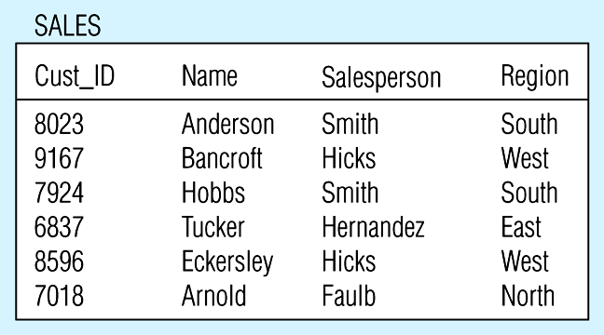
Relation with transitive dependency
SALES relation with simple data

Slide 44
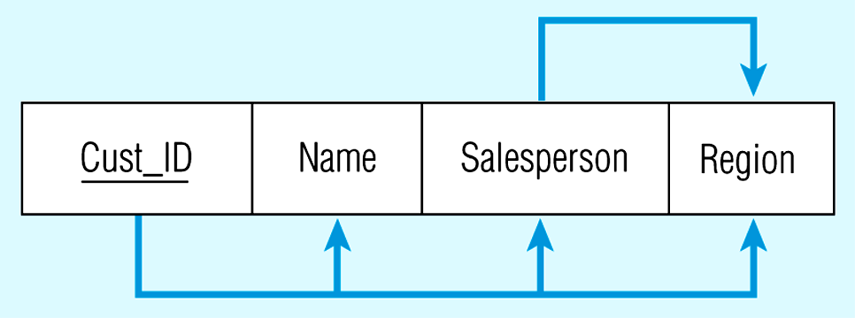
Relation with transitive dependency
CustID → Name
CustID → Salesperson
CustID → Region
All this is OK
(2nd NF)
BUT
CustID → Salesperson → Region
Transitive dependency
(not 3rd NF)

Slide 45
Anomalies
Insertion anomaly because a new salesperson assigned to the ‘North Region’ cannot be entered until a customer has been assigned, because a value for Cust_ID must be provided to insert a row in the table
Deletion anomaly because if customer 6837 is deleted from the table, we lose the information that salesperson Hernandez is assigned to the ‘East Region’
Modification anomaly because if salesperson Smith is reassigned to the ‘East Region’, several rows must be changed to reflect that fact

Slide 46
Removing transitive dependencies
This can be done by decomposing SALES into two relations (see Following Figs.)
Salesperson, which is the determinant in the transitive dependency in SALES, becomes the primary key in SPERSON
Salesperson becomes a foreign key in SALES1
Also uses less storage space because the dependent data (such as Region) do not have to repeat for each customer

Slide 47
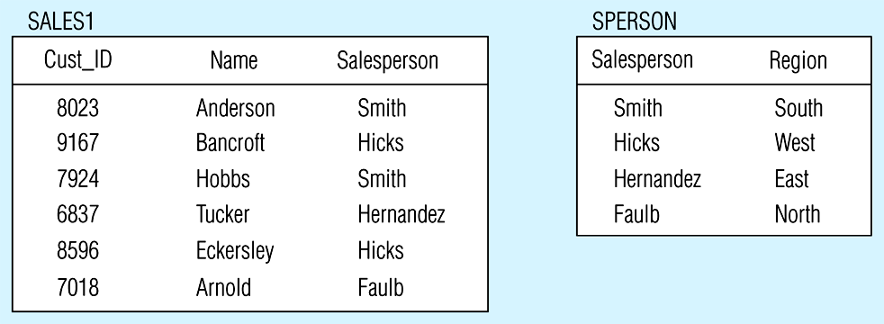
Removing a transitive dependency
(a) Decomposing the SALES relation

Slide 48
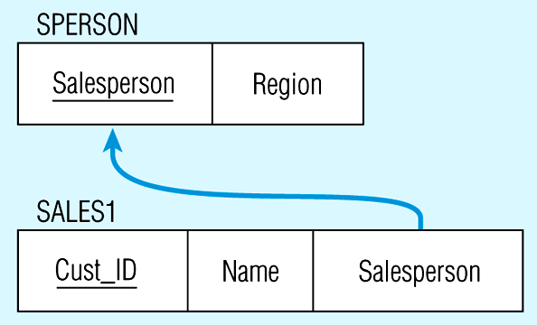
Relations in 3NF
Salesperson → Region
CustID → Name
CustID → Salesperson
Now, there are no transitive dependencies…
Both relations are in 3rd NF

Slide 49
Transitive dependencies
May also occur between sets of attributes in a relation
The relation SHIPMENT(Snum, Origin, Destination, Distance) could have a transitive dependency if the Distance attribute is functionally dependent on the pair of nonkey attributes Origin and Destination
We can remove the transitive dependencies by decomposing into 2 relations:
SHIPTO(Snum, Origin, Destination)
DISTANCES(Origin, Destination, Distance)

Slide 50
Other Normal Forms
Relations in 3NF are sufficient for most practical database applications, however 3NF does not guarantee that all anomalies have been removed
Boyce-Codd NF - All determinants are candidate keys…there is no determinant that is not a unique identifier
4NF - No multivalued dependencies
5NF - very rare
Domain-key NF - The “ultimate” NF…perfect elimination of all possible anomalies – practical utility quite limited

