Slide 1
Network Intrusion Detection Using Adversarial Machine Learning Technique
Presented By
Supervised By
Farhan Shariar
Roll:1807094
Dr. Kazi Md. Rokibul Alam
Professor
Department of Computer Science & Engineering
Khulna University of Engineering & Technology
Khulna -9203, Bangladesh

Slide 2
OUTLINE
Motivation
Introduction
Related works
Objectives
Methodology
Progress
Conclusion
References

Slide 3
MOTIVATION
Cybersecurity threats are growing rapidly in modern days.
The conventional Intrusion Detection Systems are struggling to keep up with evolving attack methods.
To overcome with the current situation we need advanced techniques to predict the attack methods as well as we have to train the system to successfully detect the attacks.

Slide 4
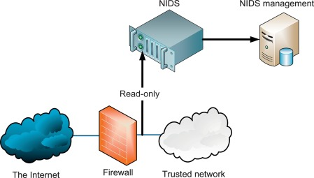
Introduction
What is an Intrusion Attack?
A security event, or a combination of multiple security events, that constitutes a security incident in which an intruder gains, or attempts to gain, access to a system or system resource without having authorization to do so
Network Intrusion Detection System(NIDS):
A network security technology originally built for detecting vulnerability exploits against a target application or computer
A listen-only device. The NIDS monitors traffic and reports results to the administrator.
Figure 1: NIDS

Slide 5
Introduction
Limitations of Conventional Machine Learning Based NIDS:
Can hardly detect modified malicious traffic.
Role of Adversarial Machine Leaning in NIDS
Adversarial machine learning involves training models to be robust against adversarial attacks, where malicious actors intentionally manipulate input data to deceive the model.

Slide 6
Related works
Alhajjar, al.[1] proposed three adversarial techniques to record performances of conventional machine learning models.
- Best Features:
1. Three novel approaches for generating adversarial attacks.
2. Simple approach with extensive False-Position rate.
- Limitations:
1. Adversarial Attack is not discussed on Advanced machine learning models.
2. Did not mentioned the reason about different false-position rates on different models.

Slide 7
Related works
Imrana, al.[2] proposed a Bidirectional LSTM Deep Learning approach for intrusion detection
- Best Features:
1. Higher accuracy for U2R and R2L attack.
2. Works better than conventional LSTM model.
- Limitations:
1. No discussion or analysis on adversarial attack-based inputs and corresponding performance of the model.

Slide 8
Problem Statement
Adversarial examples manipulate machine learning models to induce misclassifications in NIDS.
Conventional NIDS struggle to effectively counter the subtleties of adversarial manipulation.
The problem centers on fortifying NIDS against adversarial attacks to prevent breaches and disruptions.
An interdisciplinary approach is essential to comprehensively address this vulnerability.

Slide 9
OBJECTIVES
Assess NIDS susceptibility: Explore the extent of vulnerability to adversarial inputs.
Evaluate specialized Bidirectional LSTM model: Measure the effectiveness of a customized model in detecting adversarial attacks.
Generate adversarial instances: Utilize GAs and GANs to create potent adversarial inputs.
Enhance NIDS robustness: Propose an innovative methodology to strengthen NIDS against adversarial attacks.
Provide practical insights: Offer actionable insights into adversarial impact on NIDS for informed security strategies.

Slide 10
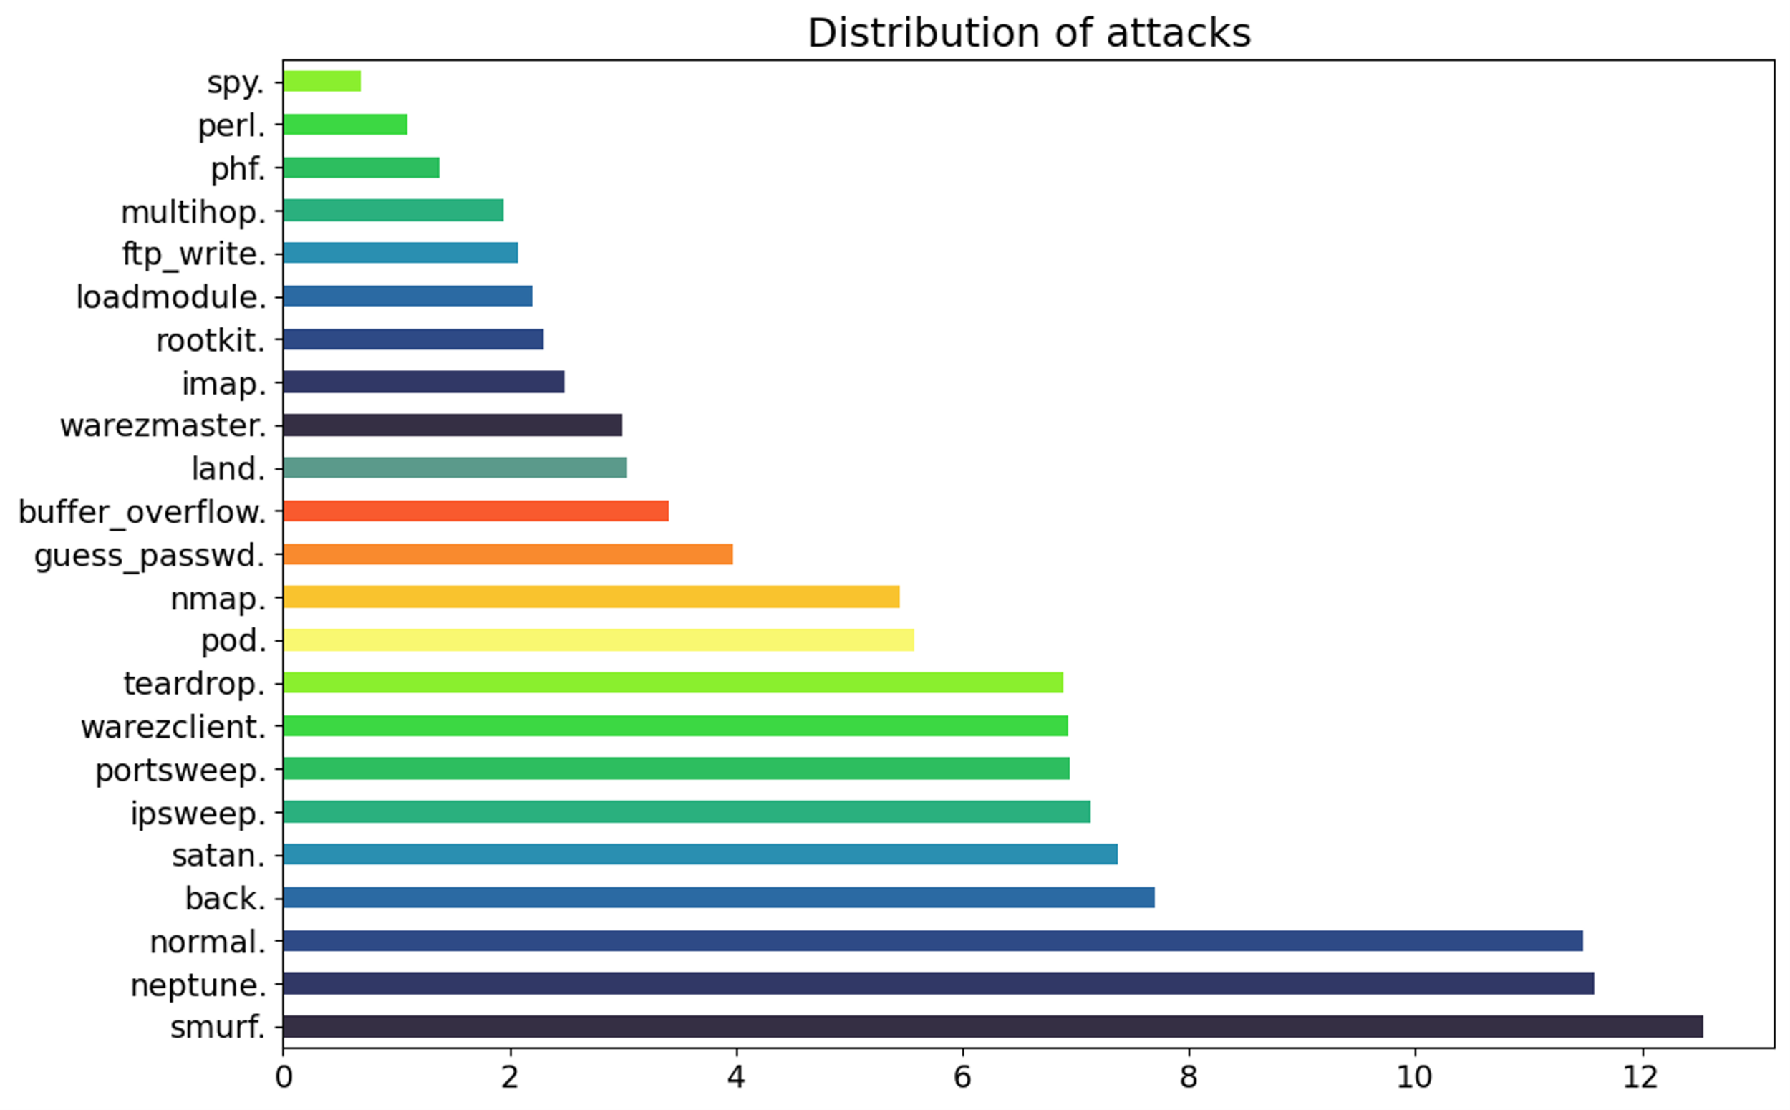
METHODOLOGY
1. Dataset Observation and Preprocessing:
The NSL-KDD dataset
Four main categories of attacks: DoS (Denial of Service), R2L (Remote-to-Local), U2R (User-to-Root), and probing attacks.
Total features: 41 (Mutable: 21)
Preprocessing:
1. One hot Encoding(121 features)
2. Min-max scaling
Figure 2: Distribution of Attacks (NSL-KDD)

Slide 11
METHODOLOGY Contd.
2. Adversarial Instance Generation:
Two approaches:
1. Genetic Algorithm(Mutation and crossover on mutable features)
2. Generative Adversarial Network (GAN)
3. Specialized Bidirectional LSTM model:
Developing a specialized Bidirectional Long Short-Term Memory (LSTM) Deep Learning model is crafted to capture temporal patterns within network data effectively.

Slide 12
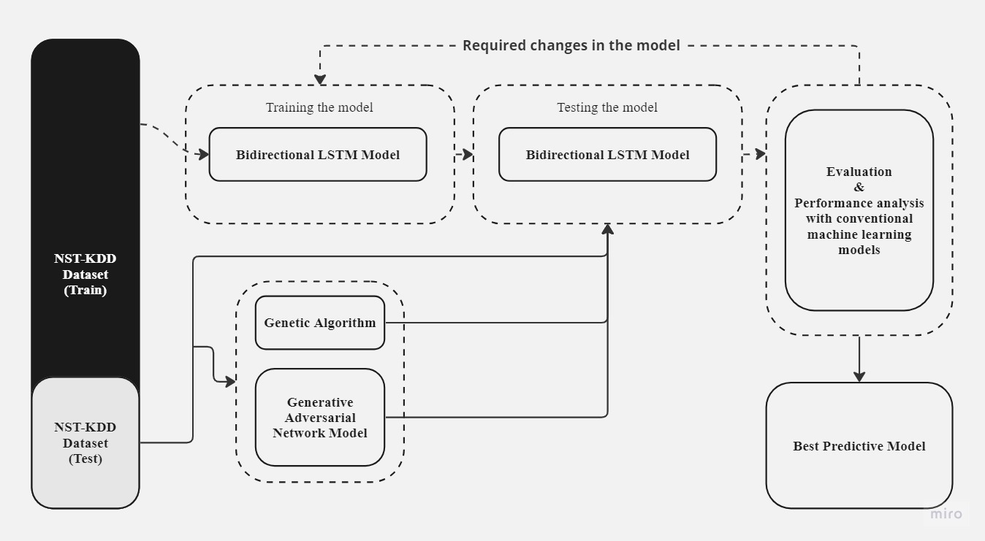
METHODOLOGY Contd.
Testing with two types of dataset:
1. Original test data
2. Adversarial data
Tuning model parameters to get the best output.
Selecting the model
Figure 3: Overview of proposed approach

Slide 13
METHODOLOGY Contd.
4. Comparison and Insights:
Test conventional NIDS models and specialized LSTM model against adversarial instances.
Measure accuracy, precision, and detection capabilities under adversarial conditions.
Method | Accuracy(KDDTest+) | Accuracy(KDDTest-21)
Random forest | 80.67% | 63.26%
Conventional LSTM | 89.81% | 79.87%
BiDLSTM | 94.26% | 87.46%
Table 1: Comparison with other machine learning models by Y. Imrana et al[2]

Slide 14
PROGRESS
Completed
Remaining
Idea Selection.
Comprehensive Literature Study.
Finalizing the Research Focus.
Methodology Study.
Dataset Acquisition
Prepare adversarial input generation methods.
Implementation a detection model
Finalizing the Research Focus.
Implementation a detection model
Evaluate the Model's Performance and Make Necessary Changes for Improvement

Slide 15

PROGRESS CONTD.
Figure 4: Gantt Chart

Slide 16
CONCLUSION
Exposing vulnerabilities: Adversarial attacks highlight weaknesses in NIDS models.
Specialized model's potential: Bidirectional LSTM model identifies adversarial noise amidst genuine patterns
Societal implications: Strengthening NIDS is essential for safeguarding digital realms.
Fortifying defenses: Addressing adversarial vulnerabilities is pivotal for network security.

Slide 17
references
[1] E. Alhajjar, P. Maxwell, and N. Bastian, “Adversarial machine learning in Network Intrusion Detection Systems,” Expert Systems with Applications, vol. 186, p. 115782, Dec. 2021, doi: https://doi.org/10.1016/j.eswa.2021.115782.
‌[2] Y. Imrana, Y. Xiang, L. Ali, and Z. Abdul-Rauf, “A bidirectional LSTM deep learning approach for intrusion detection,” Expert Systems with Applications, vol. 185, p. 115524, Dec. 2021, doi: https://doi.org/10.1016/j.eswa.2021.115524.
‌[3] S.-J. Horng et al., “A novel intrusion detection system based on hierarchical clustering and support vector machines,” Expert Systems with Applications, vol. 38, no. 1, pp. 306– 313, Jan. 2011, doi: https://doi.org/10.1016/j.eswa.2010.06.066

Slide 18
THANK YOU

Slide 19
Questions?

