Slide 1
Blind (Un-Informed)
and
Heuristic (informed) Strategies

Slide 2
Blind vs. Heuristic Strategies
Blind (or un-informed) strategies have no additional information except available in problem definition
  Distinguish a goal state from a non goal state.
Heuristic (or informed) strategies know whether one non goal state is more promising than others.

Slide 3
Example: 8-puzzle
For a blind strategy, N1
and N2 are just two nodes
(at some depth in the search
tree)
For a heuristic strategy
counting the number of
misplaced tiles, N2 is more
promising than N1
8
2
3
4
7
STATE
N1
5
1
6
1
2
3
1
2
3
4
5
6
4
5
STATE
7
8
N2
7
8
6
Goal state

Slide 4
Blind Strategies
Breadth-first
  Bidirectional
Depth-first
  Depth-limited
  Iterative deepening
Uniform-Cost
Step cost = 1
Step cost = c ≥ ε > 0

Slide 5
Breadth-First Strategy
Expand shallowest unexpanded node.
New nodes are inserted at the end of FRINGE.
1
2
3
FRINGE = (1)
4
5
6
7
FRINGE:
Set of search nodes that have not been expanded yet
The ordering of the nodes in FRINGE defines the search strategy

Slide 6
Breadth-First Strategy
Expand shallowest unexpanded node.
New nodes are inserted at the end of FRINGE.
1
2
3
FRINGE = (2, 3)
4
5
6
7

Slide 7
Breadth-First Strategy
Expand shallowest unexpanded node.
New nodes are inserted at the end of FRINGE.
1
2
3
FRINGE = (3, 4, 5)
4
5
6
7

Slide 8
Breadth-First Strategy
Expand shallowest unexpanded node.
New nodes are inserted at the end of FRINGE.
1
2
3
FRINGE = (4, 5, 6, 7)
4
5
6
7

Slide 9
Bidirectional search
Run two simultaneous searches-one forward from the initial state and the other backward from the goal state.
It is implemented by checking each node before it is expanded to see if it is in the fringe of the other search tree.
Otherwise Stop when two searches meet in the middle.

Slide 10
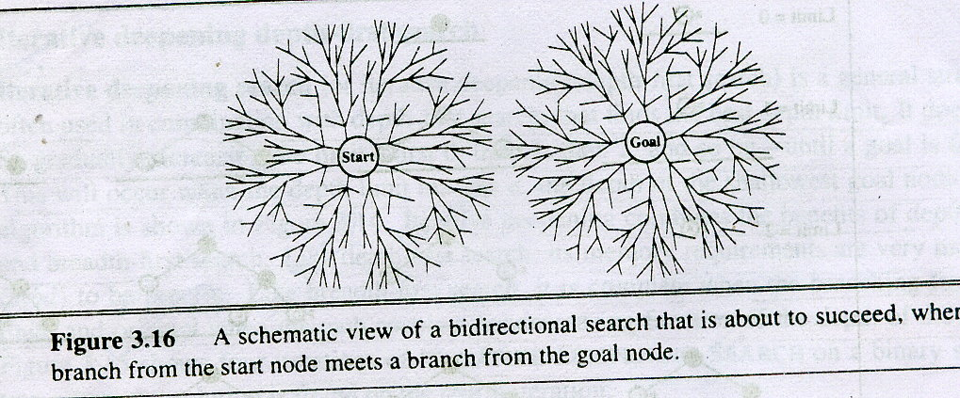
Bidirectional Strategy

Slide 11
Bidirectional Strategy
2 fringe queues: FRINGE1 and FRINGE2
d
d/2
d/2

Slide 12
Depth-First Strategy
Expand deepest unexpanded node
New nodes are inserted at the front of FRINGE
1
2
3
4
5

Slide 13
Depth-First Strategy
Expand deepest unexpanded node
New nodes are inserted at the front of FRINGE
1
2
3
4
5

Slide 14
Depth-First Strategy
Expand deepest unexpanded node
New nodes are inserted at the front of FRINGE
1
2
3
4
5

Slide 15
Depth-First Strategy
Expand deepest unexpanded node
New nodes are inserted at the front of FRINGE
1
2
3
4
5

Slide 16
Depth-First Strategy
Expand deepest unexpanded node
New nodes are inserted at the front of FRINGE
1
2
3
4
5

Slide 17
Depth-First Strategy
Expand deepest unexpanded node
New nodes are inserted at the front of FRINGE
1
2
3
4
5

Slide 18
Depth-First Strategy
Expand deepest unexpanded node
New nodes are inserted at the front of FRINGE
1
2
3
4
5

Slide 19
Depth-First Strategy
Expand deepest unexpanded node
New nodes are inserted at the front of FRINGE
1
2
3
4
5

Slide 20
Depth-First Strategy
Expand deepest unexpanded node
New nodes are inserted at the front of FRINGE
1
2
3
4
5

Slide 21
Depth-First Strategy
Expand deepest unexpanded node
New nodes are inserted at the front of FRINGE
1
2
3
4
5

Slide 22
Depth-First Strategy
Expand deepest unexpanded node
New nodes are inserted at the front of FRINGE
1
2
3
4
5

Slide 23
Problem
If one subtree were of unbounded depth but contained no solution, it would never terminate.
To overcome this depth limited search is used.

Slide 24
Depth-Limited Strategy
Depth-first with depth limit k (maximal depth below which nodes are not expanded)
Three possible outcomes:
  Solution
  Failure (no solution)
  Cutoff (no solution within depth limit)

Slide 25

Iterative deepening search l =0

Slide 26

Iterative deepening search l =1

Slide 27

Iterative deepening search l =2

Slide 28

Iterative deepening search l =3

Slide 29
Uniform-Cost Strategy
Each step has some cost ≥ ε > 0.
The cost of the path to each fringe node N is
g(N) = Σ costs of all steps.
The goal is to generate a solution path of minimal cost.
The FRINGE is sorted in increasing cost.
A
S
0
1
10
S
5
B
5
G
A
B
C
1
5
15
5
15
C
G
G
11
10

Slide 30
Informed Search
Informed search(heuristic search)
  They are given problem-specific knowledge such how far it is from the goal.

Slide 31
General approach
Best-first search: The node is selected for an expansion based on an evaluation function.f(n).
Define an evaluation function:
f : node N → real number
whose value depends on the state of N
The node with the lowest evaluation is selected for expansion, because the evaluation measures the distance to the goal.
Order the fringe in increasing f
[the smaller f, the better]
Choose the node that appears to be best according to the evaluation function.

Slide 32
Heuristic Function
Key components of best-first search is heuristic function.
Function h(N) that estimates the cost of the cheapest path from node N to goal node.
Example: 8-puzzle
1
2
3
1
2
3
h(N) = number of misplaced tiles
= 0
4
5
6
4
5
6
7
8
7
8
N
goal

Slide 33
Heuristic Function
Key components of best-first search is heuristic function.
Function h(N) that estimates the cost of the cheapest path from node N to goal node.
Example: 8-puzzle
5
8
1
2
3
h(N) = number of misplaced tiles
= ?
4
2
1
4
5
6
7
3
6
7
8
N
goal

Slide 34
Heuristic Function
Key components of best-first search is heuristic function.
Function h(N) that estimates the cost of the cheapest path from node N to goal node.
Example: 8-puzzle
5
8
1
2
3
h(N) = number of misplaced tiles
= 6
4
2
1
4
5
6
7
3
6
7
8
N
goal

Slide 35
Examples of Evaluation functions
Let g(N) be the cost of the best
path found so far between the initial
node and N
f(N) = h(N) → greedy best-first
f(N) = g(N) + h(N)

Slide 36

Romania with step costs in km

Slide 37
Greedy best-first search
Evaluation function f(n) = h(n) (heuristic)
h(n) = estimate of cost from n to goal
e.g., h_{SLD}(n) = straight-line distance from n to Bucharest.
h_{SLD}(arad)=?
Greedy best-first search expands the node that appears to be closest to goal

Slide 38

Greedy best-first search example

Slide 39

Greedy best-first search example

Slide 40

Greedy best-first search example

Slide 41

Greedy best-first search example

Slide 42
Greedy best-first search
It is not optimal.

Slide 43
A* search
Idea: avoid expanding paths that are already expensive
Evaluation function f(n) = g(n) + h(n)
g(n) = cost so far to reach n
h(n) = estimated cost from n to goal
f(n) = estimated total cost of path through n to goal

Slide 44

A* search example

Slide 45

A* search example

Slide 46

A* search example

Slide 47

A* search example

Slide 48

A* search example

Slide 49

A* search example

Slide 50
8-Puzzle
f(N) = h(N) = number of misplaced tiles
3
3
4
5
3
4
2
4
2
1
3
3
0
4
5
4

Slide 51
8-Puzzle
f(N) = g(N) + h(N)
with h(N) = number of misplaced tiles
3+3
1+5
2+3
3+4
5+2
0+4
3+2
4+1
1+3
2+3
5+0
3+4
1+5
2+4

