Slide 1
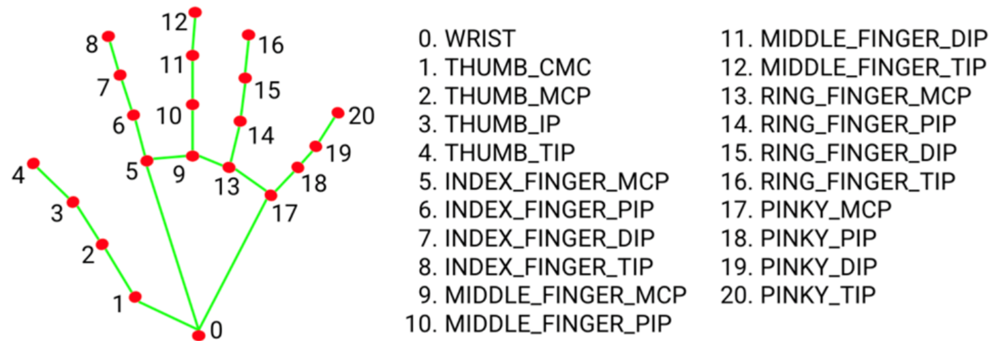
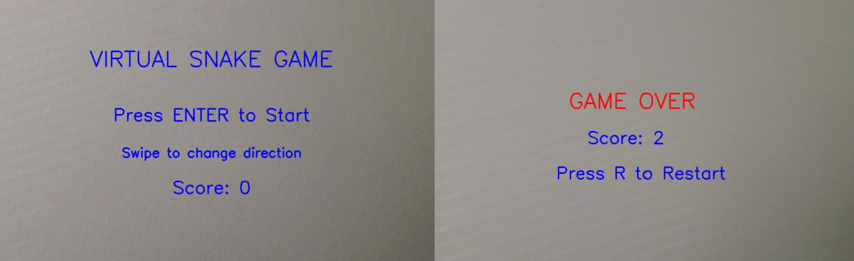
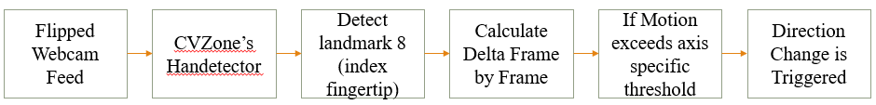
Vitrtual Snake Game
Shounak Powar Ishani Cheke
What is Gesture controlled Gaming
A Food Consumption
Collision Detection
.
                The food in the game is represented as a small image (e.g., food.png) and is randomly placed on the screen using Python’s random.randint() function. The food appears within the bounds of the play area and not overlapping any snake segment. In each frame, the game checks whether the head of the snake has collided with the food. This is determined by comparing the coordinates of the head and the food, allowing for a small tolerance to account for frame rate differences.
                distance = math.hypot(food_x - head_x, food_y - head_y)
                If distance < threshold:
                food_eaten = True
The evolution of human-computer interaction (HCI) has shifted from traditional keyboard and mouse inputs to more natural and immersive modalities like gesture control. In this project, we explore the integration of real-time hand tracking into a familiar and iconic game—the classic Snake. By replacing physical inputs with webcam-based gesture recognition, we create a contactless, intuitive interaction model where players control the snake using simple hand movements. This approach not only modernizes the gameplay experience but also showcases the potential of computer vision and gesture-based interfaces in broader applications. The project demonstrates how tools like OpenCV, MediaPipe, and CVZone can be combined to develop responsive, immersive, and user-friendly interaction systems.
At each frame update, the system performs collision detection to determine if the snake’s head has come into contact with any restricted element. Three types of collisions are monitored: self-collision, where the snake’s head overlaps any part of its own body; boundary collision, where the snake moves beyond the visible screen edges; and obstacle collision, where the head strikes any static object placed in the environment during enhanced game modes. These conditions are detected through coordinate comparisons between the snake’s head position and other entities. When a collision is detected, a game-over flag is triggered, and OpenCV renders an overlay message displaying the player's final score, effectively ending the game loop and signaling the end of the session.
∞
Mediapipe’s Hand Detection Landmarks
Et
Visual Feedback
A Gesture Detection Pipeline
Game Mechanism
snake’s Growth
The game retains the core mechanics of the classic Snake game, where the player navigates a continuously moving snake to consume food, grow in length, and avoid collisions. Unlike traditional keyboard-controlled versions, directional input in this version is managed through swipe-like gestures of the index finger, detected via a webcam. The snake turns only when a valid gesture is registered, preserving the continuous motion and strategic challenge of the original. Each food item consumed increases both the snake’s length and the player's score, progressively raising the difficulty as space for movement becomes limited. The game concludes with a game-over state if the snake collides with the screen boundary, its own body, or predefined obstacles.
When the food is detected as "eaten," the system performs three key actions: it generates a new food position on the screen, increments the player's score, and increases the snake's length. The snake is internally managed as a list of coordinate pairs, where each element represents one segment of the snake’s body (snake_list = [[x1, y1], [x2, y2], ...]). On each frame update, a new head segment—based on the snake’s direction—is inserted at the beginning of the list. If no food has been consumed, the last segment (the tail) is removed to maintain a constant length. However, when food is consumed, this tail removal step is skipped, causing the snake to grow naturally. This logic ensures consistent behavior while enabling responsive and visually smooth growth directly tied to player input, reinforcing the connection between gesture actions and in-game outcomes.
The game visuals are entirely rendered using OpenCV, eliminating the need for any external game engines. Each segment of the snake is drawn in real-time using cv2.circle(), while text overlays such as the current score or "Game Over" message are displayed using cv2.putText(). Unlike primitive shapes, the food item is displayed using a preloaded image, which adds visual detail and enhances the game’s appearance. The game frame is continuously updated and displayed using OpenCV’s cv2.imshow() function. In addition to gameplay visuals, an optional debugging window can display hand tracking overlays with detected landmarks, offering real-time visual feedback on gesture accuracy. This approach ensures efficient rendering while maintaining a clean and interactive user interface.
Github: https://github.com
Poster Session
youremail@iastate.edu

