Slide 1

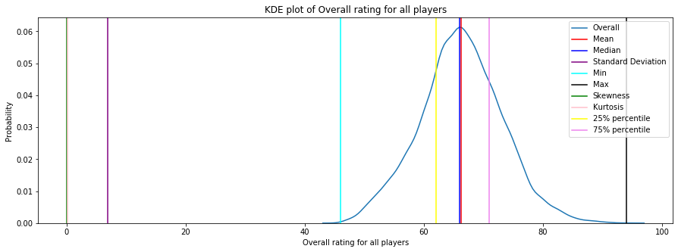
distribution PLOT of Overall rating for all players

Slide 2

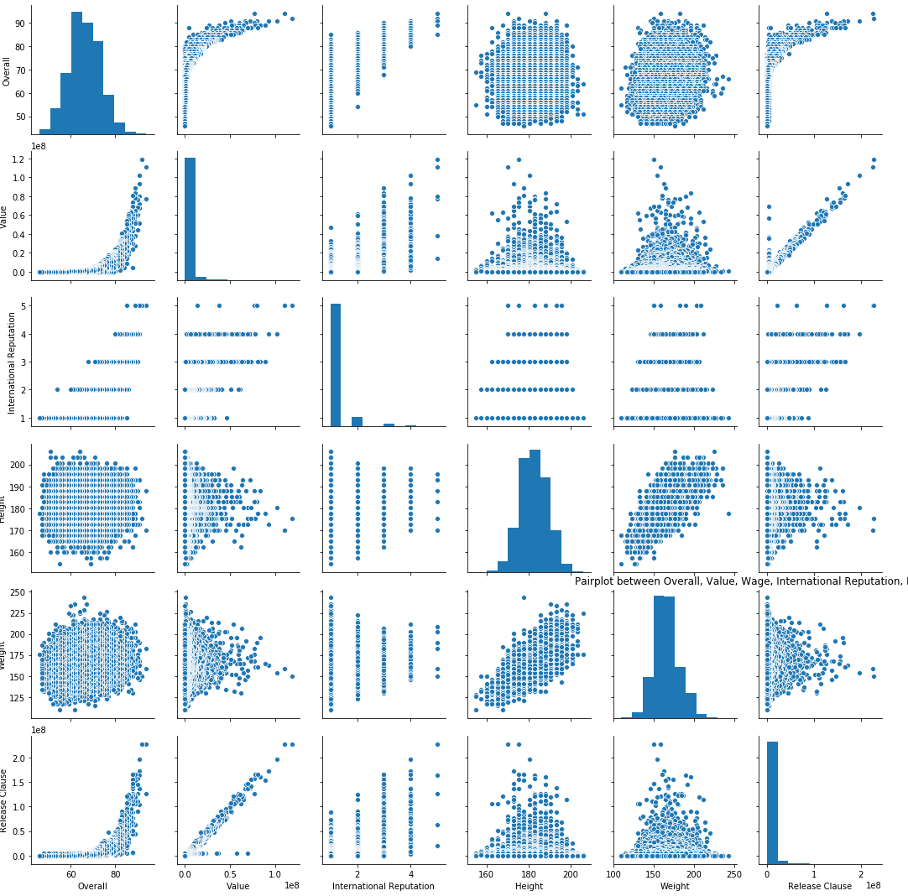
pair plots for the following variables: Overall, Value, Wage, International Reputation, Height, Weight, Release Clause

Slide 3
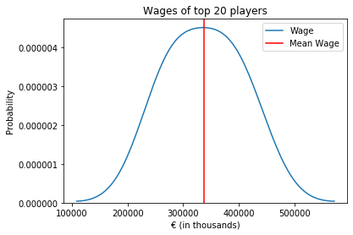
AVERAGE WAGE OF TOP 20 PLAYERS

Slide 4
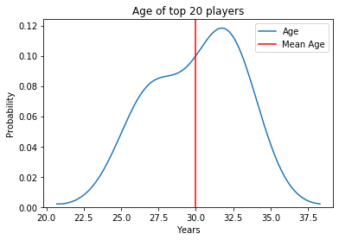
AVERAGE AGE OF TOP 20 PLAYERS

Slide 5
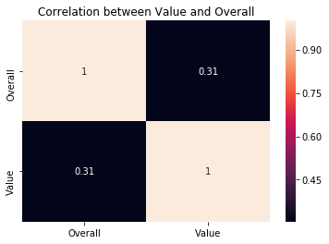
Heatmap for the correlation between Overall and value

Slide 6
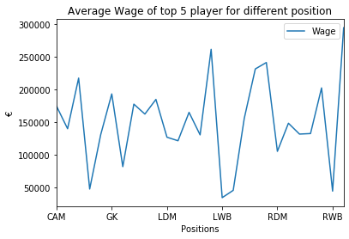
AVERAGE WAGE OF TOP 5 PLAYERS FROM DIFFERENT POSITION

