Slide 1
FRC Strategy
Jesse Knight
FRC 1885

Slide 2
This Session
Is…
Interactive, like Kickoff
An analytical approach to breaking down a game
A review of previous games
Meant to be done in December as a warm-up to kickoff
Is Not…
Going to tell of every uncommon anecdote
A guide to running your season

Slide 3
Format of this Session
Review game animations from 2007-2016
Only limited by time
2012, 2007, 2015, 2016
Discuss
What to do
Autonomous
Micro Strategies
Review actual game results
Week 1 Regionals
DC, VCU, Chesapeake
Championships

Slide 4
First: WHAT to do in a Game?
Types of success
Dominant (top 5%)
Team Player
All solo (sometimes)
Impact of repeating simple strategies multiple times
Special scoring situations
Most important rule of Strategy Brainstorming
If the rules don’t say a robot can’t do something … then you’re allowed to do it

Slide 5
Autonomous Strategy Overview
The animation usually shows the best autonomous for most
“Drive forward for 4 seconds” can usually score something
Interacting with partners
Get something out of their way (2015)
Setting up game pieces for them to take from you (2011/2014)
Active delivery to partners (2012)
Consistency vs Risk
3 discs vs 7 discs (2013)
3 high baskets vs 5 (2012)

Slide 6
Decisive Micro-Strategies
Some decisions have a HUGE impact on complexity
What game elements & zones get top priority
Field exclusion zones
Where to acquire the game piece
Randomly from the floor is an option
Slot, platform, pedestal (etc) are always the most consistent locations

Slide 7
Robot Priorities
With such a limited amount of time, what systems do you focus on most?
Karthik explains it much better than I do:
http://www.youtube.com/watch?v=Apk_X-maRf8
Search YouTube for “Effective FIRST Strategies”
It’s a 1:50:44 clip from Simbotics on YouTube

Slide 8

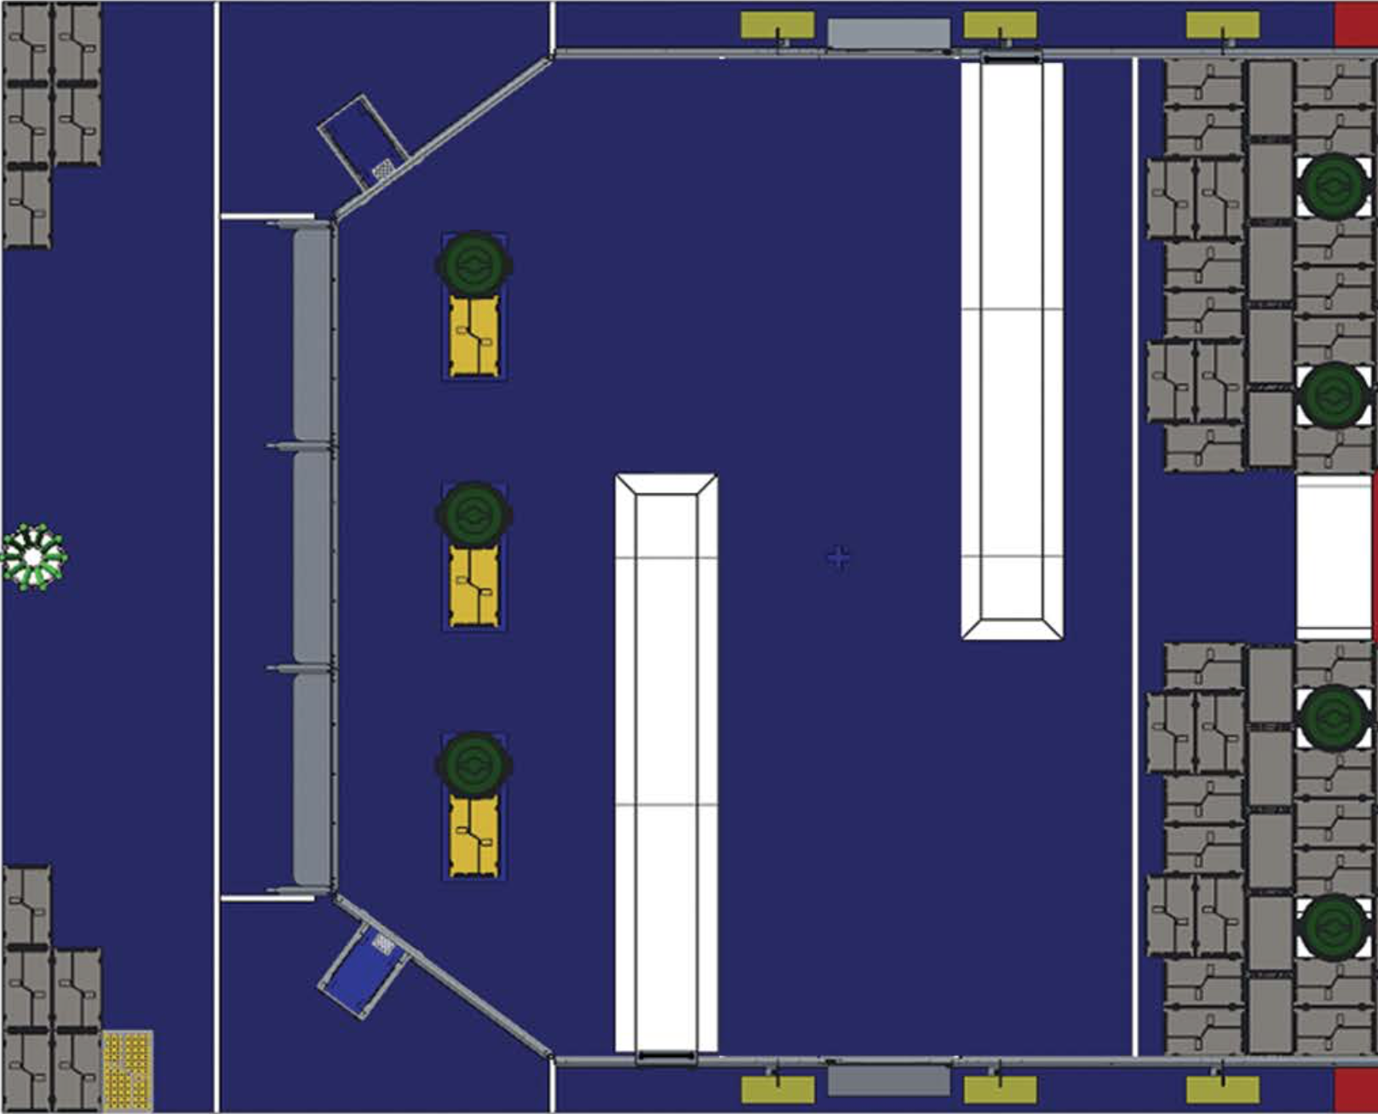
FRC 2015: Recycle Rush
<Video> - Field Layout below

Slide 9
FRC 2015: Recycle Rush
What to do?
Autonomous Strategies
Micro Strategies

Slide 10
Effective Winners
Could stack a tower of 4+ totes with a Can
At high levels of play, grab a can from the middle in auto
At high levels of play, manipulate the can

Slide 11

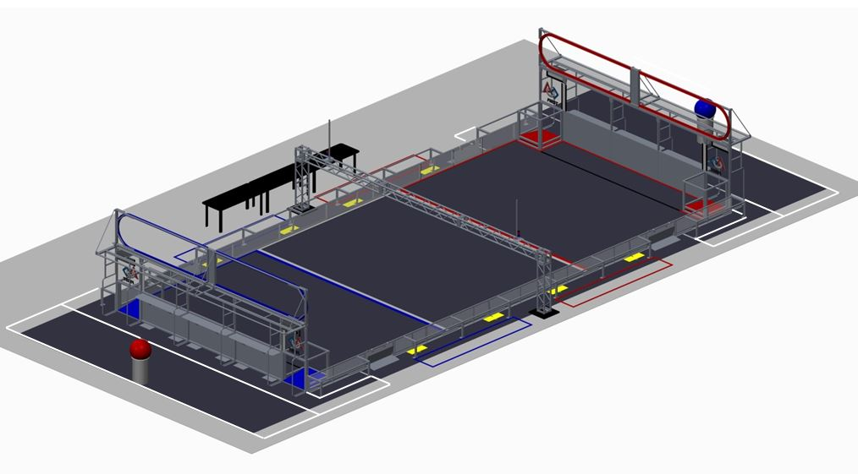
FRC 2014: Aerial Assist
<Video> - Field Layout below

Slide 12
FRC 2014: Aerial Assist
What to do?
Autonomous Strategies
Micro Strategies

Slide 13
Effective Winners
Could pass a ball to a partner
AND/OR
Launch a ball over the TRUSS
AND/OR
Score in the High Goal
AND
Play defense

Slide 14

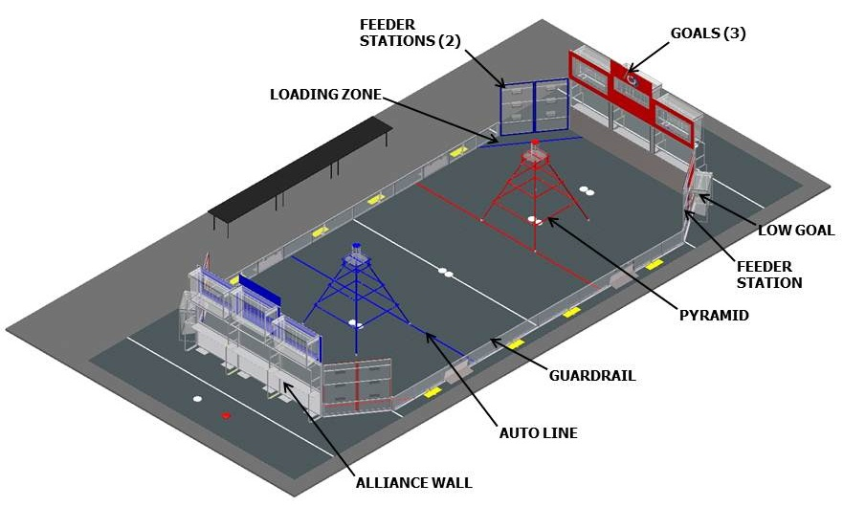
FRC 2013: Ultimate Ascent
<Video> - Field Layout below

Slide 15
FRC 2013: Ultimate Ascent
What to do?
Autonomous Strategies
Micro Strategies

Slide 16
Effective Winners
Going under pyramid helped avoid defense
Not a must
Autonomous
Consistent 3-disc
Defense
SHORT robots with GREAT, well-practiced drivers
Simple, highly-repeatable strategy
4 discs under-center, quick lineup (4-6 cycles)

Slide 17

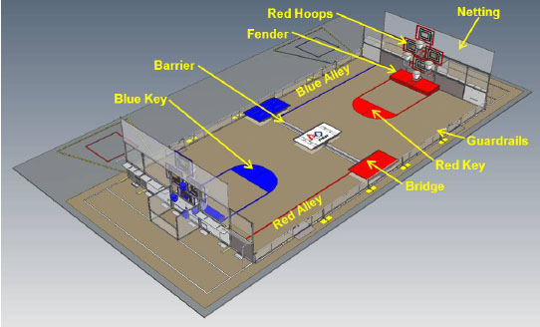
FRC 2012: Rebound Rumble
<Video> - Field Layout below

Slide 18
FRC 2012: Rebound Rumble
What to do?
Autonomous Strategies
Micro Strategies

Slide 19
Effective Winners
Field exclusion: 50% smaller without special consideration
Defense wasn’t possible without effective crossing
Autonomous options
Feed balls into partner
Consistency was easily doable
Drive forward and score into middle basket
Human player (non-obvious from animation)
Could launch ‘down’ fast enough to put the balls on the scoring side

Slide 20

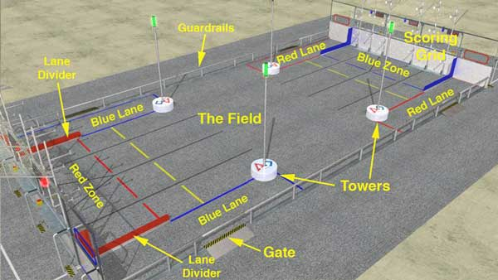
FRC 2011: Logomotion
<Video> - Field Layout below

Slide 21
FRC 2011: Logomotion
What to do?
Autonomous Strategies
Micro Strategies

Slide 22
Effective Winners
Special Scoring: 1st & 2nd place minibots
Smart human players had a major impact
Launching across the field to avoid defense
Control specific types of tubes
Dead-reckoned autonomous was ‘mostly’ effective

Slide 23

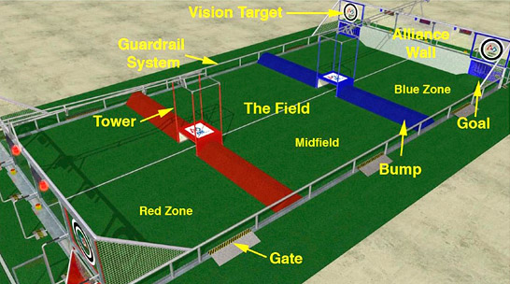
FRC 2010: Breakaway
<Video> - Field Layout below

Slide 24
FRC 2010: Breakaway
What to do?
Autonomous Strategies
Micro Strategies

Slide 25
Effective Winners
Most robots did not need to traverse zones
Endgame: 2 points
More than the average robot could score in 2 minutes with soccer balls
Dominant robots had great ball acquisition
A role for nearly every type of robot
Wonky seeding system
For fun
Search for videos of FRC 469, Las Guerillas

Slide 26

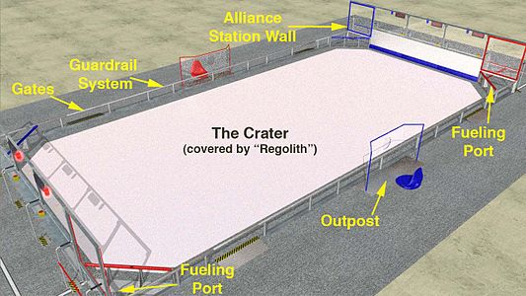
FRC 2009: Lunacy
<Video> - Field Layout below

Slide 27
FRC 2009: Lunacy
What to do?
Autonomous Strategies
Micro Strategies

Slide 28
Effective Winners
Autonomous
MUST move
Many robots moved into position for human loading
Empty Cell & Super Cell were ‘snuck’ into play
Defensive pinning was effective, but difficult without practice
Human player’s role was crucial

Slide 29

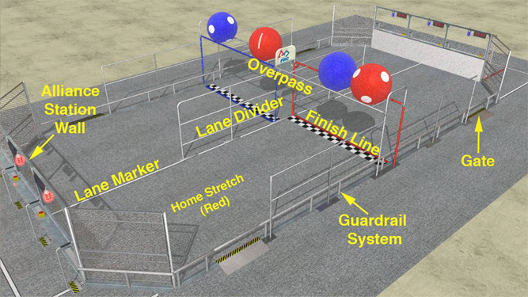
FRC 2008: Overdrive
<Video> - Field Layout below

Slide 30
FRC 2008: Overdrive
What to do?
Autonomous Strategies
Micro Strategies

Slide 31
Effective Winners
Not a great year for defense
The best offensive robots were great at
Driving
Acquiring (only applied to offense in ‘08)
Autonomous
Driving forward gave points 100% of the time
Dead-reckoned, timed autonomous routines could get 4-5 lines >50% of the time

Slide 32

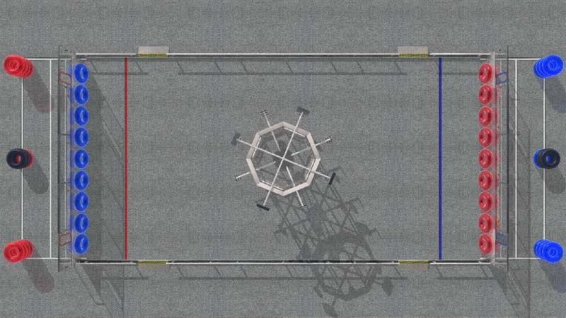
FRC 2007: Rack N Roll
<Video> - Field Layout below

Slide 34
FRC 2007: Rack N Roll
What to do?
Autonomous Strategies
Micro Strategies

Slide 35
Effective Winners
Heavy defensive robots
Nullified rack scoring
Messing up the opposing home zone could pull defensive lift bots back early
Robots which could lift two other robots
Consistent +60 points
Any scoring autonomous

Slide 36
Closing Thoughts
Remember, take a minute to figure out WHAT to do!
Communicate and convince the rest of the team

