Slide 1

Intro to web dashboards
Erik Boesen
December 10, 2016
FIRST Chesapeake Pre-Season Workshop
With thanks to Dustin Spicuzza

Slide 2
Agenda
History & Alternatives
Why Web-Based?
How it works
FRC Dashboard
Demo
Questions

Slide 3
Audience Assumptions
Knows how to use a browser
Common-sense knowledge of FRC Networking
Some programming experience
Not necessary, but helps

Slide 4
Dashboards
Lots of options these days
LabVIEW Dashboard
SmartDashboard/SFX
Custom (Java, C#, Web, et al)

Slide 5
Dashboard Applications
Robot Control by secondary operator
Click a button, make something happen
Set up autonomous mode
Makes it easy to switch between different mode settings on the fly

Slide 6
Dashboard Uses
Tuning
Changing positions dynamically
Better than constant code redeploy!
Providing visual feedback for sensors
Good for debugging hardware issues

Slide 7
History
Dashboards

Slide 8
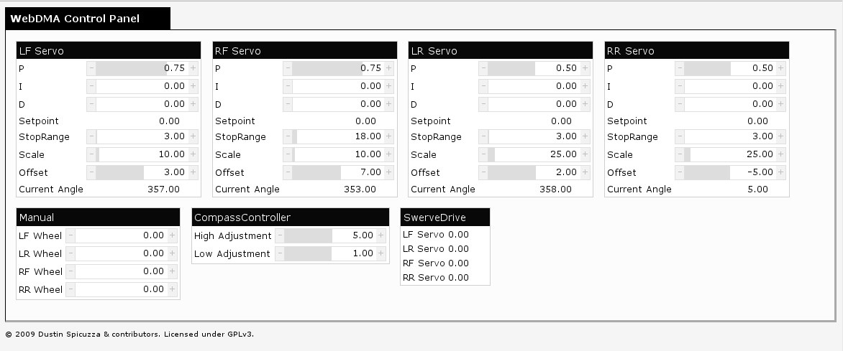
History: 2009/2010
WebDMA (C++)

Slide 9
History: 2009/2010
WebDMA (C++)
Not actually a dashboard
Ran an in-process webserver on the cRIO
UI was HTML/JS
Great for tuning and little else

Slide 10
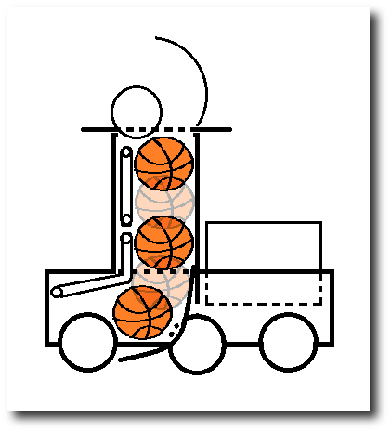
History: 2012
Custom SmartDashboard widget (Java)
Show ball when sensor is on
But…
Little/poor documentation
Java swing is complicated, hard for new programmers
Layout is terrible
Hard to setup

Slide 11
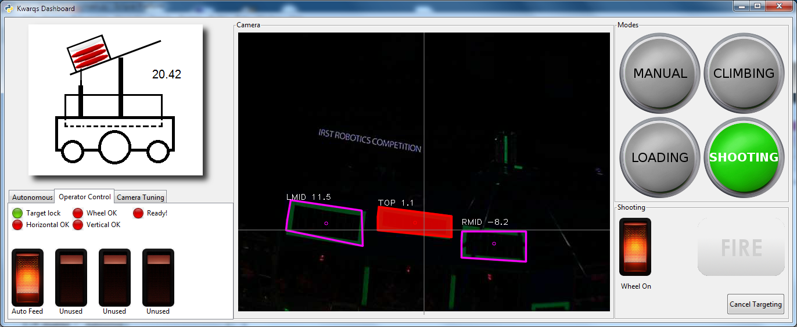
History: 2013/2014
PyGTK + touchscreen laptop

Slide 12
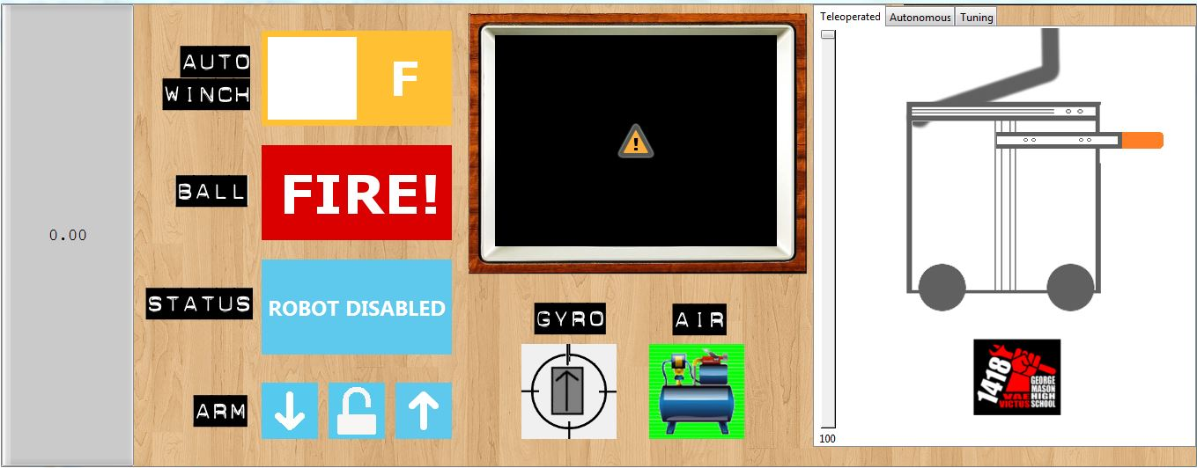
History: 2013/2014
PyGTK + touchscreen laptop

Slide 13
History: 2013/2014
PyGTK + touchscreen laptop
Looks a bit better
Integrated with image processing
Communications via pynetworktables
But…
Python is great, GTK less so
Difficult to customize interface
Very difficult to teach

Slide 14
pynetworktables2js
Introducing

Slide 15
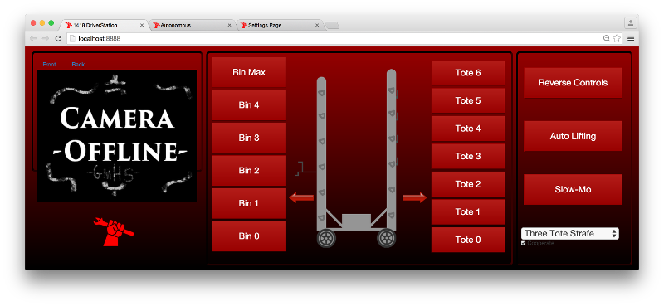
History: 2015 - Present
1418’s 2015 Dashboard

Slide 16
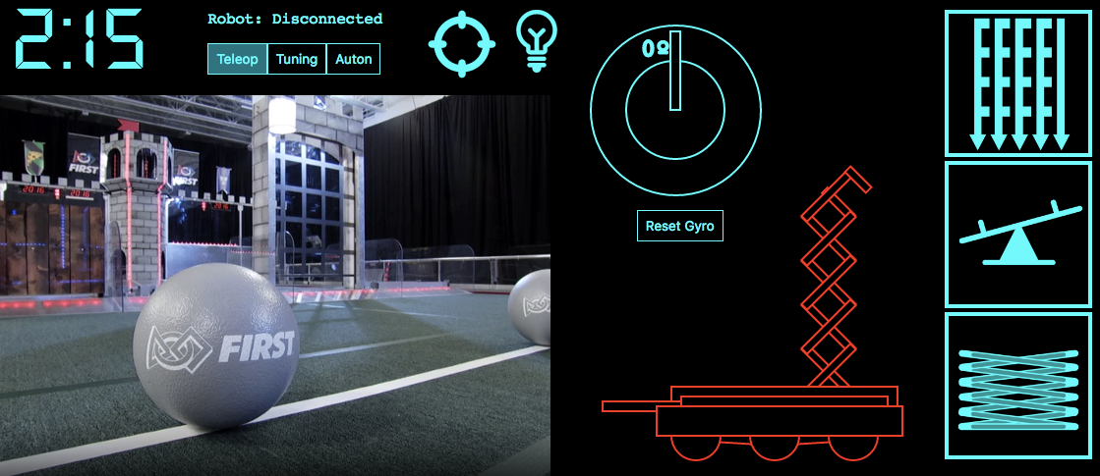
History: 2015 - Present
1418’s 2016 Dashboard

Slide 17
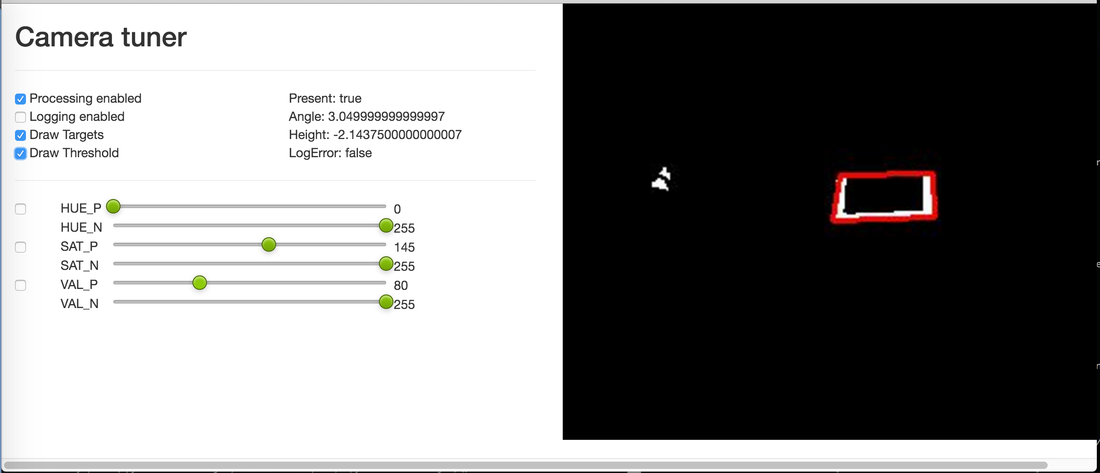
History: 2015 - Present
Interactive camera threshold tuning

Slide 18
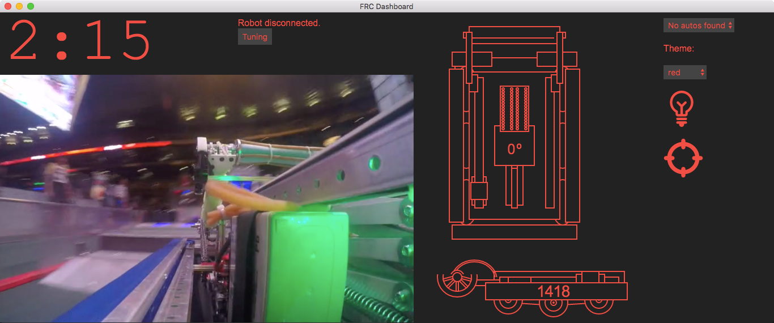
History: 2015 - Present
1418’s 2016 Dashboard – FRC Dashboard Rebuild (1418)

Slide 19
Why pynetworktables2js
TL;DR: Simpler.
Lowers the barrier of entry: as easy as making a webpage

Slide 20
Why pynetworktables2js
Many students already know how to create webpages
And if not, easy to learn; lots of online resources
Outreach to artistic students
Introduce to programming concepts

Slide 21
Why pynetworktables2js
Very flexible
Anything you can do in a webpage
Simple to get started
Cross platform
Windows + OSX + Linux
Actually has documentation
Unlike most other dashboard alternatives

Slide 22
HOW IT WORKS
Let’s get started

Slide 23
How it works
Browser talks to Python server running on your laptop
Python server uses NetworkTables to communicate with Robot
Results are passed back/forth to webpage

Slide 24
How it works
FMS
Websocket
Robot
Code
NT
NT
NT
Webpage
PythonWeb
Server

Slide 25
How it works
Webserver runs on the laptop
Could be run on robot; would be wasteful and inconvenient
NetworkTables
Easy to use distributed key-value protocol from WPILib
Very little setup
pynetworktables 50ms max latency – not bad
Notes:
Inconvenient because you wouldn’t be able to load the page until the robot connects to FMS

Slide 26
NetworkTables Basics
On the server…
On the client…
table.putString(“key”, “something”)
x = table.getString(‘key’)
// output is ‘something’
printf(“%s\n”, x);

Slide 27
pynetworktables2js Basics
Very similar to other languages
getValue/putValue only
Doesn’t need getNumber/getString/etc
Uses full path of keys, no tables
// getValue will return the correct type
var coolThing = NetworkTables.getValue(“/table/key”); // putValue doesn’t care about what type you pass NetworkTables.putValue(“/table/string_key”, “my value”);
NetworkTables.putValue(“/table/bool_key”, true);
NetworkTables.putValue(“/table/number_key”, 42.0);

Slide 28
GETTING STARTED
Let’s get started

Slide 29
Getting Started
Install pynetworktables2js
See the documentation
Create a directory with web content
Run the server from inside the directory
Navigate to localhost:8888
On Windows:
py -m pynetworktables2js
On Linux/OSX:
python -m pynetworktables2js

Slide 30
Your first webpage
<!DOCTYPE html> <html lang=”en”><body>
Connected: <span id=”connected”>false</span>
<!-- Include the API -->
<script src=”/networktables/networktables.js”></script>
<script type=”text/javascript”>
function onConnected(connected) {
document.getElementById(“connected”).textContent = connected;
}
NetworkTables.addRobotConnectionListener(onConnected, true);
</script>
</body>
</html>

Slide 31
pynetworktables2js API
NetworkTables.addRobotConnectionListener(f)
Calls a function to tell you that the page is connected to the robot
Driver wants to know if the dashboard isn’t going to actually do anything!

Slide 32
pynetworktables2js API
NetworkTables.putValue(k,v)
Sets the value in NetworkTables
Give it ~50ms to get to the Robot
If not connected to robot, value may be discarded

Slide 33
pynetworktables2js API
NetworkTables.getValue(k, [default])
Returns the current value of a key or null
I rarely use getValue
What happens if the value changes?
How do you find out about the change?
If not connected to robot, value isn’t always meaningful

Slide 34
pynetworktables2js API
NetworkTables.addKeyListener(k, f, [imm])
Set a function that will be called whenever the value for a particular key is changed.
It will usually call you when the robot connects, as the values will change
If you set the third parameter to true, it will call you immediately with the current value

Slide 35
REAL DASHBOARD CODE
Putting it all together

Slide 36
Putting it all together
Let’s show how to display simple feedback of a digital input
Here’s the steps
Create an SVG circle element
Add a listener for the value being sent over NetworkTables
Change color when the value is received

Slide 37
Putting it all together
Include the API in your page
<!DOCTYPE html> <html>
<head>
<script src=“/networktables/networktables.js”></script>
</head>

Slide 38
Putting it all together
Create an SVG circle element
<svg width="100" height="100">
<circle id="switch" cx="50" cy="50" r="40"
stroke="black" stroke-width="4"
fill="gray" />
</svg>

Slide 39
Putting it all together
Add a listener for the value being sent over NetworkTables
<script type=“text/javascript”>
function onSwitchChanged(key, value, isNew) {
// TODO
}
NetworkTables.addKeyListener('/SmartDashboard/switch',
onSwitchChanged, true);
</script>

Slide 40
Putting it all together
Change color upon new value
Hint: Use jQuery to make it easier :)
function onSwitchChanged(key, value, isNew) {
if (value) {
$("#switch").css("fill", "red");
} else {
$("#switch").css("fill", "green");
}
}

Slide 41
Demo
Putting it all together

Slide 42
2015 UI Demo
Putting it all together

Slide 43
pynetworktables2js API
There’s lots more...
Read the documentation

Slide 44
pynetworktables2js API
Useful helper functions for common UI tasks
Easy toggle button
HTTP Camera support
Robot connection indicator
SendableChooser related helpers

Slide 45
pynetworktables2js tips
Acquire a touchscreen laptop
Fairly inexpensive these days
Create multiple pages, and show them using browser tabs
One page for teleop
One page for autonomous options
One page for tuning

Slide 46
Future work
pynetworktables2js is a good start…
Need more widgets/helpers
Single executable deploy for 2017
Would love more contributors (hint, hint)
Need a ‘TableViewer’ integrated into pynetworktables2js
There’s a PR on github, needs work

Slide 47
Future work
NetworkTables 3.0 support for 2017
Enables persistent settings
Can talk to LabVIEW
Will probably happen…

Slide 48
Want More?
This presentation + code available online*
https://github.com/virtuald/frc-dashboard-workshop
* Sometime on Sunday

Slide 49
FRC Dashboard
Uses Electron framework to run HTML/JS app
Allows teams to more easily get up-and-running with web dashboards
Easy customization and expansion using prebuilt modules

Slide 50
Resources
pynetworktables2js
Code + Examples: https://github.com/robotpy/pynetworktables2js
Documentation: http://pynetworktables2js.readthedocs.io

Slide 51
Resources
1418’s UI repos
https://github.com/frc1418/2015-ui
https://github.com/frc1418/2016-ui
FRCDashboard
http://frcdashboard.github.io/

Slide 52
Questions?

