Slide 1
Scouting 101
By Joey Kerns

Slide 2
About Me
Alumnus of Team 614
Driver, Programmer, Electrical lead from 2007-2009
Mentor
Head Coach, Team 614, 2013-present
Programming/Electrical, Team 5587, 2015-present
Volunteer
Referee for FIRST Chesapeake

Slide 3
Why Scout?
Scouting is the most important, but least talked about aspect of FRC competitions.
Being about to collect useful data on your teammates and opponents will be useful no matter the scenario.
This can be used to get parents and less experienced students involved at competition.
Scout your own robot! See what your team can improve on!

Slide 4
Know Your Resources
Man-power
Who can scout?
ANYONE! Students, parents, and mentors all make great scouts. All that is needed is a basic understanding of the game.
How many people do you have scouting?
This will determine what types of scouting would be easier for your team. More people = more data.
If you find that you don’t have enough people, work with another team! The wonderful thing about FRC is that people are willing to collaborate.
If that isn’t working, find an established team, and ask if you can use their data.
The worst that can happen is that they say no.
I have shared my team’s data numerous times, and I’m always willing.

Slide 5
Know Your Resources
Man-power
Technology
Paper and pencil is fine! Just make sure you have a way to organize it.
Tablets and laptops make for good scouting setups. Just make sure you have a way to sync.
Have a way to communicate your data! Prepare data for your drive team to use before their matches
Notecards work great.
Text messages do too.

Slide 6
Know Your Resources
Man-power
Technology
Game experience
The leader of the scouting group should know the game well.
Watch matches before the competition on thebluealliance.com.
For people new to FRC or this year’s game, have the one page game description available.
Practice scouting during practice matches!

Slide 7
Scouting Methods
Pre-competition scouting
Watch matches of the teams at your competition that have already competed!
All FRC competitions are free to the public to spectate, or you can watch the matches through The Blue Alliance.
Stay up to date with teams’ social media.
Often they will show functions of their robot off before competition.

Slide 8
Methods of Scouting
Pre-competition scouting
Pit scouting
This involves sending students to other team’s pit during the beginning of competition.
Can take pictures of the robots for later reference.
Little useful data comes from pit scouting. I use it more as a networking time for my students to chat about robots with other teams.

Slide 9
Methods of Scouting
Pre-competition scouting
Pit scouting
Objective scouting vs. Subjective scouting
Objective scouting takes data and nothing else.
Ex. How many high goals made? How many gears did they deliver?
Subjective scouting is commentary on the performance of the robot.
Ex. How did the driver perform against defense? How well did they utilize the teleoperated period? (climbed the rope early/too late?)
I prefer a healthy mix.
Comment boxes at the end of the sheet for any additional information.

Slide 10
Methods of Scouting
Pre-competition scouting
Pit scouting
Objective scouting vs. Subjective scouting
Man-marking vs Zone scouting
Man-Marking puts a scout in charge of watching a single robot each match.
Requires AT LEAST 7 scouts. (1 for organizational purposes)
Try to assign scouts the same teams
By watching the same teams, they will become familiar with how they operate.
My preferred method. It makes data collection easier. But, it is tough to judge how a team plays with their alliance.

Slide 11
Methods of Scouting
Pre-competition scouting
Pit scouting
Objective scouting vs. Subjective scouting
Man-marking vs Zone scouting (cont.)
Zone marking puts scouts in charge of different areas of the field.
Best method for small scouting teams.
Easier for scouts to judge teamwork of an alliance.
Tougher for scouts to collect data on specific robots.
May get very confusing with the amount of fuel on the field, and multiple robots delivering gears at the same time.

Slide 12
Using Your Data
Match strategy
By knowing what other robots at your competition can do, you can better prepare yourself for your matches.
Make sure to communicate your data to your drive team!
Drive teams can utilize pre-match reports to determine what strategy they will attempt during a match.
It is very useful to know what your opponents can do, but it is just as useful to know what your own alliance is capable of.
Can craft alliance specific strategies for the elimination rounds based on your opponents.

Slide 13
Using Your Data
Match strategy
By knowing what other robots at your competition can do, you can better prepare yourself for your matches.
Make sure to communicate your data to your drive team!
Drive teams can utilize pre-match reports to determine what strategy they will attempt during a match.
It is very useful to know what your opponents can do, but it is just as useful to know what your own alliance is capable of.
Can craft alliance specific strategies for the elimination rounds based on your opponents.

Slide 14
Data Collection and Use
Collect only data you will potentially use and not what you can collect
Too much data can overwhelm you
Difficult to understand
Collect current Data
Teams can continually upgrade their robot at a competition or between competitions
Collected data is only one part of the scouting
Trust and relationships are important

Slide 15
Data Collection and Analysis
Alex Schultz
Team 1418
Lead Scouting

Slide 16
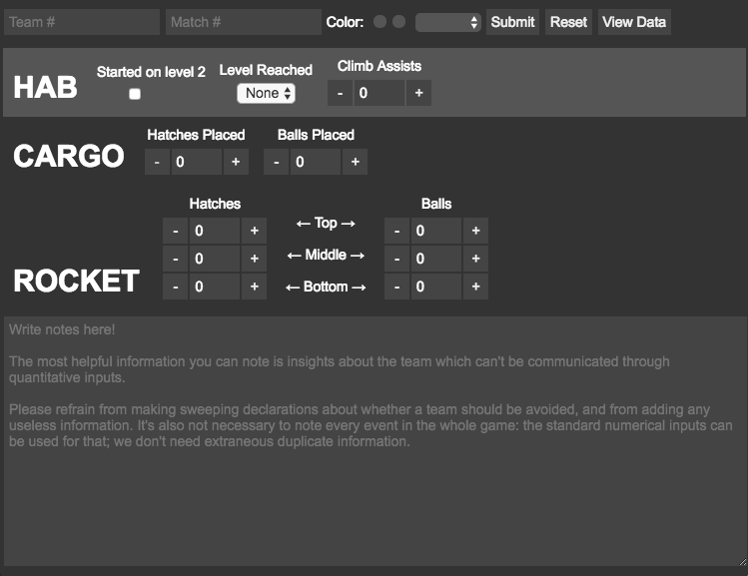

Notes:
Explain how the program works

Slide 17
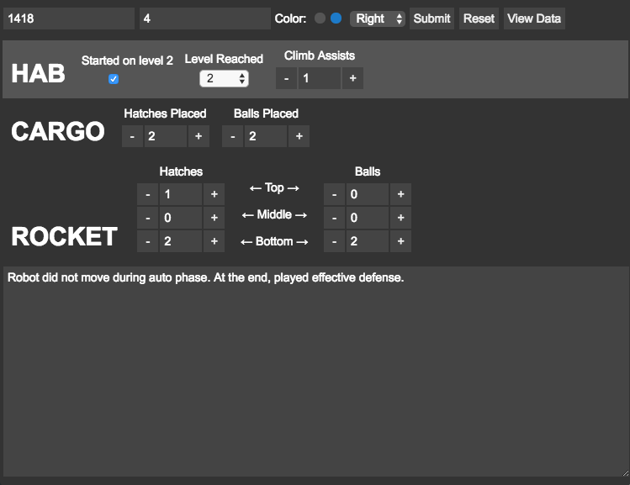
Notes:
Example of filled out scout report.

Slide 18
Notes:
Talk about how data analysis works: gathering all the json files, putting it into one csv, organizing and analyzing data to draw conclusions on who would be good teammates.

Slide 19
Useful Links
The Blue Alliance
Greatest database for pre-competition scouting. Live streams are linked directly on the homepage, and you can search any team in existence.
Wildrank
A great start to using computers/tablets for scouting. Highly customizable with little effort. Don’t waste time reinventing the wheel.
Steamworks game description
A quick 1 page document that explains this year’s game.
Steamworks Cheatsheet
Shows how many points each task is worth, along with a labeled field.
Jbkerns@fcps.edu
My email address, if you have any further questions.

