Slide 1

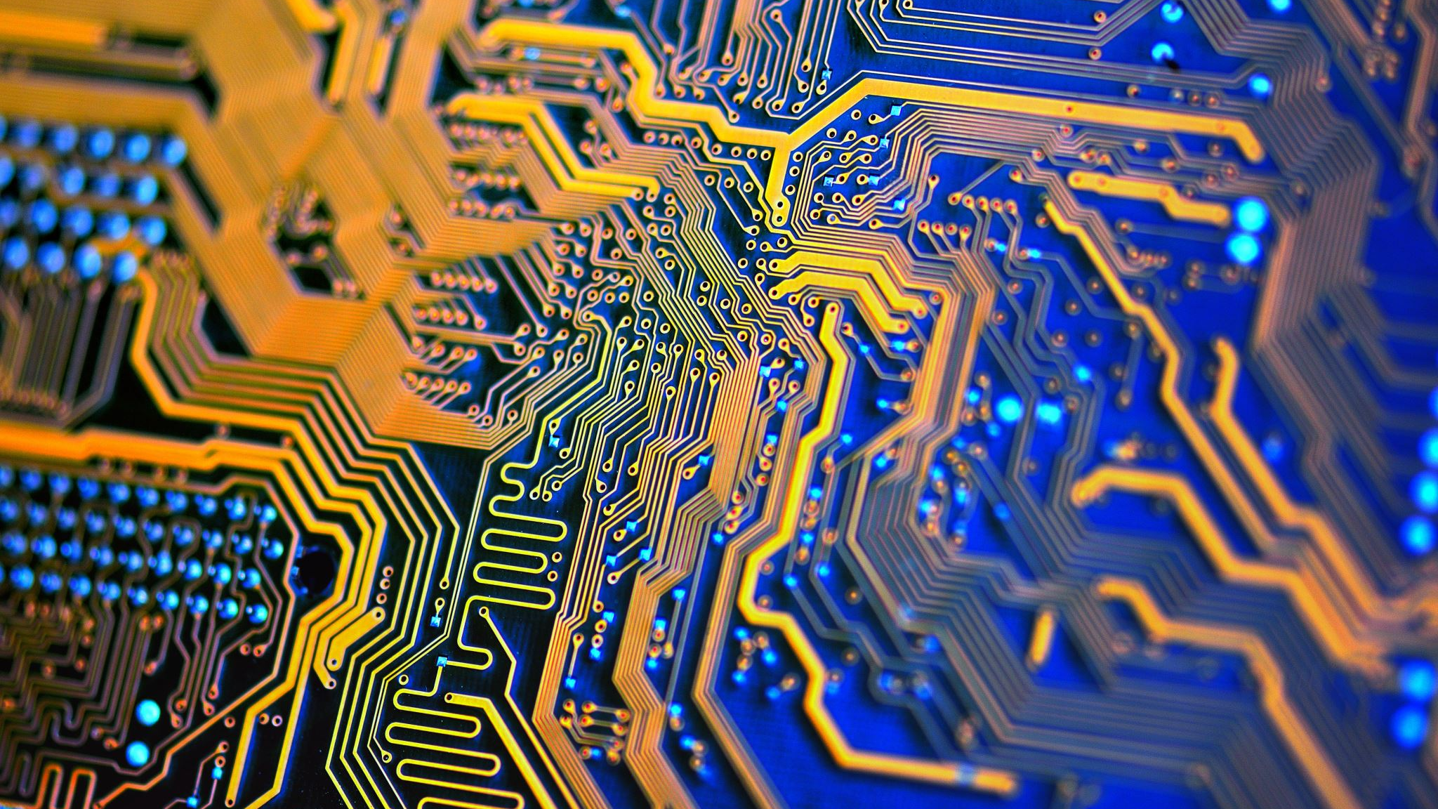
Analysis on ASL Dataset
Shourish Kothawale

Slide 2
Introduction
Project Goal: Automate classification of American Sign Language (ASL) letters using deep learning.
Dataset: Sign Language MNIST from Kaggle, 200x200 pixel images of ASL hand gestures.
Steps:
Exploratory Data Analysis (EDA): Understand dataset, identify patterns.
Data Munging: Preprocess and transform data.
Modeling: Implement and evaluate Convolutional Neural Networks (CNNs).
Comparison: Compare performance of CNNs with other techniques.
Objective: Optimize classification models for accurate ASL letter recognition.

Slide 3
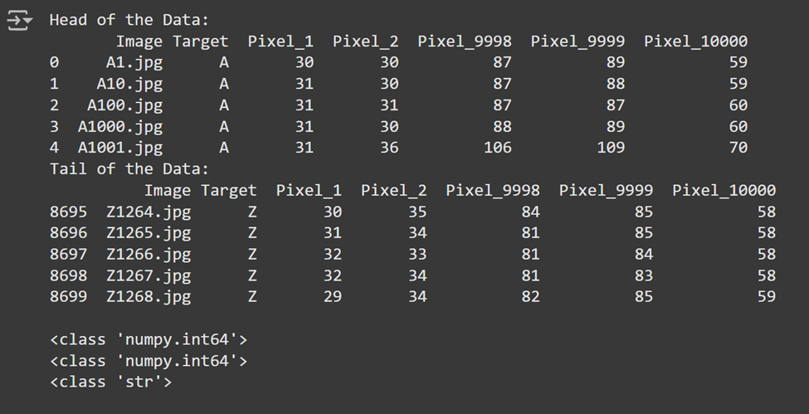
Data Peek
Head and Tail
Pixels are Integer
Target is string

Slide 4
Data Munging
Data Munging: Cleaning and transforming data for machine learning.
Dataset Reduction: Reduced from 84,000 to 8,400 images for efficiency.
Grayscale Conversion: Transformed color images to grayscale to focus on key features and reduce complexity.
Image Resizing: Resized images from 200x200 to 100x100 pixels for faster processing while retaining essential details.
Outcome: Data cleaned, transformed, and optimized for model training.

Slide 5
Exploratory Data Analysis

Slide 6
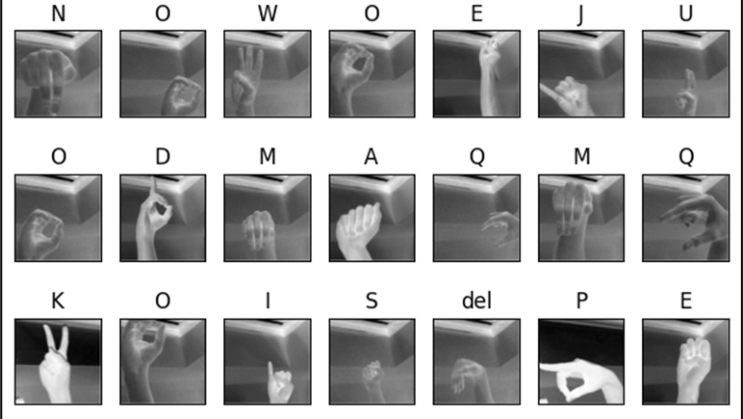

Slide 7
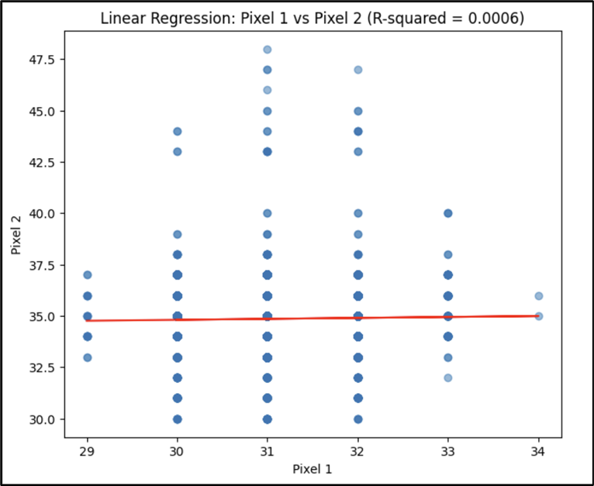
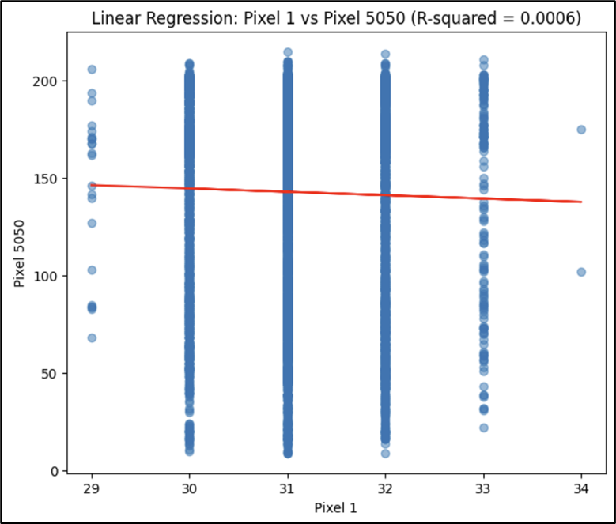
Further away
Nearest

Slide 8
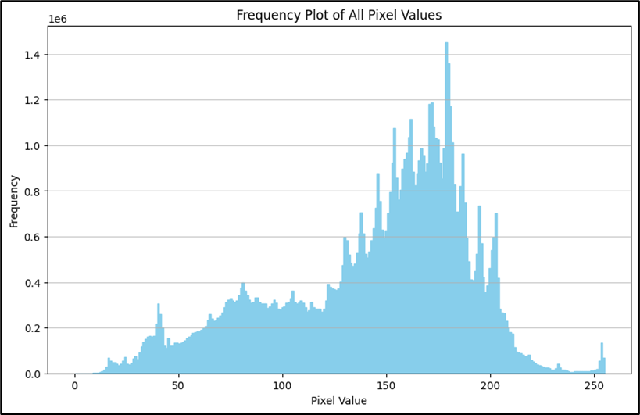
Clustered in range 125 to 200
Pixel Contributions

Slide 9
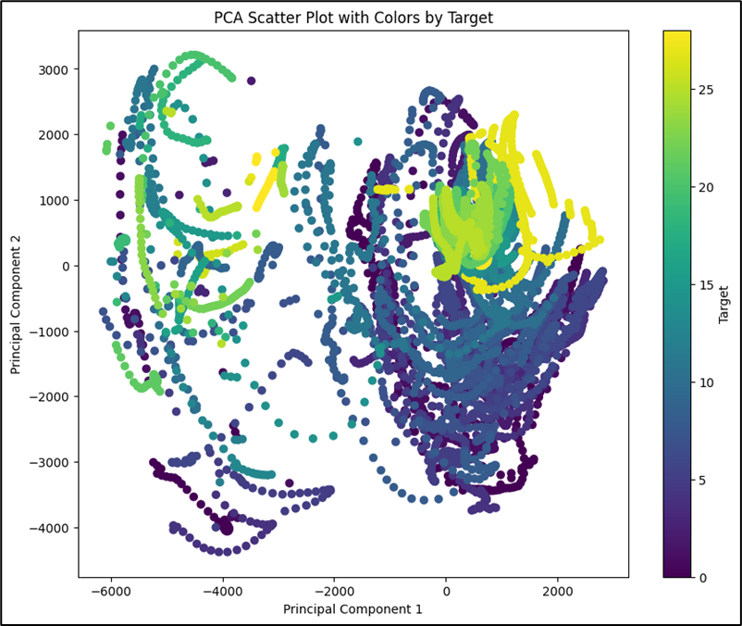
PCA
Very spread out
(24.92% from PC1 and 13.95% from PC2)
38.87% total variability

Slide 10
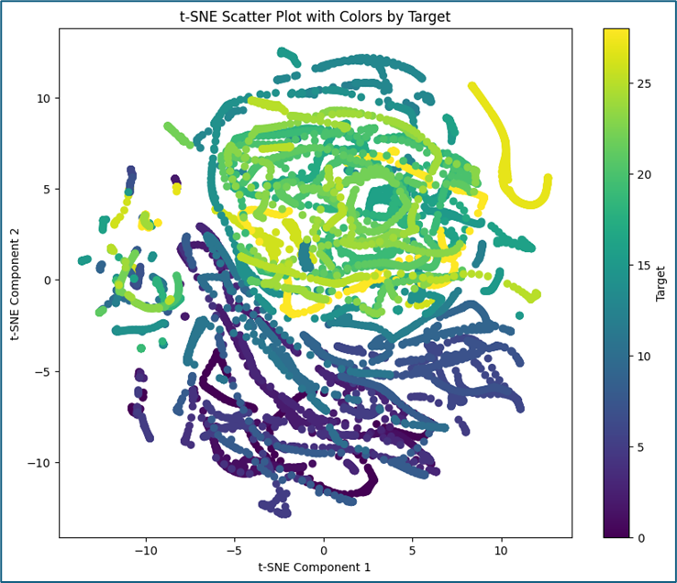
TSNE just like its counterpart has similar problems. This is evident since there are 10,000 dimensions, and it would be a very hard to capture them in 2 PCs

Slide 11
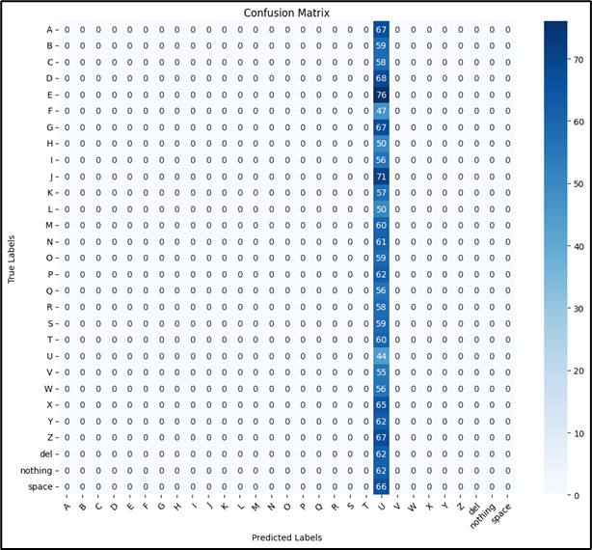
3% accuracy, Very Bad
Could be that Layers weren't optimized well
Or Logical Error setting up CNN

Slide 12
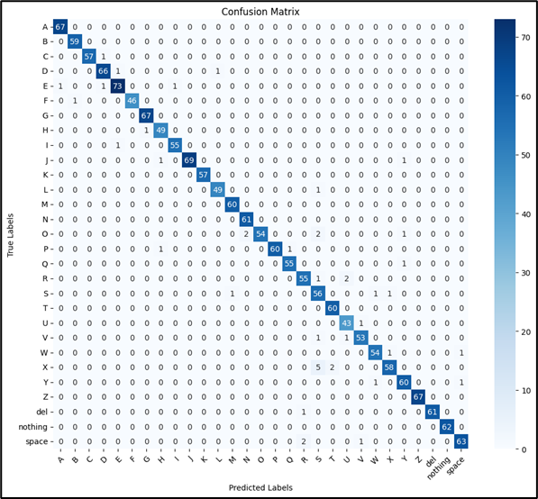
95% Accuracy Very Good
Kfold 5 fold for Hyperparameter
Centers 5

Slide 13
Future works
Transfer Learning: Use pre-trained CNN models (e.g., MobileNetV2, ResNet) to improve accuracy and reduce training time.
Real-Time ASL Translation: Integrate model with a camera for live ASL gesture recognition.
Model Improvements: Experiment with different CNN architectures, add layers, and tune hyperparameters.
Dataset Expansion: Include colored images and noise to enhance robustness for real-world conditions.

Slide 14
Conclusion
Demonstrated the potential of CNNs for ASL gesture classification with an emphasis on data preprocessing and analysis.
Identified challenges in hyperparameter tuning and image fidelity, highlighting areas for improvement.
Future work will focus on leveraging transfer learning, live ASL translation, and expanding the dataset for increased robustness.
Project serves as a foundation for refining deep learning techniques in ASL recognition.

