Slide 1
LEAF RECOGNITION SYSTEM FOR PLANT SPECIES IDENTIFICATION
Parthiv – 2022BCS0073
Shoury – 2022BCS0217
Sai Teja – 2022BCS0106
Rohan – 2022BCD0058
Varun – 2022BCS0094
Mohan – 2022BCS0142

Slide 2
Introduction and Objective
Introduction:
Identifying plant species manually requires expert knowledge and is time-consuming.
With the help of computer vision, plants can be identified automatically using leaf images.
Leaf shape, color, vein pattern, and texture provide unique species-specific characteristics.
Objective:
To develop an efficient plant species identification system using deep learning techniques supported by OpenCV and image preprocessing.
To analyze leaf characteristics such as shape, color, texture, and vein structure for accurate classification.

Slide 3
Dataset Overview
Dataset Used:
Flavia Leaf Dataset (from Kaggle)
Contains approximately 2000 high-quality leaf images.
Each image has a resolution of 1600 × 1200 pixels.
Captured under controlled lighting conditions.
Key Features:
Includes multiple plant species.
Provides clear leaf edges and vein patterns — ideal for feature extraction.
Used for image classification and shape-based plant recognition research.

Slide 4
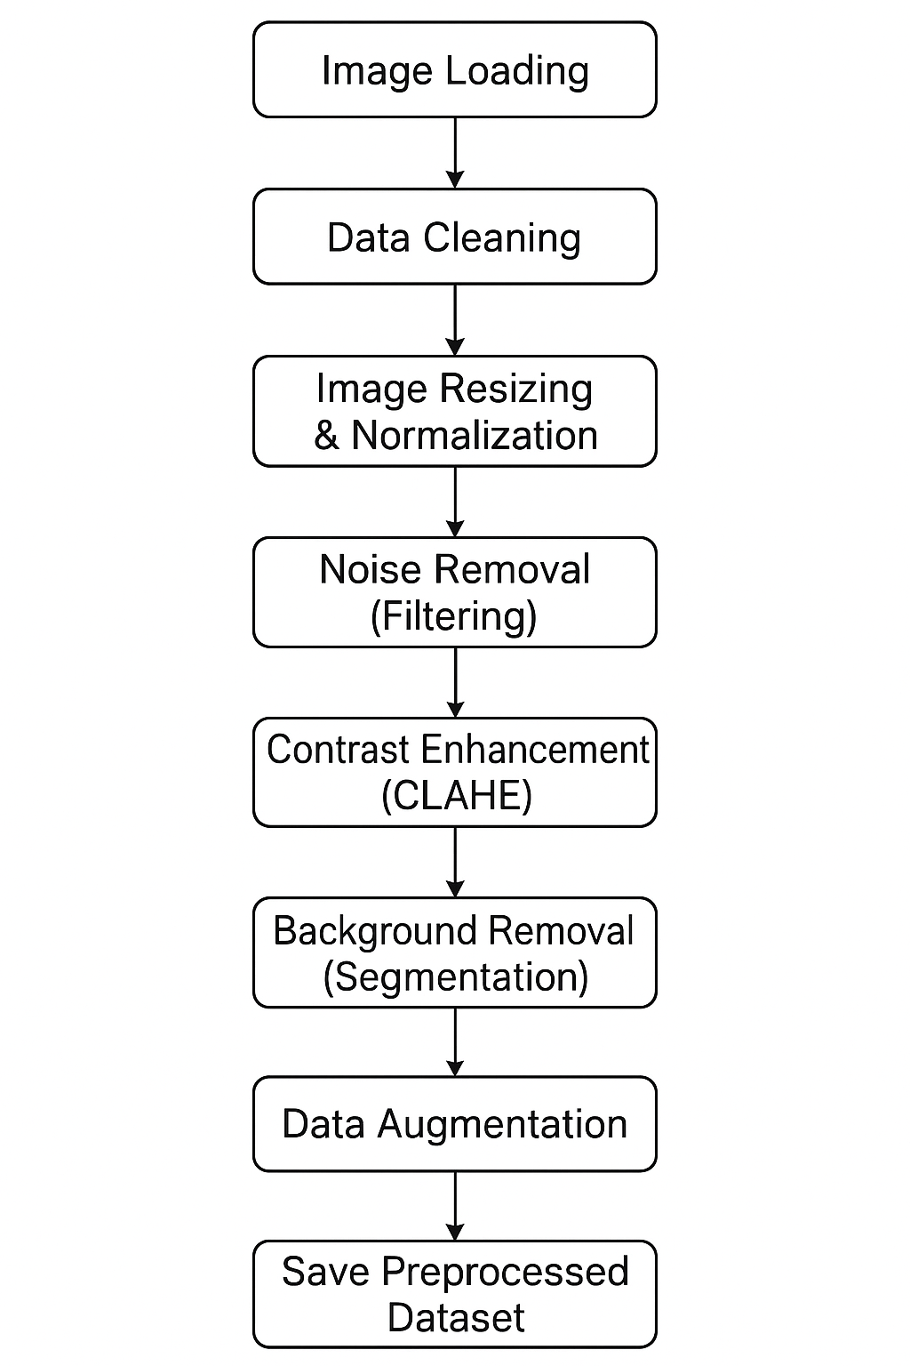
Data Preprocessing Flowchart

Slide 5
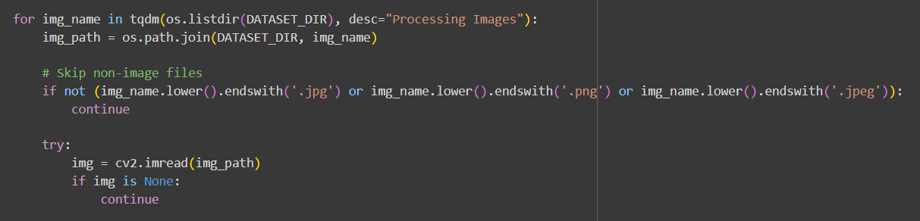
Image Loading & Data Cleaning
Description:
Images are loaded from Google Drive using the cv2 package.
Only valid image formats (JPG, PNG, JPEG) are considered.
Corrupted or unreadable files are automatically skipped.
Purpose:
Ensure the dataset is consistent and free from damaged or irrelevant data.
code snippet :

Slide 6
Image Resizing and Normalization
Steps:
Each image is resized to 128×128 pixels for uniformity.
Pixel values are normalized to [0,1] to stabilize training and speed up convergence.
Why Important:
Deep learning models expect fixed-size inputs.
Normalization helps the network learn efficiently and prevents numerical instability.

Slide 7
Noise Removal and Contrast Enhancement
Noise Removal (Filtering):
Gaussian filter applied to smooth edges and remove random pixel noise.
Contrast Enhancement (CLAHE):
CLAHE (Contrast Limited Adaptive Histogram Equalization) improves local contrast and reveals fine leaf vein details.
Outcome:
Sharper leaf edges, enhanced textures, and improved feature visibility.

Slide 8
Background Removal (Segmentation)
Process:
Convert image to grayscale.
Apply Otsu’s thresholding to create a binary mask separating leaf and background.
Use median filtering to refine mask and keep only the leaf region.
Purpose:
Remove background noise so the model focuses purely on the Region of Interest (ROI) — the leaf.

Slide 9
Data Augmentation and Dataset Split
Data Augmentation:
Random rotations, zooms, flips, and shifts are applied using Keras ImageDataGenerator.
Helps the model generalize better and reduces overfitting.
Train–Validation–Test Split:
70% → Training
15% → Validation
15% → Testing
Ensures balanced and unbiased evaluation of the model.

Slide 10
Conclusion and Next Steps
Conclusion:
Successfully preprocessed and cleaned the Flavia dataset.
Implemented essential steps like filtering, segmentation, and augmentation for better model accuracy.
The dataset is now ready for feature extraction and model training.
Next Steps:
Extract shape, color, and texture features.
Build and train a Convolutional Neural Network (CNN) for leaf classification.
Evaluate model performance using accuracy, precision, recall, and F1-score.

Slide 11
Team Contribution
NAME | CONTRIBUTION
PARTHIV
SHOURY
SAI TEJA
VARUN
ROHAN
MOHAN

Slide 12
References
Flavia Leaf Dataset – [Kaggle Dataset Link]
OpenCV Documentation – Image Processing Functions
TensorFlow/Keras Documentation – Data Augmentation Techniques
Python Libraries – NumPy, Matplotlib, Scikit-learn

