Slide 1
ML FOR LANGUAGE PROCESSING | EM40001
IMAGE-TO-TEXT DESCRIPTION GENERATION
Using pretrained BLIP Base and BLIP Large models
Group 16
Ayushman Mahapatra (2330020)
Shourya Basu (2330400)
Shrutik Sinha (2330404)
Manit Kumar Sahu (2430605)

Slide 2
1. Problem Statement & Objectives
Problem Statement
Understanding an image requires identifying its visual content and expressing it in natural language. Manual image description can require time and effort.
Objectives
• Generate descriptions using pretrained BLIP Base and BLIP Large
• Use the MS COCO 2017 Validation Dataset
• Evaluate captions with BLEU, METEOR and ROUGE-L
• Compare model performance and limitations
ML FOR LANGUAGE PROCESSING | GROUP 16
2

Slide 3
2. Proposed Processing Pipeline
Input image
Image loading and RGB conversion
BLIP image preprocessing
Image encoder and visual features
Text generation
Caption decoding
Generated description
ML FOR LANGUAGE PROCESSING | GROUP 16
3

Slide 4
3. Models & Implementation
BLIP Base
Salesforce/blip-image-captioning-base
Smaller model configuration.
BLIP Large
Salesforce/blip-image-captioning-large
Larger model configuration.
• Environment: Google Colab (GPU or CPU; NVIDIA T4 when available)
• Libraries: Python, PyTorch, Hugging Face Transformers, Pillow, NumPy, NLTK, ROUGE Score and Matplotlib
• Images are loaded, converted to RGB and prepared by the corresponding BLIP processor.
• Both models use the same caption-generation settings and evaluation dataset.
ML FOR LANGUAGE PROCESSING | GROUP 16
4

Slide 5
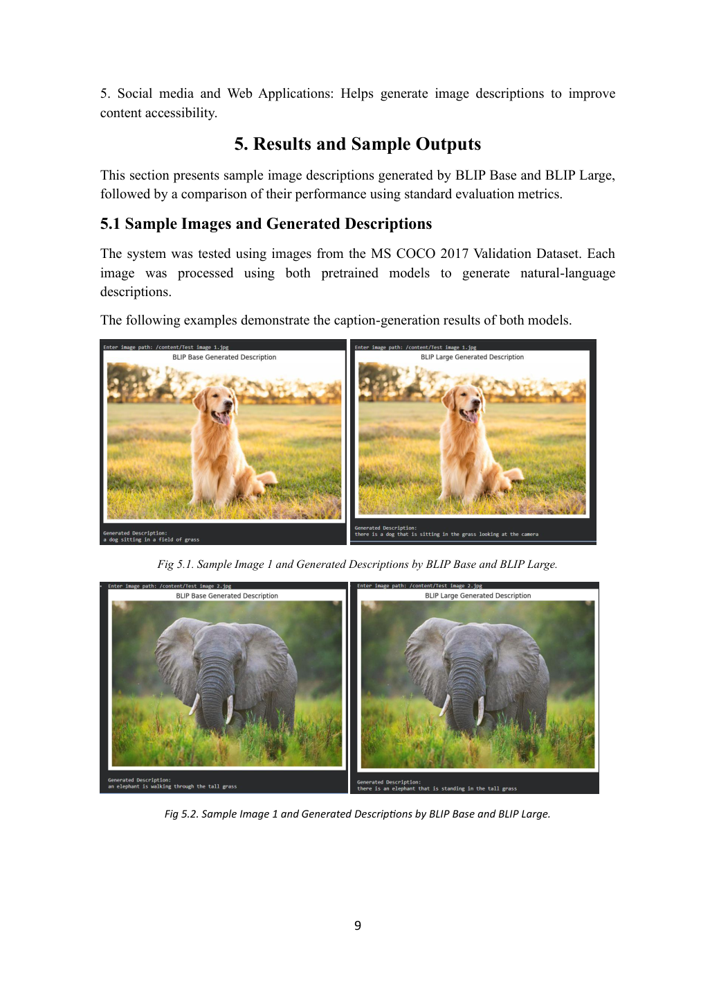
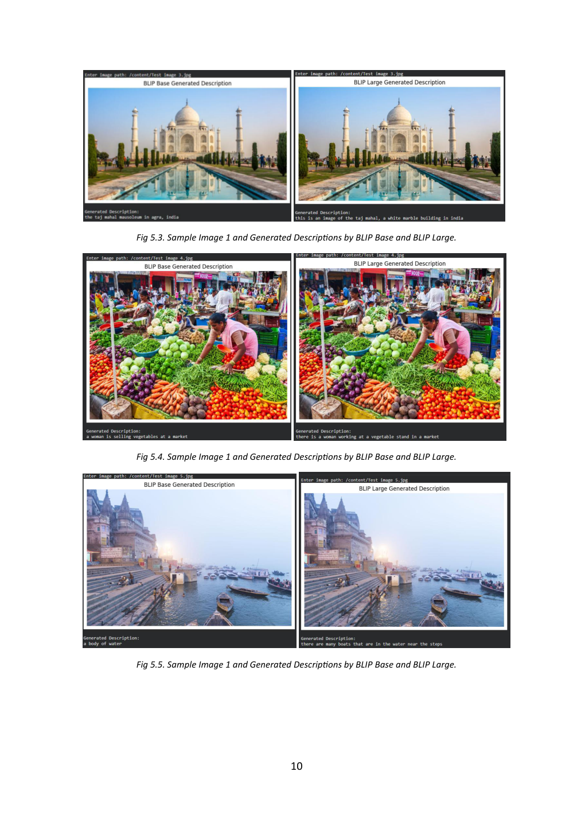
4. Demonstration: Sample Inputs & Outputs
ML FOR LANGUAGE PROCESSING | GROUP 16
5

Slide 6
5. Results & Model Comparison
Evaluation / Runtime | BLIP Base | BLIP Large
BLEU-1 | 0.6327 | 0.6763
BLEU-2 | 0.5031 | 0.5202
BLEU-4 | 0.3053 | 0.2898
METEOR | 0.4239 | 0.5284
ROUGE-L | 0.5381 | 0.5394
Average inference time | 0.2578 s | 0.4704 s
Throughput | 3.88 img/s | 2.13 img/s
Model parameters | 223,971,600 | 446,290,500
Peak GPU memory | 1,096.56 MB | 1,952.90 MB
ML FOR LANGUAGE PROCESSING | GROUP 16
6

Slide 7
6. Usability & Limitations
Practical Applications
• Accessibility support with text-to-speech
• Image search and retrieval
• Digital content organisation
• Educational materials
• Social media and web content
• Automated image documentation
System Limitations
• May misunderstand complex scenes or relationships
• Captions may omit details or contain errors
• Usually generates short descriptions
• Evaluation depends on the dataset and reference captions
• BLIP Large requires more computation
ML FOR LANGUAGE PROCESSING | GROUP 16
7

Slide 8
7. Group Contributions
Ayushman Mahapatra | Roll No. 2330020
Contribution: Contribution: Dataset Collection and Preparation, Image Preprocessing, and Input Image Management.
Shourya Basu | Roll No. 2330400
Contribution: BLIP Model Integration, including implementation of BLIP Base and BLIP Large for image caption generation.
Shrutik Sinha | Roll No. 2330404
Contribution: Model Evaluation, Performance Analysis, and Comparison of Generated Captions using BLEU, METEOR, and ROUGE-L metrics.
Manit Kumar Sahu | Roll No. 2430605
Contribution: Project Documentation, Results Compilation, Presentation Preparation, and Demonstration.
ML FOR LANGUAGE PROCESSING | GROUP 16
8

Slide 9
Project Links
GitHub Repository
https://github.com/Shourya-Basu/Image-to-Text_Description_Generation
Demonstration Video
https://www.youtube.com/watch?v=0f6SnVhzlEM
MS COCO 2017 Dataset
https://cocodataset.org/#download
BLIP Base Model
Salesforce/blip-image-captioning-base
BLIP Large Model
Salesforce/blip-image-captioning-large
Project Notebook
https://colab.research.google.com/drive/1iX2zN8-TGlNTQB_lCS52HfXuTYOl5LBE?usp=sharing
9

Slide 10
Thank you

