Slide 1
ParkNow
The OTP-based parking marketplace
Product, operations and engineering
Kolkata launch plan
Design v1.1 / September 2026
Notes:
Source: ₹Parking Marketplace Low Level Design.pdf, version 1.1, 10 September 2026. Local file: /Users/warriorbiswas/Downloads/₹Parking Marketplace Low Level Design.pdf.
Pages 1–2. This presentation describes an intended system under engineering review. It does not assert that ParkNow has launched or met its targets. Audience: product, business, engineering, operations and finance stakeholders.

Slide 2
PRODUCT THESIS
The customer problem
Drivers need a parking promise they can rely on at the entrance.
Before arrival
At the entrance
After departure
A driver needs to understand the location, price and arrival window before paying.
A paid booking still depends on an owner honoring capacity and verifying the vehicle.
The driver needs an accurate final bill and a visible refund or amount due.
Product hypothesis derived from the design. Customer demand still needs pilot validation.
ParkNow
2
Notes:
Source: ₹Parking Marketplace Low Level Design.pdf, version 1.1, 10 September 2026. Local file: /Users/warriorbiswas/Downloads/₹Parking Marketplace Low Level Design.pdf.
Relevant PDF pages: 1, 14, 21, 28.
The problem framing is an inference from the supplied requirements, not a quantified market study. Validate willingness to pay and owner behavior during the pilot.

Slide 3
PRODUCT OVERVIEW
The ParkNow operating model
Drivers prepay for capacity at verified, attended private parking.
Driver
Owner and staff
ParkNow
Search and book a space. Show separate entry and exit codes. Receive a bill based on the verified stay.
Commit usable capacity. Check the booking and vehicle. Confirm observed entry and departure.
Coordinate reservations and payments. Resolve failed arrivals. Reconcile money and owner statements.
ParkNow
3
Notes:
Source: ₹Parking Marketplace Low Level Design.pdf, version 1.1, 10 September 2026. Local file: /Users/warriorbiswas/Downloads/₹Parking Marketplace Low Level Design.pdf.
Relevant PDF pages: 1, 3–4, 28–29.

Slide 4
VERSION 1
Launch scope
Included
Operating approach
Deferred
One Kolkata cluster
Android and mobile web
Attended private sites
One controlled entrance
Separate car and bike pools
Existing owner or staff verifies movement. ParkNow provides booking software, support and financial controls.
Cameras, QR verification and barriers
Platform-employed attendants
Wallets, passes and dynamic pricing
A second city and AI assistance
ParkNow
4
Notes:
Source: ₹Parking Marketplace Low Level Design.pdf, version 1.1, 10 September 2026. Local file: /Users/warriorbiswas/Downloads/₹Parking Marketplace Low Level Design.pdf.
Relevant PDF pages: 1, 6, 27–29.

Slide 5
CUSTOMER LIFECYCLE
The complete parking journey
01 Find and review
Choose a site, arrival time and duration. Review the full quote and saved policy.
02 Reserve and pay
Create a short hold. Confirm the booking only after verified payment capture.
03 Enter and park
Owner verifies ENTRY and observed admission. The paid duration starts at entry.
04 Leave and settle
Owner verifies EXIT. Finalize the bill, refund unused advance and later settle the owner.
ParkNow
5
Notes:
Source: ₹Parking Marketplace Low Level Design.pdf, version 1.1, 10 September 2026. Local file: /Users/warriorbiswas/Downloads/₹Parking Marketplace Low Level Design.pdf.
Relevant PDF pages: 14–19, 22–24.

Slide 6
BOOKING
Search, quote and hold
Search snapshot
Filter verified sites by vehicle class, hours and protected interval capacity.
Immutable quote
Save tariff, fee, tax configuration and arrival, refund and overstay policies.
Three-minute hold
Lock the pool and reserve one compatible capacity token for the full interval.
Verified capture
Check provider payment facts. Late money requires eligible reacquisition or a full refund.
ParkNow
6
Notes:
Source: ₹Parking Marketplace Low Level Design.pdf, version 1.1, 10 September 2026. Local file: /Users/warriorbiswas/Downloads/₹Parking Marketplace Low Level Design.pdf.
Relevant PDF pages: 5, 14–16.
The search result is a timestamped snapshot. Ranking uses versioned weights for walking distance, price and reliability. A quote creates no inventory claim. A hold creates a three-minute deadline. The client callback is not authoritative evidence of capture.

Slide 7
GATE VERIFICATION
Entry and exit use separate codes
The owner selects the booking before checking a code.
Driver device
Authorized verifier
Server transition
Generate a six-digit code every 30 seconds. Entry and exit credentials work offline after provisioning.
Match the vehicle and booking at the assigned site. Confirm the physical movement with the code.
Consume the credential and commit the session change together. Five failures lock that purpose for ten minutes.
Login OTPs remain separate. Staff never receive the driver’s code-generating secret.
ParkNow
7
Notes:
Source: ₹Parking Marketplace Low Level Design.pdf, version 1.1, 10 September 2026. Local file: /Users/warriorbiswas/Downloads/₹Parking Marketplace Low Level Design.pdf.
Relevant PDF pages: 16–19.
The design specifies six-digit TOTP, 30-second steps, HMAC-SHA-256, separate random 256-bit ENTRY and EXIT secrets and current plus immediate neighboring steps. Purpose and state checks remain mandatory. Independent six-digit streams may collide. The design rejects relevant entry/exit collisions and requires a later exit code, pending Security review.

Slide 8
PARKING SESSION
Physical departure controls session closure
A checkout request records intent. Verified departure ends the session.
While parked
At departure
When money is due
Keep the timer and occupied state active. An extension adds time only after capacity protection and verified capture.
Verify EXIT or record an authorized override. Close the session, finalize the bill and protect turnover time.
Allow physical departure. Keep a receivable or refund obligation in the financial record.
ParkNow
8
Notes:
Source: ₹Parking Marketplace Low Level Design.pdf, version 1.1, 10 September 2026. Local file: /Users/warriorbiswas/Downloads/₹Parking Marketplace Low Level Design.pdf.
Relevant PDF pages: 18–20.

Slide 9
WORKED JOURNEY
A three-hour booking, step by step
Event | Time | Meaning
Target arrival | 18:00 | Original protected interval begins
Latest arrival | 18:15 | Proposed 15-minute arrival grace
Verified entry | 18:08 | Three paid hours end at 21:08
Verified departure | 20:18 | Actual stay is 2 hours 10 minutes
Turnover complete | 20:33 | Capacity can become available again
The original claim ends at 21:30. Arrival grace remains a Product decision, D02.
ParkNow
9
Notes:
Source: ₹Parking Marketplace Low Level Design.pdf, version 1.1, 10 September 2026. Local file: /Users/warriorbiswas/Downloads/₹Parking Marketplace Low Level Design.pdf.
Relevant PDF pages: 14, 19, 22–23, 32.
The target arrival is 18:00. Proposed arrival grace is 15 minutes and turnover is 15 minutes, so the original reservation is [18:00,21:30). Product must approve D02. Entry at 18:08 gives a paid end of 21:08. Departure at 20:18 gives turnover through 20:33. Actual elapsed time is 2h10m and billed time is 2h15m.

Slide 10
RELIABILITY
Offline operation and exceptions
Situation | Immediate behavior | Control
Driver has no signal | Generate provisioned gate codes locally | Owner verifies online
Driver phone is dead | Use an authorized, reason-coded override | Record physical evidence and review
Owner loses connectivity | Record a provisional physical event | Pause sales and reconcile evidence
Site cannot honor arrival | Offer full refund or accepted alternative | Preserve the original site failure
Offline driver codes and offline owner verification have different trust boundaries.
ParkNow
10
Notes:
Source: ₹Parking Marketplace Low Level Design.pdf, version 1.1, 10 September 2026. Local file: /Users/warriorbiswas/Downloads/₹Parking Marketplace Low Level Design.pdf.
Relevant PDF pages: 16–17, 19, 21–22.

Slide 11
CAPACITY RECOVERY
Overstays protect existing obligations
Open session
Paid time ending does not release a bay. Stop new instant sales for the affected token.
Future booking
Reassign to equivalent capacity at the same site when available.
Unresolved conflict
Mark fulfillment at risk. Offer a different site only with acceptance, or provide a full refund.
Billing cap
Limit charges under the approved policy. Keep occupancy unresolved until departure evidence exists.
ParkNow
11
Notes:
Source: ₹Parking Marketplace Low Level Design.pdf, version 1.1, 10 September 2026. Local file: /Users/warriorbiswas/Downloads/₹Parking Marketplace Low Level Design.pdf.
Relevant PDF pages: 20–22.

Slide 12
COMMERCIAL EXAMPLE
Billing follows the verified stay
Customer calculation | Basis | INR
Prepaid parking | 3 hours × 40 | 120.00
Convenience fee | Planning assumption | 7.00
Captured payment | Parking advance + fee | 127.00
Final customer bill | 2.25 hours × 40 + 7 | 97.00
Unused advance refund | 127 − 97 | 30.00
Illustrative pricing, excluding tax. Minimum charge: one hour, then 15-minute increments.
ParkNow
12
Notes:
Source: ₹Parking Marketplace Low Level Design.pdf, version 1.1, 10 September 2026. Local file: /Users/warriorbiswas/Downloads/₹Parking Marketplace Low Level Design.pdf.
Relevant PDF pages: 22–23.
Illustrative source assumptions: INR 40 hourly parking, 15% commission on final parking and INR 7 convenience fee. One-hour minimum, then round usage upward to 15-minute increments. Taxes excluded. This completed-session example retains the fee. Failed fulfillment refunds the entire payment including fee.

Slide 13
BUSINESS MODEL
Revenue and owner entitlement
Illustrative completed session with INR 90 of final parking charges.
INR 76.50
INR 20.50
Owner entitlement
Platform revenue
85% of final parking
INR 13.50 commission + INR 7 fee
Revenue before costs and tax. Contribution must also cover payment, support and failure costs.
ParkNow
13
Notes:
Source: ₹Parking Marketplace Low Level Design.pdf, version 1.1, 10 September 2026. Local file: /Users/warriorbiswas/Downloads/₹Parking Marketplace Low Level Design.pdf.
Relevant PDF pages: 22–24, 36.
From the source worked example: owner entitlement 90×85%=76.50. Commission 90×15%=13.50. Convenience fee INR7. Platform revenue before costs and taxes 20.50. These are commercial planning assumptions, not actual revenue or profit. Contribution formula is a proposed management lens, not a complete approved accounting policy.

Slide 14
MONEY MOVEMENT
Refunds and owner settlement
Refund obligation
Persist it with the triggering event. Show complete only after provider confirmation.
Weekly eligibility
Include completed, reconciled, undisputed sessions with sufficiently collected funds.
Owner statement
List each booking, final parking, commission, recoveries and net entitlement.
Provider outcome
Reconcile unknown transfers before retrying. A weekly statement does not prove bank settlement.
ParkNow
14
Notes:
Source: ₹Parking Marketplace Low Level Design.pdf, version 1.1, 10 September 2026. Local file: /Users/warriorbiswas/Downloads/₹Parking Marketplace Low Level Design.pdf.
Relevant PDF pages: 23–24, 27.

Slide 15
SUPPLY OPERATIONS
Owner onboarding and daily operations
Before activation
During operations
Access and support
Verify the site through a visit. Record the entrance and usable capacity by vehicle class. Confirm operating and verification hours.
Lookup bookings and verify movement. Report obstructions. Pause new sales when capacity becomes unreliable.
Use individual staff identities. Restrict earnings to owner finance roles. Keep an incident timeline for disputed events.
ParkNow
15
Notes:
Source: ₹Parking Marketplace Low Level Design.pdf, version 1.1, 10 September 2026. Local file: /Users/warriorbiswas/Downloads/₹Parking Marketplace Low Level Design.pdf.
Relevant PDF pages: 6, 21–22, 28–29, 36.
Physical site visit and verification precede activation. Owners commit pool capacity and cannot reduce it in a way that invalidates accepted claims. Existing owners or staff attend sites. Operational escalation thresholds remain to be approved.

Slide 16
FRONTEND EXPERIENCE
The product must work at the gate
Driver clarity
Show Paying, Confirming, Confirmed and Refunding as distinct states.
Gate usability
Use large digits and tap targets. Keep cached bookings available when maps are slow.
Language coverage
Provide English, Bengali and Hindi across screens and notification templates.
Device baseline
Test a 2 GB Android phone over 3G. Refresh authoritative state within five seconds.
ParkNow
16
Notes:
Source: ₹Parking Marketplace Low Level Design.pdf, version 1.1, 10 September 2026. Local file: /Users/warriorbiswas/Downloads/₹Parking Marketplace Low Level Design.pdf.
Relevant PDF pages: 28–29.

Slide 17
SYSTEM ARCHITECTURE
One transactional backend
Layer | Design choice | Responsibility
Applications | React Native and Next.js | Driver, owner and administration journeys
API | NestJS modular monolith | Authorized commands and domain invariants
Authority | PostgreSQL with PostGIS | Booking, inventory, billing and audit state
Async work | Workers, queues and adapters | Payments, refunds, deadlines and settlement
Disposable state | Redis and live updates | Search projections and refresh hints
ParkNow
17
Notes:
Source: ₹Parking Marketplace Low Level Design.pdf, version 1.1, 10 September 2026. Local file: /Users/warriorbiswas/Downloads/₹Parking Marketplace Low Level Design.pdf.
Relevant PDF pages: 2–5, 27, 30.
Source architecture retains React Native, Next.js, NestJS, PostgreSQL/PostGIS, Redis, durable queues and provider adapters. Modules run in one API deployment with separately running workers. Provider requests occur after commit, outside domain transactions. This describes the supplied design, not a deployed technology inventory.

Slide 18
DATA INTEGRITY
Database constraints protect the promise
Capacity
Prevent overlapping live claims on the same token. Serialize mutations with pool locks.
Sessions
Allow one session per booking and one open physical session per token.
Money
Store integer paise. Balance each journal entry and preserve immutable financial history.
Retries
Commit the command, its idempotent result, audit and outbox event together.
ParkNow
18
Notes:
Source: ₹Parking Marketplace Low Level Design.pdf, version 1.1, 10 September 2026. Local file: /Users/warriorbiswas/Downloads/₹Parking Marketplace Low Level Design.pdf.
Relevant PDF pages: 5–10.

Slide 19
EVENTS AND INTEGRATIONS
Durable work and provider recovery
Commit first
Handle retries
Resolve uncertainty
Save business state and an outbox event in one database transaction. Publish only committed events.
Expect duplicate delivery. Deduplicate consumers and use stable operation references for external effects.
Keep unknown payment, refund and transfer results unresolved until reconciliation proves the outcome.
Database deadline sweeps recover missed messages. Notifications never define booking state.
ParkNow
19
Notes:
Source: ₹Parking Marketplace Low Level Design.pdf, version 1.1, 10 September 2026. Local file: /Users/warriorbiswas/Downloads/₹Parking Marketplace Low Level Design.pdf.
Relevant PDF pages: 24–27.

Slide 20
ACCESS AND PRIVACY
Security follows role and purpose
Scoped access
Drivers see their own bookings. Verifiers act only at assigned sites. Recheck current membership.
Protected credentials
Encrypt gate secrets. Keep OTPs and personal identifiers out of logs and events.
Platform controls
Require MFA for Operations, Finance and Admin. Separate adjustment proposal and approval.
Provider data paths
Validate residency across identity, payment, maps, messaging, storage and telemetry.
ParkNow
20
Notes:
Source: ₹Parking Marketplace Low Level Design.pdf, version 1.1, 10 September 2026. Local file: /Users/warriorbiswas/Downloads/₹Parking Marketplace Low Level Design.pdf.
Relevant PDF pages: 16–17, 29–30.

Slide 21
RELEASE ACCEPTANCE
Performance and recovery targets
Requirement | Target | Evidence
Cached search | p95 < 1 second | Representative cluster load test
Gate verification | p95 < 750 ms | Concurrent gate test
Client state visibility | Within 5 seconds | Entry and exit telemetry
Critical API availability | 99.9% monthly | Availability and incident records
Recovery point / time | ≤ 5 min / ≤ 60 min | Timed restore and reconciliation drill
Targets from the design. No measured performance or production availability is supplied.
ParkNow
21
Notes:
Source: ₹Parking Marketplace Low Level Design.pdf, version 1.1, 10 September 2026. Local file: /Users/warriorbiswas/Downloads/₹Parking Marketplace Low Level Design.pdf.
Relevant PDF pages: 30–31.
All figures on this slide are source PRD acceptance targets, not measurements. Cached inventory search p95 <1 second. Gate verification p95 <750ms excluding provider time. Critical API availability 99.9% monthly. RPO <=5 min, RTO <=60 min. Restore financial writes only after reconciling provider activity and uncertain occupancy.

Slide 22
PROPOSED GO-TO-MARKET
A focused Kolkata pilot
Validate reliable supply in one cluster before expanding demand.
Supply first
Concentrated demand
Expansion evidence
Recruit owners near a consistent arrival destination. Confirm committed hours and rehearse both gate checks.
Invite drivers with repeat parking needs in that cluster. Explain the entrance, arrival window and refund policy.
Review gate success and failed arrivals alongside repeat use, support workload and contribution per session.
Proposed acquisition approach. Pilot staffing, spend and dates still need an agreed plan.
ParkNow
22
Notes:
Source: ₹Parking Marketplace Low Level Design.pdf, version 1.1, 10 September 2026. Local file: /Users/warriorbiswas/Downloads/₹Parking Marketplace Low Level Design.pdf.
Relevant PDF pages: 1, 34, 37.
The one-cluster pilot and stage sizes come from the source. The acquisition approach on this slide is a recommendation for discussion, not a commitment in the source. No market size, CAC, growth forecast or competitor superiority is asserted.

Slide 23
DELIVERY PLAN
Implementation and rollout
Stage | Deliverable | Exit evidence
Foundation | Identity, supply, schema, audit and outbox | Access and transaction invariants
Booking and session | Search through verified entry and exit | Last-space races and real-device journeys
Finance and recovery | Ledger, refunds, statements and offline review | Provider and restore drills
R0 supervised alpha | 5–8 sites with supervised arrivals | Observed completion of full journeys
R1 closed pilot | 12–20 owners and 40–60 spaces | Three gates met for four weeks
R2 opens the public cluster after P1 delivery and measured support readiness. Dates are unassigned.
ParkNow
23
Notes:
Source: ₹Parking Marketplace Low Level Design.pdf, version 1.1, 10 September 2026. Local file: /Users/warriorbiswas/Downloads/₹Parking Marketplace Low Level Design.pdf.
Relevant PDF pages: 36–37.

Slide 24
SUCCESS CRITERIA
Closed-pilot launch gates
All three must hold for four consecutive weeks.
>95%
<3 min
<2%
First-attempt
entry success
Median owner
response
Failed
arrivals
Report sample sizes. Count overrides as unsuccessful first-attempt OTP entry.
ParkNow
24
Notes:
Source: ₹Parking Marketplace Low Level Design.pdf, version 1.1, 10 September 2026. Local file: /Users/warriorbiswas/Downloads/₹Parking Marketplace Low Level Design.pdf.
Relevant PDF pages: 34–35, 37.
The source requires >95% first-attempt entry success, median owner response <3 minutes and failed arrivals <2%, over four consecutive weeks. Count overrides as first-attempt OTP failures. Report denominators and sample sizes. Owner response starts at the driver arrival notice, which is self-reported. Use stricter <2% PRD threshold over S3 <3%.

Slide 25
OPEN DECISIONS
Decisions before a paid pilot
Decision | Accountable role | Required outcome
Arrival grace and cancellation | Product and Finance | Approved windows and fee treatment
Overstay, cap and pricing | Product and Finance | Versioned rules with explicit amounts
Tax and owner settlement | Finance and Backend | Invoice rules and proven provider cadence
Offline evidence and retention | Operations and Security | Permit, correction and retention policies
Failure and refund reporting | Product and Finance | Separate unused-time refunds from losses
The source remains under engineering review. These decisions are release prerequisites.
ParkNow
25
Notes:
Source: ₹Parking Marketplace Low Level Design.pdf, version 1.1, 10 September 2026. Local file: /Users/warriorbiswas/Downloads/₹Parking Marketplace Low Level Design.pdf.
Relevant PDF pages: 34–36.

Slide 26
TEAM COMMITMENTS
The next milestone is a supervised full journey
Complete one booking through entry, departure, refund and owner statement.
Product and Finance
Engineering and QA
Operations
Resolve commercial terms and arrival policies. Approve invoice treatment and settlement expectations.
Prove inventory and money invariants. Exercise late capture, duplicate requests and offline recovery.
Verify initial sites. Train owner staff and rehearse dead phones, blocked spaces and failed arrivals.
ParkNow
26
Notes:
Source: ₹Parking Marketplace Low Level Design.pdf, version 1.1, 10 September 2026. Local file: /Users/warriorbiswas/Downloads/₹Parking Marketplace Low Level Design.pdf.
Relevant PDF pages: 31–37.
This slide synthesizes the source implementation sequence and review checklist. It is a recommended immediate milestone, not a committed delivery date or a claim of completion.

Slide 27
TECHNICAL APPENDIX
API and command contracts
Identity and scope
Derive actor and permission from authentication. Never trust a client user ID or role.
Versioned commands
Require Idempotency-Key and expectedVersion. Persist a canonical request hash and result.
Server authority
Return requestId, serverTime and aggregate version. Calculate price and event times on the server.
Error recovery
Refresh after conflicts. Accept a new quote after expiry. Retry transient failures with the same key.
ParkNow
27
Notes:
Source: ₹Parking Marketplace Low Level Design.pdf, version 1.1, 10 September 2026. Local file: /Users/warriorbiswas/Downloads/₹Parking Marketplace Low Level Design.pdf.
Relevant PDF pages: 10–14.
Summarizes source API principles rather than defining new route names. All routes use /v1. Commands require authenticated actor, idempotency key and expectedVersion when updating aggregates. Gate failures normalize nonexistent, wrong-site, unpaid, consumed and invalid-code failures.

Slide 28
TECHNICAL APPENDIX
Acceptance evidence by failure class
Failure class | Source tests | Required result
Capacity and timing | T01, T14–T18 | One claim, protected turnover, no false vacancy
Payment ambiguity | T02–T05, T21 | Verified capture, explicit refunds, no duplicate movement
Codes and access | T06–T11, T19–T20 | Purpose checks, limits, fallback and revoked access
Departure and recovery | T12–T13, T17, T23, T26 | Physical exit, retained evidence, reconciled restore
Ledger and workers | T22, T24–T25 | Safe replay, approval separation, correct arithmetic
Run concurrency tests against PostgreSQL with real constraints and adapters against provider sandboxes.
ParkNow
28
Notes:
Source: ₹Parking Marketplace Low Level Design.pdf, version 1.1, 10 September 2026. Local file: /Users/warriorbiswas/Downloads/₹Parking Marketplace Low Level Design.pdf.
Relevant PDF pages: 31–34.

Slide 29
TECHNICAL APPENDIX
Booking and fulfillment remain distinct
Booking
HOLD, CONFIRMED, IN_USE and COMPLETED describe progress through the booking journey.
Payment and refund
Confirmation requires capture. A refund can remain pending after a booking expires or fails.
Fulfillment
A confirmed booking may become AT_RISK when physical capacity cannot support its arrival.
Recovery
Preserve customer rights and financial records while relocating or refunding the affected booking.
ParkNow
29
Notes:
Source: ₹Parking Marketplace Low Level Design.pdf, version 1.1, 10 September 2026. Local file: /Users/warriorbiswas/Downloads/₹Parking Marketplace Low Level Design.pdf.
Relevant PDF pages: 15–16, 20–21.

Slide 30
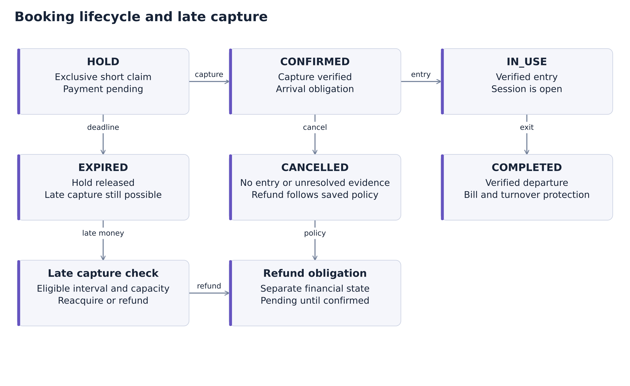
Source design diagram / PDF page 16
30
Notes:
Source: ₹Parking Marketplace Low Level Design.pdf, version 1.1, 10 September 2026. Local file: /Users/warriorbiswas/Downloads/₹Parking Marketplace Low Level Design.pdf.
Page 16, Figure 6. Original supplied diagram retained as an image. The diagram is source artwork, not an editable native flowchart. Booking state and fulfillment state are separate.

Slide 31
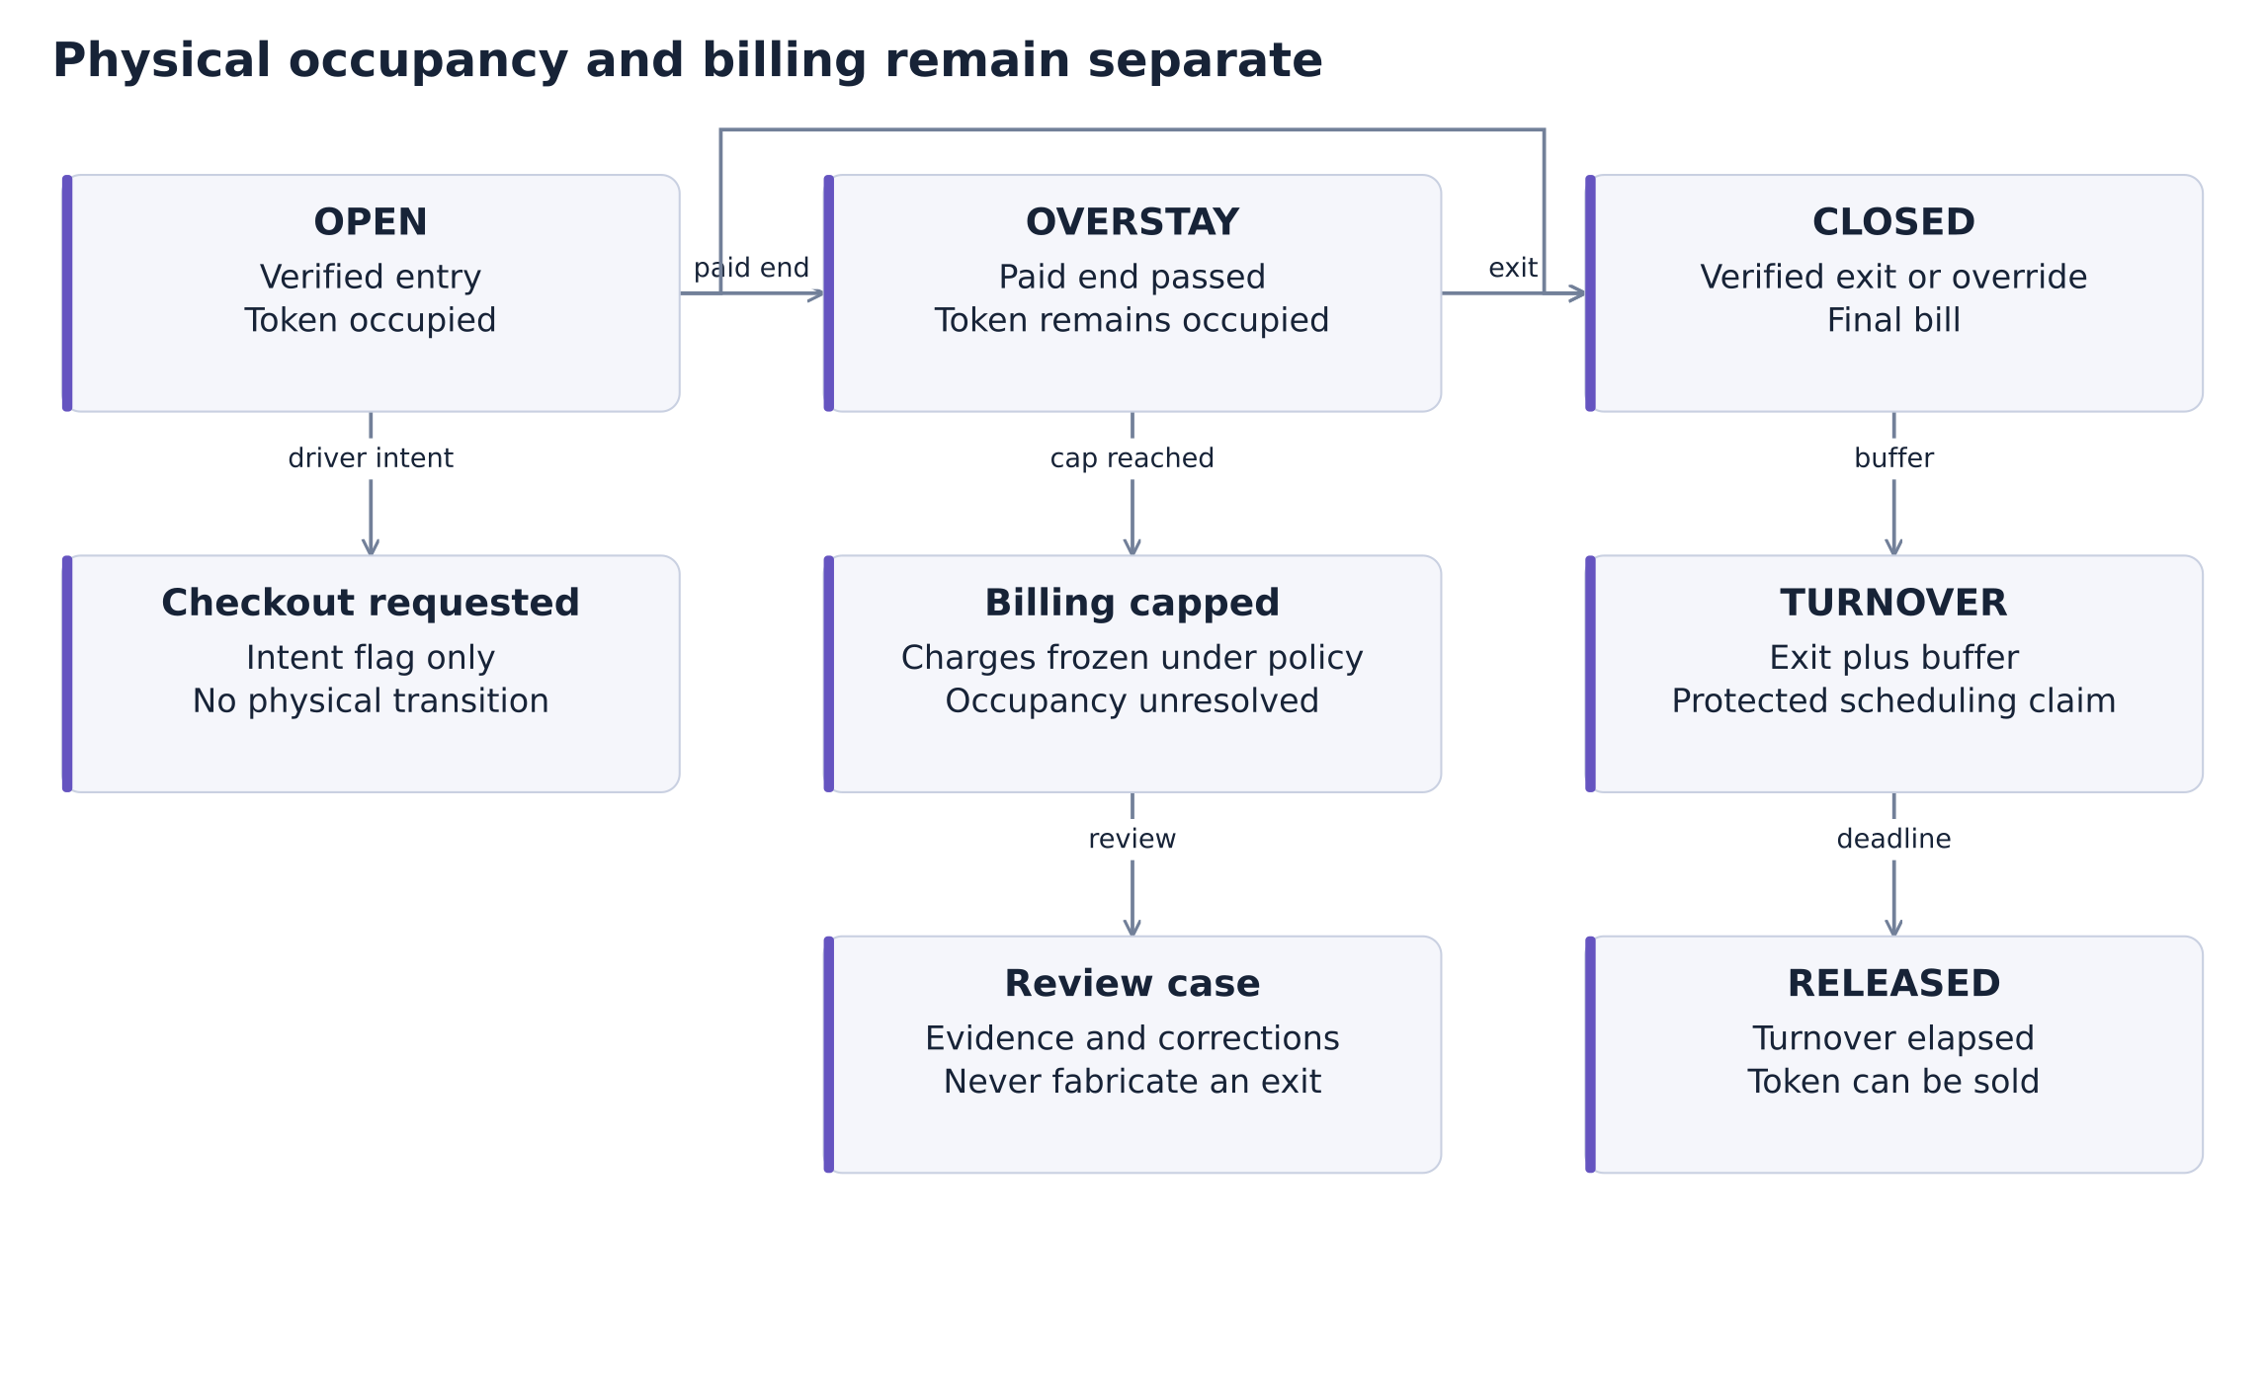
Source design diagram / PDF page 20
31
Notes:
Source: ₹Parking Marketplace Low Level Design.pdf, version 1.1, 10 September 2026. Local file: /Users/warriorbiswas/Downloads/₹Parking Marketplace Low Level Design.pdf.
Page 20, Figure 9. Original supplied diagram retained as an image. Billing caps never release occupancy. Turnover protects the token after observed departure.

Slide 32
REFERENCE APPENDIX
Source and interpretation
Primary source
Parking Marketplace Low Level Design, v1.1, 10 September 2026. Product owner: Priyanshu Maity.
Source status
37-page supplied PDF. Engineering review required. Requirements describe intended behavior.
Related documents
The PDF cites PRD, earlier LLD and business-model PDFs. This deck relies on their treatment in the supplied PDF.
Presentation additions
Problem framing and acquisition approach are labeled hypotheses or proposals. Commercial examples exclude tax.
ParkNow
32
Notes:
Source: ₹Parking Marketplace Low Level Design.pdf, version 1.1, 10 September 2026. Local file: /Users/warriorbiswas/Downloads/₹Parking Marketplace Low Level Design.pdf.
Relevant PDF pages: 1–2, 34–37.

