Slide 1
Echo State Networks
Group H

Slide 2
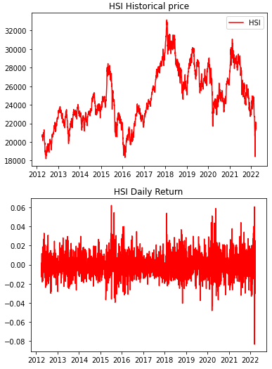
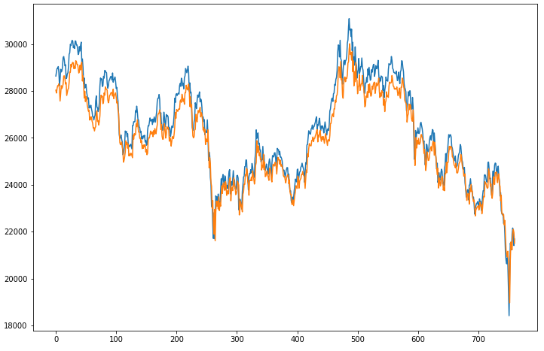
LSTM prediction for low volatile securities is relatively good...
HSI Index
Ann. Vol.: 18.7%
Actual vs Predictions price
Actual
Prediction

Slide 3
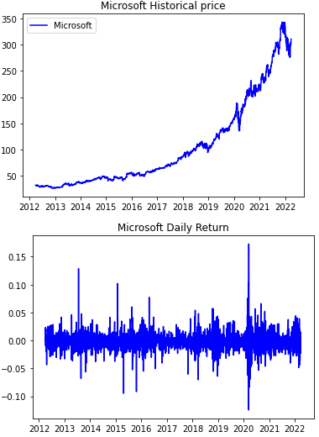
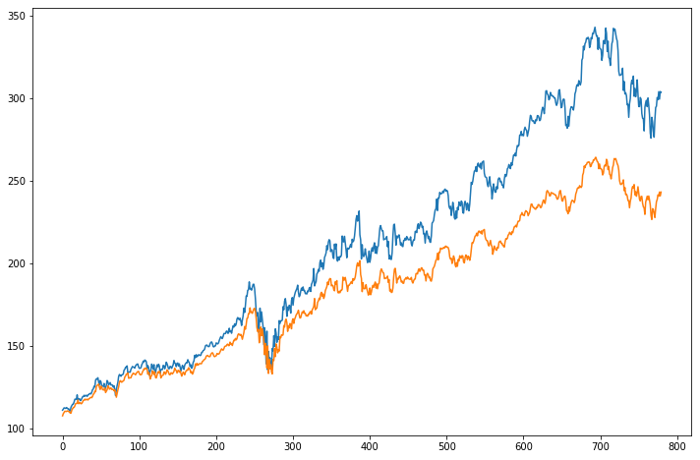
… but LSTM performs poorly when the price is more volatile
Microsoft
Ann. Vol.: 25.9%
Actual vs Predictions price
Actual
Prediction

Slide 4
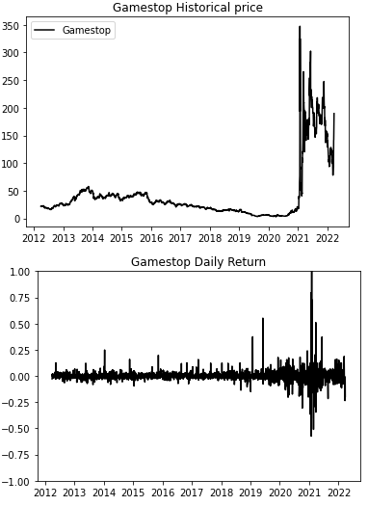
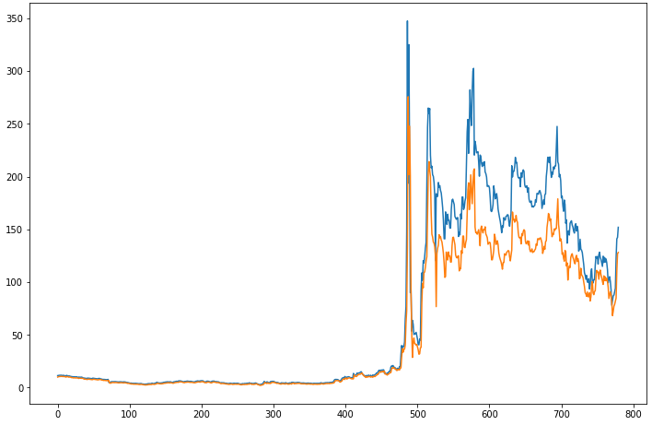
… but LSTM performs poorly when the price is more volatile
Gamestop
Ann. Vol.: 93.9%
Actual vs Predictions price
Actual
Prediction

Slide 5
Echo State Network better captures non-linearity
NN have problems such as complex network structures, slow convergence, and high computational costs.
Difficulty to capture non linearity / chaotic time series.
New form of RNN with a loosely connected hidden layer called a ‘reservoir’ -> Echo State Network (ESN).
Introduced by Herbert Jaeger in 2001. Practical significance was recognized when first applied to wireless commutation related fields in 2004.
Fast training
Easier to implement
Better capture of non-linearity
Widely applied in fields such as robot control, object tracking, moving-target detection, and incident monitoring.

Slide 6

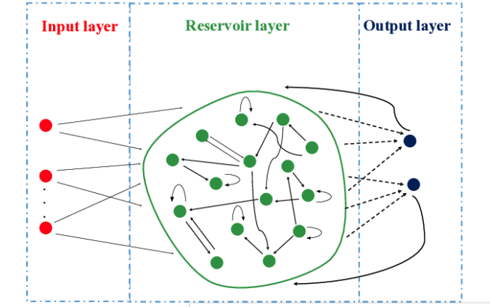
Reservoir Computing
What is Chaos?
All the necessary information as knobs.
Reservoir state stored
Output layer learns according to state.
Notes:
Chaos means simply a network where even if you slightly change the initial state, it can drastically change the final result. Like Weather prediction, financial forecaast.
We twist and turn the knobs.aka hyperparamter tuning For reservoir computer these knobs are variables in a complex mathematical equations and when all knobs are trained just right we can find a number of paths to the chaotic system. RMSE

Slide 7
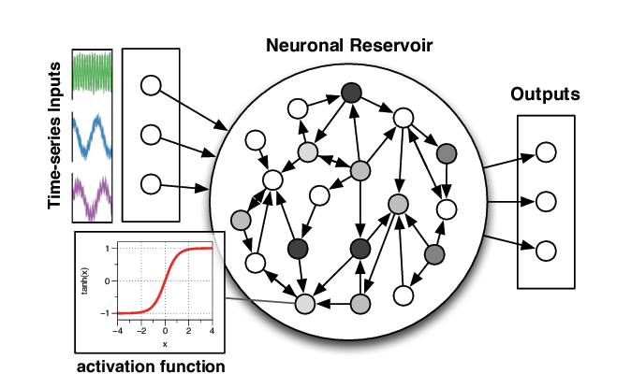

ESN - Architecture
General case of Reservoir Computing
Benefits of RNN - problems of RNN
Sparsely connected neurons <10%.
What is ECHO?
Fixed and random weights.
Output weights trainable.
Notes:
Benefits of RNN - Input dependent on each other
Problems - Vanishing gradient problem.
the reservoir states are captured over time and stored. Once all of the training inputs have been applied, a simple application of linear regression can be used between the captured reservoir states and the target outputs. These output weights can then be incorporated into the existing network and used for novel inputs.
\The idea is that the sparse random connections in the reservoir allow previous states to "echo" even after they have passed, so that if the network receives a novel input that is similar to something it trained on, the dynamics in the reservoir will start to follow the activation trajectory appropriate for the input and in that way can provide a matching signal to what it trained on, and if it is well-trained it will be able to generalize from what it has already seen, following activation trajectories that would make sense given the input signal driving the reservoir.
The advantage of this approach is in the incredibly simple training procedure since most of the weights are assigned only once and at random. Yet they are able to capture complex dynamics over time and are able to model properties of dynamical systems

Slide 8
Code Implementation and Experiments
Code can be found here: https://github.com/Shourya0404/COMP7409
Reference: https://github.com/ciortanmadalina/EchoStateNetwork

Slide 9
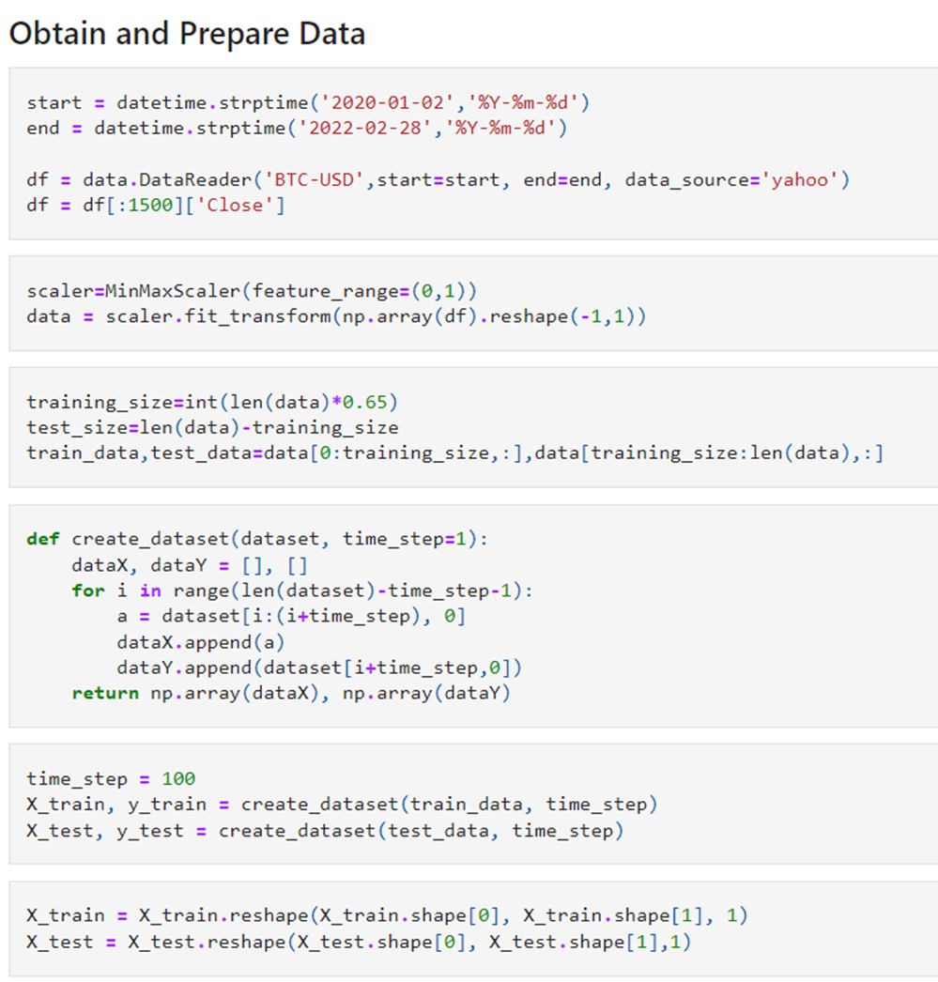
Data Preparation
•Same pipeline as in lecture
•Time Step = 100
•65% data used for training
•MinMax Scaler used for data transformation
•Use data from Jan 2020 to Feb 2022

Slide 10
Model Building Steps
Reservoir Representation of Data
PCA for Dimensionality Reduction
Ridge Regression to Build Prediction Model
Notes:
Reservoir Hyperparameters:
100-500 neurons
Leak = 0.1
Noise = 0.02

Slide 11
Experimental Setup
•LSTM and ESN performance compared based on MSE Loss and Training Time
•Tested on various financial instruments such as forex, equities, crypto, and index funds
•Low Volatility and High Volatility Instruments Included

Slide 12
Comparison of LSTM and ESN: MSE Loss
•LSTM performs better on low volatility instruments
•ESN performs better on high volatility instruments
Instrument | LSTM* | ESN* | Volatility
EUR/USD | 0.0054 | 0.0372 | 6.6%
Hang Seng Index | 0.0059 | 0.0078 | 21.9%
Bitcoin | 0.0047 | 0.0050 | 64.7%
Ethereum | 0.0173 | 0.0124 | 85.2%
Gamestop | 0.0097 | 0.0064 | 178.8%
* MSE Error used to measure performance on Scaled Data

Slide 13
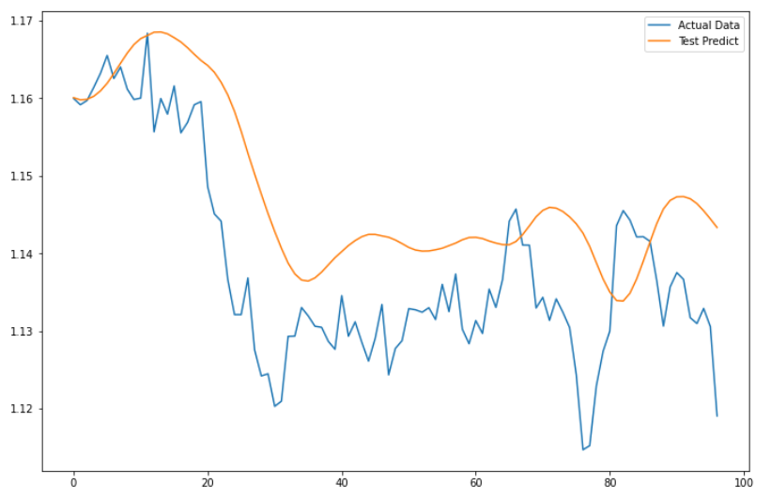
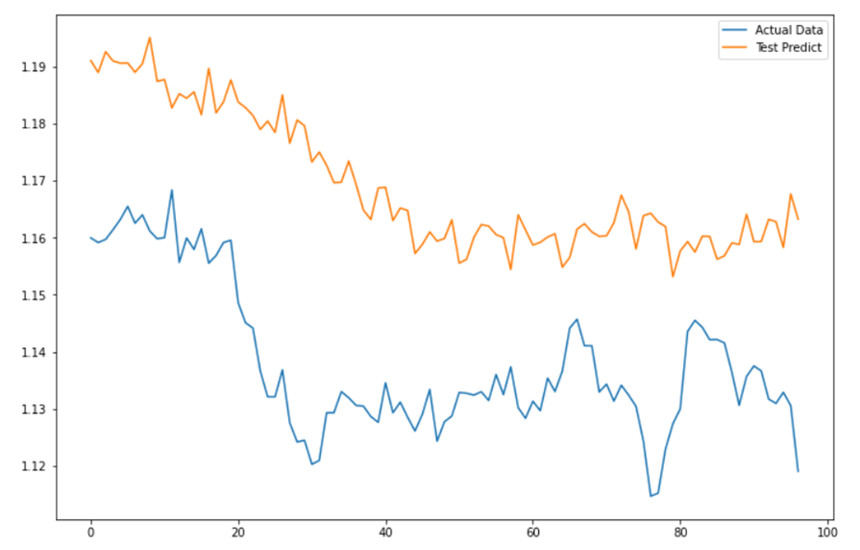
Test Predictions - EUR/USD (Low Volatility 6.6%)
LSTM
ESN
LSTM fits better

Slide 14
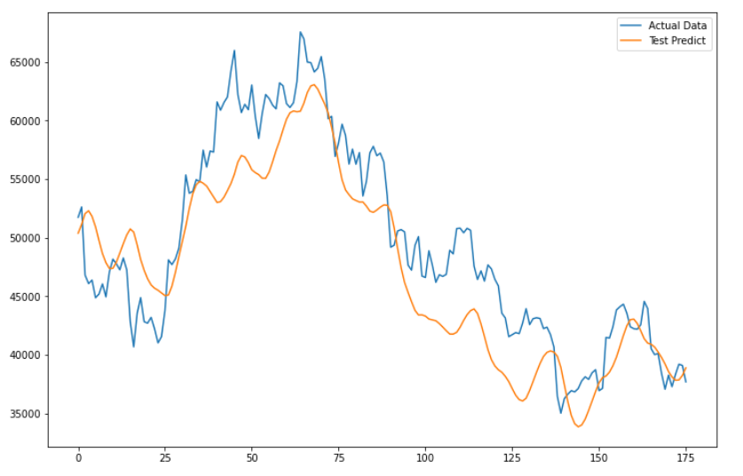
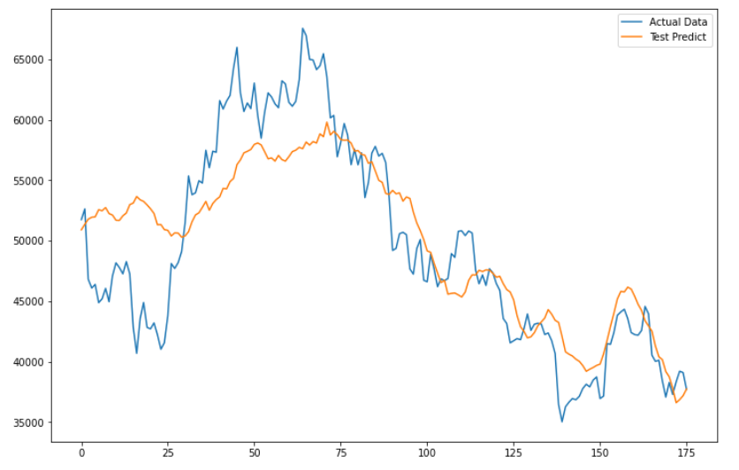
Test Predictions - BTC (High Volatility 64.7%)
LSTM
ESN
Similar Results on LSTM and ESN

Slide 15
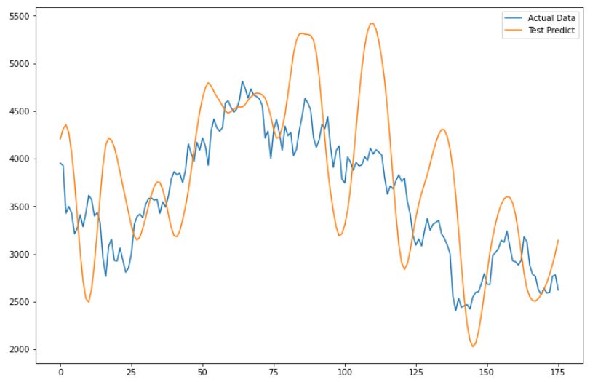
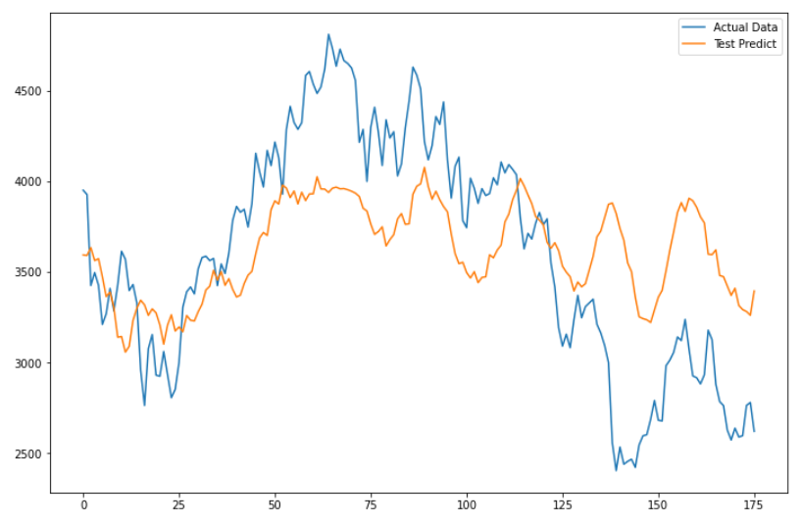
Test Predictions - ETH (High Volatility 85.2%)
LSTM
ESN
ESN fits better

Slide 16
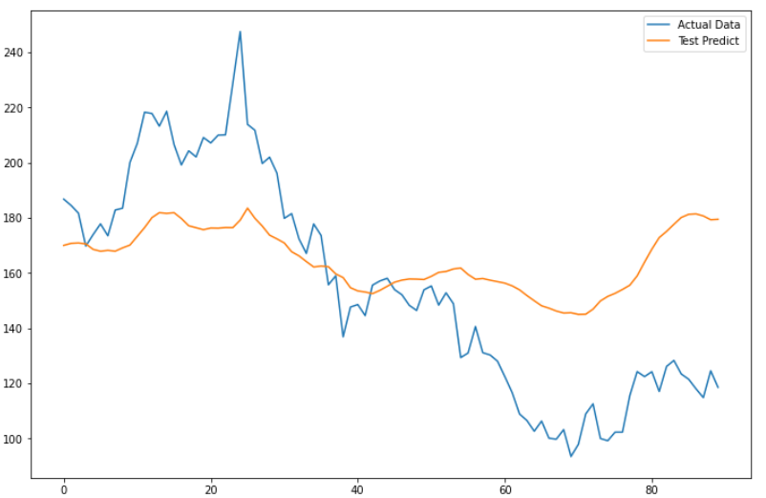
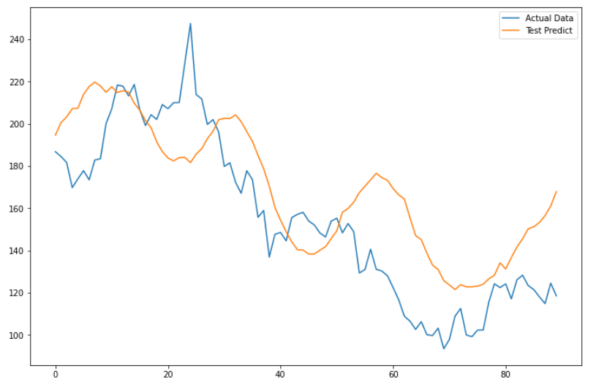
Test Predictions - GME (High Volatility 178.8%)
LSTM
ESN
ESN fits a lot better

Slide 17
Comparison of LSTM and ESN: Training Time
•ESN is much faster
•Less parameters to tune because reservoir weights are fixed
•PCA further reduces parameters
•Simple predictor: Ridge Regression
Instrument | LSTM* | ESN*
EUR/USD | 59.3 | 1.1
Hang Seng Index | 49.5 | 4.8
Bitcoin | 85.5 | 4.2
Ethereum | 82.4 | 1.8
Gamestop | 50.8 | 0.7
* Training Time in Seconds

Slide 18
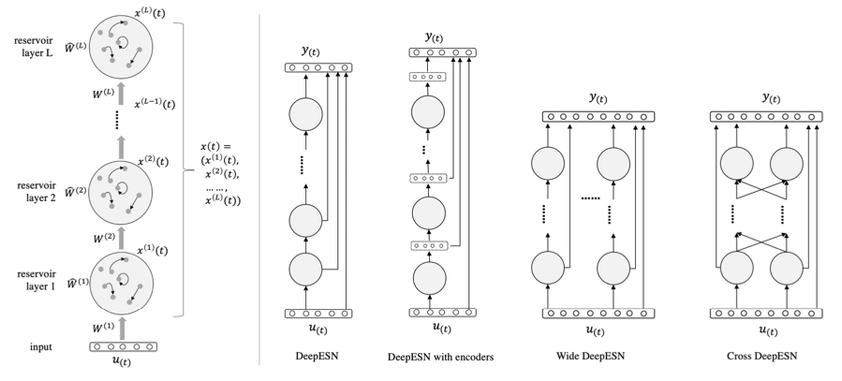
Beyond ESNs
DeepESNs
Image from Sun, C., Song, M., Hong, S. and Li, H., 2020. A review of designs and applications of echo state networks. arXiv preprint arXiv:2012.02974.
Notes:
DeepESN:
Deep learning version of ESN introduce in 2017: Gallicchio, Claudio, Alessio Micheli, and Luca Pedrelli. "Deep reservoir computing: A critical experimental analysis." Neurocomputing 268 (2017): 87-99.
Efficiently trained deep network
Add capacity to learn abstract, complex features to ESN
Input layer, dynamic stacking reservoirs and output layer
Output of one layer is input of the next layer
Figure shows different architectures

Slide 19
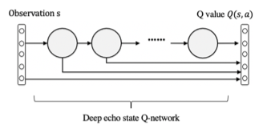
Beyond ESNs
Combinations with other networks
Image from Sun, C., Song, M., Hong, S. and Li, H., 2020. A review of designs and applications of echo state networks. arXiv preprint arXiv:2012.02974.
Notes:
Combined with reinforcement learning:
Potential to combine the two to create a trading strategy
Chaotic time-series events actions taken based on that to maximise the reward and therefore profit
Example:
SARSA update: can look ahead more than one step to incorporate future rewards (Szita, István, Viktor Gyenes, and András Lőrincz. "Reinforcement learning with echo state networks." In International Conference on Artificial Neural Networks, pp. 830-839. Springer, Berlin, Heidelberg, 2006.)

Slide 20
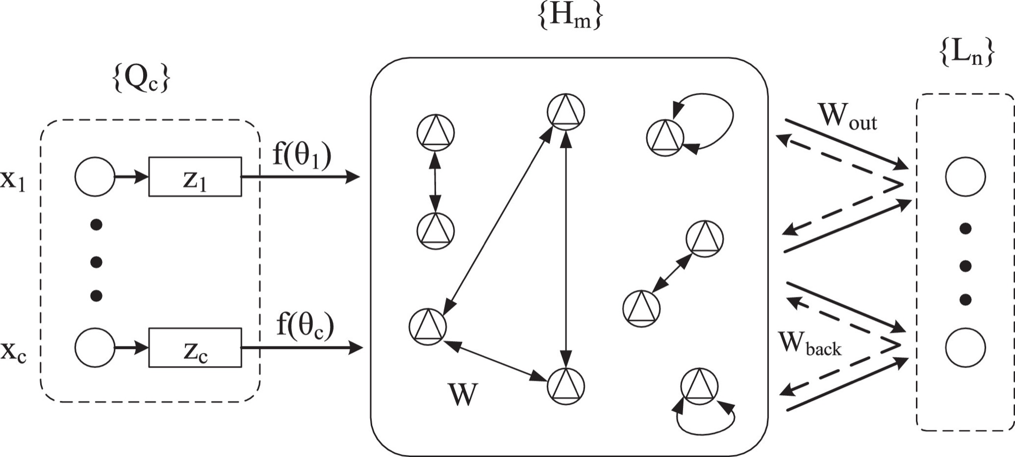
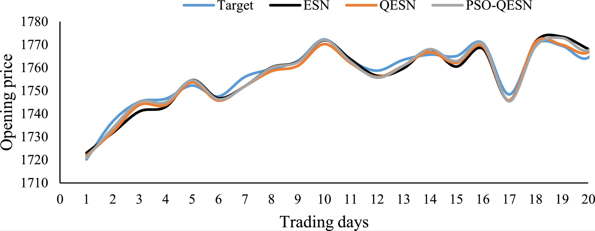
Beyond ESNs
QESN
Images from Liu, Junxiu, Tiening Sun, Yuling Luo, Su Yang, Yi Cao, and Jia Zhai. "An echo state network architecture based on quantum logic gate and its optimization." Neurocomputing 371 (2020): 100-107.
Notes:
Quantum ESN:
Take advantage of features of Quantum computing to address drawbacks of traditional NN:
Limited memory capacity
Forgetting while learning new information
Real number input goes through input layer and converted from real to quantum state
Neurons in the reservoir are based on qubit neurons and remain sparsely connected
Prediction accuracy improved by 30% on time series prediction tasks
S&P 500 Index price predictions RMSE:
ESN: 71.9
QESN: 8.2

Slide 21
Conclusion
Reservoir computing to predict chaos in time-series
Fast training: fewer parameters to train due to fixed reservoir weights
Better performance on high volatility instruments compared with LSTM
DeepESN and QESN has potential further improvements

