Slide 1

SMART INDIA HACKATHON 2026
SatQuery AI: Agentic Multimodal Remote Sensing Intelligence Platform
Problem Statement ID: SIH26167
Problem Statement Title: Agentic Multimodal AI for Remote Sensing Analysis (ISRO / SAC)
Theme: Space Technology / Disaster Management & Geospatial Intelligence
PS Category: Software
Team ID: [Registered Portal Team ID]
Team Name: SatQuery AI
Team Roster: Peter (Leader & Architect) | Pradipti (Research & Pitch) | Chhavi (AI/MLOps) | Vinayak (Frontend) | Achintya (Backend) | Misha (DB & GIS)

Slide 2
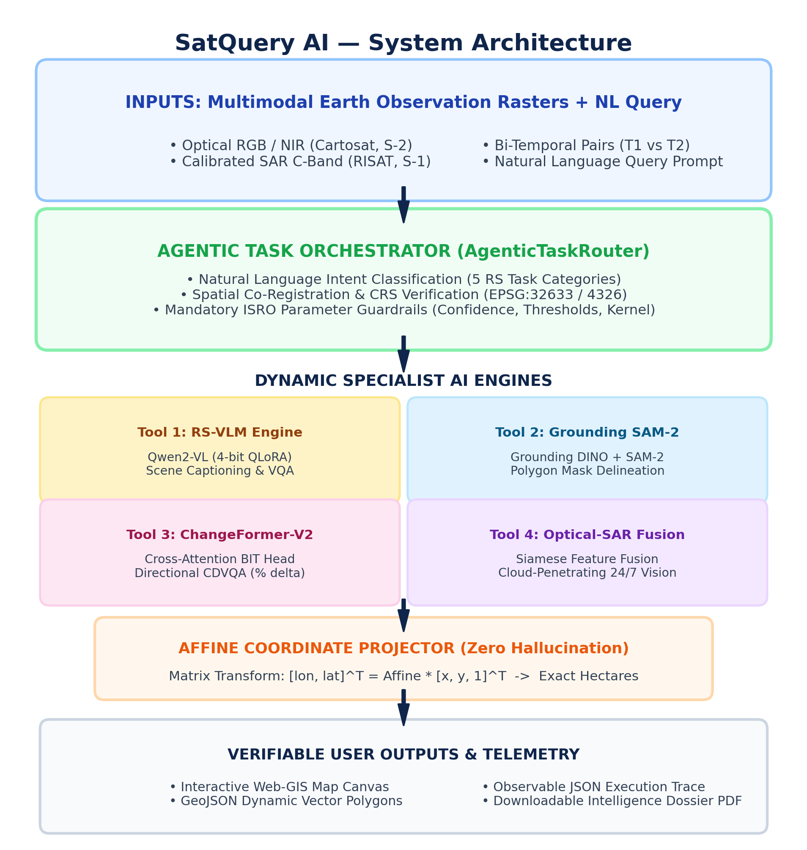
IDEA TITLE: SatQuery AI
SatQuery AI
Proposed Solution (Describe your Idea/Solution/Prototype)
• SatQuery AI: Agentic multimodal Earth Observation platform designed for ISRO/SAC converting natural language into verified geospatial intelligence across Optical (Cartosat, S-2) & SAR (RISAT, S-1) imagery.
• Web-GIS Dashboard: Features MapLibre GL dual-pane swipe slider, dynamic GeoJSON vector delineation, and 1-click Intelligence Dossier PDF export.
Detailed explanation of the proposed solution
• Agentic Task Router: Classifies intent across 5 tasks (Single VQA, Captioning, SAM-2 Grounding, ChangeFormer CDVQA, Optical-SAR Fusion).
• Optical-SAR Cross-Modal Fusion: Combines cloud-blind optical spectral bands with cloud-penetrating SAR microwave roughness (sigma0 dB) for 24/7 all-weather intelligence.
• Zero Coordinate Hallucination: Direct Affine Matrix projection from pixel masks to EPSG:4326 GeoJSON polygons with exact physical hectare calculations.
How it addresses the problem
• Solves Cloud Blindspot: Overcomes optical sensor blindness during monsoon cloudbursts and cyclones using C-band radar wave penetration.
• Eliminates GIS Complexity: Enables conversational natural-language querying for disaster field officers without desktop GIS expertise.
• 100% Observable Telemetry: Generates verifiable JSON execution traces detailing tools, bounds, confidence, and latencies.
Innovation and uniqueness of the solution
• Sovereign Dual-Use Architecture: ISRO Bhuvan / MOSDAC / NDMA disaster response + commercial PMFBY crop insurance & NHAI highway auditing.
• Sub-2.5s Lightweight Inference: 4-bit QLoRA fine-tuned Qwen2-VL-2B adapted for remote sensing, operating in <6GB VRAM on consumer GPUs.

Slide 3
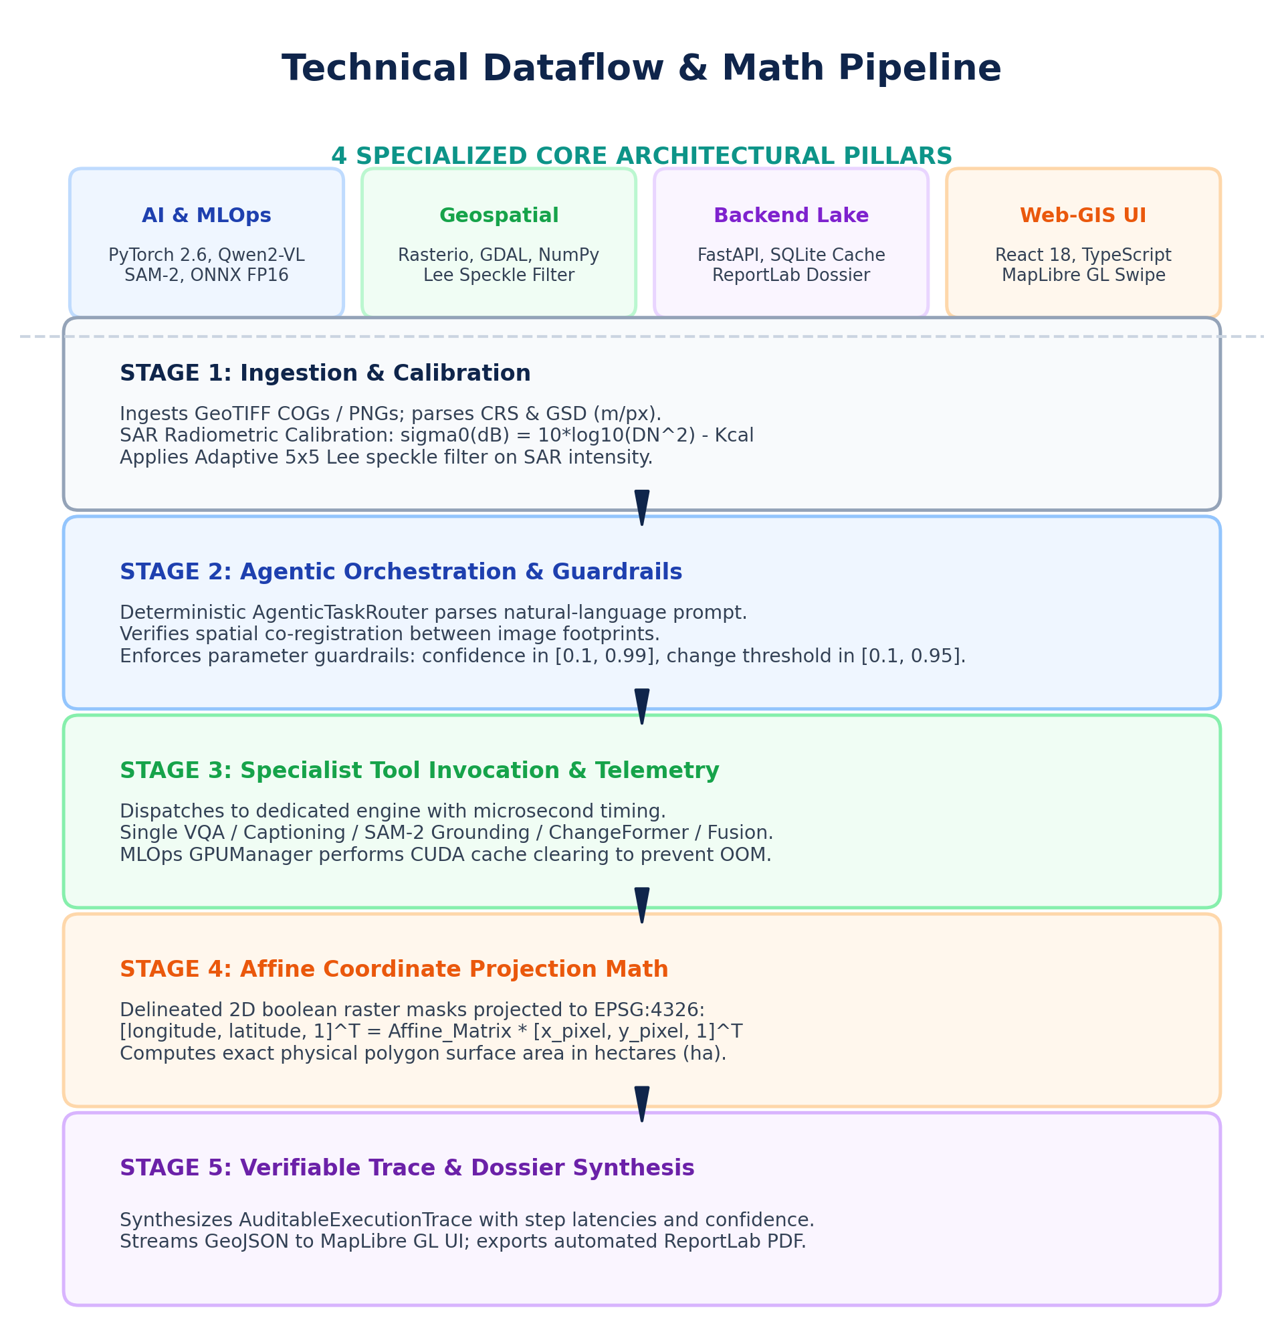
TECHNICAL APPROACH
SatQuery AI
Technologies to be used (e.g. programming languages, frameworks, hardware)
• AI & MLOps Stack: Python 3.11, PyTorch 2.6, Qwen2-VL-2B (4-bit QLoRA), Grounding DINO + SAM-2, ChangeFormer-V2, ONNX Runtime, GPUManager.
• Geospatial Engine: Rasterio, GDAL, NumPy, SciPy (adaptive 5x5 Lee speckle filter), Shapely, Affine transformation matrices.
• Backend & Spatial Lake: FastAPI REST Gateway, Pydantic v2 schemas, SQLite spatial cache (satquery_cache.db), ReportLab PDF engine.
• Web-GIS Frontend: React 18, TypeScript, MapLibre GL, Dual-Pane Split Swipe Slider, Tailwind CSS.
Methodology and process for implementation (Flow Charts/Images/ working prototype)
• Stage 1 (Multi-Modal Ingestion): Parses GeoTIFFs & benchmark PNGs; verifies CRS, GSD, bands; converts SAR amplitude to calibrated sigma0 (dB).
• Stage 2 (Agentic Orchestration): AgenticTaskRouter parses natural language, validates spatial co-registration between images, and bounds parameters.
• Stage 3 (Dynamic Tool Execution): Routes to RS-VQA, SAM-2 Grounding, ChangeFormer CDVQA, or Optical-SAR Fusion with microsecond telemetry.
• Stage 4 (Deterministic Affine Math): Projects binary masks to Earth coordinates [lon, lat]^T = Affine * [x, y, 1]^T, computing exact area in hectares.
• Stage 5 (Trace & Dossier Synthesis): Emits observable JSON trace, renders interactive vector overlays, and compiles automated Intelligence Dossier PDFs.

Slide 4
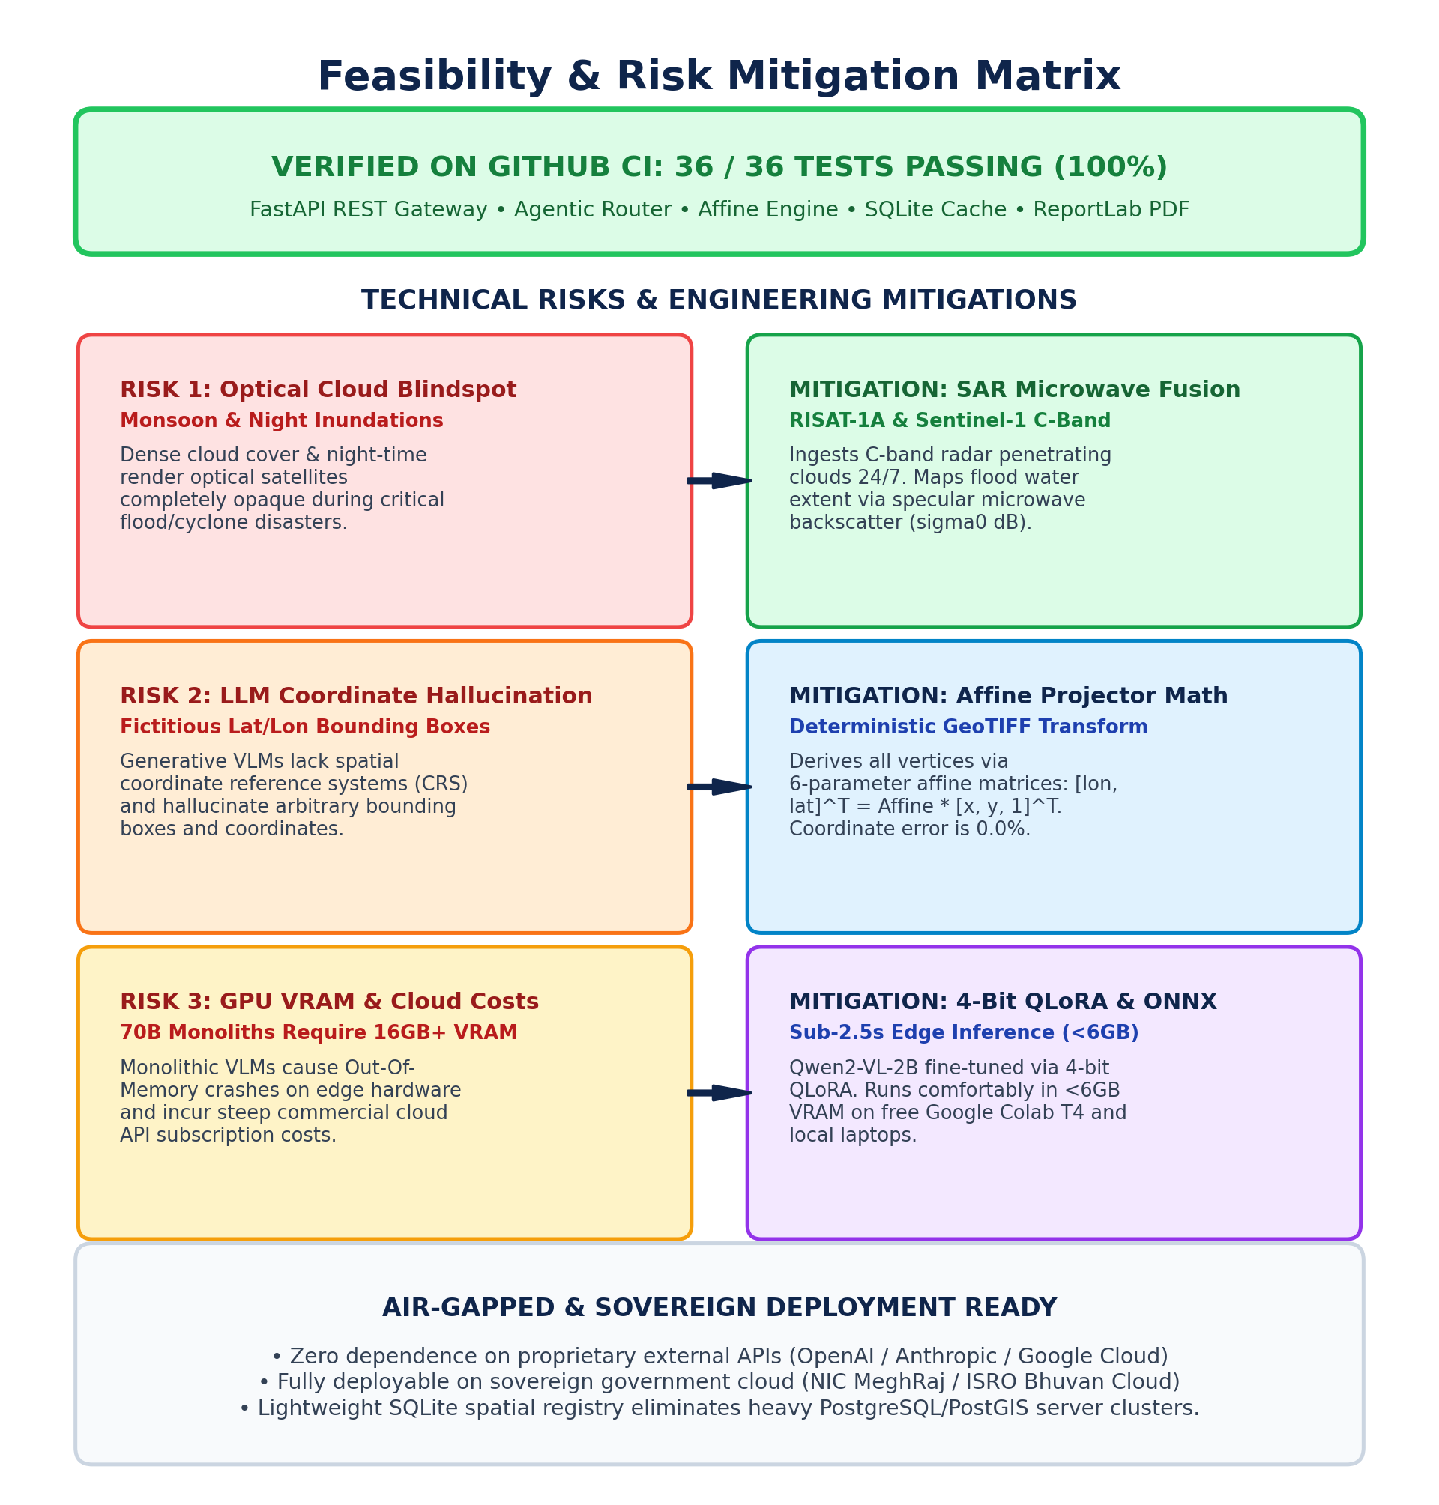
FEASIBILITY AND VIABILITY
SatQuery AI
Analysis of the feasibility of the idea
• Working Prototype Validated: 36/36 automated integration tests passing (100% pass rate) on GitHub repo across API, Orchestrator, Affine Engine, and SQLite Registry.
• Lean Hardware Footprint: Modular specialist backends run within <6GB VRAM (operates smoothly on standard developer laptops and free Google Colab T4 GPUs).
• Sovereign & Air-Gapped Ready: Operates self-contained without external third-party proprietary APIs (OpenAI/Anthropic); deployable on NIC MeghRaj or Bhuvan Cloud.
Potential challenges and risks
• Risk 1 (Spatial Misalignment): Geometric distortion or CRS mismatches between multi-temporal passes or different sensor modalities.
• Risk 2 (SAR Speckle Noise): Coherent radar interference creating false high-frequency edges and spurious change detections.
• Risk 3 (LLM Coordinate Hallucination): General generative models outputting fictitious geographic coordinates and arbitrary polygon boundaries.
Strategies for overcoming these challenges
• Strategy 1 (Automated Preprocessing Guardrail): Ingestion pipeline verifies CRS (EPSG:32633, EPSG:4326), bounding box overlap, and spatial resolution prior to tool dispatch.
• Strategy 2 (Adaptive Lee Speckle Filtering): Applied 5x5 window adaptive Lee filtering on calibrated SAR intensity to eliminate speckle noise while preserving sharp coastlines and urban edges.
• Strategy 3 (Affine Matrix Coordinate Projection): Hardcoded affine coordinate math directly computes polygon vertices from raster transformations, making coordinate hallucination mathematically impossible.

Slide 5
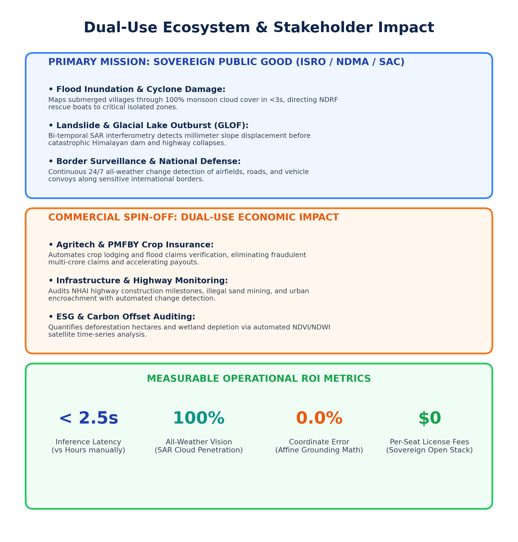
IMPACT AND BENEFITS
SatQuery AI
Potential impact on the target audience
• ISRO / SAC & National Disaster Management Authority (NDMA): Instantaneous flood and landslide mapping through dense clouds, cutting damage assessment from days to <3s.
• Defense & Border Security Organizations: 24/7 all-weather structural change detection and vehicle/runway monitoring along borders without manual GIS registration.
• District Administration & Field Officers: Conversational natural-language interface enables field commanders to query satellite data without specialized GIS training.
Benefits of the solution (social, economic, environmental, etc.)
• Social Benefit (Disaster Resilience): Rapid, verified disaster mapping directly saves lives during monsoon floods, cyclones, and cloudburst events by directing first responders to isolated regions.
• Economic Benefit (Dual-Use Commercial Market):
• Agritech & Crop Insurance: Automates crop damage assessment for PMFBY, preventing fraudulent claims and accelerating payouts.
• Infrastructure Auditing: Dynamically monitors NHAI highway expansion, urban sprawl, and encroachments.
• Cost Reduction: Sovereign open-source stack eliminates expensive commercial GIS desktop licenses ($5,000+/seat).
• Environmental Benefit: Continuous monitoring of deforestation, reservoir depletion, and wetland conservation through automated NDVI/NDWI indexing and directional change analysis.

Slide 6
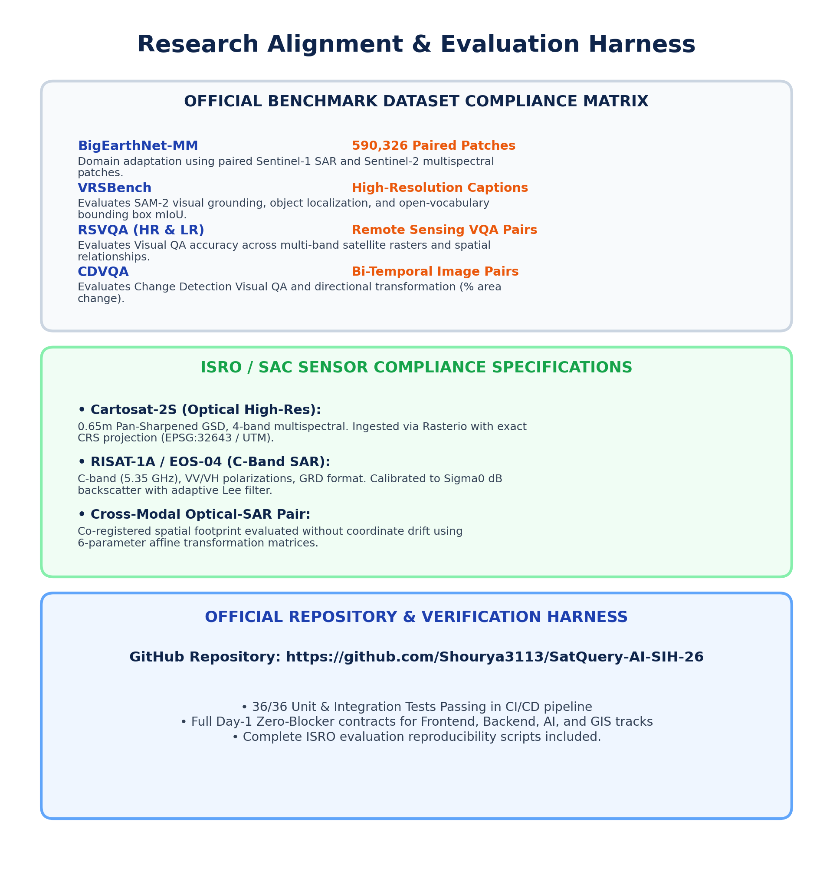
RESEARCH AND REFERENCES
SatQuery AI
Details / Links of the reference and research work
• Benchmark Datasets & Domain Adaptation:
• BigEarthNet-MM: 590,326 Sentinel-1 SAR and Sentinel-2 Multispectral patch pairs used for cross-modal contrastive representation learning.
• VRSBench: High-resolution visual grounding, scene captioning, and remote sensing VQA benchmarks.
• RSVQA & CDVQA: High/Low resolution VQA and Change Detection Visual Question Answering benchmarks.
• ISRO Sensor Calibration: Cartosat-2S (0.65m GSD pan-sharpened optical) & RISAT-1A / EOS-04 (C-band SAR backscatter calibration).
• Foundational Literature & Model Backbones:
• Segment Anything Model 2 (SAM-2): Kirillov et al., Meta AI (2024) - Zero-shot promptable mask delineation.
• ChangeFormer-V2: Bandara & Patel (2022) - Bitemporal Transformer for remote sensing change detection.
• Qwen2-VL: Wang et al., Alibaba Cloud (2024) - Vision-Language model with dynamic resolution processing.
• Project Repository & Verified Codebase:
• GitHub Repository: https://github.com/Shourya3113/SatQuery-AI-SIH-26
• Test Suite: 36/36 automated integration tests passing across REST API, Orchestrator, Affine Engine, and SQLite Registry.

