Slide 1
Optimizing the
2028 Olympics
Optimizing the
2028 Olympics
Using historical data to drive smarter planning for athletes, host cities, and NOCs
Aaron Huang · Roshan Dileep · Shourya Batra
Homestead High School, CA | 2025-26 | Chapter #8990

Slide 2
Homestead FBLA · Data Analysis
Our Client & Research Question
How can historical Olympic participation and performance data
be used to optimize planning decisions for the 2028 Olympics?
We focused on three key stakeholders:
Athletes
Los Angeles
NOCs

Slide 3





Workflow & Methodology
01
02
03
04
Merged & Filtered Summer Games
Handled Missing Values
Participation · Medals · Age
Clustering & Regression
GitHub · Python · Pandas
scikit-learn · Jupyter
Data Collection
Processing
Analysis
Reproducibility
1896–2016 Athlete Event Data
NOC Regions + World Bank GDP
All work in GitHub — fully auditable by SportsFanatics

Slide 4


Larger Venues
Athlete Villages
Transit & Security
Prioritize capacity for Track and Field & Swimming
Locate near highest-traffic venues
Scale staffing to major event days
Host City: Participation by Sport
203
Track and Field
Countries: most of any sport
186
Swimming
Countries: second highest
Feasible — concentrates resources on highest-impact sports, replicable by any host city

Slide 5
Recommendation: Los Angeles
Larger Venues
Athlete Villages
Transit & Security
Prioritize capacity for Track and Field & Swimming
Locate near highest-traffic venues
Scale staffing to major event days
Feasible: concentrates resources on highest-impact sports, replicable by any host city

Slide 6
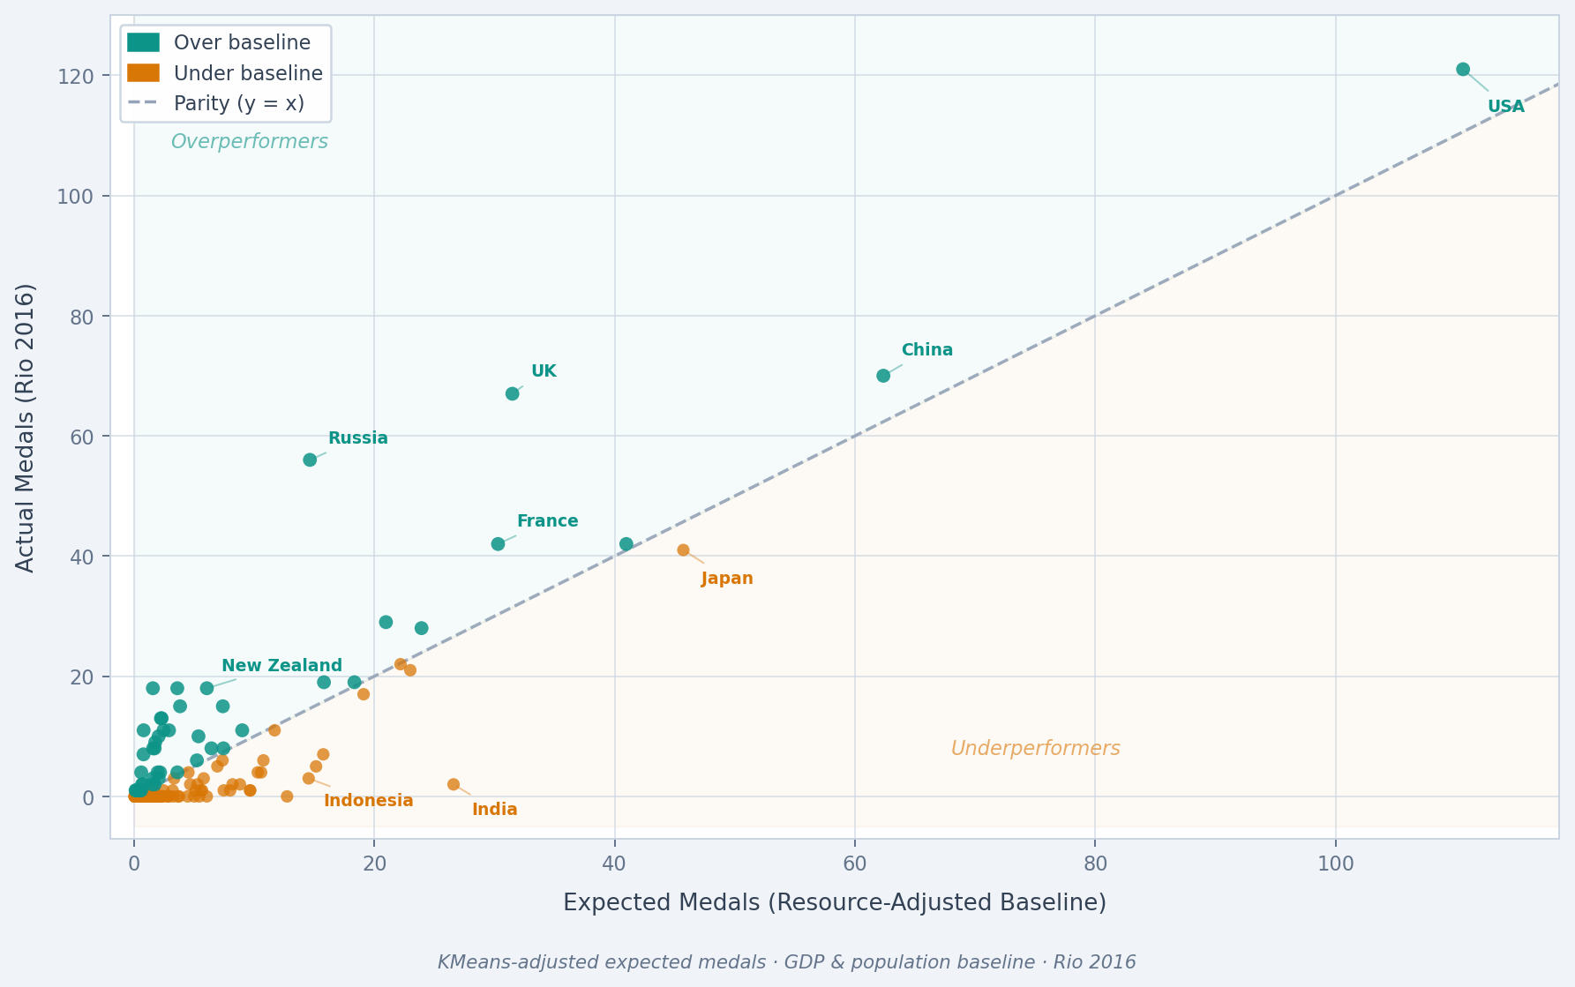


Resource-Adjusted Medal Performance
Overperformers
New Zealand · France
Russia · UK
Underperformers
Japan · Indonesia
India · Mexico

Slide 7

Recommendation: NOCs Worldwide
Benchmark against peers with similar GDP — replicate what outperformers do
Jordan — Below Baseline
Azerbaijan — Above Baseline
→
Broad delegation, limited specialization
Similar resources to Azerbaijan
Concentrated coaching investment
Targeted medal-producing sports
Elite development pipelines
Feasible — reallocate existing resources strategically, not just increase spending

Slide 8
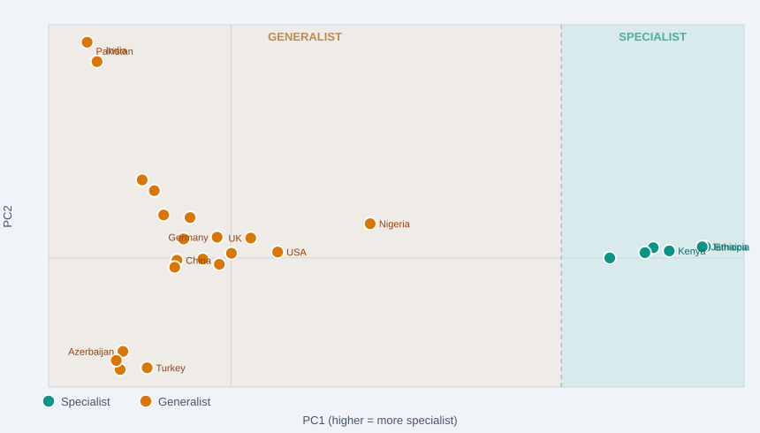

Country Strategy Clusters
SPECIALIST
Medals in 1–2 sports:
Jamaica · Kenya · Ethiopia · Morocco
GENERALIST
Medals across many sports:
USA · China · Germany · UK
KMeans clustering on medal distribution · PCA for 2D projection

Slide 9
Recommendations: Country Strategy
Deepen investment in strongest sports
Elite coaching & sports science
Early talent identification
Maintain diversified sport investment
Prioritize pipeline depth & consistency
Develop talent across federations
SPECIALIST
GENERALIST
Feasible: aligns with existing national strengths, no structural overhaul required

Slide 10
Athlete Peak Age Windows by Sport
Align Training Schedules
Adjust Selection Criteria
Early Peak
Rhythmic Gymnastics
Median ~18 · tight window
Match intensity to sport-specific peak age windows
Physical peak vs experience depends on the sport
Late Peak
Shooting & Equestrian
Median 32–34 · wide window
Median medal-winning age by sport · Teal = younger peak Crimson = experience-based

Slide 11


Recommendation: Athlete Development
Align Training Schedules
Adjust Selection Criteria
Match intensity to sport-specific peak age windows
Physical peak vs experience depends on the sport
Resources Required
Long-Term Development Plans
Coaching Education
Athlete Monitoring
Feasible: data-informed adjustments to existing pipelines, shareable globally

Slide 12

Key Takeaways
Los Angeles
Concentrate infrastructure & operations on Track and Field and Swimming
NOCs Worldwide
Benchmark against peers and reallocate resources to what actually works
Athletes Globally
Train and peak at the right time using sport-specific pipelines
More effective, sustainable, and equitable Olympic planning for LA 2028 and beyond

Slide 13
Athletes
Los Angeles
NOCs
Works Cited
Datasets
Data Analysis Competitive Event Guidelines: Olympic athlete-event data 1896–2016
Data Analysis Competitive Event Guidelines: NOC region mapping
World Bank Open Data: GDP per capita (current US$) & population
Software & Libraries
Python · Pandas · NumPy (data wrangling)
scikit-learn (regression & KMeans clustering)
Matplotlib · Seaborn · Jupyter Notebooks
Repository
GitHub: full codebase and data pipeline available for audit

Slide 14
Homestead FBLA · Data Analysis
Thank You!
We are now open to questions
Aaron · Shourya · Roshan · Homestead FBLA
Athletes
Los Angeles
NOCs

