Slide 1
Optimizing the
2028 Olympics
Optimizing the
2028 Olympics
Using historical data to drive smarter planning for athletes, host cities, and NOCs
Aaron Huang · Roshan Dileep · Shourya Batra
Homestead High School, CA | 2025-26 | Chapter #8990

Slide 2
Homestead FBLA · Data Analysis
Our Client & Research Question
How can historical Olympic participation and performance data
be used to optimize planning decisions for the 2028 Olympics?
We focused on three key stakeholders:
Athletes
Los Angeles
NOCs

Slide 3





Workflow & Methodology
01
02
03
04
Merged & Filtered Summer Games
Handled Missing Values
Participation · Medals · Age
Clustering & Regression
GitHub · Python · Pandas
scikit-learn · Jupyter
Data Collection
Processing
Analysis
Reproducibility
1896–2016 Athlete Event Data
NOC Regions + World Bank GDP
All work in GitHub — fully auditable by SportsFanatics

Slide 4


Transit & Lanes
Medical & Recovery
Security & Staffing
Pre-position shuttles & lanes by zone load
Scale capacity to load, not stadium seating
Weight staffing to the three high-load zones
Host City: The Distributed-Venue Challenge
41%
Downtown / Expo
Largest single-zone load
77%
Top 3 Zones
of all 11,179 athletes
LA28 Olympic venue plan, approved by the IOC and publicly released April 15, 2025. la28.org
Olympic athlete-events data, 1896–2016 (Kaggle, via Sports Reference) · Rio 2016 Summer Games subset
Feasible: reallocates existing budget, traced to LA28's plan — replicable by any host

Slide 5



Recommendation: Los Angeles
Transit & Lanes
Medical & Recovery
Security & Staffing
Pre-position shuttles & lanes by zone load
Scale capacity to load, not stadium seating
Weight staffing to the three high-load zones
Feasible: reallocates existing budget, traced to LA28's plan — replicable by any host

Slide 6
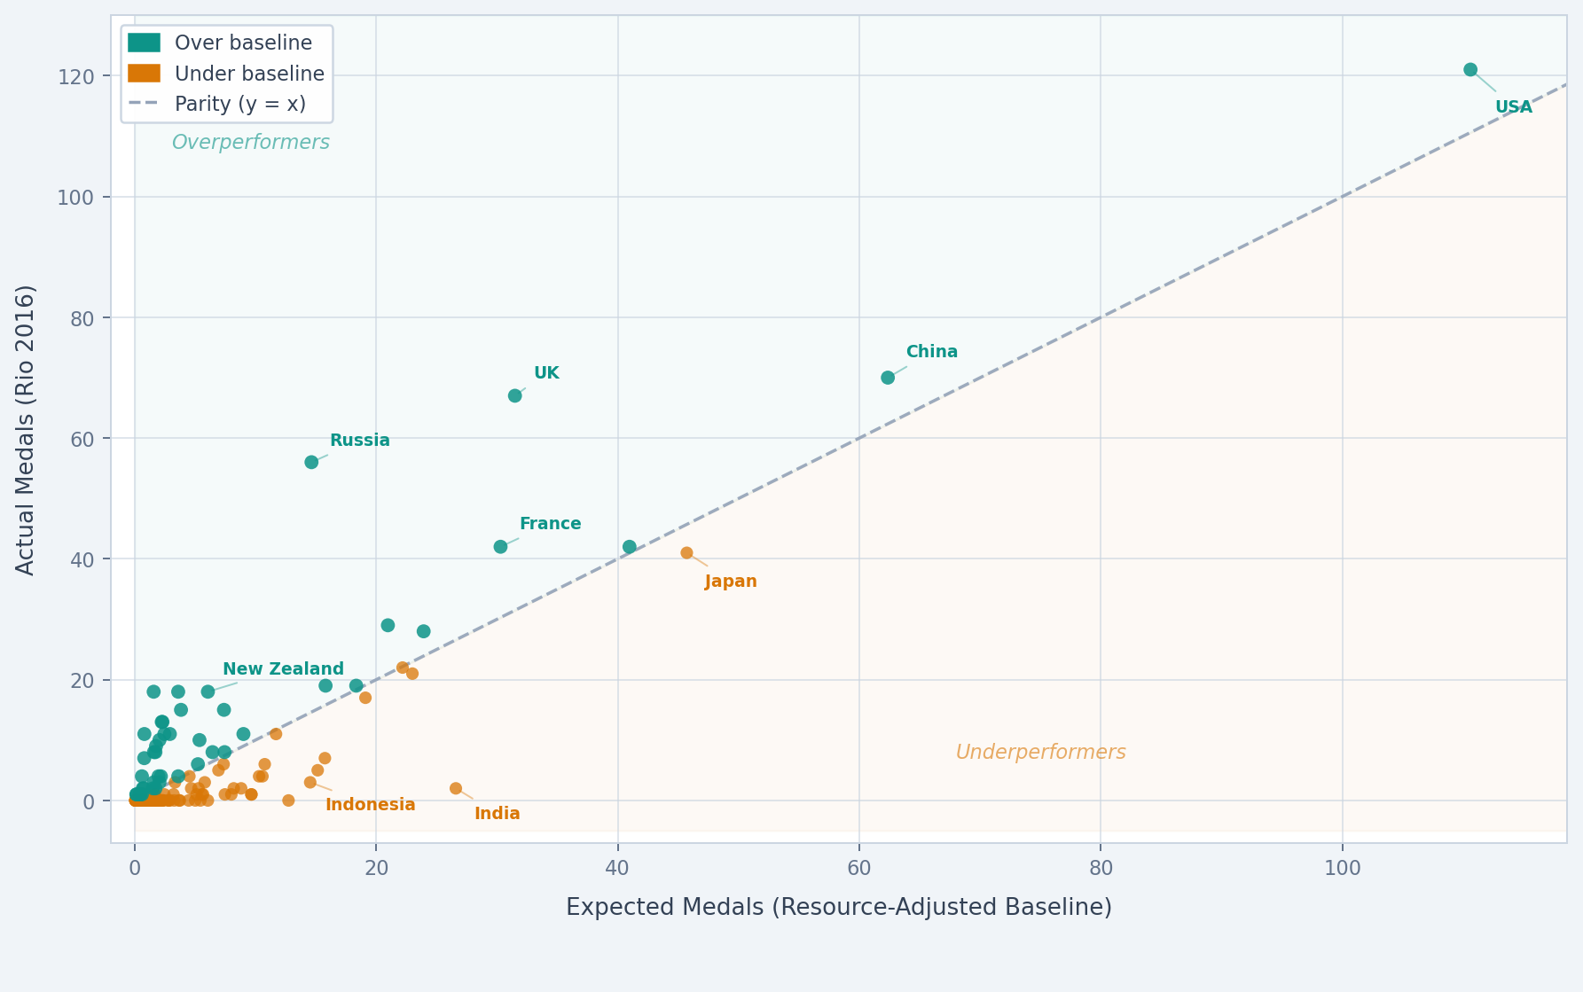


Resource-Adjusted Medal Performance
Overperformers
New Zealand · France
Russia · UK
Underperformers
Japan · Indonesia
India · Mexico
GDP per capita (NY.GDP.PCAP.CD) and population (SP.POP.TOTL), World Bank, 2016.
Poisson-modeled expected medals · GDP & population baseline · Rio 2016

Slide 7

Recommendation: NOCs Worldwide
Benchmark against peers with similar GDP — replicate what outperformers do
Jordan — Below Baseline
Azerbaijan — Above Baseline
→
Broad delegation, limited specialization
Similar resources to Azerbaijan
Concentrated coaching investment
Targeted medal-producing sports
Elite development pipelines
Feasible — reallocate existing resources strategically, not just increase spending

Slide 8
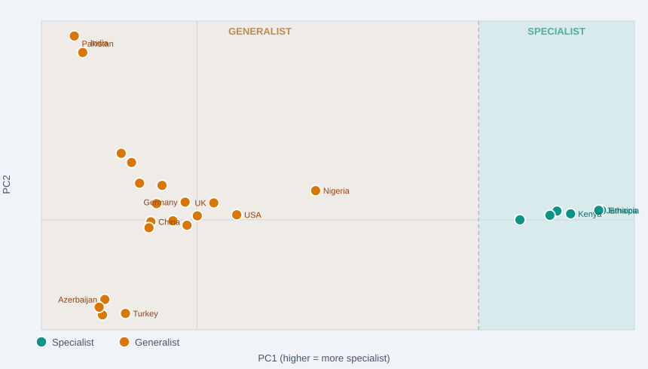

Country Strategy Clusters
SPECIALIST
Medals in 1–2 sports:
Jamaica · Kenya · Ethiopia · Morocco
GENERALIST
Medals across many sports:
USA · China · Germany · UK
KMeans clustering on medal distribution · PCA for 2D projection

Slide 9
Recommendations: Country Strategy
Deepen investment in strongest sports
Elite coaching & sports science
Early talent identification
Maintain diversified sport investment
Prioritize pipeline depth & consistency
Develop talent across federations
SPECIALIST
GENERALIST
Feasible: aligns with existing national strengths, no structural overhaul required

Slide 10


Athlete Peak Age Windows by Sport
Align Training Schedules
Adjust Selection Criteria
Early Peak
Rhythmic Gymnastics
Median ~18 · tight window
Match intensity to sport-specific peak age windows
Physical peak vs experience depends on the sport
Late Peak
Shooting & Equestrian
Median 32–34 · wide window
Median medal-winning age by sport · Teal = younger peak Crimson = experience-based

Slide 11


Recommendation: Athlete Development
Align Training Schedules
Adjust Selection Criteria
Match intensity to sport-specific peak age windows
Physical peak vs experience depends on the sport
Resources Required
Long-Term Development Plans
Coaching Education
Athlete Monitoring
Feasible: data-informed adjustments to existing pipelines, shareable globally

Slide 12

Key Takeaways
Los Angeles
Allocate transit, medical & staffing by each zone's athlete load
NOCs Worldwide
Benchmark against peers and reallocate resources to what actually works
Athletes Globally
Train and peak at the right time using sport-specific pipelines
More effective, sustainable, and equitable Olympic planning for LA 2028 and beyond

Slide 13
Athletes
Los Angeles
NOCs
Works Cited
Datasets
Data Analysis Competitive Event Guidelines: Olympic athlete-event data 1896–2016
Data Analysis Competitive Event Guidelines: NOC region mapping
World Bank Open Data: GDP per capita (current US$) & population
Software & Libraries
Python · Pandas · NumPy (data wrangling)
scikit-learn (regression & KMeans clustering)
Matplotlib · Seaborn · Jupyter Notebooks
Repository
GitHub: full codebase and data pipeline available for audit

Slide 14
Homestead FBLA · Data Analysis
Thank You!
We are now open to questions
Aaron · Shourya · Roshan · Homestead FBLA
Athletes
Los Angeles
NOCs

