Slide 1
Convolutional Neural Networks

Slide 2
Convolutional Neural Networks
Image Processing is a method to perform some operations on an image, in order to get an enhanced image or to extract some useful information from it. It is a type of signal processing in which input is an image and output may be image or characteristics/features associated with that image.
Computer Vision is a field of computer science that works on enabling computers to see, identify and process images in the same way that human vision does, and then provide appropriate output. It is like imparting human intelligence and instincts to a computer. In reality though, it is a difficult task to enable computers to recognize images of different objects.

Slide 3
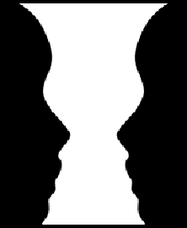
Convolutional Neural Networks

Slide 4

Convolutional Neural Networks

Slide 5

Convolutional Neural Networks
But, the question arise, how will be learning in this stage?
Let’s understand the learning first
about kids!

Slide 6
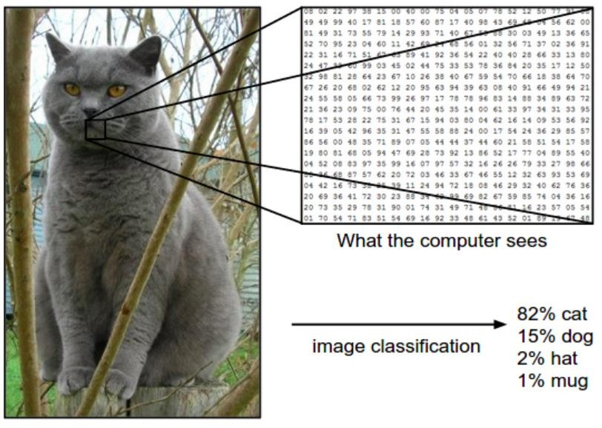
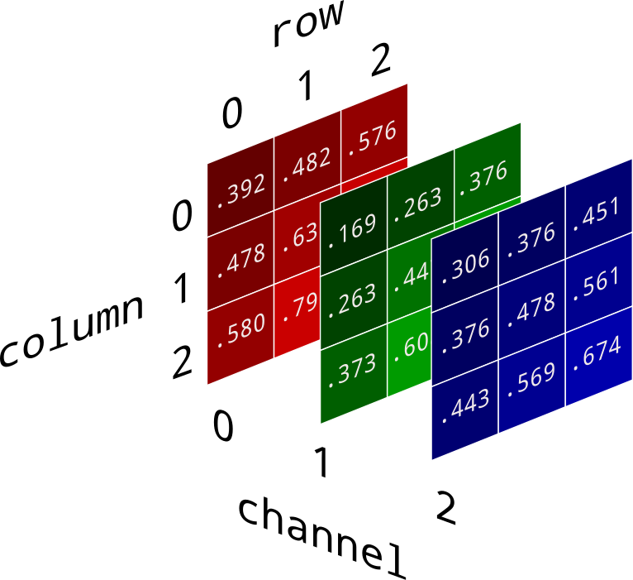
So, what about the Computer? CNN?
Learning… (by image features)
Gray scale image or RGB image

Slide 7
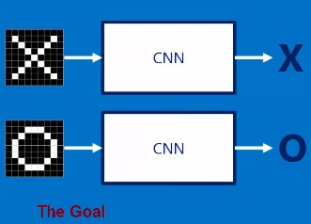
Learning…
So, What about the Computer? CNN?
X
Here CNN work as like black box, so what is inside the black box!
O

Slide 8
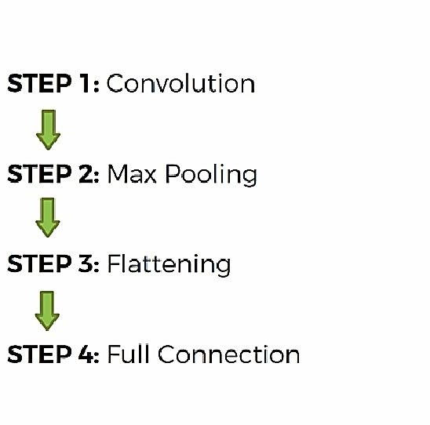
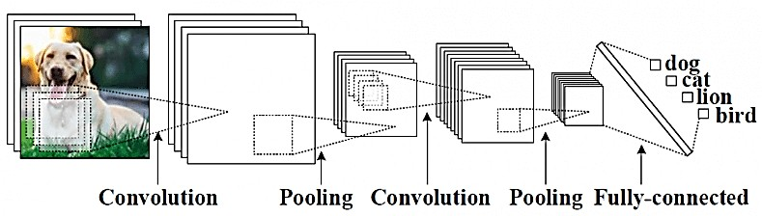
Steps in CNN

Slide 9
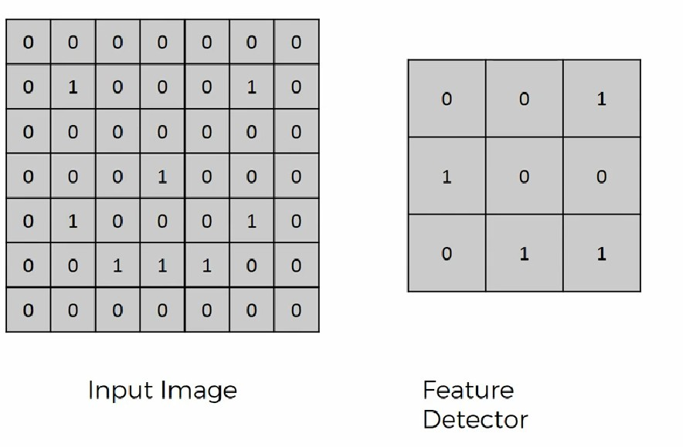
1. Convolutional ( of Smiling Face)

Slide 10
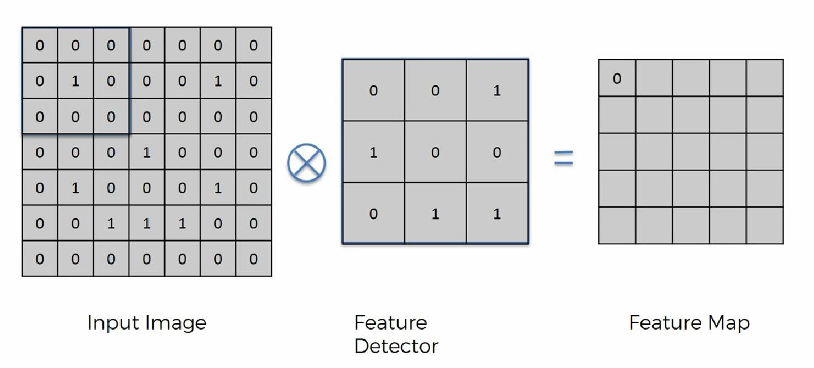
1. Convolutional ( of Smiling Face)

Slide 11
Feature map = Image_Size – Filter_Size +1
Output_Size = (Image_Size – Filter_Size +2*Padding + 1)/stride
Padding = (F – 1)/2

Slide 12
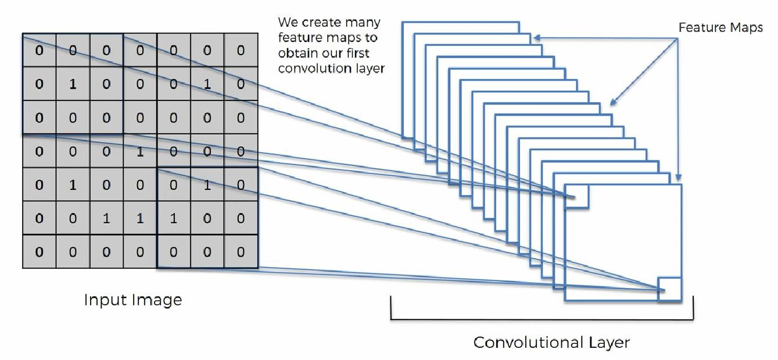
1. Convolutional ( of Smiling Face)

Slide 13
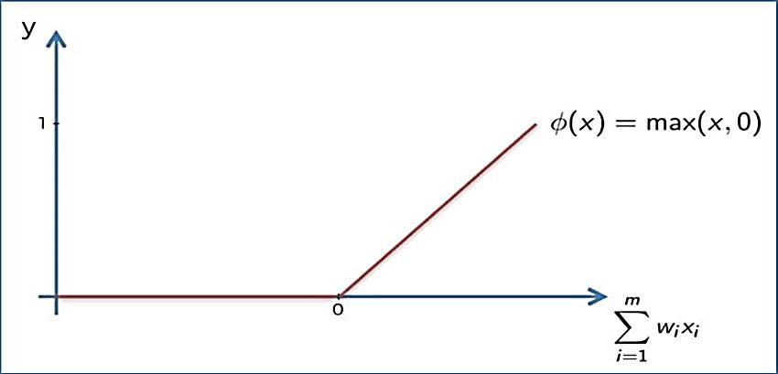
1. Convolutional ( of Smiling Face)
Appling ReLu Activation function to decrease the linearity in the image, because the image originally non linear!

Slide 14
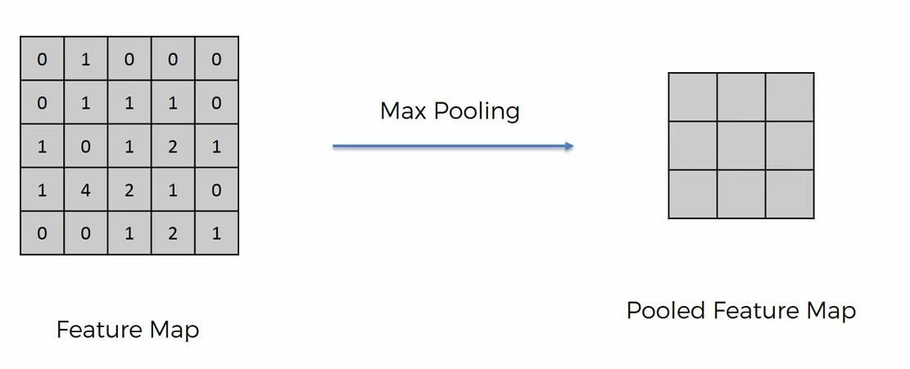
2. Pooling
A pooling layer is another building block of a CNN. Its function is to progressively reduce the spatial size of the representation to reduce the amount of parameters and computation in the network. Pooling layer operates on each feature map independently. The most common approach used in pooling is max pooling.

Slide 15
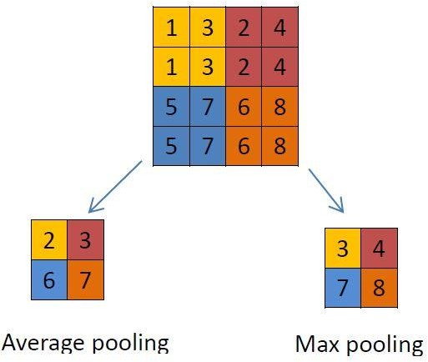
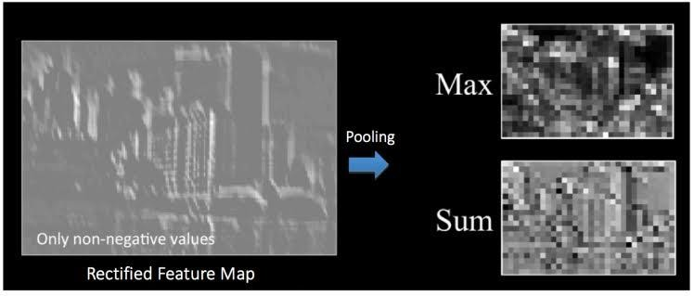
Max / Avg. Pooling

Slide 16
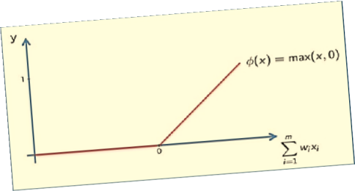
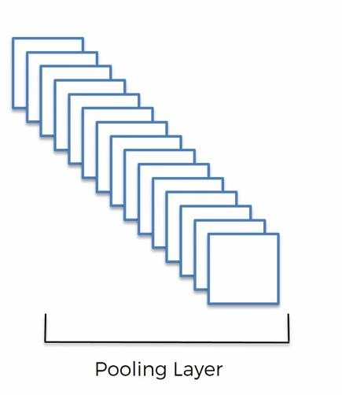
Pooling…

Slide 17
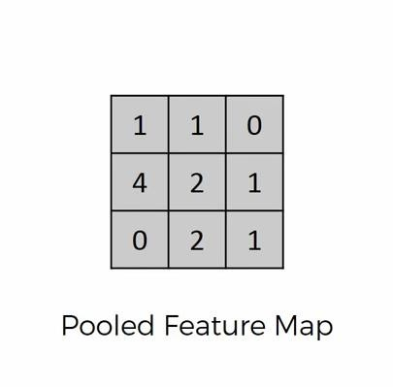
3. Flattening
Flattening is converting the data into a 1-dimensional array for inputting it to the next layer. We flatten the output of the convolutional layers to create a single long feature vector. And it is connected to the final classification model, which is called a fully- connected layer

Slide 18
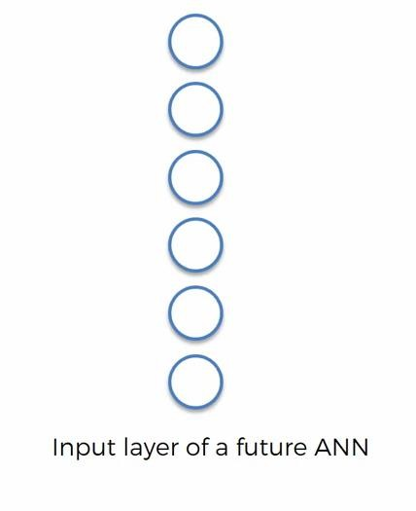
Flattening …

Slide 19
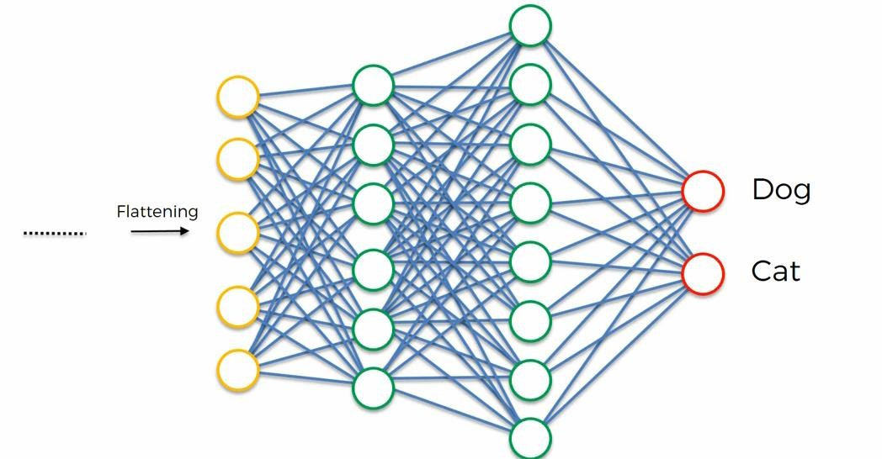
4. Fulling Connection

Slide 20
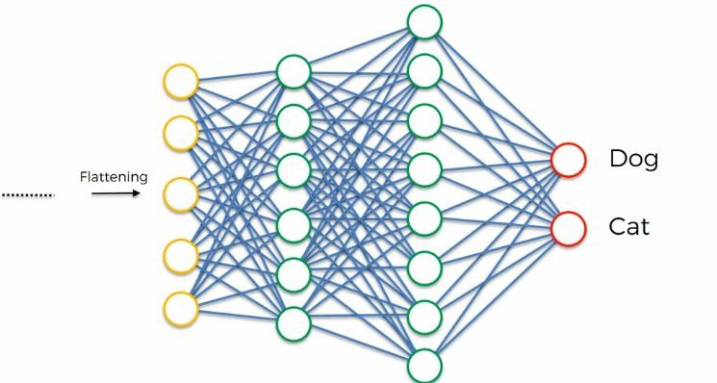

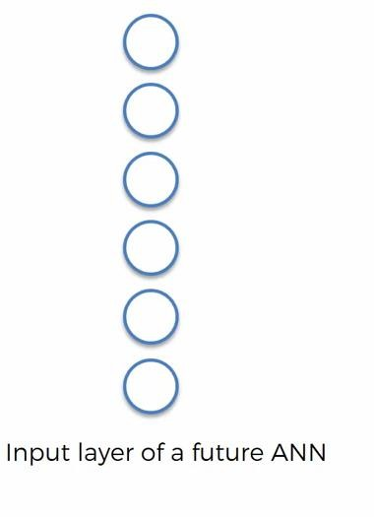
Complete CNN in one View

Slide 21
Q. Input= 32*32*3 10 5*5 filters with stride 1, padding 2 what is the output volume size?

