Slide 1
Machine Learning & Deep Learning

Slide 2
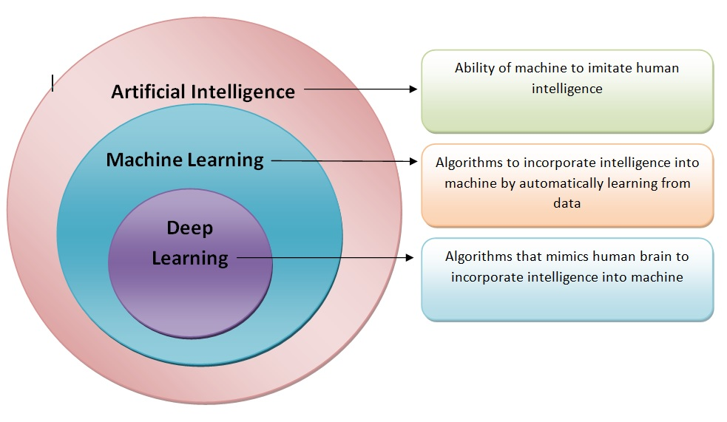

Slide 3
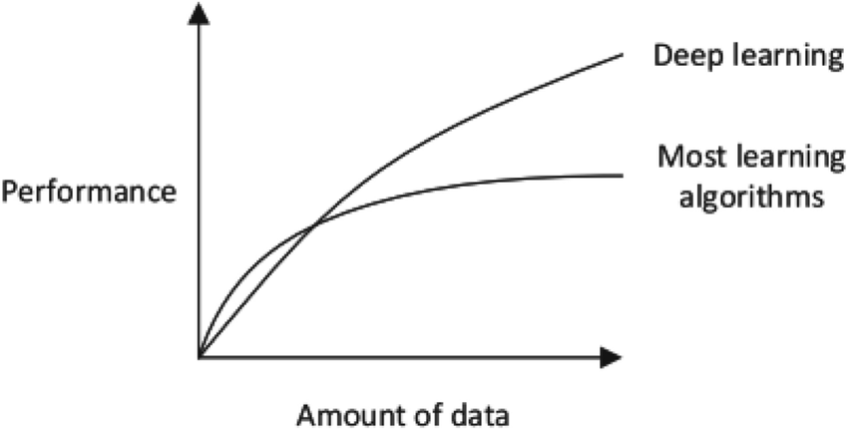
ML Vs DL

Slide 4
ML Vs DL
Machine Learning | Deep Learning
Take decisions on past data | Take decisions on artificial neural networks
Lower data for training | Huge data for training
Works on low end systems | Need high end systems
Testing takes longer time | Less testing time
Crisp rules & reasons why decision is taken | Difficult to interpret why decision is taken

Slide 5
Supervised Learning and k Nearest Neighbors

Slide 6
Supervised learning and classification
Given: dataset of instances with known categories
Goal: using the “knowledge” in the dataset, classify a given instance
  predict the category of the given instance that is rationally consistent with the dataset

Slide 7
Classifiers
X1
X2
feature
values
X3
Y
…
Classifier
category
Xn
DB
collection of instances
with known categories

Slide 8
Algorithms
K Nearest Neighbors (kNN)
Naïve-Bayes
Decision trees
Support vector machines etc…

Slide 9
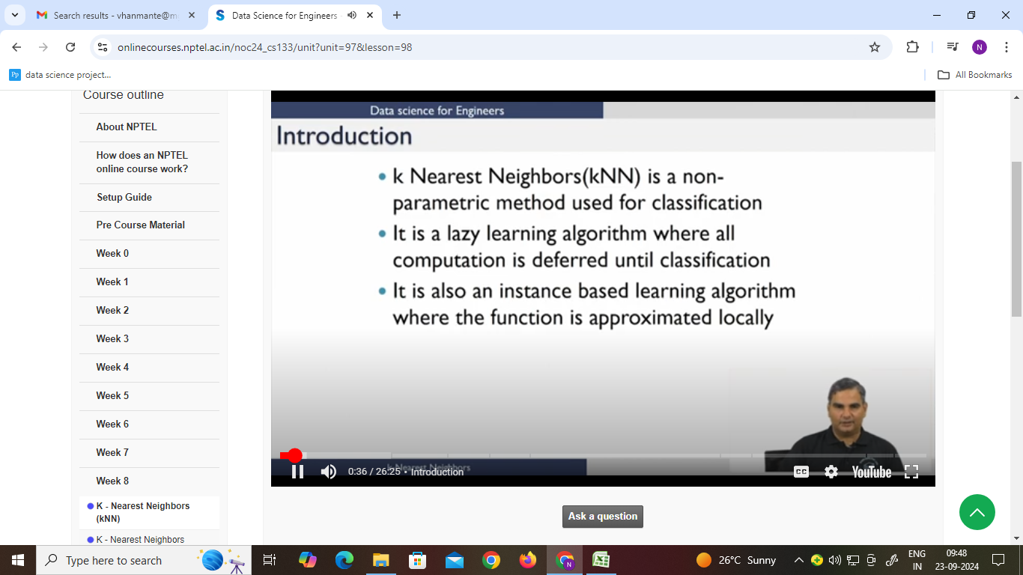
KNN Introduction

Slide 10
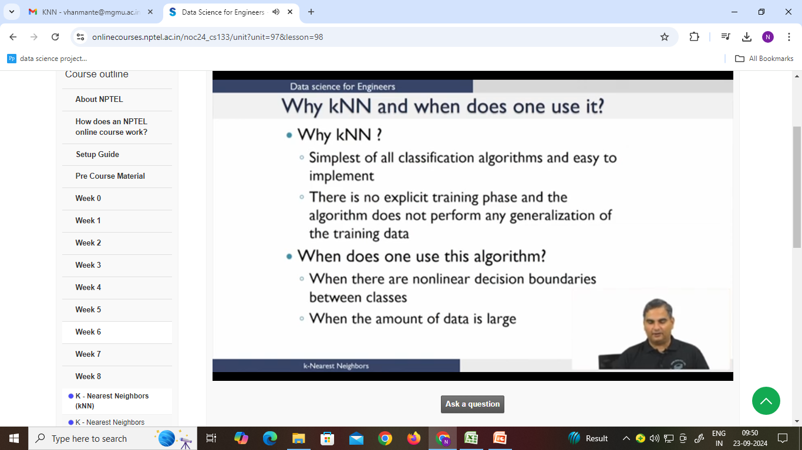
KNN

Slide 11
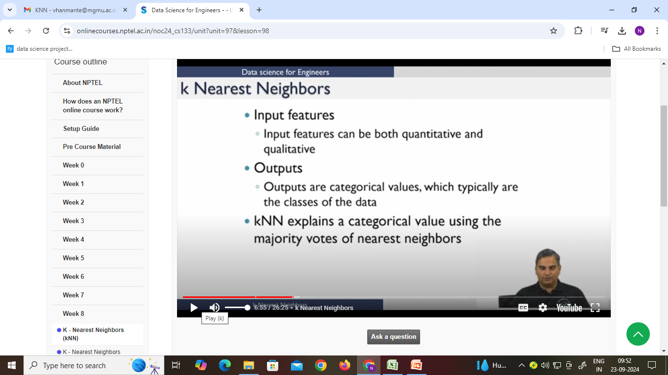
KNN

Slide 12
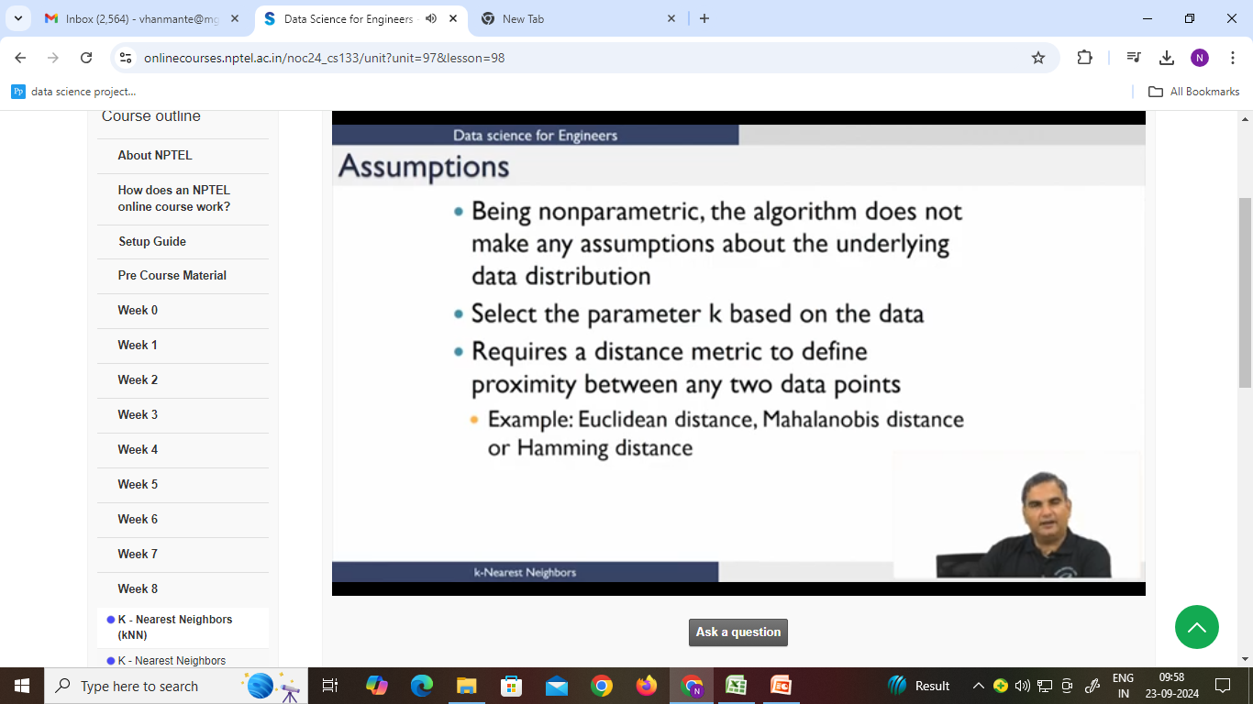

Slide 13
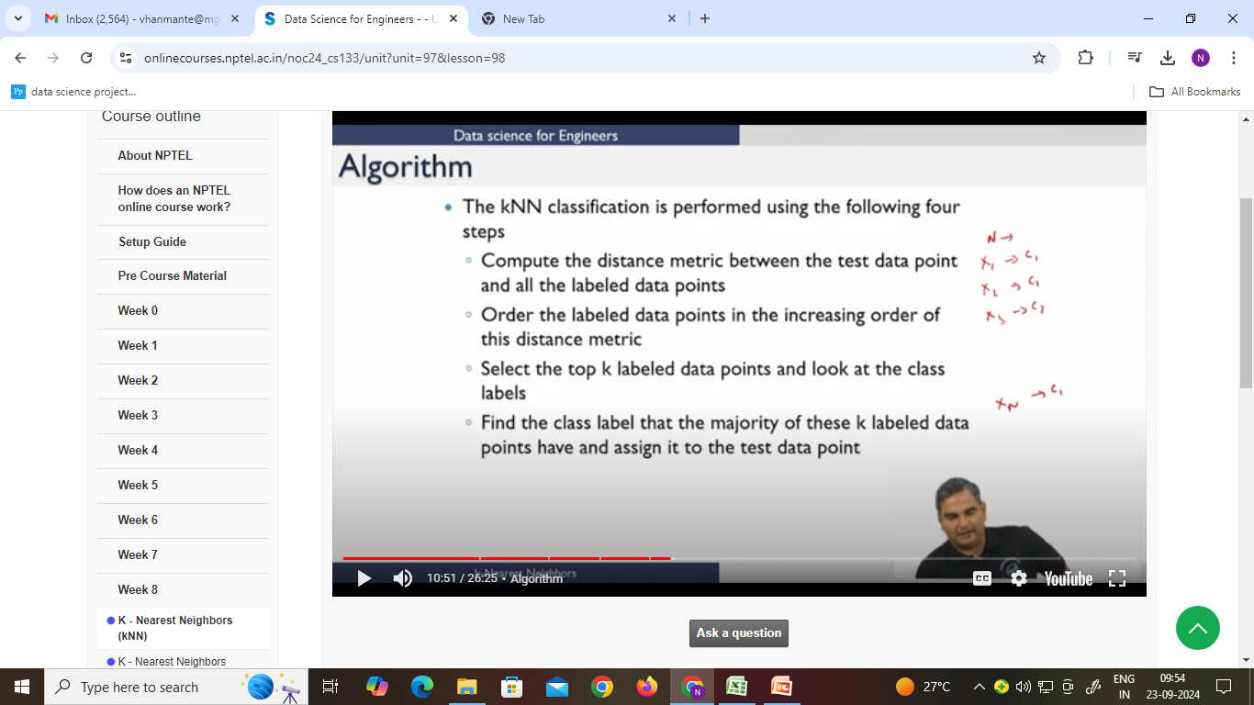
Algorithm

Slide 14
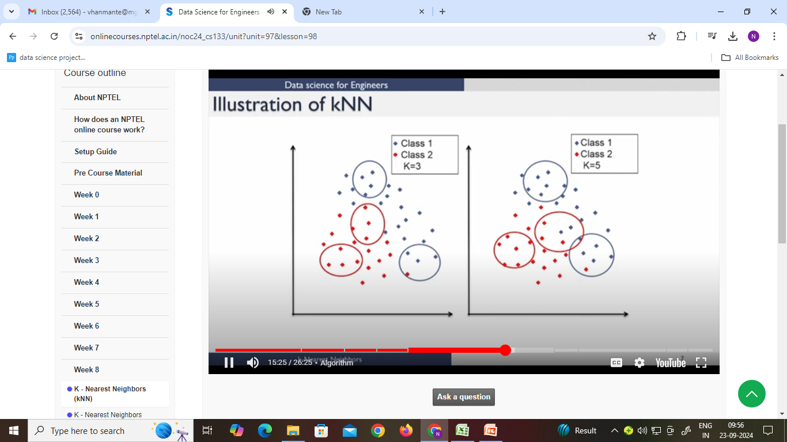

Slide 15
K - Nearest Neighbors
For a given instance T, get the top k dataset instances that are “nearest” to T
  Select a reasonable distance measure
Inspect the category of these k instances, choose the category C that represent the most instances
Conclude that T belongs to category C

Slide 16
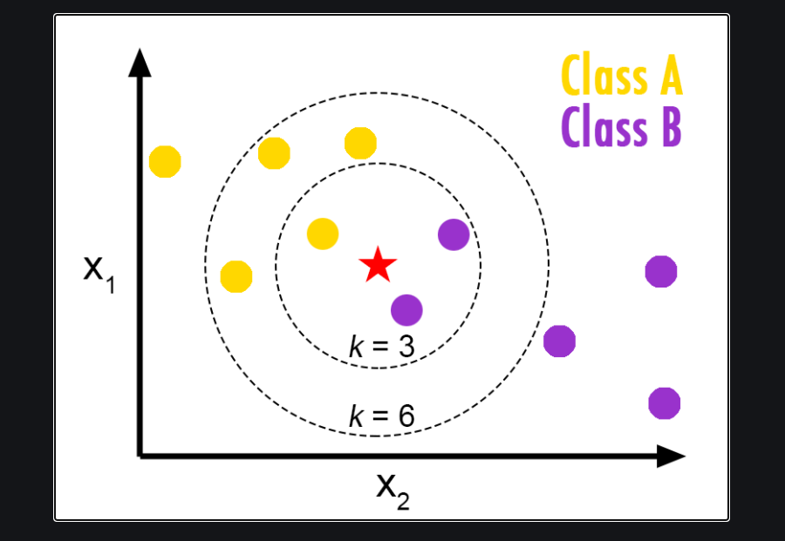
KNN

Slide 17
KNN
KNN assigns a new data point to the class of its closest neighbors, based on a distance metric.
KNN can also be slow and inefficient, especially when dealing with large and high-dimensional datasets.

Slide 18
Distance formula
Euclidian distance: squareroot of sum of squares of differences
for two features: (Δx)² + (Δy)²
Intuition: similar samples should be close to each other
  May not always apply

Slide 19
Incomparable ranges
The Euclidian distance formula has the implicit assumption that the different dimensions are comparable
Features that span wider ranges affect the distance value more than features with limited ranges

Slide 20
Non-numeric data
Feature values are not always numbers
Example
  Boolean values: Yes or no, presence or absence of an attribute
  Categories: Colors, educational attainment, gender
How do these values factor into the computation of distance?

Slide 21
Dealing with non-numeric data
Boolean values => convert to 0 or 1
  Applies to yes-no/presence-absence attributes
Non-binary characterizations
  Use natural progression when applicable; e.g., educational attainment: GS, HS, College, MS, PHD => 1,2,3,4,5
  Assign arbitrary numbers but be careful about distances; e.g., color: red, yellow, blue => 1,2,3
How about unavailable data?
(0 value not always the answer)

Slide 22
Preprocessing your dataset
Dataset may need to be preprocessed to ensure more reliable data mining results
Conversion of non-numeric data to numeric data
Calibration of numeric data to reduce effects of disparate ranges
  Particularly when using the Euclidean distance metric

Slide 23
k-NN variations
Value of k
  Larger k increases confidence in prediction
  Note that if k is too large, decision may be skewed
Weighted evaluation of nearest neighbors
  Plain majority may unfairly skew decision
  Revise algorithm so that closer neighbors have greater “vote weight”
Other distance measures

Slide 24
Other distance measures
City-block distance (Manhattan dist)
  Add absolute value of differences
Cosine similarity
  Measure angle formed by the two samples (with the origin)
Jaccard distance
  Determine percentage of exact matches between the samples (not including unavailable data)
Others

Slide 25
k-NN Time Complexity
Suppose there are m instances and n features in the dataset
Nearest neighbor algorithm requires computing m distances
Each distance computation involves scanning through each feature value
Running time complexity is proportional to m X n

Slide 26
Example
Ingredient | Sweetness | Crunchiness | Food Type
Apple | 10 | 9 | Fruit
Bacon | 1 | 4 | Protein
Banana | 10 | 1 | Fruit
Carrot | 7 | 10 | Vegetable
Celery | 3 | 10 | Vegetable
Cheese | 1 | 1 | Protein
Tomato | 6 | 4 | ???

Slide 27
Quiz
Which of the statement is INCORRECT about KNN algorithm?
1. KNN works ONLY for binary classification problems
2. If k=1, then the algorithm is simply called the nearest neighbour algorithm
3. Number of neighbours (K) will influence classification output
4. None of the above

