Slide 1

ALGORITHMIC TRADING
DS13_assignment_03_Shourya_Mehra
PROJECT

Slide 2

ABSTRACT
In Stock Market Prediction, the aim is to predict the open price of stocks units on a particular trading day.
The recent trend in stock market prediction technologies is the use of machine learning which makes predictions based on the values of current stock market indices by training on their previous values.
Machine learning itself employs different models to make prediction easier and authentic.
The model focuses on the use of Regression, Hyper parameter tuning and Flask based Machine learning to predict stock values and send result also on email. Factors considered are open, adjacent close.
The overall purpose of the project.
The basic design of the study.
Major trends found as a result of analysis.

Slide 3
Requirements Elicitation
What is the project ->
Purpose of this project ->
When we can use this ->
Where we can use this ->
Predict the open price of the stock units on a particular trading day.
Trade specific stocks which can produce high gains in early market conditions.
Triggered when the trading day starts.
Trading platforms like TradeStation, E*TRADE, TD Ameritrade and etc..
How to use this model :-
Fund Manager select a stock a list of stocks for trading.
Submit selected stock for estimation of open price.
Generate stock price for the selected stocks.
Confirm booking orders for trading (buy/sell).

Slide 4

Development Phase
Data acquisition
Data Exploration
Data Modeling and Evaluation
Data Model Deployment
Data Model Operation
Data Model Optimization

Slide 5
Data Acquisition
Data acquisition is the process of collecting data or information from different sources.
Yahoo finance is the place where all trading done and directly show in yahoo finance website and everyone can easily get the live and past data from this site and we also use this to get stock market data for our model.
We collect some stock data which uses in our machine learning model.
Escorts Limited
Nifty 50
Nasdaq
Hang Seng
Nikkei
Infosys
Accenture
Oracle
Cognizant
We’ll use these data because we need to predict future stocks open price and after analysis all stocks, open price depends on their stock prices.

Slide 6
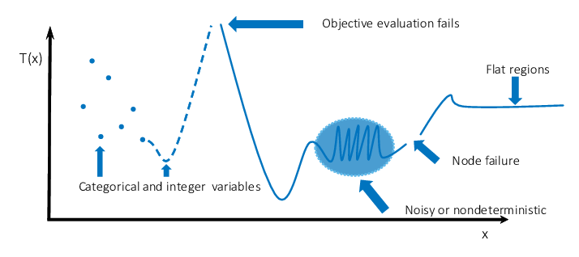
Data Exploration
In data exploration first step is to pre-process the data and then start analysis on data.
Steps of pre-processing:-
Check data type
Convert data into numerical data
Check null values and fill them
Check outliers
Apply multiple functions to remove outliers
Apply noise reduction techniques
Scale data
Find pattern in data and according to that transform data.
6
6

Slide 7
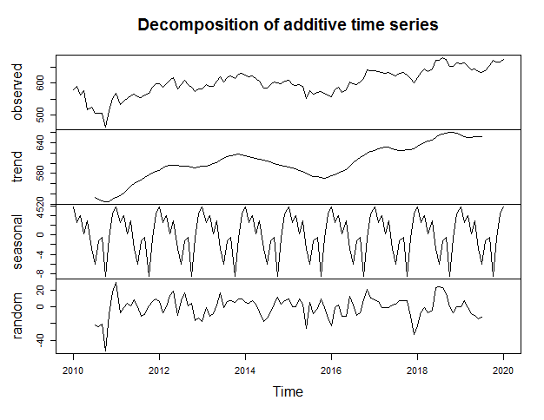
Data Exploration
Data Exploration is the process of explore data and extract information from data
Sample of data exploration
There we have broken the adjacent graph into different parts and divide it in details .
In this graph we can see actual forecast of Escorts Open price.
Trend: In the adjacent graph, trend is very less in 2010 as compare to 2020. So, we can say that price of escorts open is increase with passage of time.
Seasonal: In every season there is almost same fluctuation of escorts open price. Example in end of the season price goes down and at the starting price goes up.
Random: It means that in any unexpected event, there is sudden random variation happen like in the year 2011 stock open price goes very huge and then in 2018 price goes very down.

Slide 8
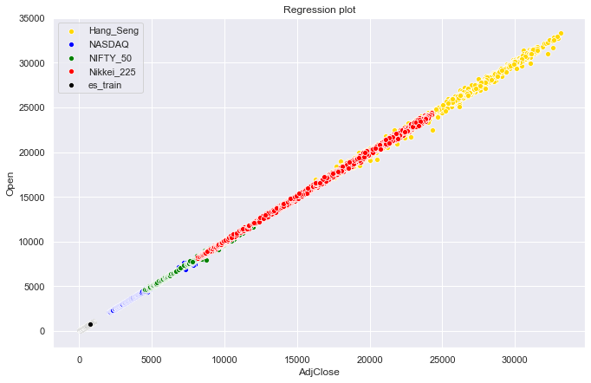
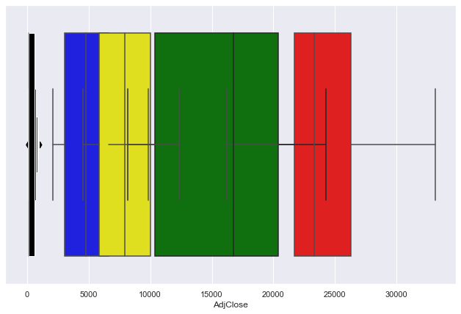
Data Exploration
As we can see in this graph data is linear and it increase with time.
The values of Hang Seng goes very high as compare to other stocks .
Escorts open and close price is very less increase as compare to other stocks.
In this there is no any outliers present as you can see in this box plot.
Box plot shows all values present near to mean, no any values are far away from the mean. So, it’s good for predicting price.
8

Slide 9
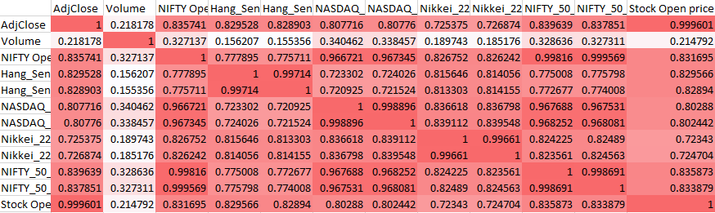
Data Exploration
As we can see in this graph Volume is very less correlated so if we remove this field effect to our data so, we’ll remove this field and all other fields are highly correlated so we do not remove other fields.
9
9

Slide 10
Data Modeling and Evaluation
Fetch data from yahoo finance
Preprocess data
Create ML model
Evaluating the prediction
Model tuning
Create final python API using ML
model library
Data Base
Data pre-processing
ML Model
Evaluate Prediction
Tuning
Model Library

Slide 11
Data Model Deployment
Data Model Deployment means after completing the machine learning model deploy model to customer.
After complete machine learning model save that model
Create API to integrate with flask framework
Create web interface
Test the model performance in the deployment environment
Follow CI/CD (continuous integration/ continuous deployment) process for deployment

Slide 12
Data Model Operation
Operation is perform by fetch live data from YAHOO FINANCE and apply some operations then give that data to model library and pass predicted result to python API.
This model have some fields: Fetch multiple data
Hang_Seng_AdjClose
Hang_Seng_Open
NASDAQ_AdjClose
Nikkei_225_AdjClose
Nikkei_225_Open
NIFTY_50_AdjClose
NIFTY_50_Open
Escort_AdjClose
ORACLE
ETC.
We need these values of past day to predict future day price.
Database
Database
Processing
Python API
Model Library

Slide 13
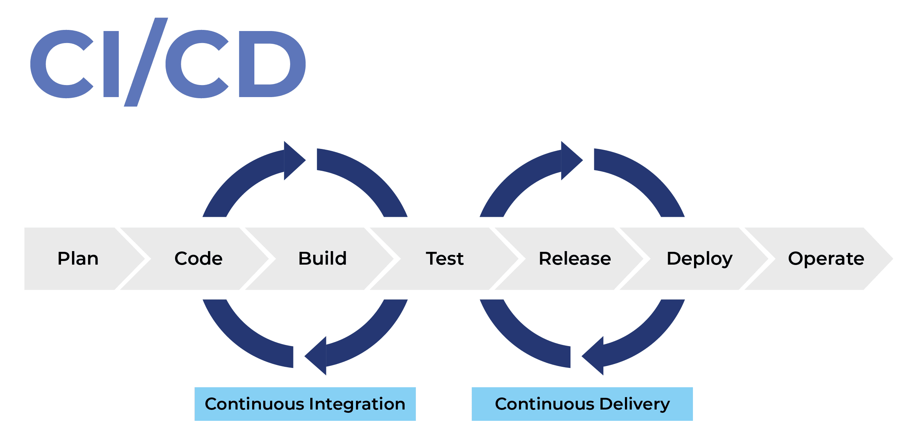
DATA MODEL OPTIMIZATION
Improve the performance of model by optimizing algorithm
Model optimizing done by hyper parameter tunning:
learning_rate
max_depths
n_estimators
n_jobs
Follow the CI/CD process for deployment updates
CI/CD is a method to frequently deliver apps to customers
by introducing automation into the stages of app
development.

Slide 14
DESIGN SPECIFICATION
Hardware configurations
Software configurations
Model architecture
Glimpse of comparison between algorithms
Web Interface glimpse

Slide 15
Minimum Hardware and Software Configuration
Hardware Configs :
Processor – Intel Xeon E2630 v4 – 10 core processor, 2.2 GHz with Turboboost upto 3.1 GHz. 25 MB Cache
Motherboard – ASRock EPC612D8A
RAM – 128 GB DDR4 2133 MHz
500 GB Hard Disk (7200 RPM) + 256 GB SSD
Intel Heatsink to keep temperature under control
Storm Trooper Cabinet
Software Configs :
Windows 8/ MacOS 10.14/ Linux/ Ubentu
Python 3.6
Pycharm/ spyder
Python Libraries (Scikit-learn, pandas, LinearRegression,flask, beautiful soup, joblib, requests, smtplib,json, itertools, logging)

Slide 16
MODEL ARCHITECTURE
YAHOO FINANCE
DATABASE
Cleaning and analysis
DATA
Preprocessing
ETL (Extract, Transform, Load)
Training data
Linear Regression,
Adaboost,
Gradient boosting,
SVR
ML Model
Hyperparameters tuning
Live data come directly into API
learning_rate
max_depths
n_estimators
n_jobs
Model Library
Model Selection
Web Interface
Web Server
Python API

Slide 17
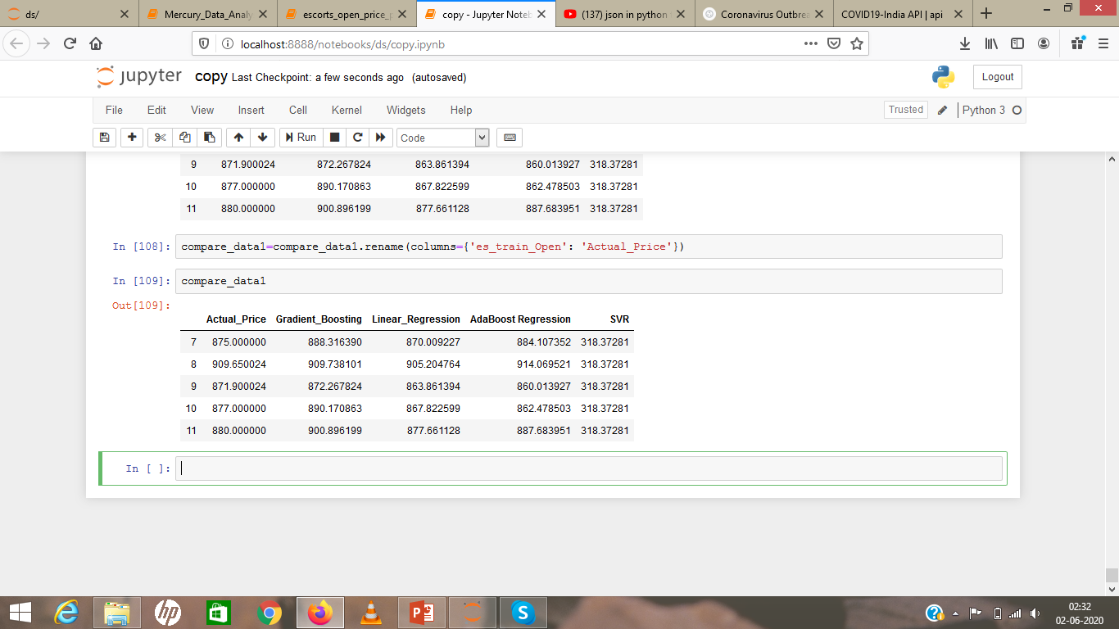
Comparison
As you can see in the comparison, we have uses four algorithms and all four algorithms gave the good results but when we compare all algorithms we can see linear regression gives outcome more accurately.
So now we measure Mean square error with live data we get this accuracy:
After comparison we linear regression because Gradient Boosting = 436.65 Linear Regression = 5.47
It gives highest accuracy AdaBoost Reg = 59.04 SVR = 315453.31

Slide 18
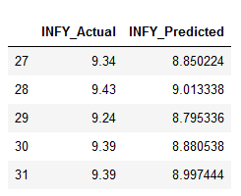
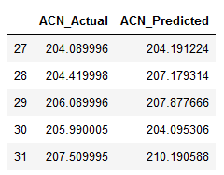
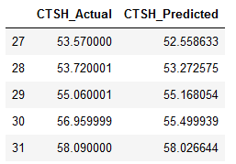
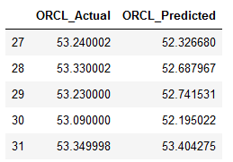
Glimpse of stocks predictions
Glimpse of 4 stocks we have use in this models.
1. Infosys 2. Accenture 3. Cognizant 4. Oracle
MSE- 0.204
MSE- 4.31 9
MSE- 0.674
MSE- 0.457
We get the lowest mean square error(MSE) mans highest accuracy.

Slide 19
Conclusion
Using this model we are able to know open price of multiple trades before opening
We get very high accuracy so this model is able to develop almost accurate result
This model makes our work easy and give a chance to get more profit
Using this model we know that when we need to sell/buy shares
This model is userfriendly anyone can easily learn how to use this model
Don’t need to check other website to get live data this model automatically fetch live data and gives you the result

