Slide 1
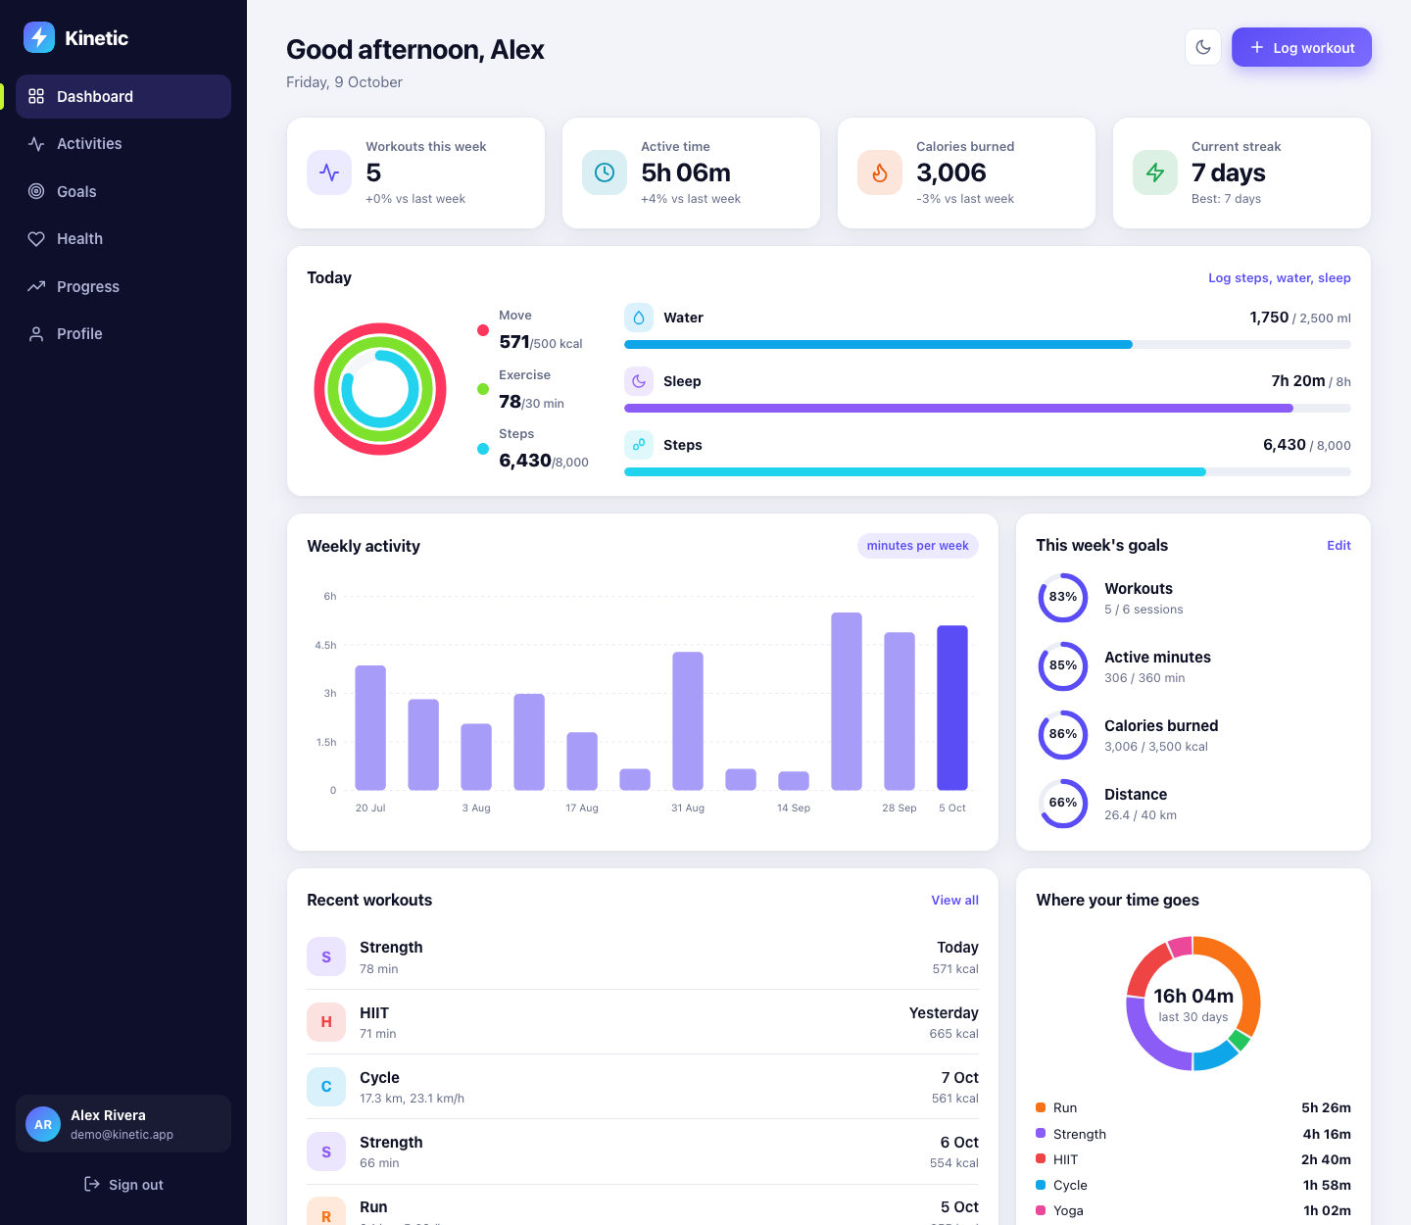
K
Kinetic
A fitness tracking web application with workouts, weekly goals, streaks and Google sign-in
Java Web Project | Servlets, JDBC, core Java

Slide 2
PROBLEM UNDERSTANDING
The problem and our solution
The problem
Our solution: Kinetic
● Workout data is scattered across notes, watches and spreadsheets
● People cannot tell if they are improving week to week
● Weekly targets are set but never checked
● Streaks and personal bests are invisible
● One log for 7 workout types, with calories estimated from body weight
● Dashboard with weekly totals, trends and time-by-type
● Goal rings for workouts, minutes, calories and distance
● Streaks, activity calendar and personal records
● Fast sign-in with Google or email
Who it is for: anyone who trains regularly and wants clear numbers, not a complicated app. Built as a full Servlet and JDBC web application with no framework.
Kinetic | Java Servlets + JDBC
2

Slide 3
WHAT IT DOES
Key features
1
2
3
4
Log and edit workouts
Smart calories
Dashboard
Weekly goals
Run, walk, cycle, swim, strength, HIIT, yoga. Duration, distance, effort, notes.
MET x weight x hours. Each activity class supplies its own MET value.
Today rings, week vs last week, 12-week chart, goal rings, time-by-type donut.
Targets for sessions, minutes, calories, distance. Saved in one transaction.
5
6
7
8
Streaks and records
Google sign-in
Daily health
Install on a phone
Current and best streak, longest distance, biggest session.
Continue with Google. Token verified on the server before a session starts.
Steps, water and sleep with daily rings, plus a body-weight trend line.
Installable web app (PWA), CSV export, light and dark mode, 17-week calendar.
Kinetic | Java Servlets + JDBC
3

Slide 4
SOLUTION DESIGN
Architecture
Browser
HTML, CSS, JS
Filters
Security, Auth
Servlets
15, extend BaseServlet
Services
Business rules
DAOs
One per table
Database
Pool + JDBC
Layered design: each layer only talks to the one below it.
Views
HTML and SVG charts
AuditLogger
worker thread
Google verifier
tokeninfo check
● Composition root: AppContext wires every DAO and service
● Thin servlets: validate, call a service, redirect
● Cross-cutting: SecurityFilter (CSP, CSRF), AuthFilter
● Observer: StatsService cache cleared on every data change
Kinetic | Java Servlets + JDBC
4

Slide 5
SETUP
Technology and project structure
Java 17
Jakarta Servlet 5
kinetic/
pom.xml, README.md
src/main/java/com/kinetic/
model/ Activity hierarchy, enums
exception/ KineticException tree
db/ ConnectionPool, Database
dao/ Dao<T,ID>, JdbcDao, 6 DAOs
service/ Auth, Activity, Goal, Stats
concurrent/ AuditLogger, OnlineUsers
util/ PasswordHasher, LruCache...
web/ filters, servlet/, view/
src/main/resources/
schema.sql, application.properties
src/main/webapp/ css/ js/ WEB-INF/
src/test/java/ 47 JUnit tests
records, switch expressions
servlets, filters, listeners
JDBC + H2
Maven + Jetty
embedded, swappable to MySQL
mvn jetty:run
JUnit 4
Google Identity
47 tests
Sign in with Google
Run it: mvn jetty:run then open localhost:8080
Kinetic | Java Servlets + JDBC
5

Slide 6
CORE JAVA
OOP: inheritance, polymorphism, interfaces
Activity (abstract)
estimateCalories() uses met()
Interfaces and abstractions
● Entity common id contract
● Trackable goals work on any activity
● Dao<T,ID> generic CRUD contract
● RowMapper<T> ResultSet to object
● GoogleTokenVerifier real and fake versions
● DataChangeListener observer
DistanceActivity
abstract: speed, pace
Strength
HIIT
Yoga
Run
Walk
Cycle
Swim
Exception hierarchy
Polymorphism: callers hold an Activity and never test its type.
KineticException (checked)
ValidationException AuthException
NotFoundException
DataAccessException (unchecked)
wraps SQLException
a.applyCalories(user.getWeightKg());
// RunActivity.met() -> speed based
// YogaActivity.met() -> 1.8 + 0.5*effort
Kinetic | Java Servlets + JDBC
6

Slide 7
CORE JAVA
Collections and generics
Dao<T extends Entity, ID>
Generic contract implemented by every DAO
Map<LocalDate, List<Activity>> byWeek =
window.stream().collect(
groupingBy(a -> weekStart(a.date())));
Map<LocalDate, Integer> minutesByDay =
window.stream().collect(toMap(
Activity::date,
Activity::durationMinutes,
Integer::sum, TreeMap::new));
enum GoalMetric { WORKOUTS {
double measure(Collection<
? extends Trackable> items)
{ return items.size(); } }, ...
LruCache<K, V>
Own generic cache: access-ordered LinkedHashMap + ReentrantLock
Collection<? extends Trackable>
Wildcard lets GoalMetric score any list of activities
EnumMap, TreeMap, TreeSet
Minutes by type, minutes by day, streak calculation
ConcurrentHashMap, key sets
Login throttle and online-users set
Optional, records, streams
findById results, Totals / Dashboard, groupingBy + toMap
Comparable<Activity>
Natural ordering by date, used by Collections.sort
Streaks use a TreeSet of active days and walk backwards from today.
Kinetic | Java Servlets + JDBC
7

Slide 8
CORE JAVA
Multithreading and synchronization
Request thread 1
log(event)
Request thread 2
log(event)
BlockingQueue
LinkedBlockingQueue(10,000)
kinetic-audit
daemon worker thread
audit_log
JDBC insert
Request thread 3
log(event)
Where synchronization is used
● AuditLogger: producer/consumer, pages never wait for a DB write
● ConnectionPool: BlockingQueue of connections, 5 s wait
● LruCache: ReentrantLock around an access-ordered map
● Transactions: ThreadLocal connection per thread
● Login throttle: ConcurrentHashMap.compute is atomic
● Online users: ConcurrentHashMap key set
● Shutdown: poison pill flushes the queue
● Proof: ConcurrencyTest, 8 threads x 50 events = 400 rows
Kinetic | Java Servlets + JDBC
8

Slide 9
JDBC
Database design
users
activities
goals
id PK
email UNIQUE
display_name, password_hash
provider LOCAL | GOOGLE
google_sub UNIQUE
weight_kg, height_cm
1
id PK
user_id FK
type, performed_on
duration_min, distance_km
intensity, calories
notes
id PK
user_id FK
metric, target
UNIQUE(user_id, metric)
N
daily_logs
body_metrics
audit_log
id PK, user_id FK
log_date UNIQUE per user
steps, water_ml, sleep_min
id PK, user_id FK
measured_on UNIQUE per user
weight_kg
id PK, user_id
event, detail
created_at
activities, goals, daily_logs and body_metrics reference users with ON DELETE CASCADE.
DAOs: UserDao, ActivityDao, GoalDao, DailyLogDao, BodyMetricDao, AuditDao extend JdbcDao and implement Dao<T, ID>.
Kinetic | Java Servlets + JDBC
9

Slide 10
JDBC
JDBC: pool, prepared statements, transactions
// JdbcDao: every query is parameterised
protected <T> List<T> query(String sql,
RowMapper<T> mapper, Object... params) {
return db.withConnection(c -> {
try (PreparedStatement ps =
c.prepareStatement(sql)) {
bind(ps, params);
try (ResultSet rs = ps.executeQuery()) {...}
● ConnectionPool: fixed size, dynamic-proxy connections: close() returns to the pool
● PreparedStatement only: no string-built SQL, so no SQL injection
● Transactions: commit and rollback, nested calls join the open one
● Batch insert: addBatch / executeBatch seeds 16 weeks of demo data
● Generated keys: RETURN_GENERATED_KEYS sets the new id
● Portable: change db.url to use MySQL or PostgreSQL
● Tested: rollback test and cascade-delete test on H2
// GoalService: all goals save, or none do
db.inTransaction(() -> {
parsed.forEach((metric, target) -> {
if (target <= 0) goals.deleteByMetric(..);
else goals.save(new Goal(...));
});
return null;
}); // commit, or rollback on any exception
Kinetic | Java Servlets + JDBC
10

Slide 11
SERVLETS
Servlets and web integration
Request
SecurityFilter
AuthFilter
Servlet
Service + DAO
View
GET or POST
headers, CSP, CSRF check
redirect to /login if no session
BaseServlet.dispatch
business rules, JDBC
HTML + SVG response
BaseServlet: one error policy
Servlet features used
● ValidationException: message shown, form re-rendered
● AuthException: 401 with the email kept
● Anything else: logged, friendly 500 page
● Post, redirect, get with one-time flash messages
● @WebServlet, @WebFilter, @WebListener
● HttpSession, session id rotation, timeout
● ServletContextListener starts the app and DB
● Error pages in web.xml, CSV file download
● /health JSON endpoint
Kinetic | Java Servlets + JDBC
11

Slide 12
AUTHENTICATION
Sign in with Google
Browser
Google
Kinetic server
Database
1 Click Continue with Google
2 Signed ID token (credential)
3 POST /auth/google + CSRF token
4 Verify via tokeninfo
5 Claims: aud, iss, exp, email
6 Find, link or create user
7 New session, redirect to dashboard
Server checks: audience equals our client ID, issuer is Google, token not expired, email verified. The browser is never trusted.
Kinetic | Java Servlets + JDBC
12

Slide 13
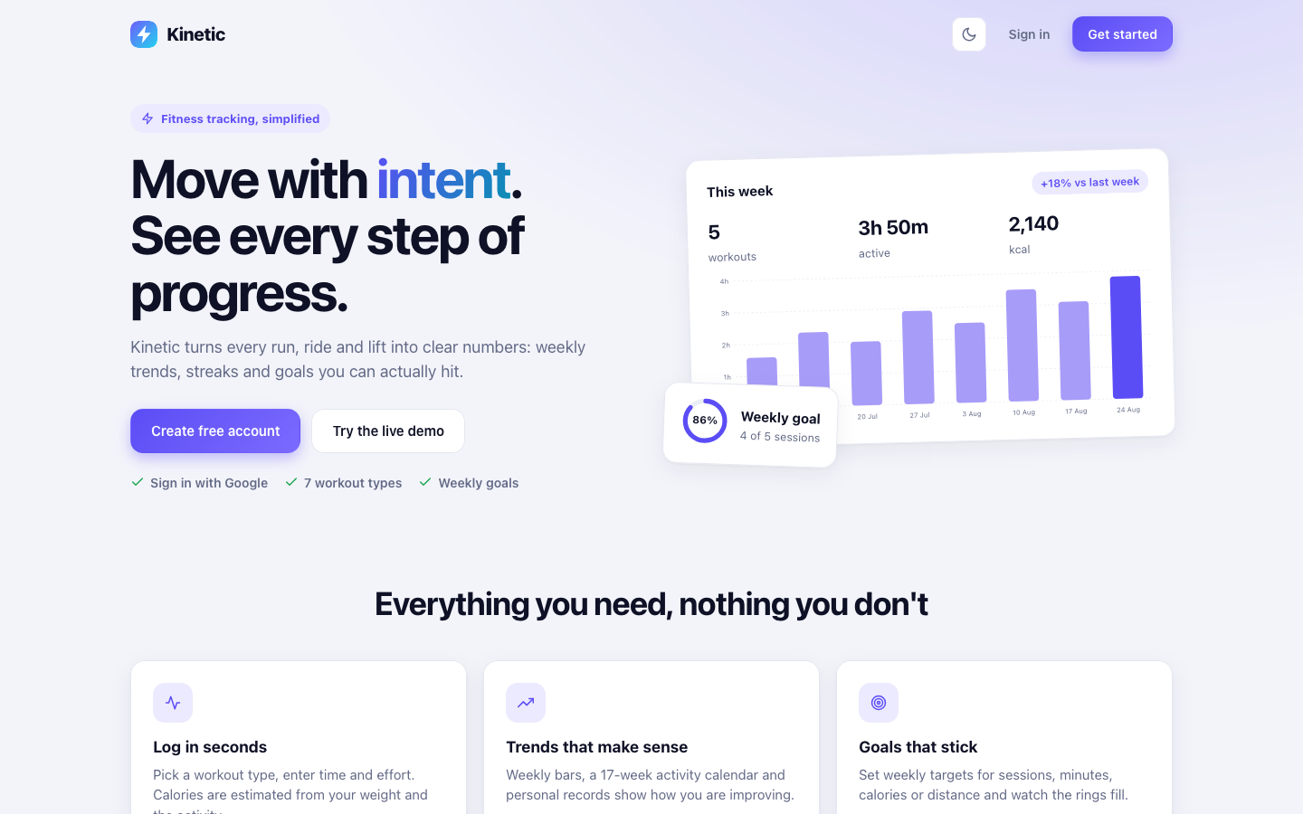
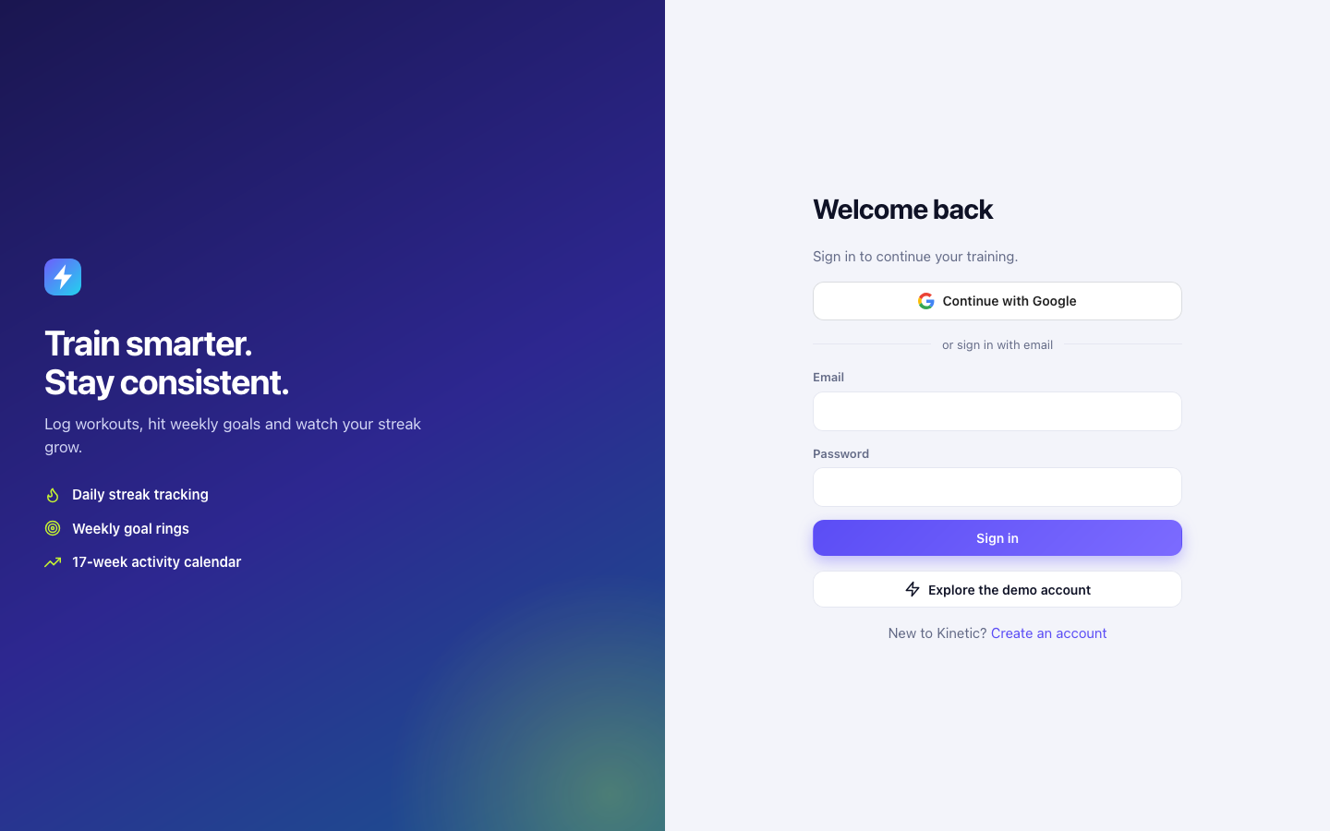
SCREENSHOTS
The application
Landing page
Sign in with Google or email
Public pages share the same design system: indigo brand colour, rounded cards, system fonts, light and dark themes.
Kinetic | Java Servlets + JDBC
13

Slide 14
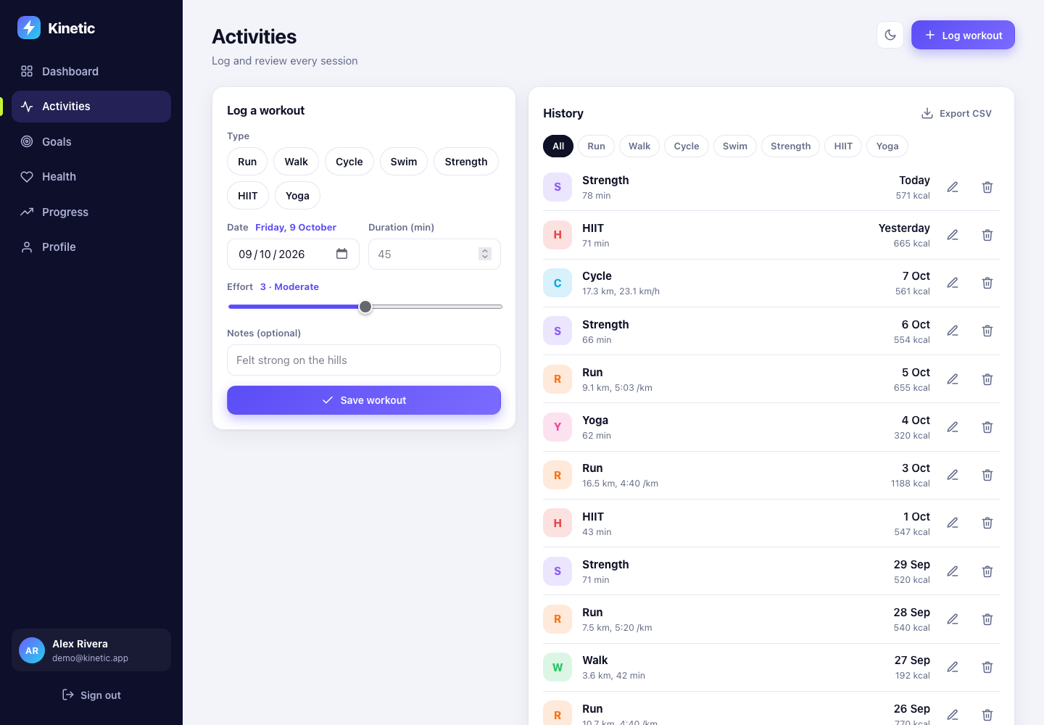
SCREENSHOTS
Dashboard and activity log
Dashboard: totals, 12-week chart, goal rings, breakdown
Activities: log form, filters, history, CSV export
Kinetic | Java Servlets + JDBC
14

Slide 15
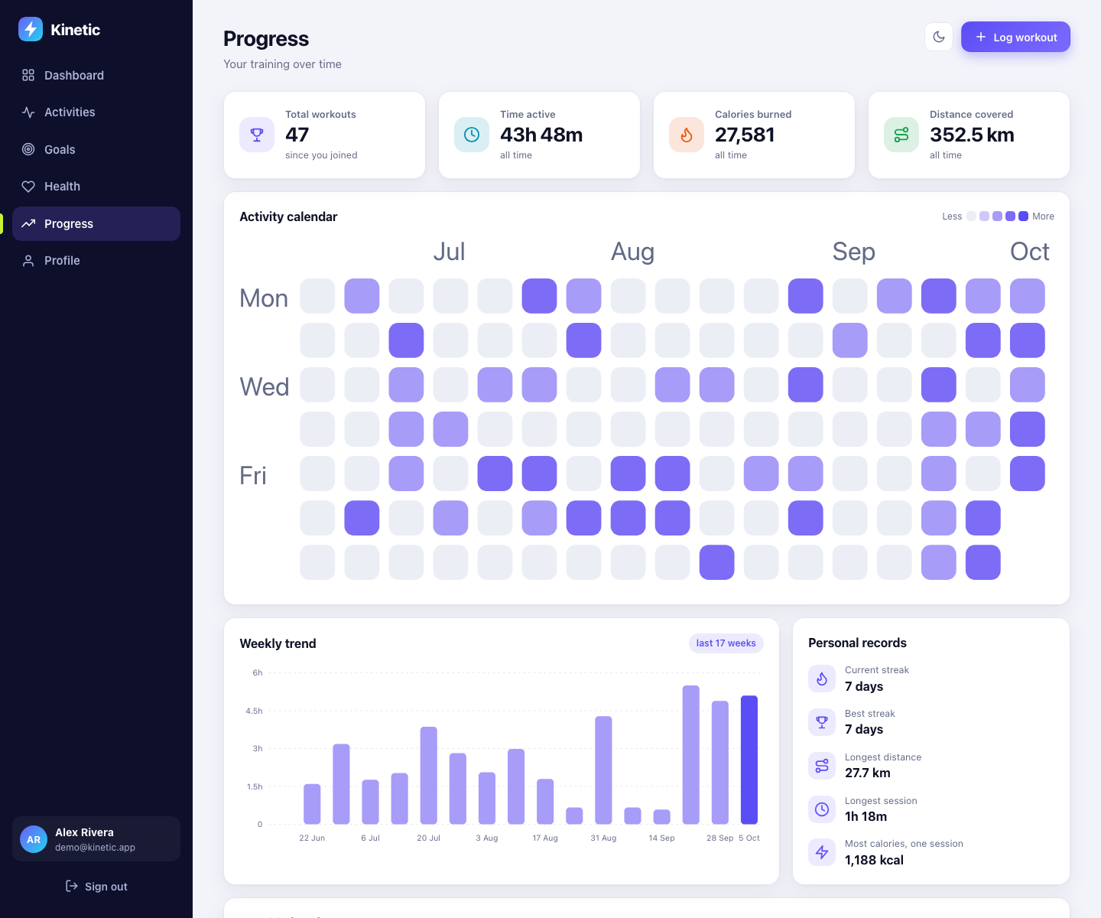
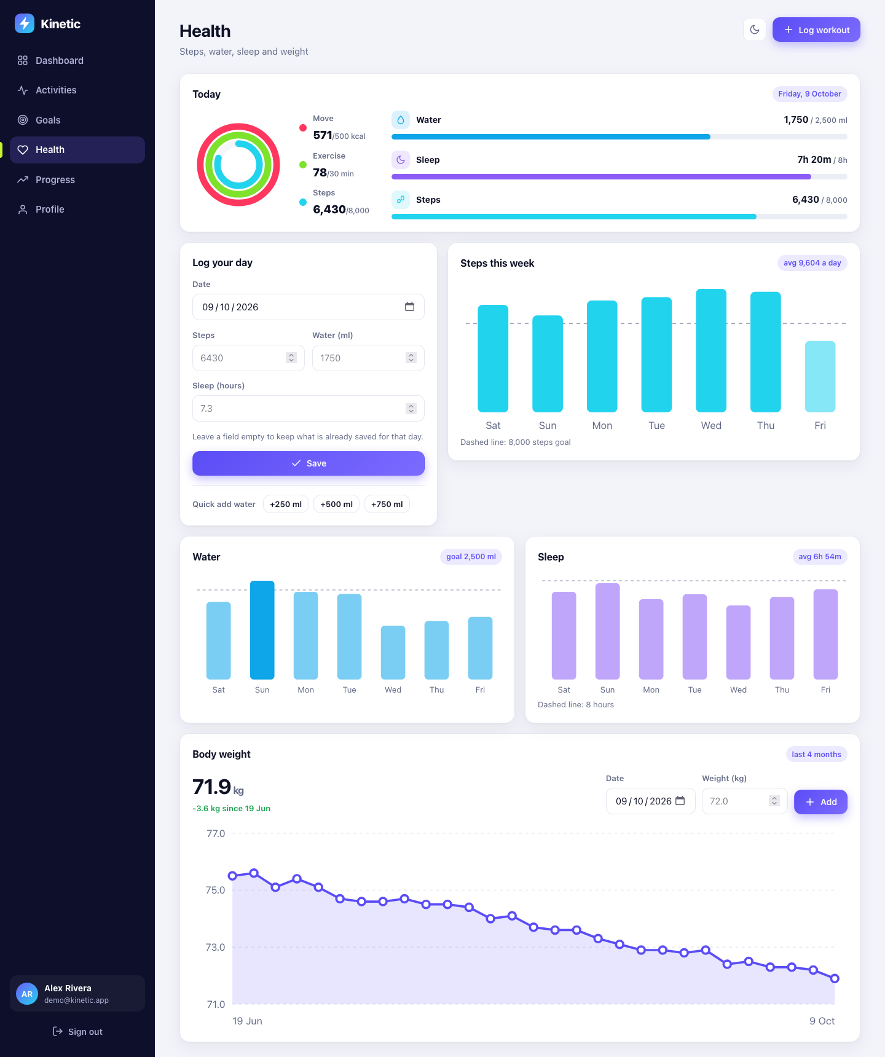
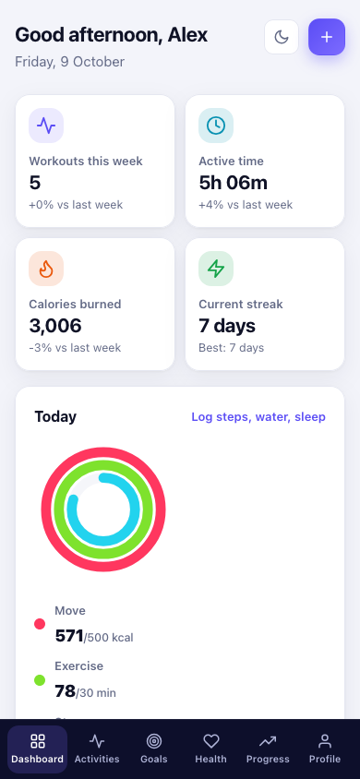
SCREENSHOTS
Health, progress and mobile
Progress: calendar heatmap, records
Health: rings, steps, water, sleep, weight
Phone layout
Kinetic | Java Servlets + JDBC
15

Slide 16
QUALITY
Security and testing
Security
Testing: 47 JUnit tests, all passing
● PBKDF2 hashing with per-user salt
● PreparedStatement everywhere (no SQL injection)
● HTML escaping on all output (no XSS)
● CSRF token on every POST
● Content-Security-Policy and security headers
● 5 failed logins per 10 minutes locks the email
● Users can only touch their own data
● Server-side Google token verification
● Polymorphic calorie maths and summaries
● Streak logic, goal scoring
● Registration, login, lockout
● Google: create, link, reject forged token
● Google claim checks (audience, issuer, expiry)
● Workout, goal, health and edit flows on in-memory JDBC
● Transaction rollback, cascade delete
● Thread safety: pool, audit logger, cache
Kinetic | Java Servlets + JDBC
16

Slide 17
COVERAGE
How the project meets the marking rubric
Rubric area | Evidence in Kinetic
Problem understanding and design | Layered architecture, ER design, clear user problem and solution
Core Java concepts | Inheritance, polymorphism, interfaces, exceptions, collections, generics, threads
Database integration (JDBC) | Own pool, PreparedStatement, transactions, batch, 6 DAO classes
Servlets and web integration | 15 servlets, 2 filters, listener, sessions, CSRF, Google login, PWA
Code quality | Modular packages, comments, central error policy, 47 tests
Kinetic | Java Servlets + JDBC
17

Slide 18
Thank you
Kinetic: move with intent.
Run mvn jetty:run then localhost:8080
Demo Try the live demo button, or demo@kinetic.app

