Slide 1
Welcome
To Our presentation

Slide 2
An Exploratory Analysis of Industrial Machine Data for Predictive Maintenance Operations

Slide 3
members
Shahriar Raz Fahim – 16101157
K.C. Zamiul Alam – 16101143
Sajib Mohajan – 16101137
Faisal Ahmed Shovon – 16101144

Slide 4
supervisor
Dr. Amitabha Chakrabarty, PhD
Associate Professor, School of Data and Sciences
Department of Computer Science and Engineering
BRAC University

Slide 5
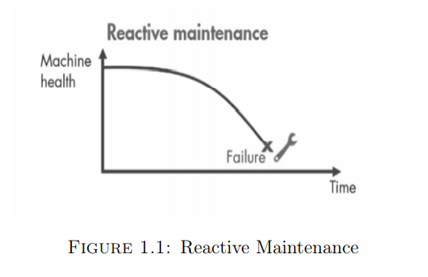
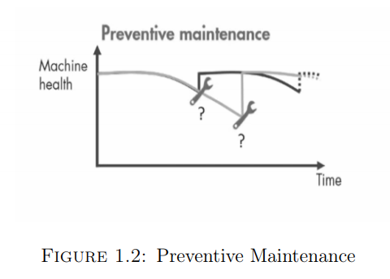
Maintenance methods

Slide 6
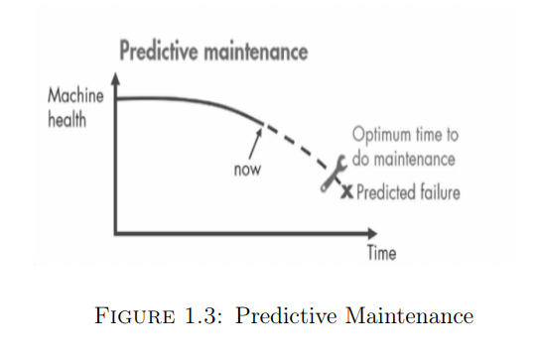
Predictive maintenance (pdm)
Ability to predict when equipment failure could occur
Maintenance performed based on health of equipment
Estimate remaining useful life and degradation rate
Formal application started in the early 1990s

Slide 7

Pdm Operations
Equipment are monitored using condition monitoring
devices (temperature sensor, voltage sensor etc.)
Sensor captures different parameters
All data are stored systematically
Data used for analysis using predictive algorithms

Slide 8

Motivation & Goals
Evaluate different approaches of data preparation
Explore time series data analysis application
Use different machine learning models and compare
performance
Contribute to the ongoing research and applications

Slide 9
Time series data

Slide 10
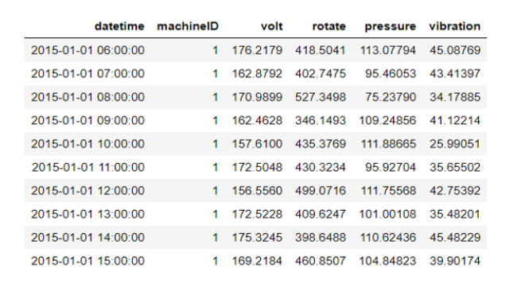
hydropower turbine
Sample size = 293100
Number of Machines = 100
Number of Machine Models = 5
Initial Sensor Data = 4

Slide 11
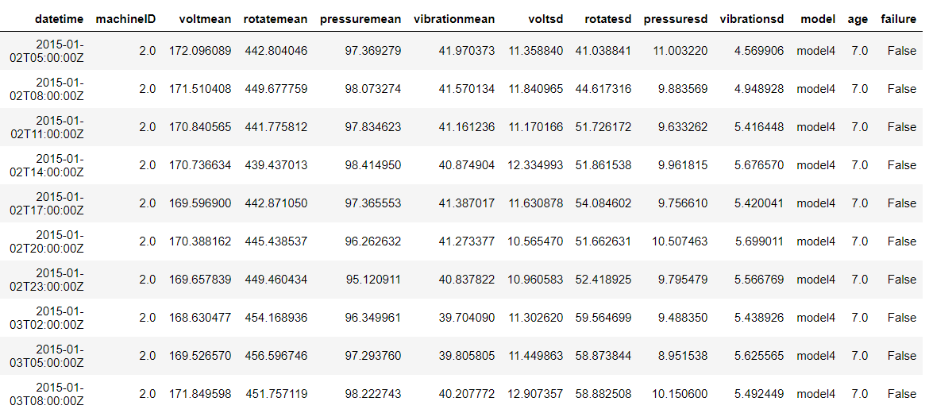
Sample data

Slide 12
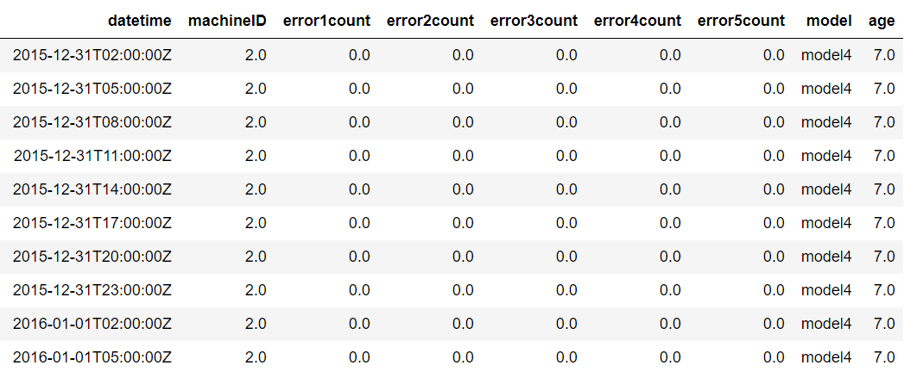
Error count summary

Slide 13
Data preparation process

Slide 14
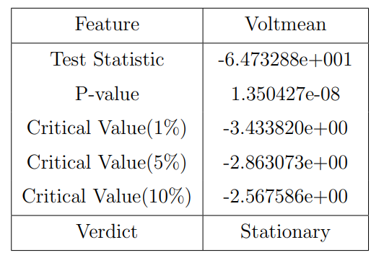
Stationarity of data
Mean and variance of the series remains
constant over a time period
Tested using ADF/KPSS test (unit root test)
Based on the p-value which accepts/rejects
Null Hypothesis (H0)

Slide 15
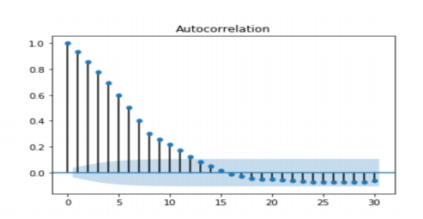
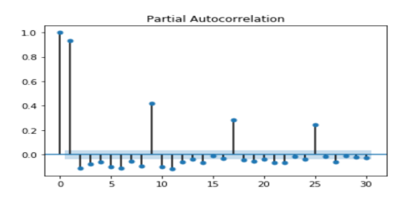
AUtocorrelation
Degree of similarity between a time series
and it’s lagged/previous values
Tested using ACF and PACF plot
Determines how much of past values need to
be accounted for
ACF and PACF Plot of Voltmean

Slide 16
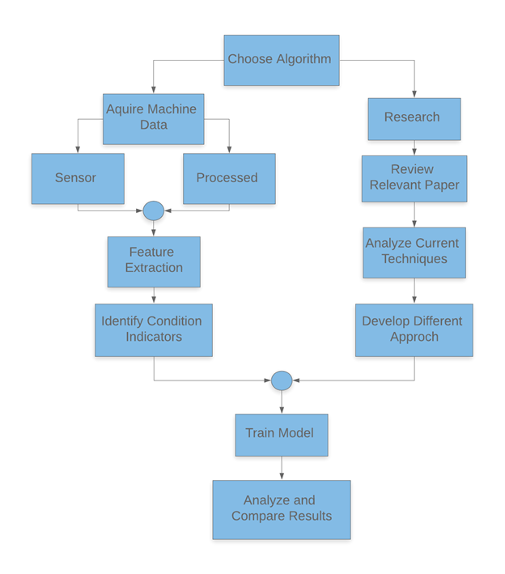
Workflow

Slide 17
Algorithms

Slide 18
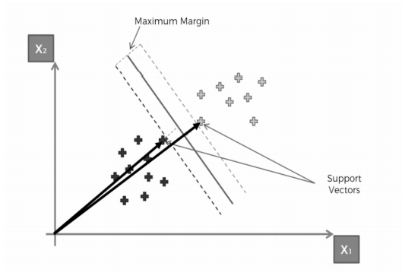
Support vector machine
Uses support vectors to draw classification
boundary
Work on all type of input data
(linear, non-linear etc.)
Performs well for Binary Classification

Slide 19
Results
SVM | Data | Accuracy | Recall of True value | F1 score of True value
Linear | Raw | 98.28% | 0.17 | 0.29
Polynomial | Differenced | 94.07% | 0.20 | 0.06
Linear | Weighted Moving Average | 99.65% | 0.50 | 0.67

Slide 20
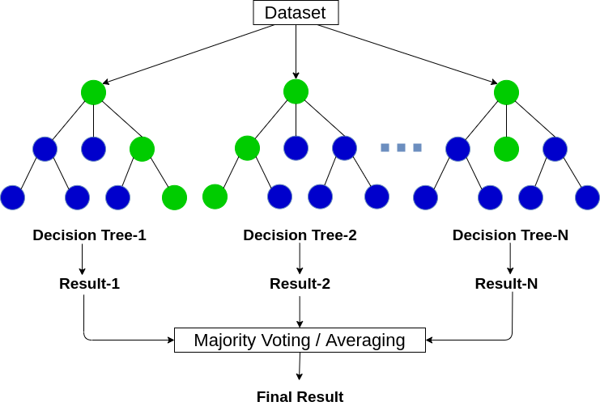
Random Forest
Why Random Forest?
Utilizes multiple decision trees
Chooses the best possible outcome based
on votes of majority
Efficiently handles datasets with missing
labels/ unclear labels
Fits in with the needs of our dataset

Slide 21
Random Forest
Preparation of The Classifier and Initial Output
Training- test split was 80% to 20%
Number of decision trees was 35 (n_estimator=35)
Accuracy was 99.32%
Utilizing weighted mean to tackle overfitting

Slide 22
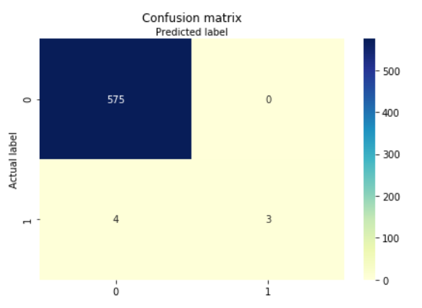
Random Forest
Confusion Matrix
99.3% successful in predicting
true negatives.
Less efficient in predicting
true positives.
Imbalance of the dataset

Slide 23
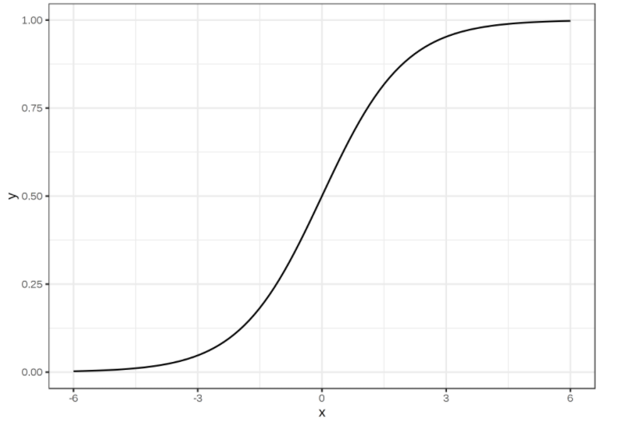
Logistic Regression
Predicts probability of a binary event happening
Deals with the issues of classification
Uses Sigmoid function, which has wide range of applications
Delivers discrete outputs

Slide 24
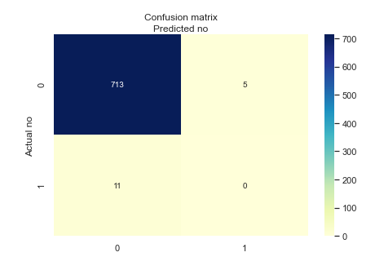
Logistic Regression
Accuracy of 97.8%
0 true positives among 11 condition positives
Inclined towards negative values
Precision and Recall score of 0

Slide 25
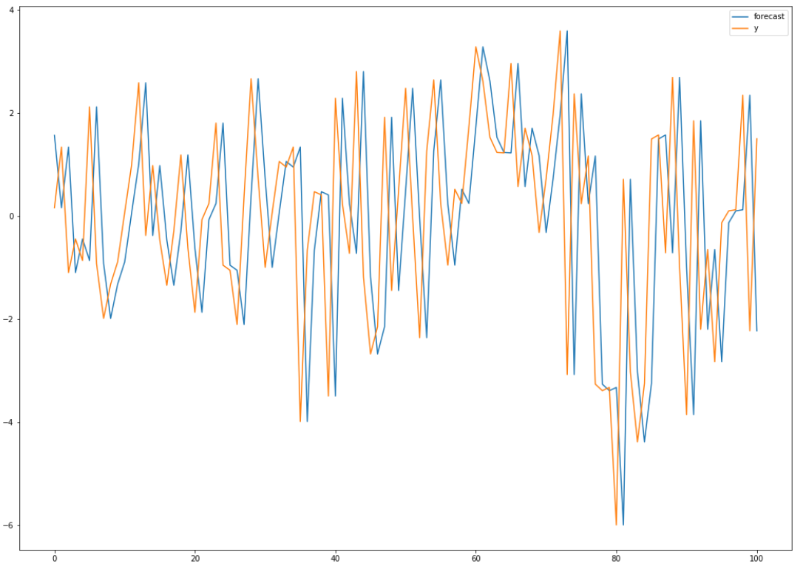
Arima
Popular times series forecasting model
Shows impact of cyclic, seasonal and irregular
events on data
Can be integrated with other models for
classification problems

Slide 26
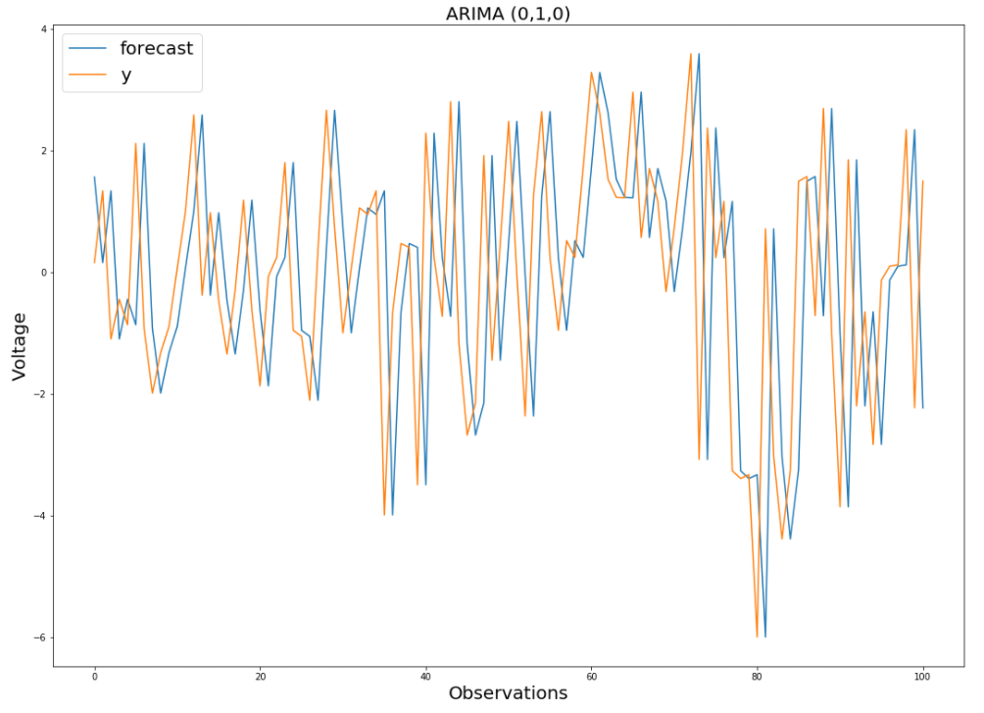
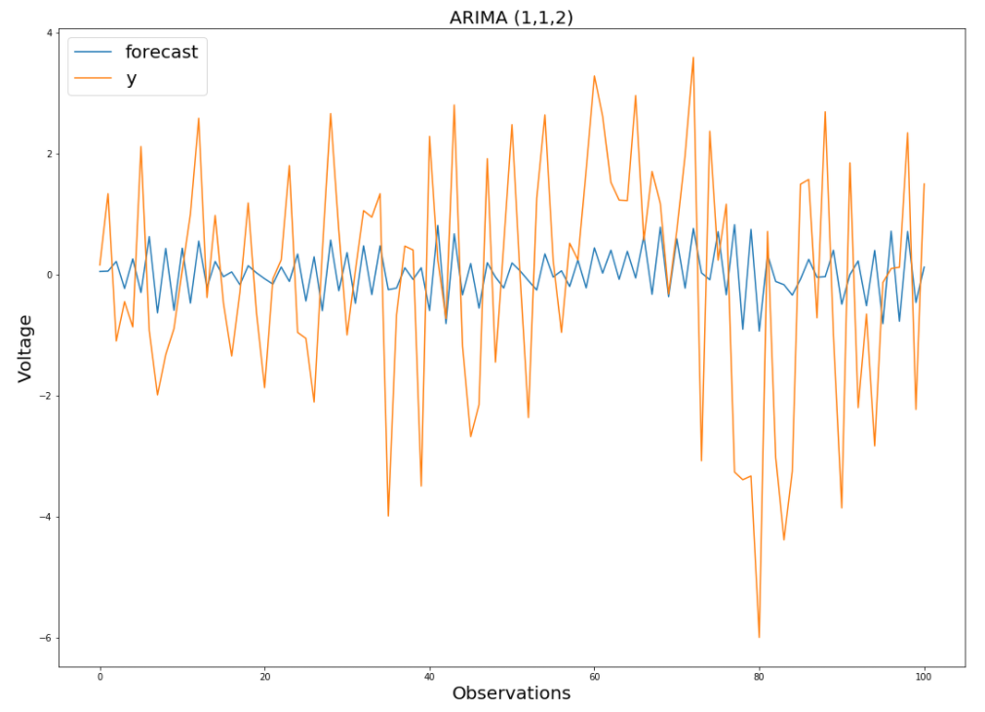
Forecast result
Figure : 1
Figure : 2

Slide 27
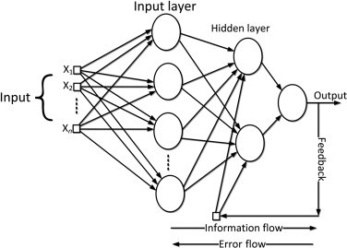
RNN
Internal/Hidden states.
Works on time series data.
Output of a previous time step is also used in the next time step

Slide 28
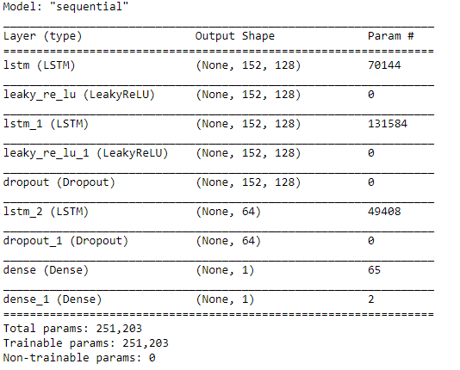
LSTM Forecasting
Sequence to sequence learning.
Multiple layers
Data scaling.
Loss function(‘Adam’)

Slide 29
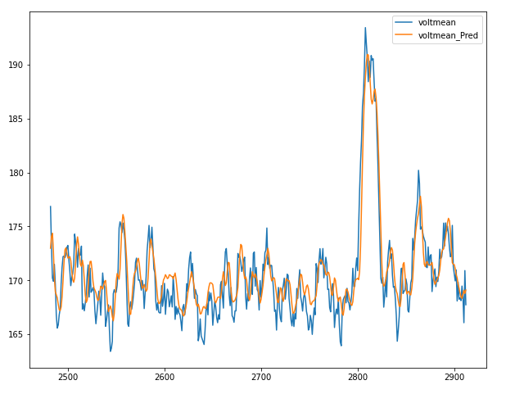
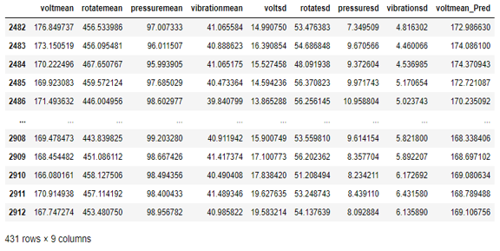
Final Prediction

Slide 30
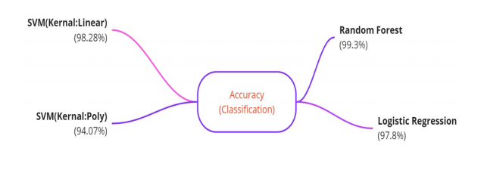
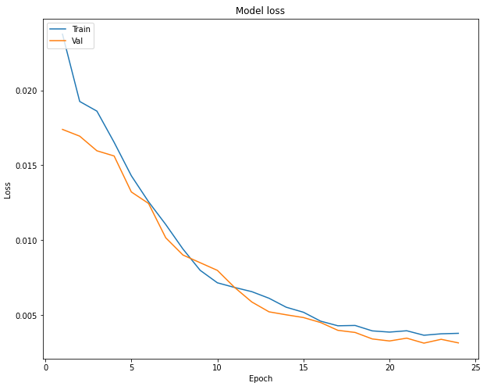
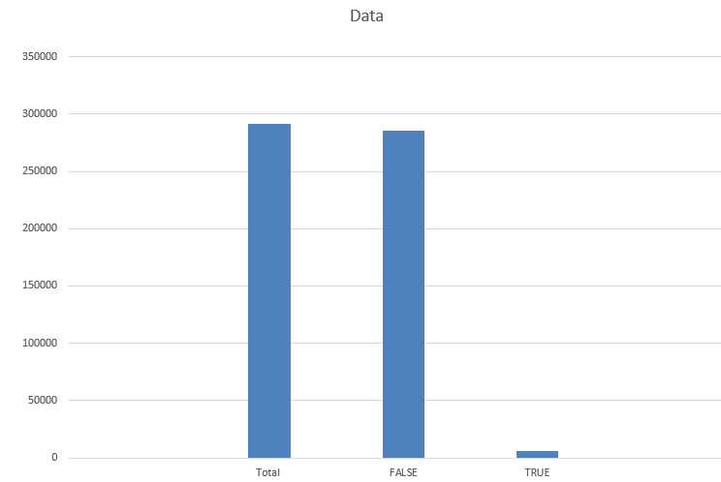
Result analysis
Imbalanced Dataset
1.92% True value.
Figure : 1
Figure : 2
Figure : 3

Slide 31
Thank You

