Slide 1
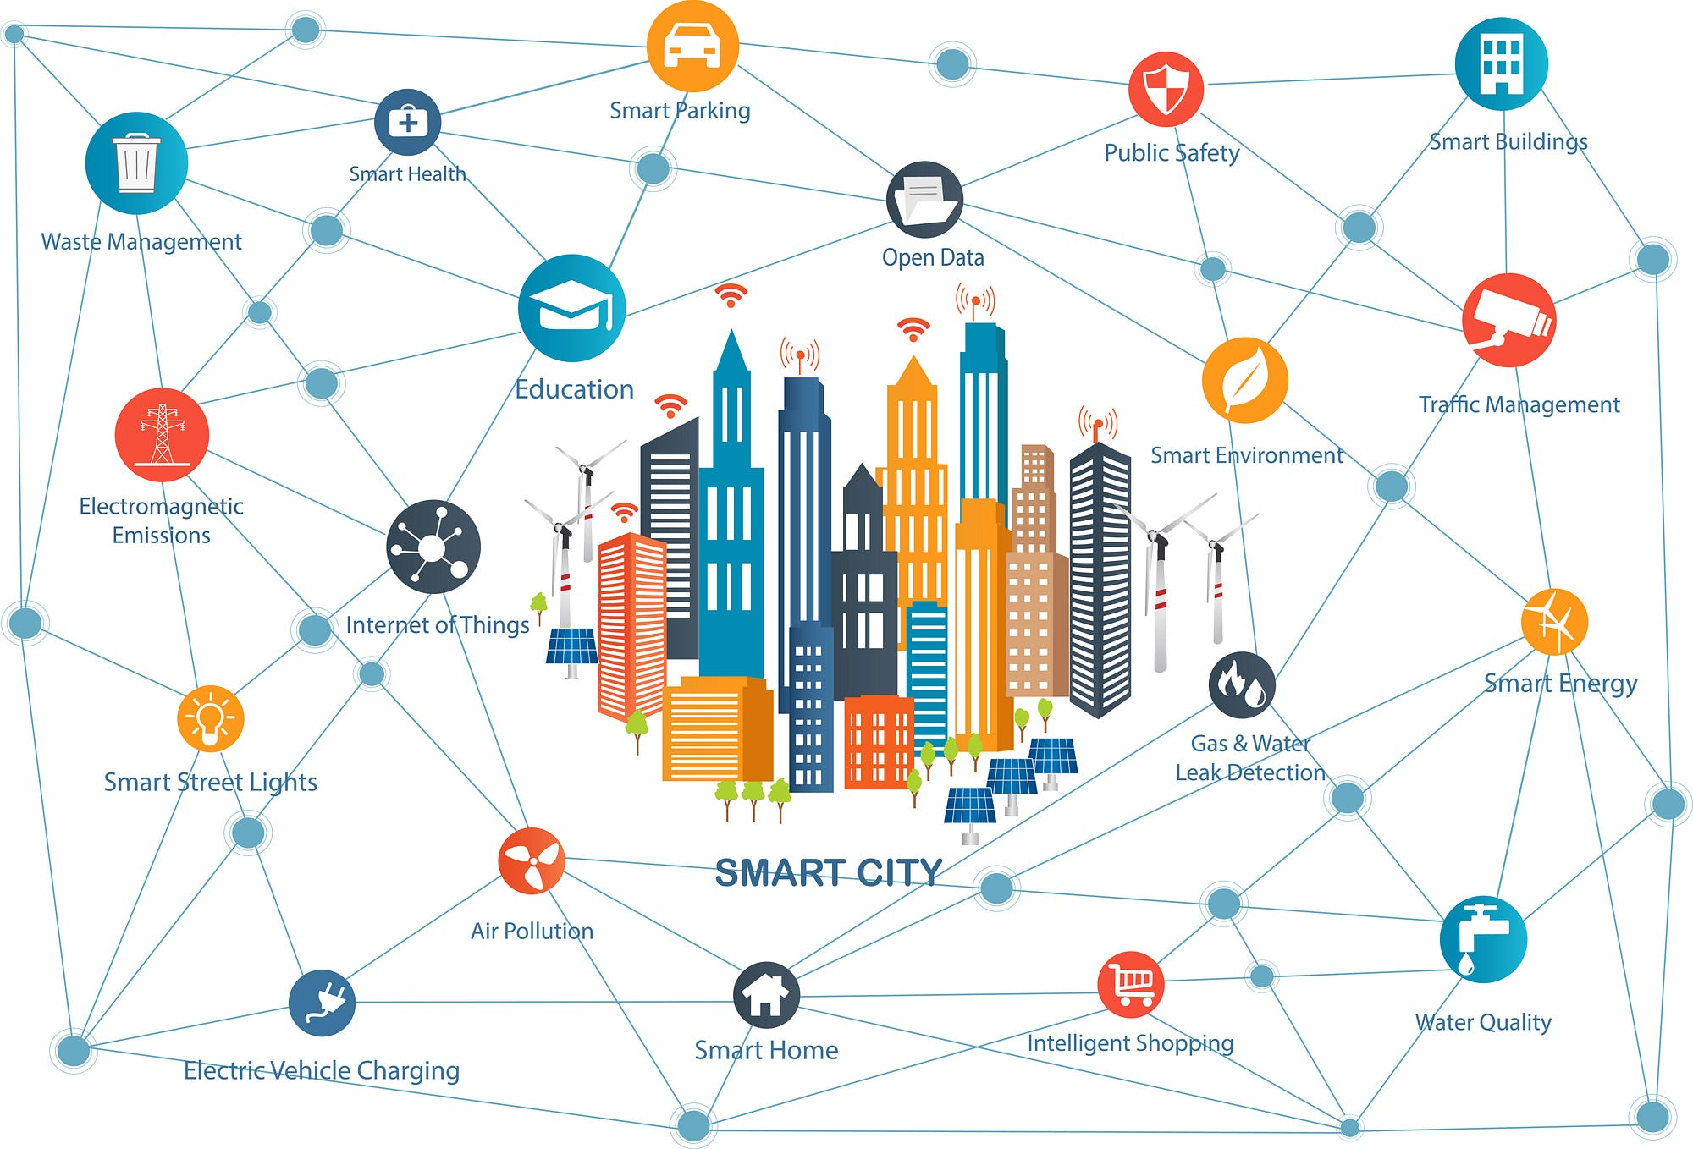
Optimizing Urban Waste Management in Dhaka
Sohely Akter Shova
Department of Economics
University of Barishal

Slide 2
Current Waste Management Practices
Overview of Dhaka's waste generation rates and composition
Collection, transportation, and disposal methods
Limitations and inefficiencies in the current system:

Slide 3
Challenges in Dhaka’s Waste Management
Population growth and increased waste generation
Inadequate infrastructure and limited landfill capacity
Health and environmental impacts (air, water, and soil pollution)Financial constraints and lack of public awareness

Slide 4

Strategies for Optimization
Waste Segregation at Source:
Benefits of segregating biodegradable, recyclable, and hazardous waste

Slide 5
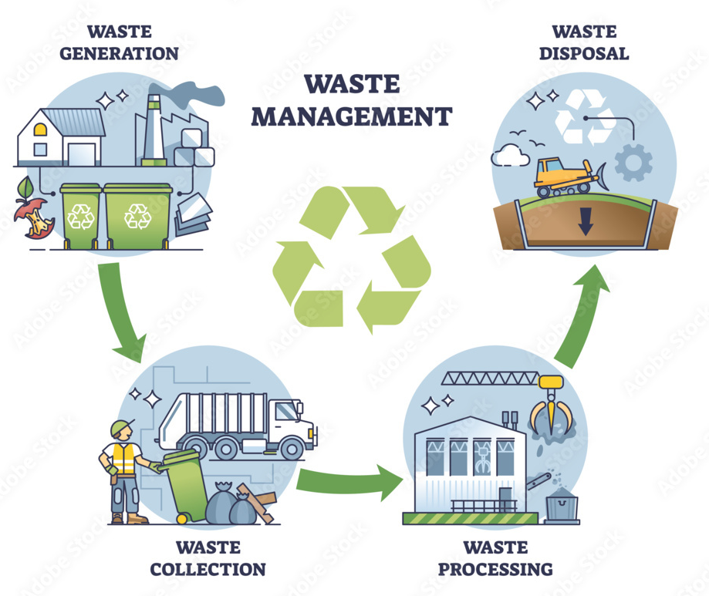
Strategies for Optimization
Recycling and Resource Recovery:
Encouraging recycling programs and composing

Slide 6
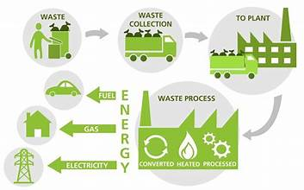
Strategies for Optimization
Waste-to-Energy Initiatives:
Potential for generating energy from waste

Slide 7
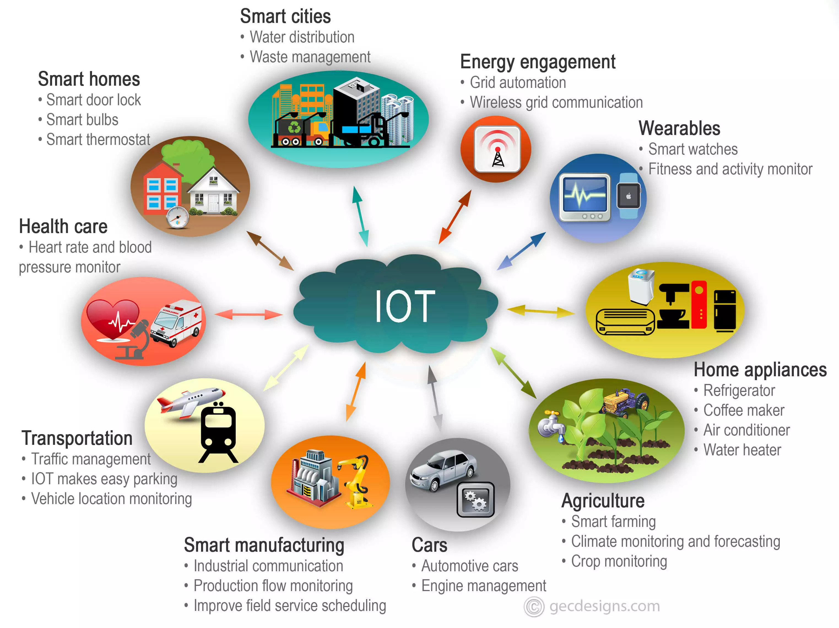
Strategies for Optimization
Digitalization and Smart Solutions: Using IoT and data-driven systems for real-time monitoring

Slide 8

Strategies for Optimization
Public-Private Partnerships:
Collaborations for sustainable waste management solutions

Slide 9
Recommendations and Future Directions
Policy changes, community involvement, and educational campaigns
Long-term plans for sustainable waste management in Dhaka

Slide 10
Thank You

