Slide 1
PFC Flyback Converter
Final Presentation
Anat Rom · Shoval Buzaglo
Supervisor: Eric Herbelin · Spring 2026
Notes:
Introduce the project and the team.

Slide 2
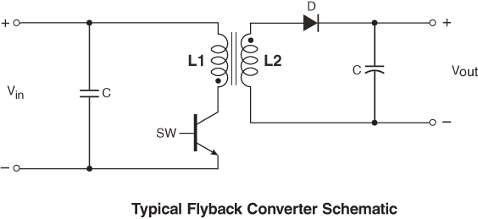
What is a Flyback Converter?
An isolated DC-DC converter whose transformer stores energy while the switch is on and releases it to the output while it is off.
Switch ON – store
Switch OFF – release
The rectified line voltage sits across the primary; its current rises linearly at Vin / Lp and energy builds up in the transformer's magnetic field. The output diode is blocked.
The stored energy transfers to the secondary, the diode conducts, and the secondary current falls linearly into the output capacitor and load.
Notes:
A flyback is a buck-boost converter with a coupled inductor. The "transformer" is really an energy store: during the on-time the primary current ramps up and energy is stored in the core; when the switch opens the energy flies back to the secondary through the diode. The winding ratio (n ≈ 2.66 in our design: Lp = 90 µH, Ls = 12.7 µH) sets the voltage conversion and the transformer provides galvanic isolation. Regulation is closed across the isolation barrier with a TL431 and a 4N25 optocoupler. In a PFC flyback the input is the rectified mains, so the input voltage itself varies as a rectified sine.

Slide 3
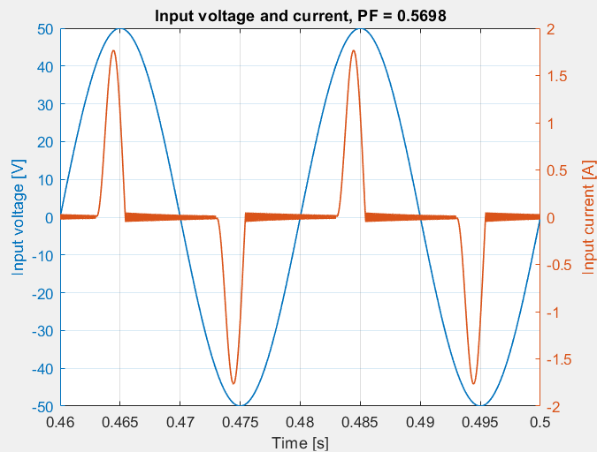
Why Do We Need PFC?
Switching loads draw current in sharp peaks and distort the mains.
A PFC stage forces the input current to follow the input voltage.
A slow control loop (~10 Hz) averages the power demand; DC capacitors absorb the fast pulses.
Without PFC: current flows only at the voltage crest (PF = 0.57)
Notes:
Without correction, the input current flows only in narrow pulses at the voltage crest.

Slide 4
Project Definition & Goals
Design and verify a 12 V / 9 W PFC Flyback converter controlled by an Arduino-class microcontroller instead of a dedicated PFC chip.
Key Performance Targets:
▸ Power Factor: ≥ 0.98 resistive, > 0.95 under varying loads
▸ Low THD: mild increase under “violent” loads
▸ Current Tracking: sinusoidal, in phase with Vin
▸ Output Stability: Vout under load steps
▸ Efficiency: measured per operating point
▸ MCU Feasibility: slow loop + one timer register

Slide 5
Project Steps
1 Theoretical Study and Requirement Definition
2 Characterization of the Reference Unit (EV44010)
3 Design of Our Arduino-Controlled Converter
4 LTspice Modelling and Simulation Campaign
5 Design of the Measurement System
6 Laboratory Measurements on the Prototype
7 Data Processing and Conclusions

Slide 6
Conduction Modes: CCM, DCM, BCM
CCM
DCM
BCM
Current never reaches zero
Current stays at zero before next cycle
Switch turns on exactly at zero current
+ Low peak currents
+ No reverse recovery, simple loop
+ Soft turn-on, Ipk = 2·Iavg
− Reverse recovery, RHP zero
− High peak and RMS currents
− Variable frequency, harder EMI filter
Our design
Reference unit

Slide 7
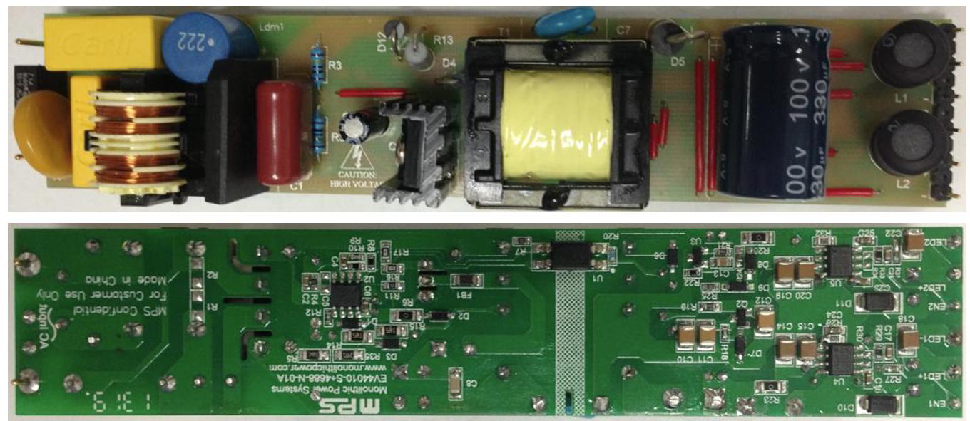
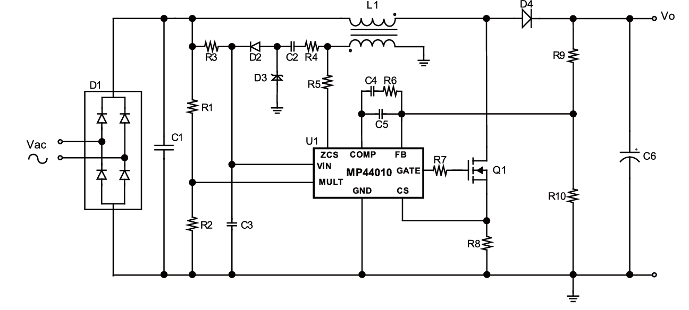
Reference Unit: EV44010 Flyback
EV44010-S+4688-N-01A board
Simplified PFC Flyback power stage

Slide 8
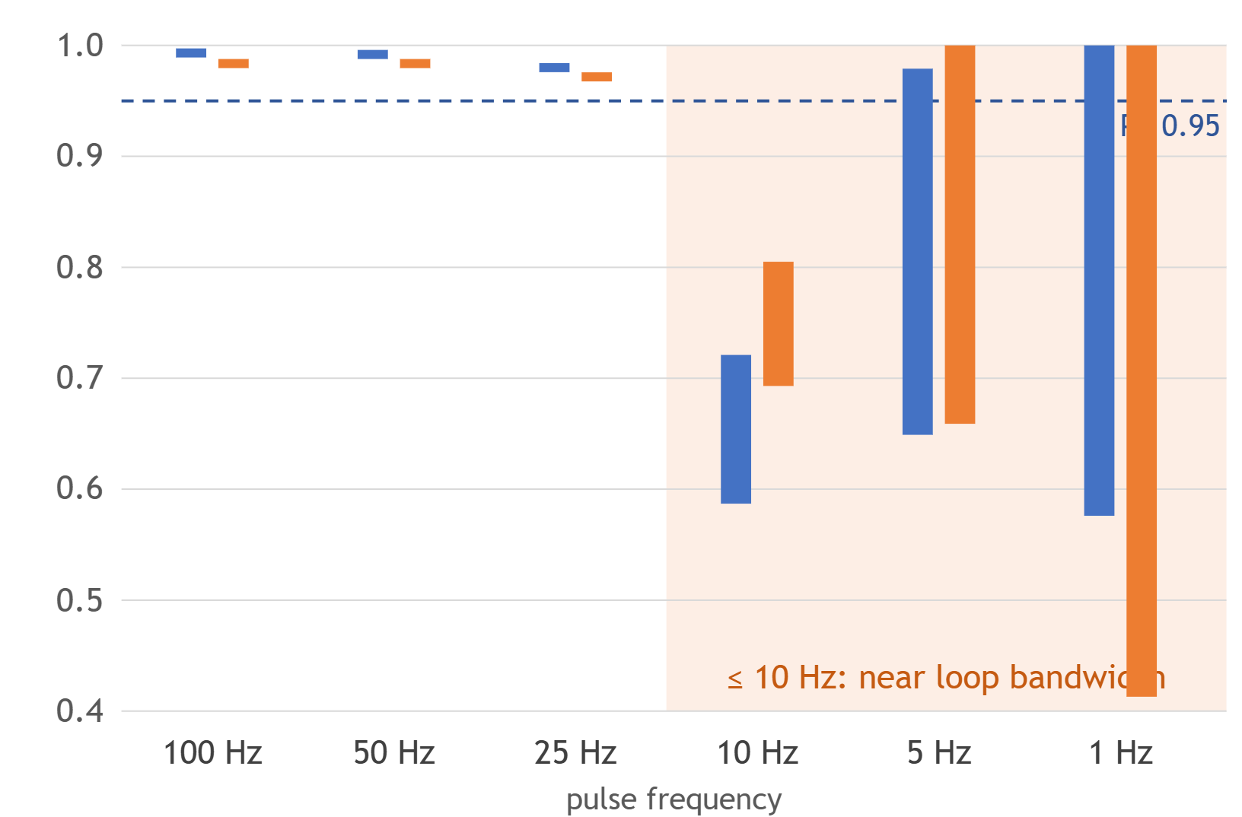
EV44010 Flyback Simulations
Reference unit, constant 0.359 A output current – load level set by the output resistance
Static loads – power factor
Pulsed load – PF range vs. pulse rate
Load | R | R + L series | R ∥ L
100 % | 0.988 | 0.989 | 0.937
75 % | 0.992 | 0.994 | 0.933
50 % | 0.986 | 0.990 | 0.926
25 % | 0.961 | 0.982 | 0.905
η at 100 % | 85.8 % | 85.8 % | 61.5 %
■ 50 → 100 % step ■ 25 → 75 % step bar = min to max PF
▸ R and R + L: PF ≥ 0.96 at every load level
▸ R ∥ L: PF 0.91–0.94, efficiency only 54–61 %
Notes:
Simulation results of the reference unit (EV44010). The unit drives a constant 0.359 A output current, so the load level is set by the output resistance: 122 Ω (100 %), 92 Ω (75 %), 61 Ω (50 %), 30.5 Ω (25 %). The inductive cases use L = 4.076 H with 20.4 Ω winding resistance. Static loads: with a resistor, or a resistor with the inductor in series, the PF stays at 0.96–0.99 at every level, and efficiency is about 86 % at full load, falling to 72–78 % at quarter load. With the inductor in parallel with the resistor, the PF drops to 0.91–0.94 and efficiency to 54–61 %. Pulsed load (50 % duty): at pulse rates of 25 Hz and above the PF stays between 0.97 and 0.99, and moves by no more than 0.005 inside a run. At 10 Hz and below, which is close to the ~10 Hz bandwidth of the voltage loop, the loop starts following the load and the PF swings widely: down to 0.59 (50→100 %) and 0.41 (25→75 %). The efficiencies above 100 % logged for the 10 Hz and 5 Hz pulse runs are measurement artefacts and are not shown.

Slide 9
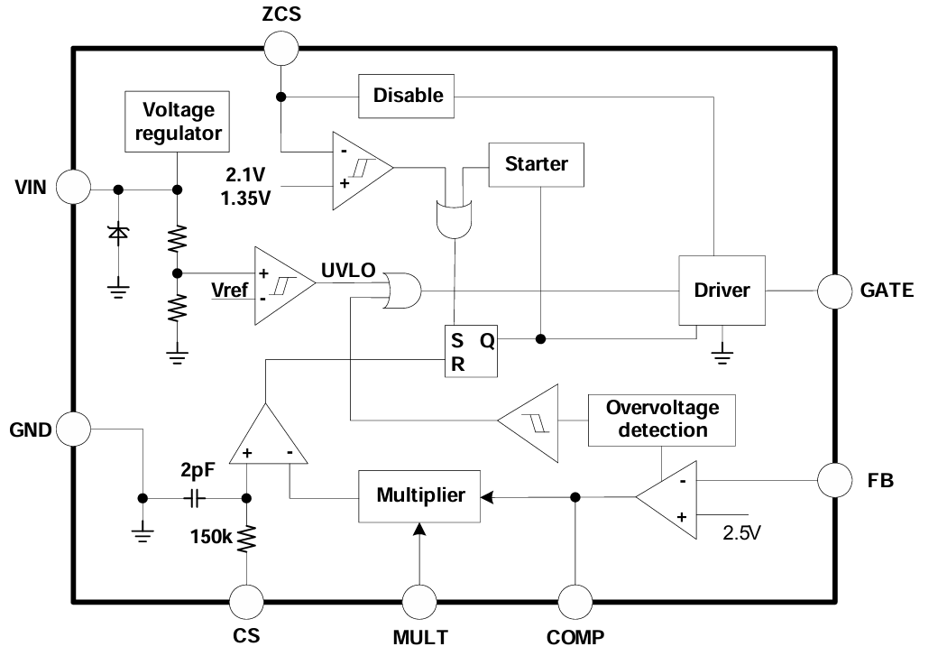
MP44010 Controller – BCM Control
▸ On-time: multiplier sets a sinusoidal peak-current envelope
▸ Off-time: ZCS pin detects zero current and restarts the cycle
▸ Result: average current in phase with Vin → PF ≈ 1
▸ Protection: two-stage OVP, zero-crossing compensation, starter

Slide 10
Our Design: Arduino-Controlled Flyback
Specification
No PFC → PFC: Four Changes
Input: 35.36 V RMS (50 V peak), 50 Hz
Bulk capacitor removed: Cin 125 µF → 10 nF
Output: 12 V / 9 W, isolated
Slow feedback: 100 kΩ / 150 nF, fc ≈ 10.6 Hz
Switching: fixed 100 kHz, DCM
Control variable: on-time instead of duty cycle
Feedback: TL431 + 4N25 optocoupler
Protection: cycle-by-cycle limit at 2.6 A
Controller: Arduino-class MCU

Slide 11
Reference Unit vs. Our Design
We keep the core idea of the EV44010 – a slow voltage loop commanding a constant on-time – and drop the parts an MCU cannot run at switching speed.
Function | EV44010 / MP44010 (reference) | Our Arduino design
Conduction mode | BCM, variable frequency | DCM, fixed 100 kHz
Voltage loop | Error amplifier, bandwidth below ~10 Hz | Slow loop, fc ≈ 10.6 Hz (kept)
Current shaping | Multiplier sets a sinusoidal peak envelope | Constant on-time – the transformer multiplies
Cycle restart | ZCS pin on an auxiliary winding | MCU timer, every 10 µs
Peak current | Ipk = 2·Iavg | 1.95 A peak for 0.7 A output
Protection | Two-stage OVP, zero-crossing comp., starter | Cycle-by-cycle limit at 2.6 A
Notes:
This slide summarises what we took from the reference unit and what we replaced. Kept: a slow voltage loop (below ~10 Hz) that commands a constant on-time. Dropped: the multiplier, the zero-current detector and the auxiliary winding, none of which a microcontroller can support at switching speed. The price is DCM's higher peak and RMS currents (1.95 A peak primary current for 0.7 A output) – acceptable at 9 W.

Slide 12
Digital Constant On-Time Control
A fixed on-time makes the transformer do the multiplication: the averaged input current follows Vin(t) with no fast current loop.
⟨iin⟩ = Vin(t) · Ton² / (2 · Lp · Ts)
≈ 153 Ω
3.43 µs
0.08 %
Emulated resistance Re
Average on-time command
On-time variation over line cycle

Slide 13
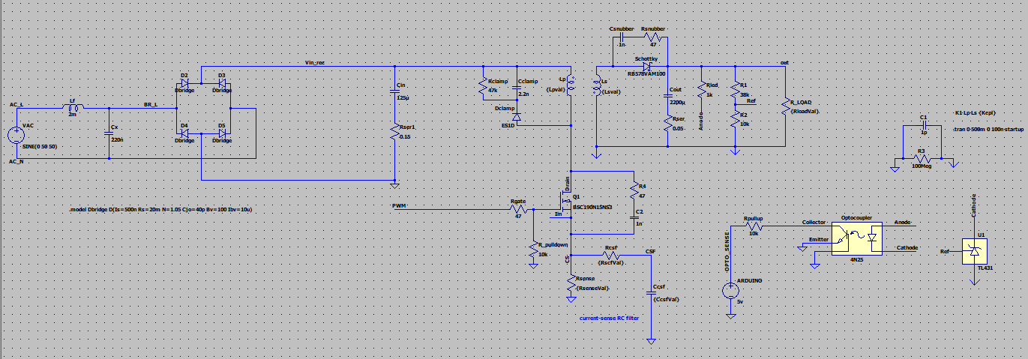
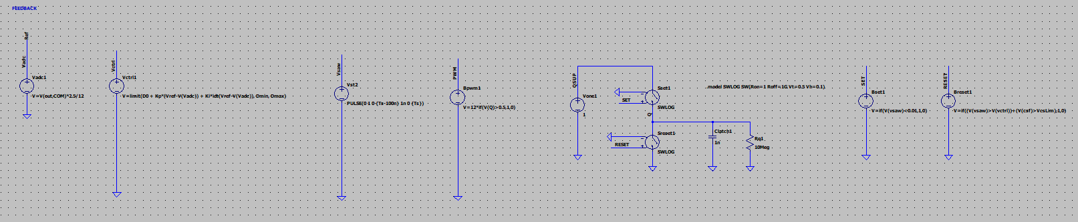
LTspice Models
Without PFC
Duty-cycle PI regulator, Cin = 125 µF

Slide 14
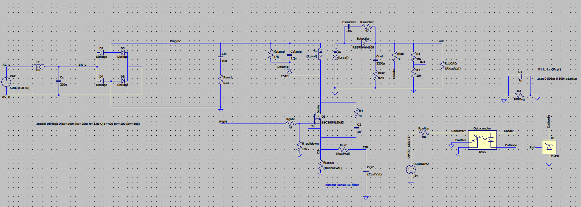
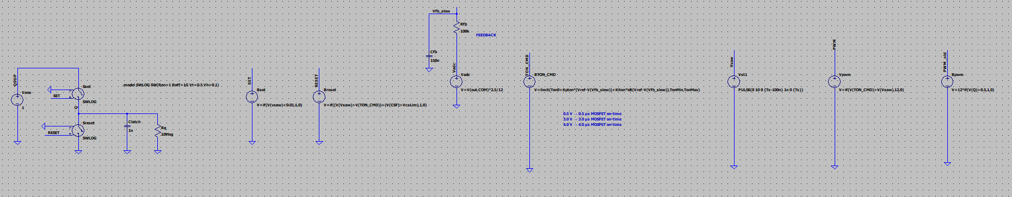
LTspice Models
With PFC
Slow loop → constant Ton, Cin = 10 nF

Slide 15
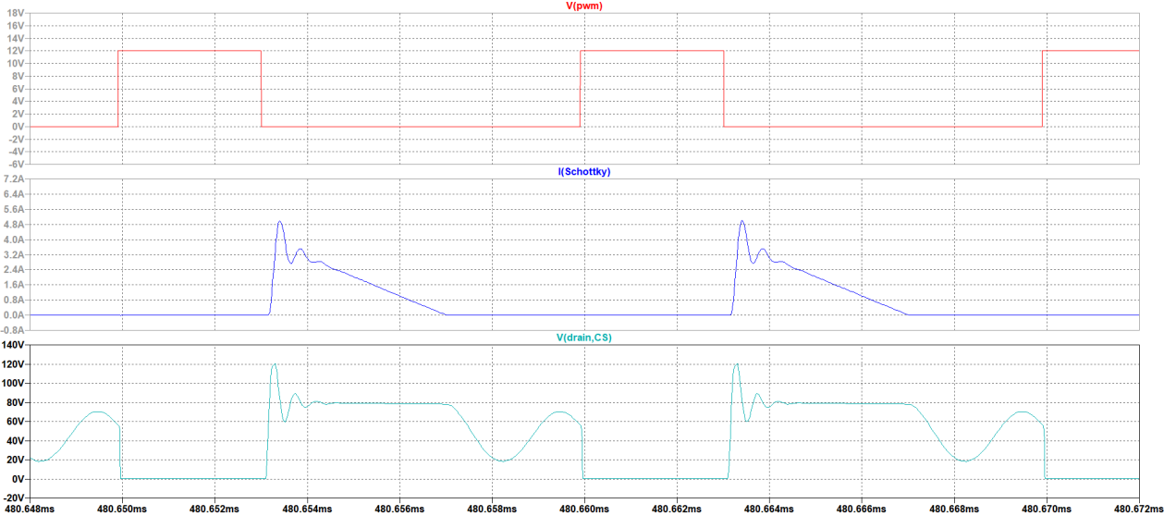
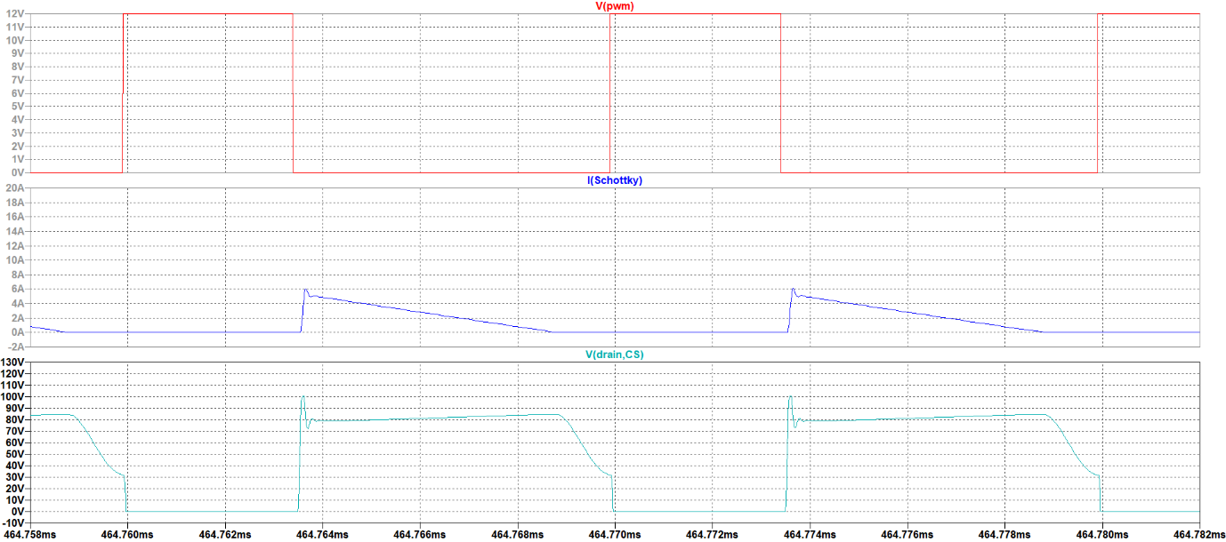
Switching Regime Verification – DCM
fs = 100 kHz, traces: V(pwm), I(Schottky), V(drain)
Without PFC
With PFC (line crest)
Dead time + free ringing, ~5 A diode peaks
Constant 3.43 µs on-time, ~5 µs demagnetisation

Slide 16
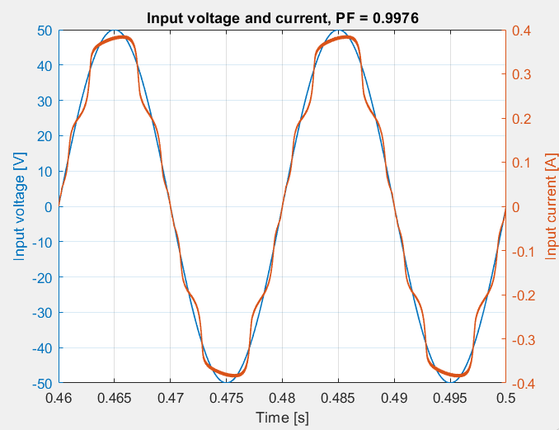
Without PFC vs. With PFC
Vin = 35.36 V RMS, Vout = 12 V, resistive load ≈ 9 W, window 0.46–0.50 s
0.5698
139.8 %
80.1 %
0.9976
6.95 %
85.1 %
PF
THD
η
PF
THD
η

Slide 17
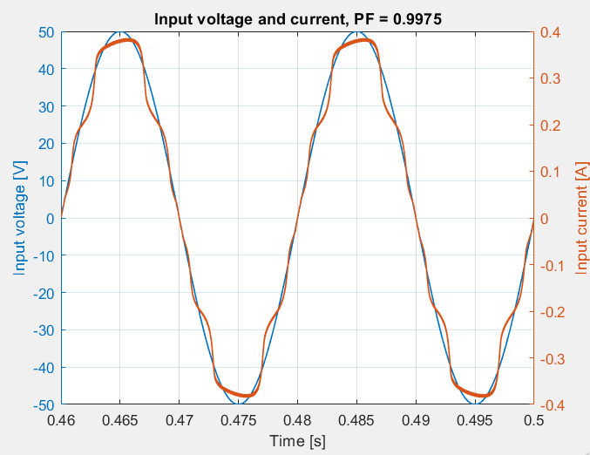
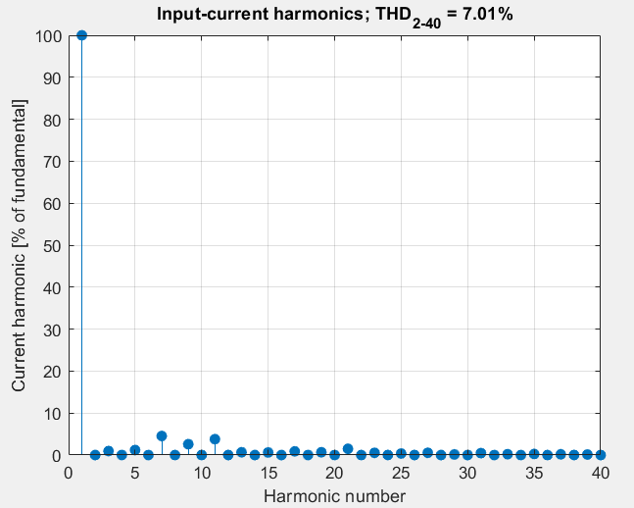
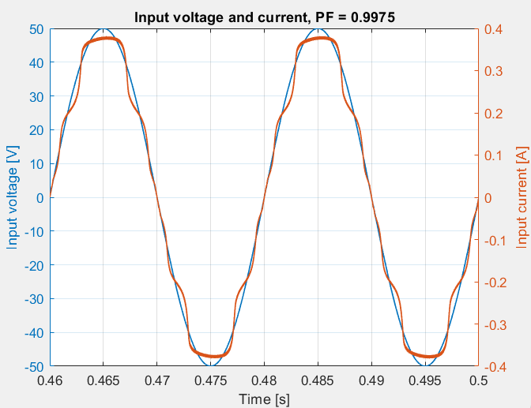
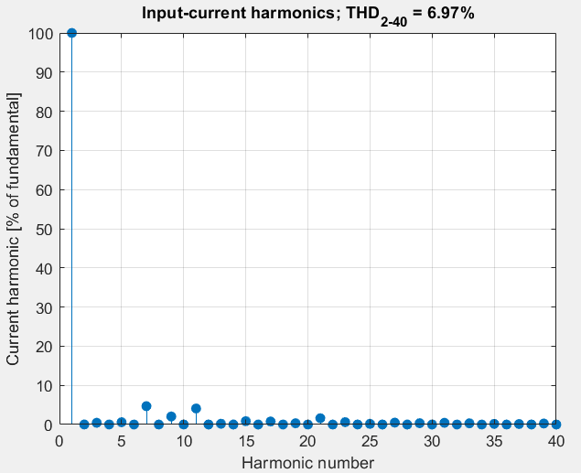
PFC – Inductive and Capacitive Loads
Same output power (≈ 8.3 W), only the load character changes
Inductive
PF 0.9975
THD 7.01 %
Capacitive
PF 0.9975
THD 6.97 %

Slide 18
Load Character Comparison
Case | PF | THD [%] | Irms [A] | Pout [W] | η [%]
No PFC (reference) | 0.5698 | 139.77 | 0.562 | 9.08 | 80.13
PFC – Resistive | 0.9976 | 6.95 | 0.278 | 8.33 | 85.12
PFC – Inductive | 0.9975 | 7.01 | 0.275 | 8.24 | 85.07
PFC – Capacitive | 0.9975 | 6.97 | 0.275 | 8.30 | 85.59
PF varies by only 0.01 % between load types – the hypothesis holds for static loads.

Slide 19
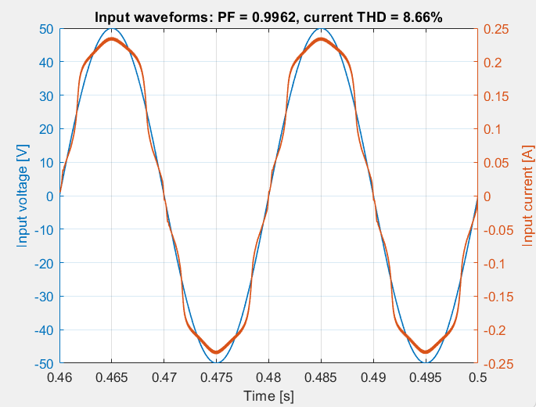
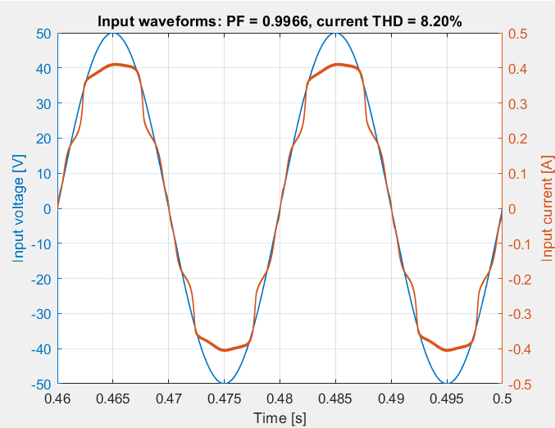
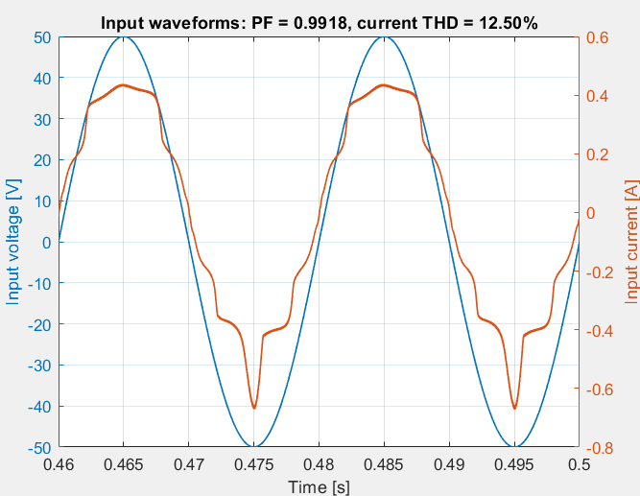
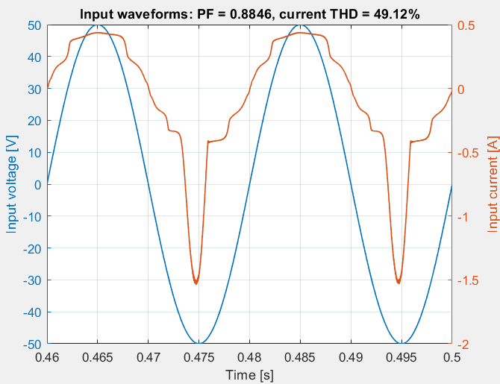
Time-Varying Load – Repeated Steps
Fixed load character, increasing step magnitude, window 0.46–0.50 s
50 → 100 %
100 → 150 %
100 → 200 %
100 → 400 %
PF 0.9962
PF 0.9966
PF 0.9918
PF 0.8846

Slide 20
Load Step Comparison
Load Step | PF | THD [%] | Pout [W] | Vout min / max [V] | η [%]
50 → 100 % | 0.9962 | 8.66 | 5.18 | 11.61 / 12.69 | 83.53
100 → 150 % | 0.9966 | 8.20 | 10.31 | 11.34 / 12.97 | 85.33
100 → 200 % | 0.9918 | 12.50 | 10.23 | 11.07 / 13.10 | 85.02
100 → 400 % | 0.8846 | 49.12 | 13.26 | 10.52 / 13.34 | 83.70
▸ Up to 2× step: PF > 0.99
▸ At 4×: DC-bus energy runs out – displacement factor still ≥ 0.9997

Slide 21
Future Implementation Steps
▸ Build the hardware prototype and reproduce the static cases
▸ Sweep load steps between 2× and 4× to find the PF = 0.95 point
▸ Measure output-voltage recovery time after a single step
▸ Repeat the 4× case with added bulk capacitance
▸ Compare against a BCM variant with zero-current detection

Slide 22
Conclusion
▸ Digital PFC on an Arduino-class MCU works: PF 0.57 → 0.998, THD 140 % → 7 %
▸ PF is independent of load character (R, L, C all ≈ 0.9975)
▸ PF depends on load dynamics – limited by DC-bus energy storage
▸ All PF loss is harmonic distortion; phase shift never exceeds 1.3°
▸ Average Vout within 0.2 % of 12 V in every case

