Slide 1




2021 International Conference on Information and
Communication Technology for Sustainable Development (ICICT4SD)
Paper ID-200
Clusterization of Different Vulnerable Countries for
Immigrants due to COVID-19 using Mean
Probabilistic Likelihood Score and Unsupervised
Mining Algorithms
Shovan Bhowmik
Dept. of Computer Science and Engineering, Bangladesh Army International University of Science and Technology (BAIUST)

Slide 2


OUTLINE
Introduction
Background
Dataset Description
Proposed Methodology
Result and Discussion
Conclusion and Future Works
References

Slide 3
INTRODUCTION
Due to the ongoing pecuniary disaster that ensued because of COVID-19, many immigrants are coming back to their ancestry from different migrant-friendly countries for several reasons.
Bangladeshi migrant workers in other countries are acutely struggling over the issues like unemployment, tremendous psychological pressure, substandard lifestyle, poor wages and isolation.
In this paper, a novel approach has been proposed to categorize these countries into five vulnerability labels based on probabilistic likelihood score (LHS) and unsupervised clustering algorithms (CA).
We have also attempted to validate our research outcome juxtaposing results generated from mean LHS and CA estimating different performance evaluation metrics and made our model more vigorous in this case.

Slide 4
BACKGROUND
Author | Work | Limitation
Abdul Azeez et al. (2020) | Assessment of the vulnerability effects of migrant workers | No clustering was created for vulnerable countries using ML or other techniques
Alok Sharma et al. (2017) | Maximum hierarchical likelihood clustering technique is proposed to classify biological data that belongs to several groups | Does not provide accurate results when applied to non-biological dataset
Khan et al. (2012) | Proposed a likelihood function for categorical LTMs which efficiently captures the correlations in discrete data and well suited for categorical data analysis | No ML algorithms was used
Shaheen et al. (2013) | Introduced unsupervised K-Means algorithm along with correlation analysis and frequent member function for labeled clustering | Better result and performance can be obtained by using K-Means++/Agglomerative/BIRCH along with Probabilistic Likelihood Score
Kumar et al. (2020) | Utilized PCA and Singular Value Decomposition (SVD) to create a recommendation system by observing images of 4000 fashion products | Only K-Means++ was applied with only 0.14 Silhouette Coefficient
Our Proposed Model | Applied Bayesian rule based probabilistic LHS following K-Means++, Agglomerative and BIRCH clustering to determine labels | Key Feature: Solution to unlabeled data with highest 74% Mutual Information score without Subjective Analysis

Slide 5
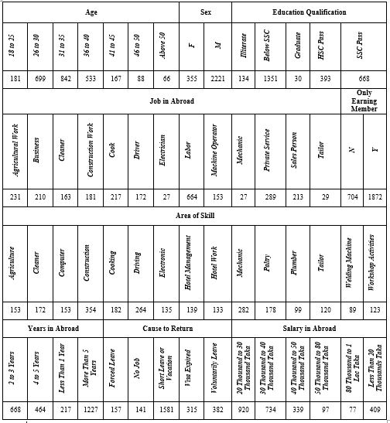
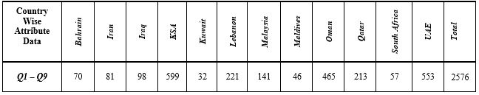
Dataset Description
Contains 2576 migrant records of 12 countries based on
a Questionnaire
Provided by YPSA (Young Power in Social Action)

Slide 6
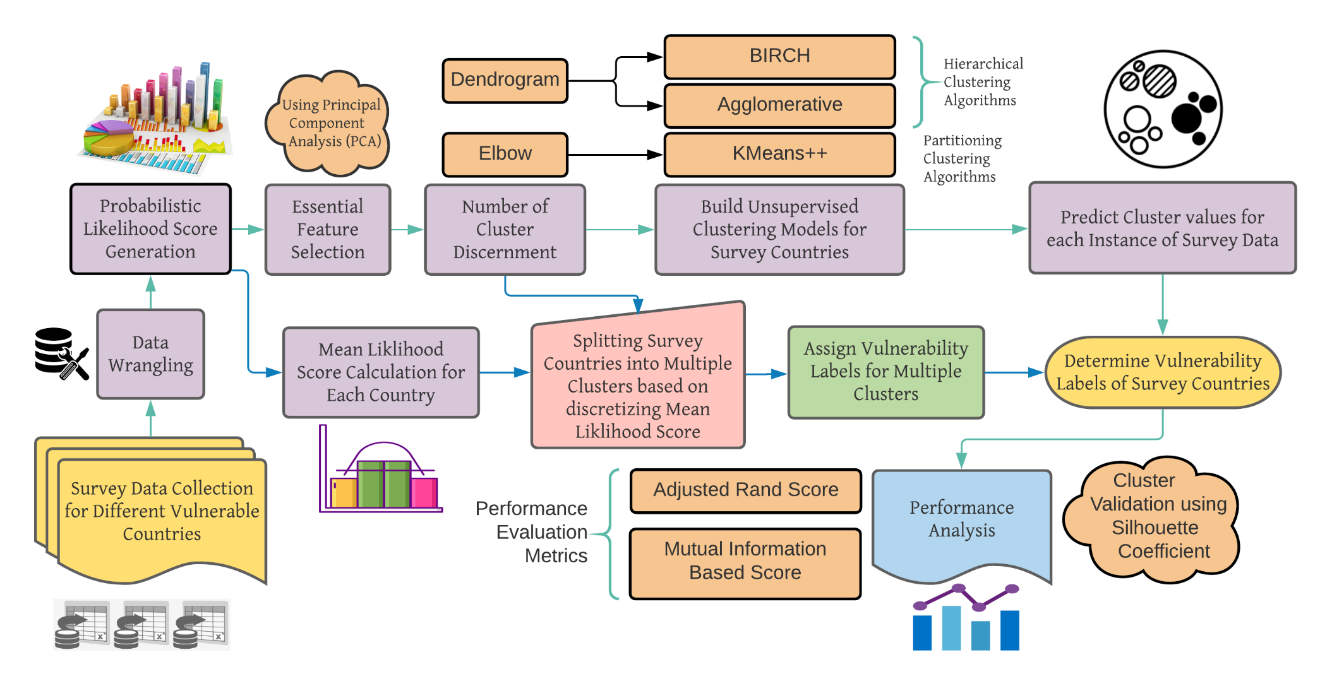
PROPOSED METHODOLOGY

Slide 7
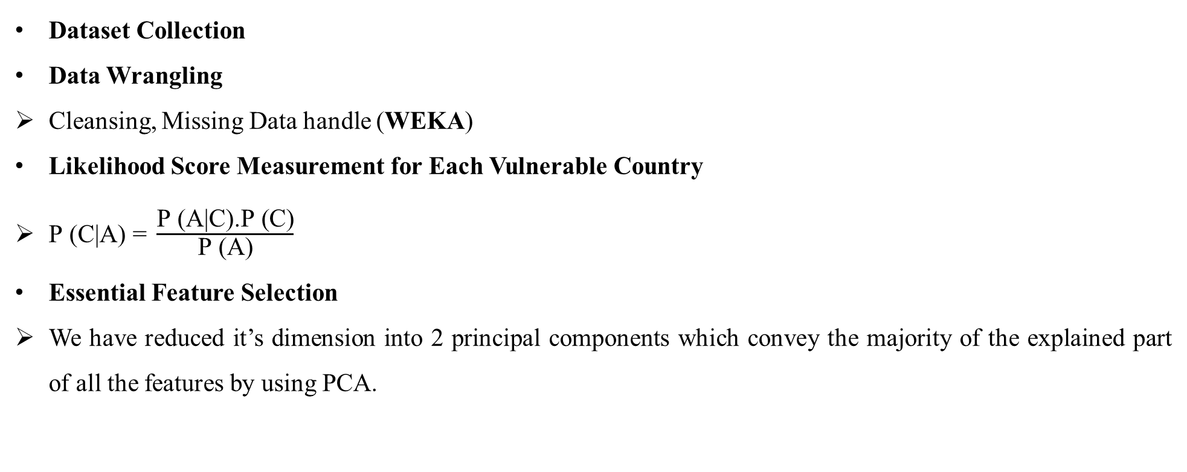
PROPOSED METHODOLOGY(Cont..)
Dataset Collection
Data Wrangling
Cleansing, Missing Data handle (WEKA)
Likelihood Score Measurement for Each Vulnerable Country
$\text{P}\text{ (}\text{C}\text{|}\text{A}\text{) = }\frac{\text{P}\text{ (}\text{A}\text{|}\text{C}\text{).}\text{P}\text{ (}\text{C}\text{)}}{\text{P}\text{ (}\text{A}\text{)}}$
Essential Feature Selection
We have reduced it’s dimension into 2 principal components which convey the majority of the explained part of all the features by using PCA.

Slide 8
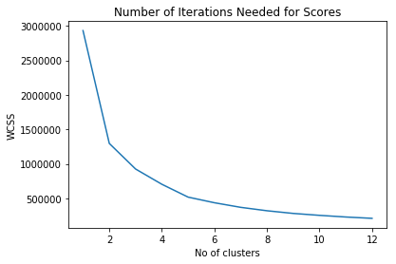
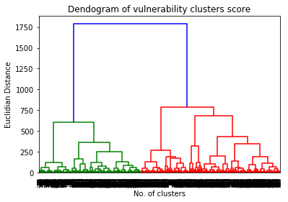
PROPOSED METHODOLOGY(Cont..)
Determining Number of Clusters
Five clusters have been ascertained for grouping of risky countries.
Elbow
Dendrogram

Slide 9
PROPOSED METHODOLOGY(Cont..)
Applying Unsupervised Clustering Algorithms
K-means++, Agglomerative and BIRCH have been applied to the LHS Scores of all the migrant records.
Mean Likelihood Score Generation for Each Country
Discretizing LHS into Different Vulnerability Labels
Equal width distribution is availed to discretize the average LHS for each of the countries.
Denoting the Labels of CA output
The labels are symbolized as Very Low, Low, Medium, High and Very High categories based on the assignment using mean LHS of the unsafe countries.
Performance evaluation of the vulnerability clusters
Adjusted Rand Index (ARI) and Mutual Information (MI) based Score have been enumerated to evaluate the labeling of our dataset.

Slide 10
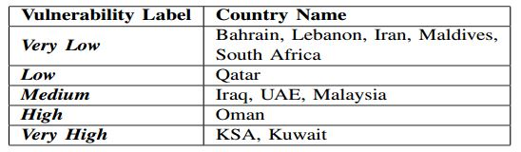
RESULT AND DISCUSSION
We have collected data of those countries which are most commonly selected by Bangladeshi working-class people and accomplished classifying them into five clusters.

Slide 11
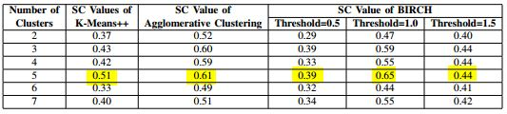
RESULT AND DISCUSSION (Cont..)
Cluster Validation using Silhouette Coefficient

Slide 12
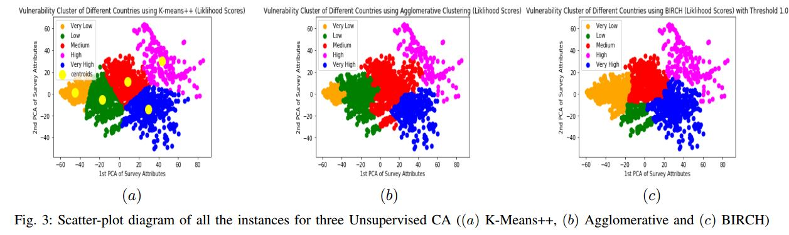
RESULT AND DISCUSSION (Cont..)
The figure shows the distribution of instances into different clusters for 2 PCA attributes.

Slide 13
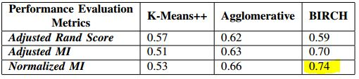
RESULT AND DISCUSSION (Cont..)
Performance Evaluation metrics score for three unsupervised mining algorithms are given in this table.

Slide 14
CONCLUSION AND FUTURE WORKS
A unique framework by using probabilistic LHS and unsupervised CA has been deployed to categorize the immigrant friendly countries into five (Very Low, Low, Medium, High and Very High) vulnerability labels.
The highest value of 0.74 has been attained as Normalized Mutual Information based Score for BIRCH clustering accompanying ample results for the remaining algorithms.
Countries with ‘Very Low’ tag can be considered as a good choice for the migrant workers for immigration.
In future, we will try to manage more real data of countries other than our gathered ones for more authenticity of our work as well as to get the overall condition of the whole world in this prospect.
We will try to do subjective analysis with the help of experts.
Other unsupervised CA and fuzzy based clustering might be availed later considering maximum likelihood estimation for more robustness of our work.

Slide 15
REFERENCES
[1] Tasneem Siddiqui. ”International labour migration from Bangladesh : a decent work perspective” ILO Working Papers 993857593402676. International Labour Organization. 2005.
[2] Abdul Azeez E P, Dandub Palzor Negi,Asha Rani & Senthil Kumar A P. “The impact of COVID-19 on migrant women workers in India”. Journal of Eurasian Geography and Economics. 26th Oct, 2020.
[3] Mohammad Rezaul Karim, Mohammad Tarikul Islam, Bymokesh Talukder. “COVID-19’s impacts on migrant workers from Bangladesh: In search of policy intervention”. World Development. Vol. 136. Dec 2020.
[4] Sami Naouali, Semeh Ben Salem and Zied Chtourou. ”Clustering Categorical Data: A Survey”. International Journal of Information Technology & Decision Making. Vol. 19, No. 01, pp. 49-96. 2020.
[5] Tommaso Rigon, Amy H. Herring, David B. Dunson. ”A generalized Bayes framework for probabilistic clustering”. arXiv: Methodology. 2020.
[6] Alan Agresti & David B. Hitchcock. ”Bayesian inference for categorical data analysis”. Statistical Methods and Applications. Vol. 14, pp. 297–330. 2005.
[7] Fasani, F. and Mazza, J. “A Vulnerable Workforce: Migrant Workers in he COVID-19 Pandemic”. EUR 30225 EN, Publications Office of the European Union, Ispra. 2020.
[8] Hans H. Bock. ”Probabilistic Models in Cluster Analysis”. Vol. 23, Issue: 1, pp. 5-28. 15th Nov, 1996.
[9] Alok Sharma, Keith A. Boroevich, Daichi Shigemizu, Yoichiro Kamatani, Michiaki Kubo, Tatsuhiko Tsunoda. “Hierarchical Maximum Likelihood Clustering Approach”. IEEE Transactions on Biomedical Engineering. Vol. 64, Issue: 1. Jan 2017.
[10] Mohammad Emtiyaz Khan, Shakir Mohamed, Benjamin M. Marlin and Kevin P. Murphy. “A Stick-Breaking Likelihood for Categorical Data Analysis with Latent Gaussian Models”. 15th International Conference on Artificial Intelligence and Statistics (AISTATS). 2012.
[11] Muhammad Shaheen, Saeed Iqbal, Fazl–e - Basit. ”Labeled Clustering: A Unique Method to Label Unsupervised Classes”. 8th International Conference for Internet Technology and Secured Transactions (ICITST). 2013.
[12] Ssvr Kumar Addagarla and Anthoniraj Amalanathan. ”Probabilistic Unsupervised Machine Learning Approach for a Similar Image Recommender System for E-Commerce”. Symmetry 2020, Vol. 12, Issue: 11, pp: 1783. 27 Oct, 2020.
[13] H. Venkateswara Reddy; B. Suresh Kumar; S. Viswanadharaju. “A Data Labeling Method for Categorical Data Clustering Using Cluster Entropies in Rough Sets”. 2014 Fourth International Conference on Communication Systems and Network Technologies. 2014.
[14] WEKA: The workbench for machine learning. Available: https://www.cs.waikato.ac.nz/ml/weka/
[15] Mohammad Reza Mahmoudi, Mohammad Hossein Heydari, Sultan Noman Qasem, Amirhosein Mosavi, Shahab S.Band. ”Principal component analysis to study the relations between the spread rates of COVID-19 in high risks countries”. Alexandria Engineering Journal. 14th Sep, 2020.
[16] Datanovia. “Determining The Optimal Number Of Clusters: 3 Must Know Methods”. Available: https://www.datanovia.com/en/lessons/determining-the-optimal-numberof- clusters-3-must-know-methods/
[17] Anupriya Vysala, Dr. Joseph Gomes. ”Evaluating and Validating Cluster Results”. 9th International Conference on Data Mining & Knowledge Management Process (CDKP). 2020.
[18] Arthur, David and Vassilvitskii, Sergei. ”k-means++: The Advantages of Careful Seeding”. Technical Report, Stanford. 2006. Available: http://ilpubs.stanford.edu:8090/778/
[19] Vera Marinova–Boncheva. ”Using the Agglomerative Method of Hierarchical Clustering as a Data Mining Tool in Capital Market”. International Journal ”Information Theories & Applications. Vol.15. 2008.
[20] sklearn.cluster.Birch. Scikit Learn. Available: https://scikitlearn.org/stable/modules/generated/sklearn.cluster.Birch.html
[21] Boris Lorbeer, Ana Kosareva, Bersant Deva, Dˇzenan Softi´c, Peter Ruppel, Axel K¨upper. ”A-BIRCH: Automatic Threshold Estimation for the BIRCH Clustering Algorithm”. INNS 2016: Advances in Big Data pp. 169-178. 08, Oct, 2016.

Slide 16
THANK YOU

